Slide 1
Any natural substance used by living things can be considered a natural resource.
For example, minerals, such as copper and iron, are natural resources. Most metals are examples of minerals.

Slide 2
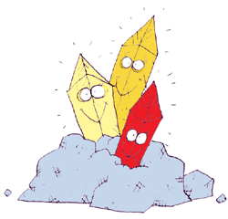
Most minerals are nonrenewable resources.
What does
that mean?

Slide 3
Nonrenewable Energy Resources

Slide 4
Nonrenewable Resources
Either can never be replaced or
can only be replaced over very long periods of time
Limited resource
Fossil Fuels (remains of living things)

Slide 5
Millions of years ago, plants began converting energy from the Sun into their own energy. Other organisms ate some of those plants.
When those plants and animals became buried under rock, they eventually became oil and coal. Thus, the energy from oil and coal started as energy from the Sun.
Nonrenewable Energy Resources [1:22]

Slide 6
Fuels that come from ancient plants and animals are known as fossil fuels. Fossil fuels contain a lot of carbon. Because fossil fuels contain a lot of carbon, along with hydrogen and oxygen, they burn easily.
The three major fossil fuels are oil, coal, and natural gas. Because of the millions of years it takes for fossil fuels to form, they are considered nonrenewable.
Formation of Fossil Fuels [2:25]
  Fossil Fuels with Bill Nye [5:44]

Slide 7
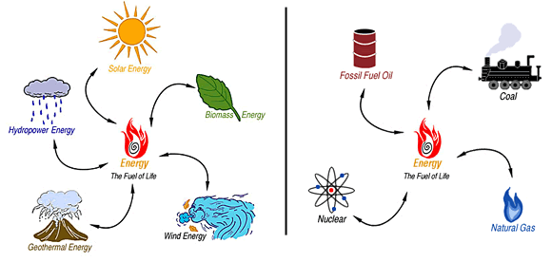
Which of the following energy resources do YOU think are NONRENEWABLE?

Slide 8
Coal
A rock that contains at least 50% plant remains.
Forms when plants die in a swampy area and are covered.

Slide 9
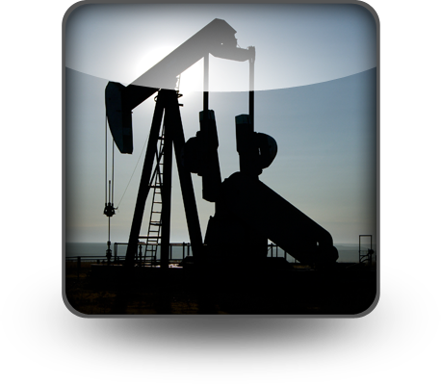
Oil
Thick, black liquid formed from buried remains of microscopic marine organisms.
Used for gasoline
and plastics

Slide 10
Natural Gas
Forms in a gaseous state- is a hydrocarbon that is lighter than oil.
Used for heating and cooking

Slide 11
Nuclear Energy
Energy produced by atomic reactions.
Nuclear fission→ heavy elements are split and energy is produced.
Produces waste

Slide 12

Propane
a flammable hydrocarbon gas present in natural gas and used as bottled fuel.

Slide 13
What is the ultimate source of energy in fossil fuels?
The sun
Plants and algae lock this energy into organic matter
When we burn plants or fossil fuels, we release the sun’s trapped energy

Slide 14
The Earth’s resources can be reduced or used up if humans don’t use conservation strategies
People can slow down the degradation (ruin) of the environment and the depletion of nonrenewable resources.

Slide 15


Renewable Energy Resources

Slide 16
Renewable Resources can be replaced in the space of a human lifetime

Slide 17
Which of the following energy resources do YOU think are RENEWABLE?

Slide 18

Solar Energy
Energy from the Sun
Solar cells collect energy from the Sun and transform it into electricity.

Slide 19
Solar Energy
Scientists are working to develop
ways to capture more of this energy
For example, buildings in colder areas can be designed to trap more solar energy.
  A building in a colder area would retain more heat from the Sun, less energy would be needed to cool it. The opposite is also true.
  Why would a building in a colder area retain more heat from the Sun?

Slide 20
Wind Energy
Windmills or wind turbines
(mechanical windmills) are used to generate electricity
Wind farms are areas where many wind turbines are set up to generate electricity

Slide 21
Wind Energy
Wind farms are often build on coastland, where there is an abundance of wind, and on farmland
Why is there an abundance of wind on the coastland?

Slide 22

Wind Energy
The advantage of wind turbines is
that they use a renewable resource
to produce electricity
What are the disadvantages?
Birds and bats can die after flying into a turbine’s blades
Wind turbines are loud, contributing to noise pollution

Slide 23
Hydroelectric
Running water is used
to generate electricity
The energy of moving water turns turbines that are connected to generators. The generators convert the mechanical energy into electrical energy

Slide 24
Hydroelectric
Dams are built on large
rivers to slow the flow of
water and create lakes.
The water moves through the dam generating electricity, and is allowed to flow out at the bottom of the dam
The advantage of hydroelectric power is that it is renewable

Slide 25
Hydroelectric
What are the disadvantages of
hydroelectric energy?
Lakes were created in places where
people lived, so they had to move
Sometimes fish use places further up the river as places to reproduce and they either died out or the dams had to have special structures built to allow the fish to go upstream past the dam

Slide 26
Geothermal
Energy that is extracted
(removed) from the ground
In areas of the world where the heat from Earth is closer to the surface, machinery is built that helps pull up heat from below the surface. The heat is brought up to a turbine where the heat helps spin a turbine which spins a generator and electricity is created

Slide 27
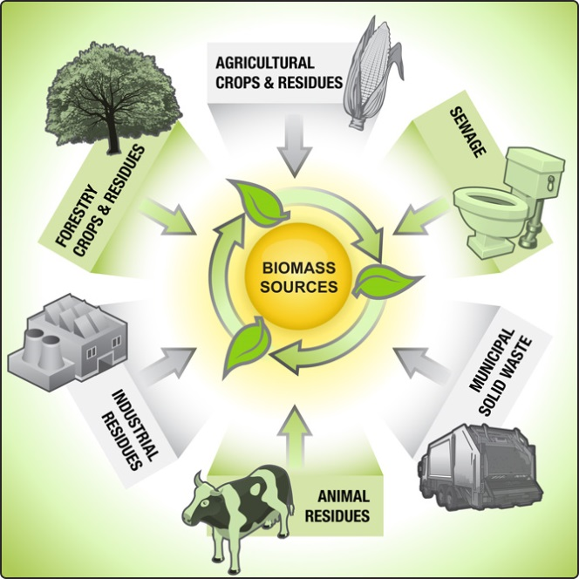
Biomass
Fuel produced from biological energy sources such as plant
materials, manure, sawdust, paper waste, and other organic materials.

Slide 28
Biomass
For example, corn
can be converted
into ethanol, a type of
alcohol that can be used as fuel
Biodiesel is made from old frying oil and is used in vehicles that burn diesel, a fuel that is usually made from fossil fuels

Slide 29
  Bill Nye Renewable Energy [3:07]
  Renewable Energy Resources: Part 1 [1:47]
  Renewable Energy Resources: Part 2 [1:17]

Slide 30
Conservation- To preserve and protect resources

