Slide 1
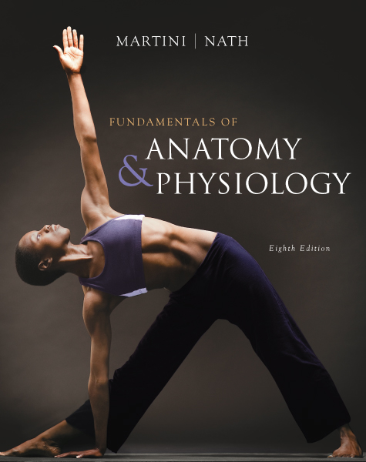
C h a p t e r
7
The Axial Skeleton - Spine
PowerPoint® Lecture Slides prepared by Jason LaPres
Lone Star College - North Harris
Modified by CHB 11/09
Copyright © 2009 Pearson Education, Inc.,
publishing as Pearson Benjamin Cummings

Slide 2
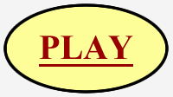
The Vertebral Column
The spine or vertebral column
Protects the spinal cord
Supports the head and body
26 bones
24 vertebrae, the sacrum, and the coccyx
The Vertebral Column

Slide 3
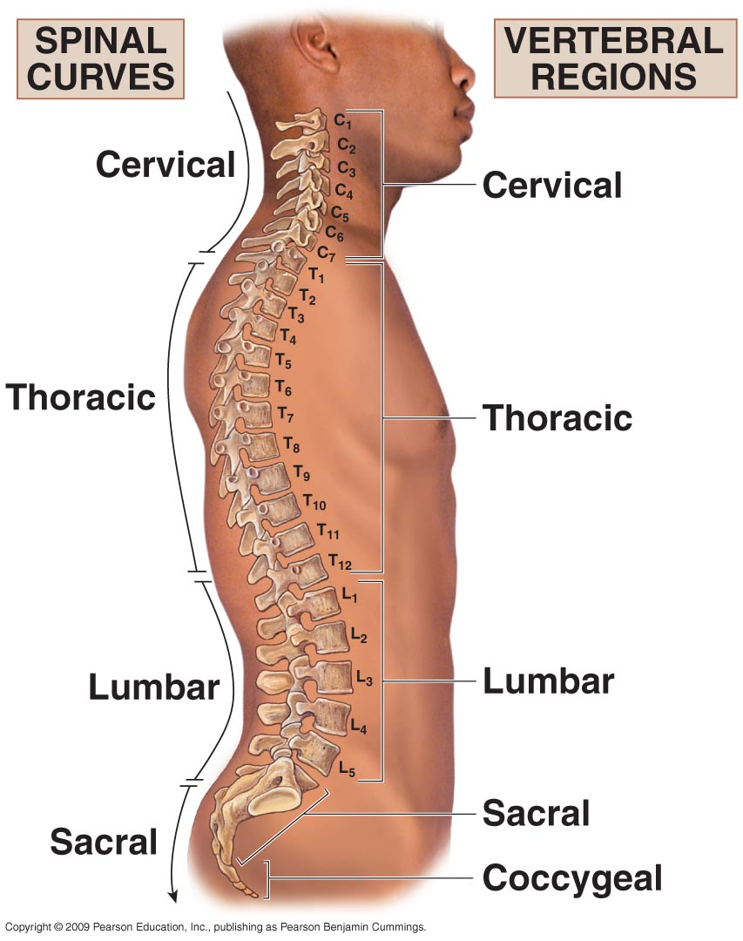
The Vertebral Column
Figure 7–16 The Vertebral Column.

Slide 4
The Vertebral Column
Vertebrae
The neck
Seven cervical vertebrae
The upper back
12 thoracic vertebrae
Each articulates with one or more pair of ribs
The lower back
Five lumbar vertebrae

Slide 5
The Vertebral Column
The Sacrum and Coccyx
The fifth lumbar vertebra articulates with the sacrum
The sacrum articulates with the coccyx

Slide 6
The Vertebral Column
Four Curvatures of the Vertebral Column
Cervical curve
Thoracic curve
Lumbar curve
Sacral curve

Slide 7
The Vertebral Column
Thoracic and sacral curves
Are called primary curves (present during fetal development)
Or accommodation curves (accommodate internal organs)
Lumbar and cervical curves
Are called secondary curves (appear after birth)
Or compensation curves (shift body weight for upright posture)

Slide 8
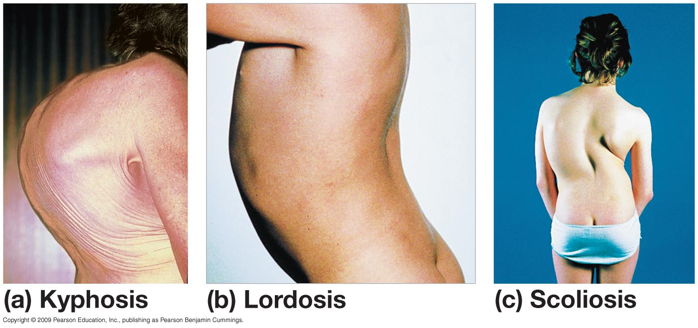
The Vertebral Column
Figure 7–17 Abnormal Curvatures of the Spine.

Slide 9
The Vertebral Column
Structure of a Vertebra
The vertebral body (centrum)
Transfers weight along the spine
The vertebral arch
Posterior margin of vertebral foramen
The articular processes
Lateral projections between laminae and pedicles

Slide 10
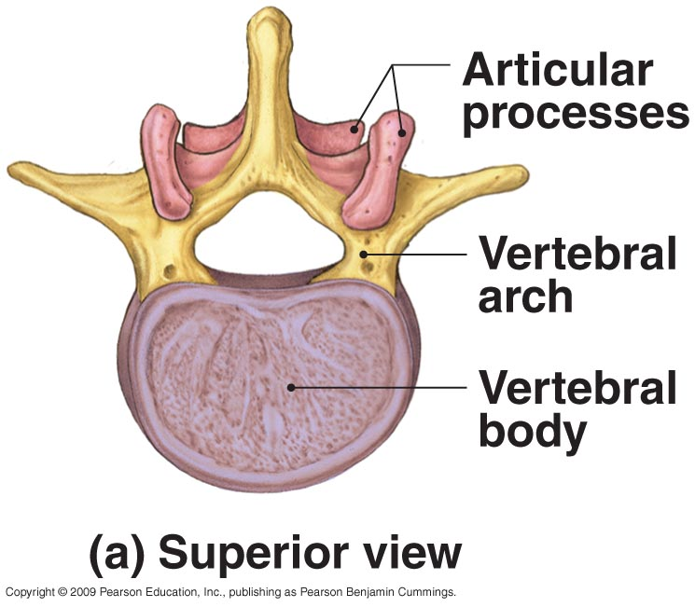
The Vertebral Column
Figure 7–18a Vertebral Anatomy.

Slide 11
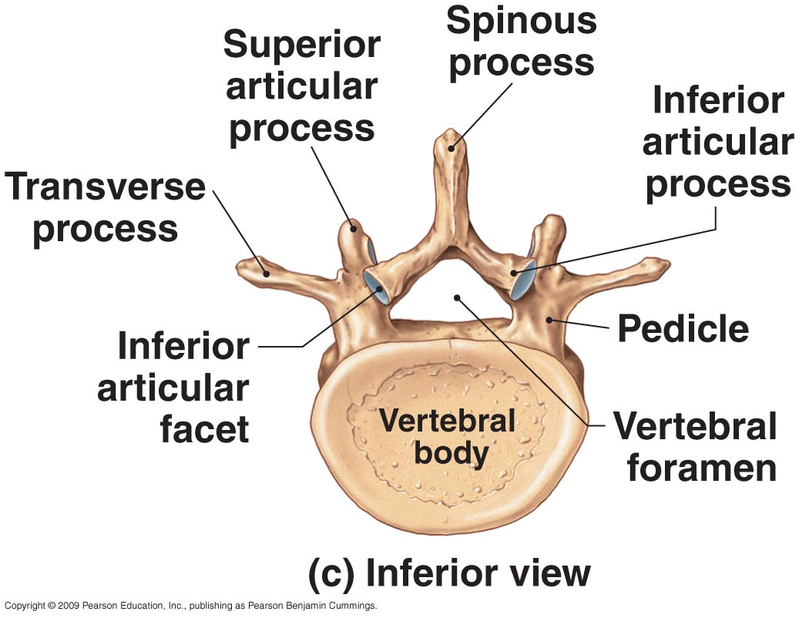
The Vertebral Column
Figure 7–18c Vertebral Anatomy.

Slide 12
The Vertebral Column
Structure of a Vertebra
The vertebral arch
Pedicles:
walls of the vertebral arch
Laminae:
roof of the vertebral arch
Spinous process:
projection where vertebral laminae fuse
Transverse process:
projection where laminae join pedicles

Slide 13
The Vertebral Column
Structure of a Vertebra
The articular processes
Superior articular process
Inferior articular process:
have articular facets on articular faces

Slide 14
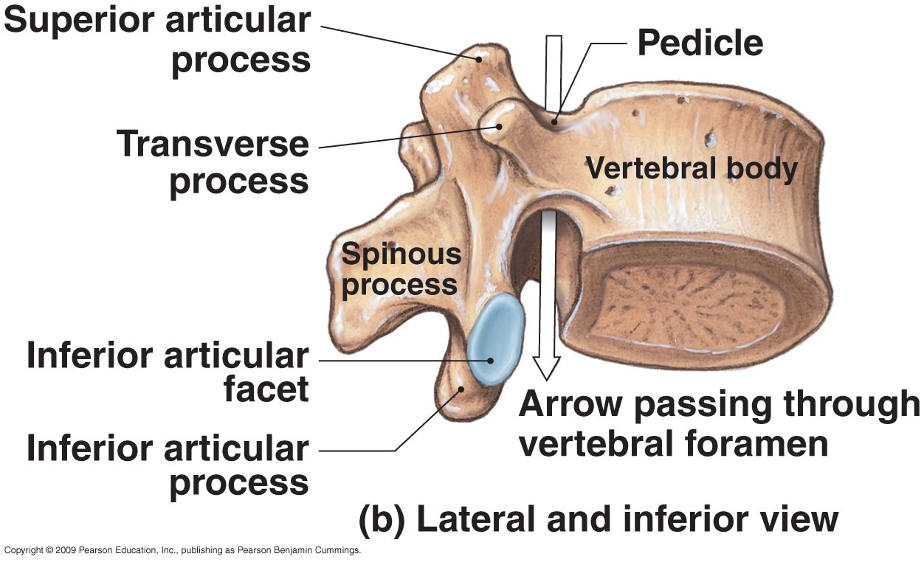
The Vertebral Column
Figure 7–18 Vertebral Anatomy.

Slide 15
The Vertebral Column
Vertebral Foramina
Intervertebral foramina
Gaps between pedicles of adjacent vertebrae
For nerve connections to spinal cord
Vertebral canal
Formed by vertebral foramina
Encloses the spinal cord
Intervertebral Discs
Are pads of fibrous cartilage
Separate the vertebral bodies
Absorb shocks

Slide 16
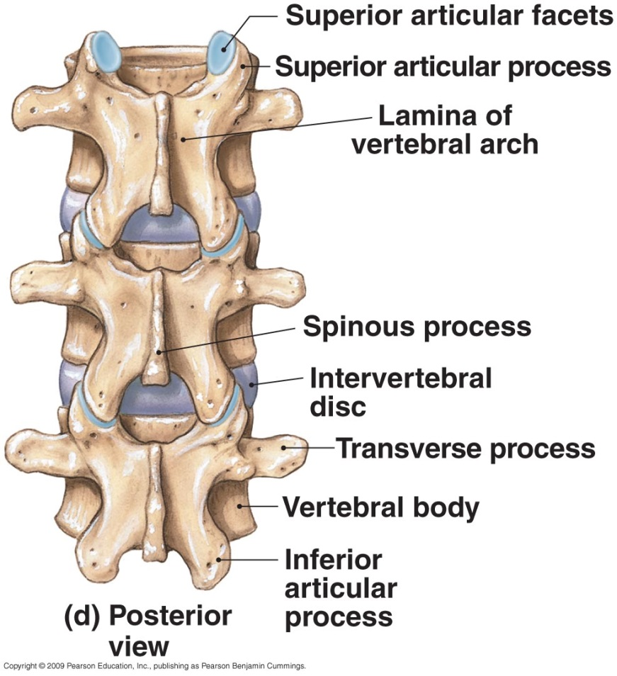
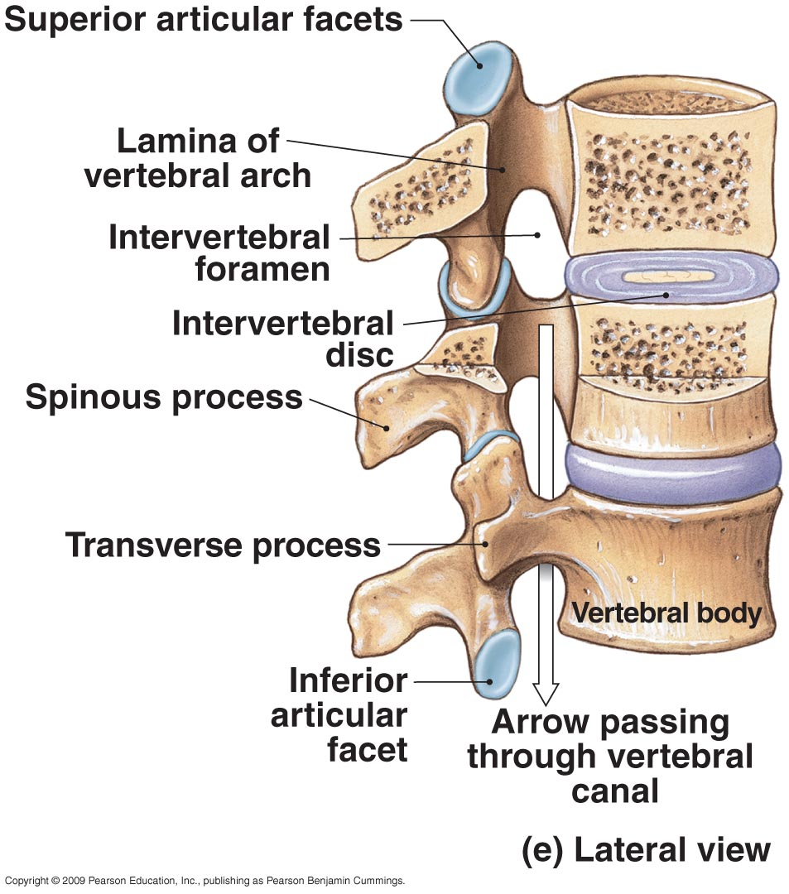
The Vertebral Column
Figure 7–18 Vertebral Anatomy.

Slide 17
Vertebral Regions
Vertebral Regions
Vertebrae are numbered
By region, from top (superior) to bottom(inferior)
C₁ articulates with skull, L₅ with sacrum
Vertebrae of each region
Have characteristics determined by functions

Slide 18
Vertebral Regions
Regions of the Vertebral Column
Cervical (C)
Thoracic (T)
Lumbar (L)
Sacral (S)
Coccygeal (Co)

Slide 19
Vertebral Regions
The Cervical Vertebrae
Small body (support only head)
Large vertebral foramen (largest part of spinal cord)
Concave superior surface
Slopes posterior to anterior
C₁ (atlas) has no spinous process
All others have short spinous processes
tip of each spinous process is notched (bifid)

Slide 20
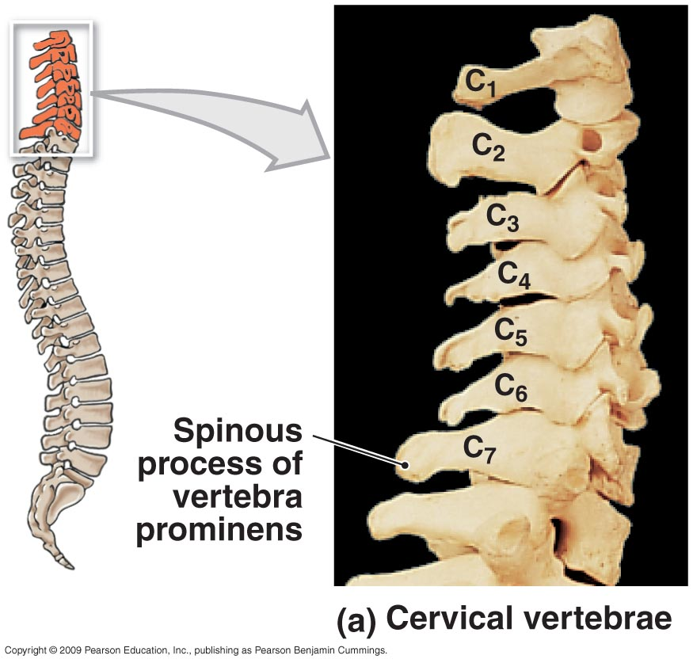
Vertebral Regions
Figure 7–19 The Cervical Vertebrae.

Slide 21
Vertebral Regions
The Cervical Vertebrae
Transverse processes
Are fused to costal processes
Which encircle transverse foramina (protect arteries and veins)
Atlas (C₁)
Articulates with occipital condyles of skull
Has no body or spinous process
Has a large, round foramen within anterior and posterior arches

Slide 22
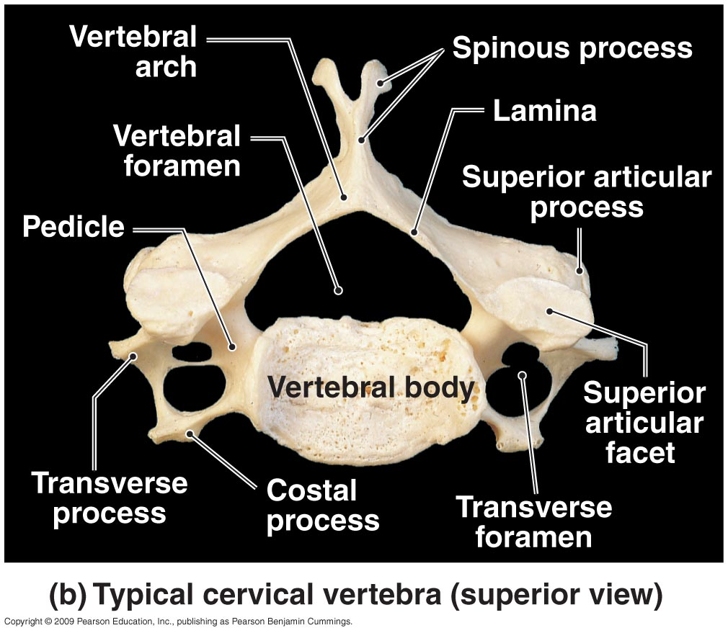
Vertebral Regions
Figure 7–19 The Cervical Vertebrae.

Slide 23
Vertebral Regions
The Cervical Vertebrae
Axis (C₂)
Supports the atlas
Has heavy spinous process
To attach muscles of head and neck
Axis and atlas bodies fuse during development to form the dens
Vertebra prominens (C₇)
Transitions to thoracic vertebrae
Has a long spinous process with a broad tubercle
Has large transverse processes
Ligamentum nuchae (elastic ligament) extends from C₇ to skull
Rotation of Cervical Vertebrae

Slide 24
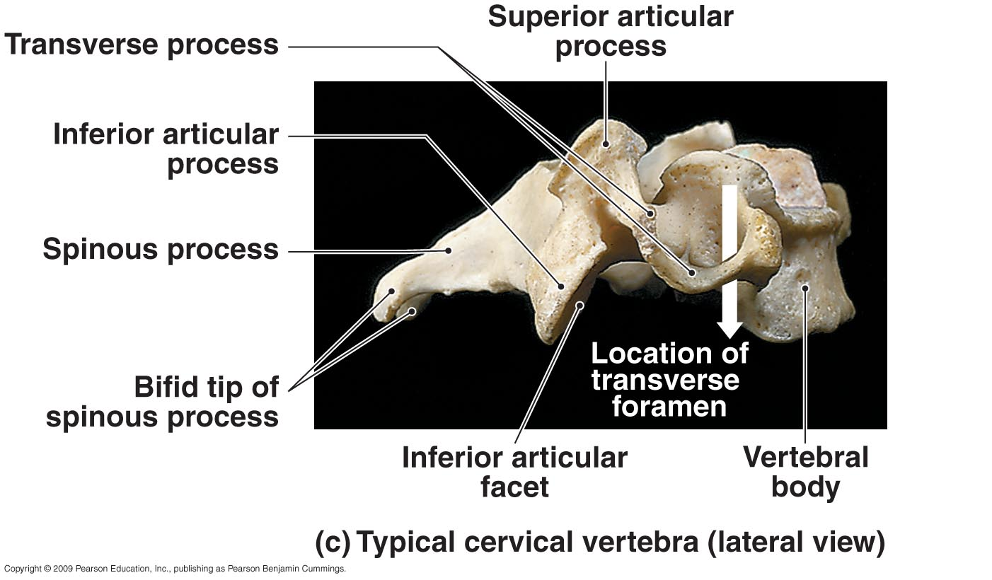
Vertebral Regions
Figure 7–19 The Cervical Vertebrae.

Slide 25
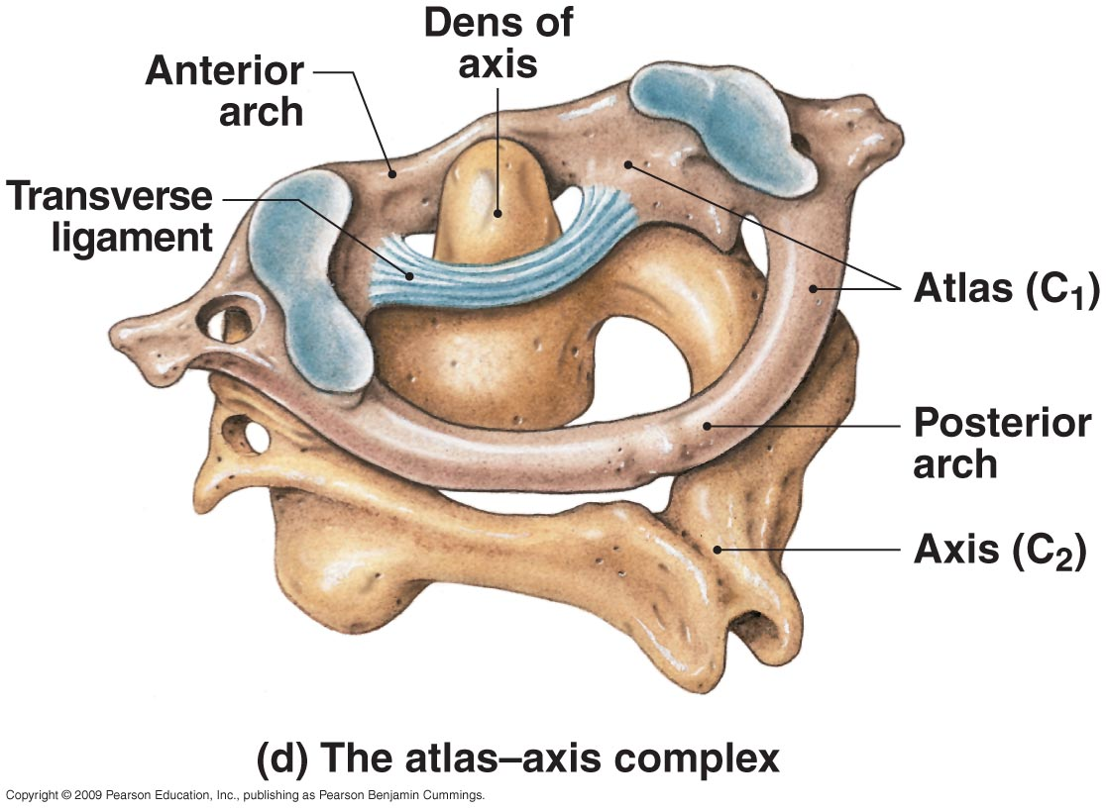
Vertebral Regions
Figure 7–19 The Cervical Vertebrae.

Slide 26
Vertebral Regions
Thoracic vertebrae (T₁–T₁₂)
Have heart-shaped bodies
Larger bodies than in C₁–C₇
Smaller vertebral foramen than in C₁–C₇
Long, slender spinous processes
Dorsolateral surfaces of body have costal facets:
Which articulate with heads of ribs

Slide 27
Vertebral Regions
Thoracic vertebrae (T₁–T₁₂)
T₁–T₁₀
Have transverse costal facets
On thick transverse processes for rib articulation
Ribs at T₁–T₁₀
Contact costal and transverse costal facets
T₁–T₈ articulate with two pairs of ribs
At superior and inferior costal facets
T₉–T₁₁ articulate with one pair of ribs
T₁₀–T₁₂ transition to lumbar vertebrae
3D Rotation of Thoracic Vertebrae

Slide 28
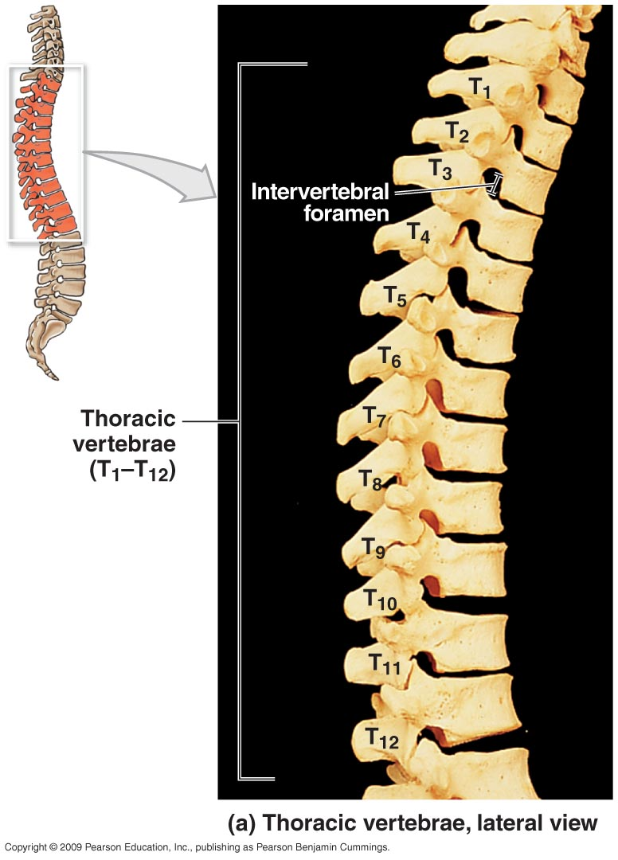
Vertebral Regions
Figure 7–20a The Thoracic Vertebrae.

Slide 29
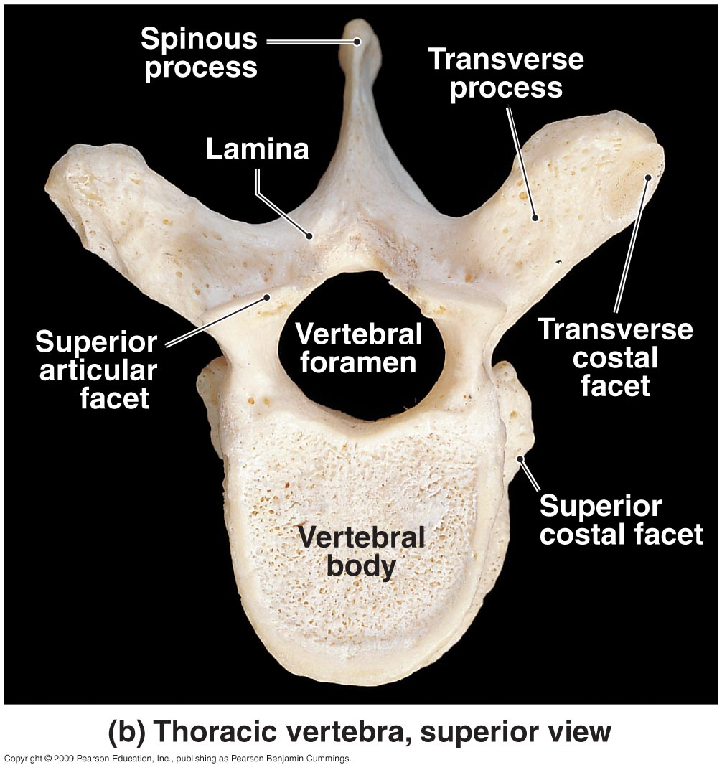
Vertebral Regions
Figure 7–20b The Thoracic Vertebrae.

Slide 30
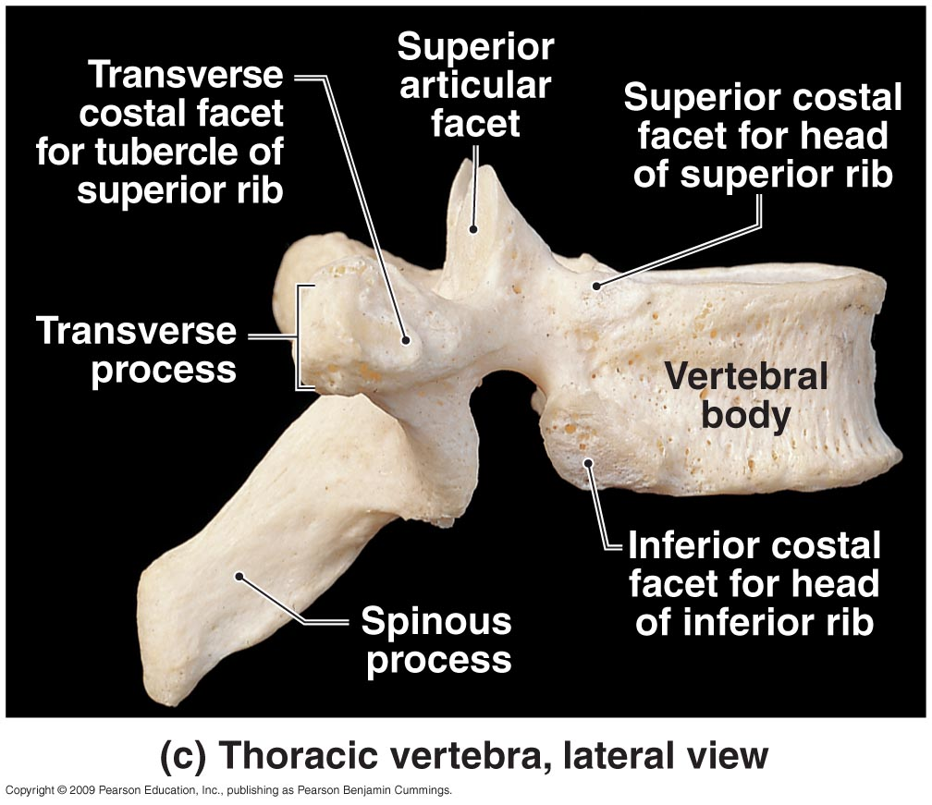
Vertebral Regions
Figure 7–20c The Thoracic Vertebrae.

Slide 31
Vertebral Regions
Lumbar vertebrae (L₁–L₅)
Largest vertebrae
Oval-shaped bodies
Thicker bodies than T₁–T₁₂
No costal or transverse costal facets
Triangular vertebral foramen
Superior articular processes
Face up and in
Inferior articular processes
Face down and out

Slide 32
Vertebral Regions
Lumbar vertebrae (L₁–L₅)
Transverse processes
Slender
Project dorsolaterally
Spinous process:
Short, heavy
For attachment of lower back muscles
3D Rotation of Lumbar Vertebrae

Slide 33
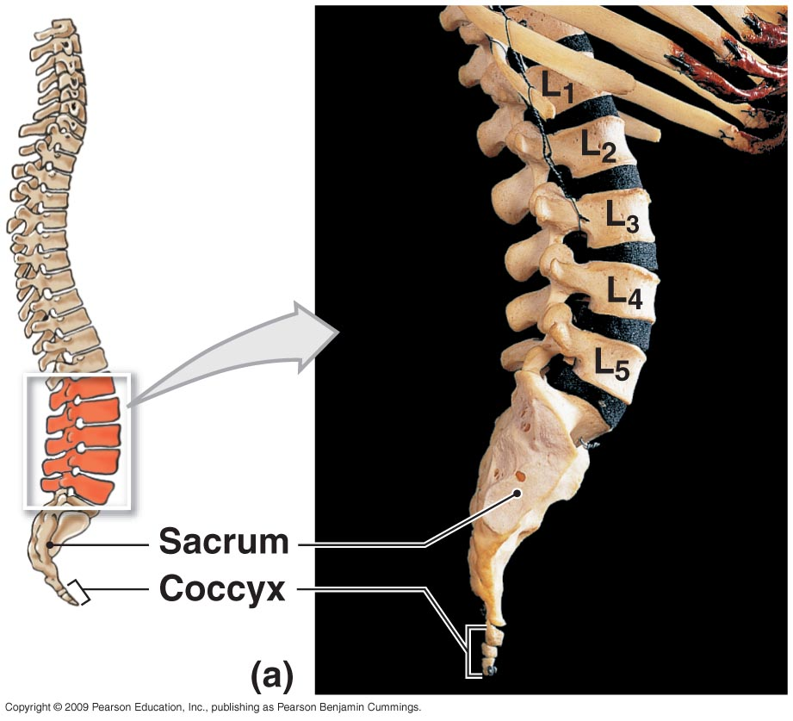
Vertebral Regions
Figure 7–21a The Lumbar Vertebrae.

Slide 34
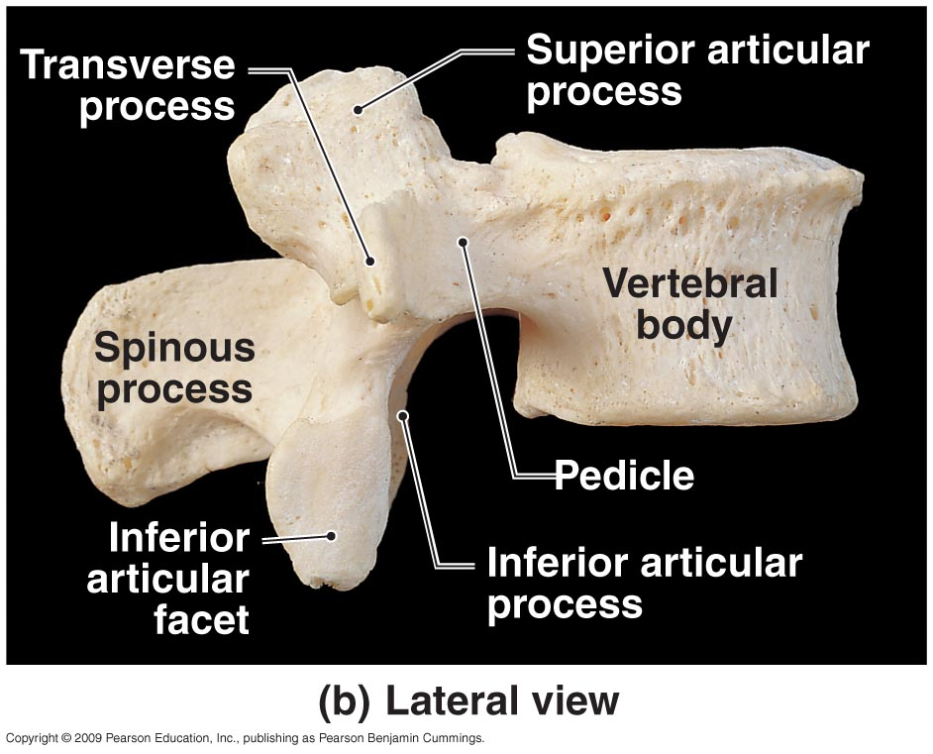
Vertebral Regions
Figure 7–21b The Lumbar Vertebrae.

Slide 35
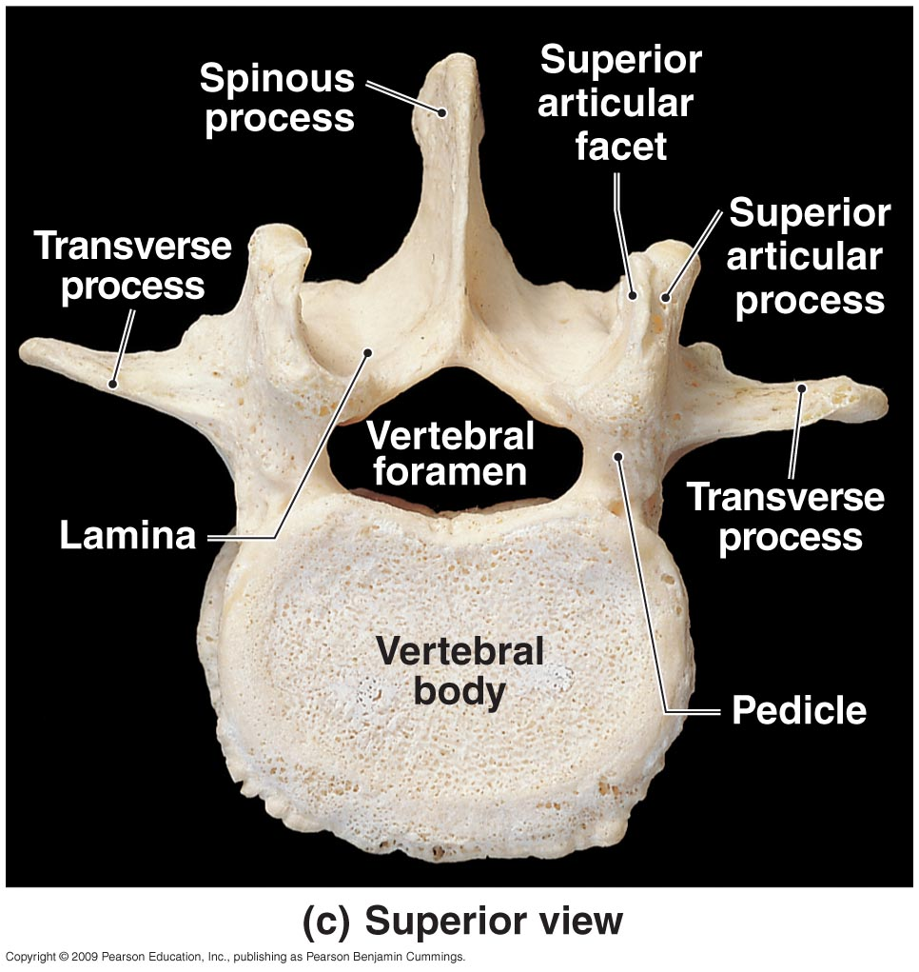
Vertebral Regions
Figure 7–21c The Lumbar Vertebrae.

Slide 36
Vertebral Regions

Slide 37
Vertebral Regions

Slide 38
Vertebral Regions

Slide 39
Vertebral Regions
The sacrum
Is curved, more in males than in females
Protects reproductive, urinary, and digestive organs
Attaches
The axial skeleton to pelvic girdle of appendicular skeleton
Broad muscles that move the thigh
The adult sacrum
Consists of five fused sacral vertebrae
Fuses between puberty and ages 25–30
Leaving transverse lines

Slide 40
Vertebral Regions
The sacrum
Sacral canal
Replaces the vertebral canal
Sacral cornua
Horn shaped
Formed by laminae of the fifth sacral vertebra
Which do not meet at midline
Sacral hiatus
Opening at the inferior end of the sacral canal
Formed by ridges of sacral cornua
Covered by connective tissues

Slide 41
Vertebral Regions
The sacrum
Median sacral crest
Fused spinous processes
Four pairs of sacral foramina open to either side
Lateral sacral crest
Fused transverse processes
Attach to muscles of lower back and hip

Slide 42
Vertebral Regions
The sacrum
Auricular surface
Thick, flattened area
Articulates with pelvic girdle (forming sacroiliac joint)
Sacral tuberosity
Rough area
Attaches ligaments of the sacroiliac joint

Slide 43
Vertebral Regions
The sacrum
Four regions of the sacrum
Base:
the broad superior surface
Ala:
wings at either side of the base
to attach muscles
Sacral promontory:
at the center of the base
Apex:
the narrow inferior portion
articulates with the coccyx

Slide 44
Vertebral Regions
The coccyx
Attaches ligaments and a constricting muscle of the anus
Mature coccyx
Consists of three to five fused coccygeal vertebrae
First two coccygeal vertebrae:
Have transverse processes
Have unfused vertebral arches
Coccygeal cornua
Formed by laminae of first coccygeal vertebra
3D Rotation of Sacrum and Coccyx

Slide 45
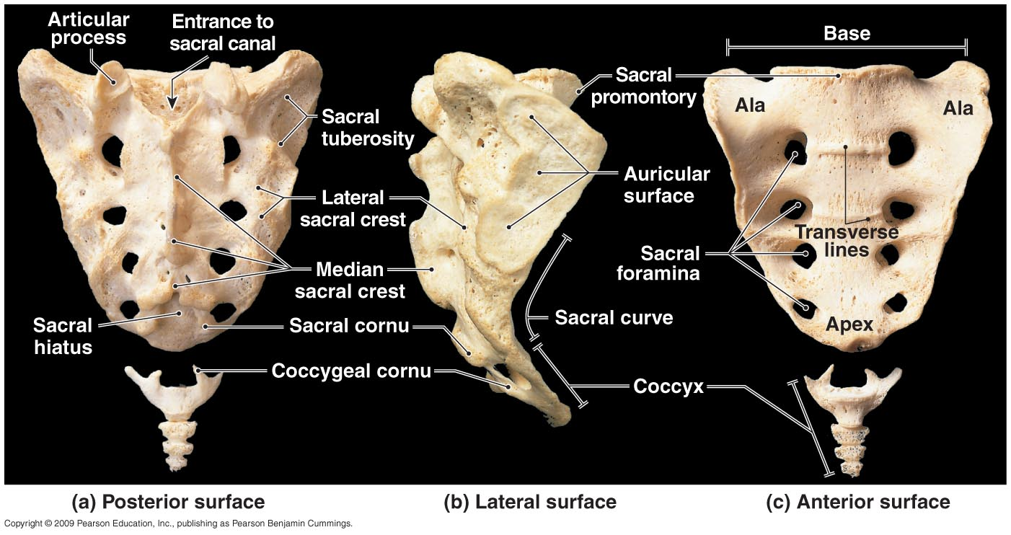
Vertebral Regions
Figure 7–22 The Sacrum and Coccyx.

Slide 46
The Thoracic Cage
The skeleton of the chest
Supports the thoracic cavity
Consists of:
thoracic vertebrae
ribs
sternum (breastbone)
The Rib Cage
Formed of ribs and sternum

Slide 47
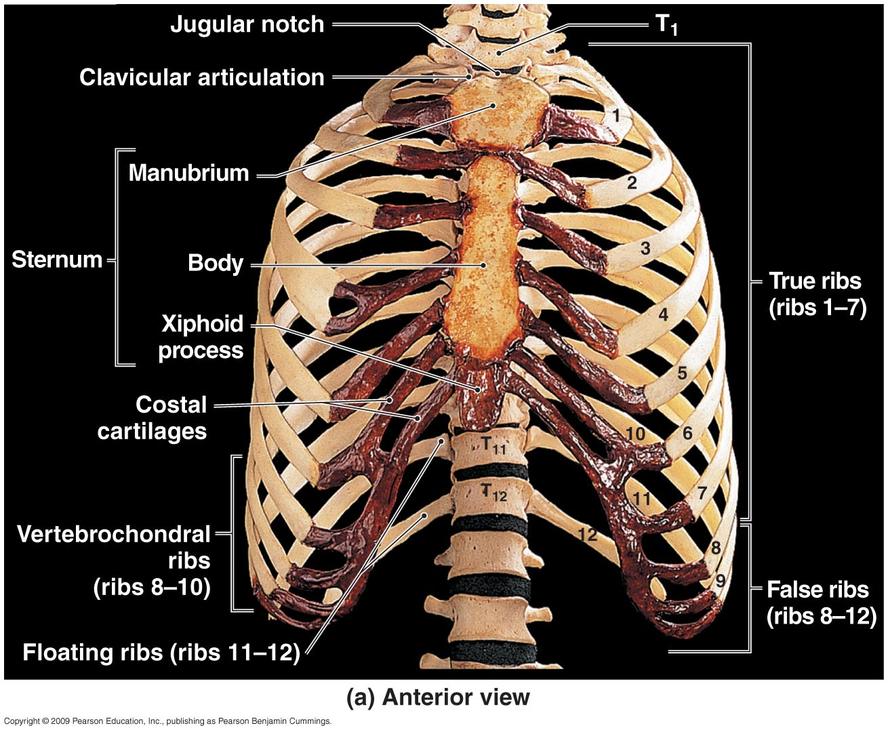
The Thoracic Cage
Figure 7–23a The Thoracic Cage.

Slide 48
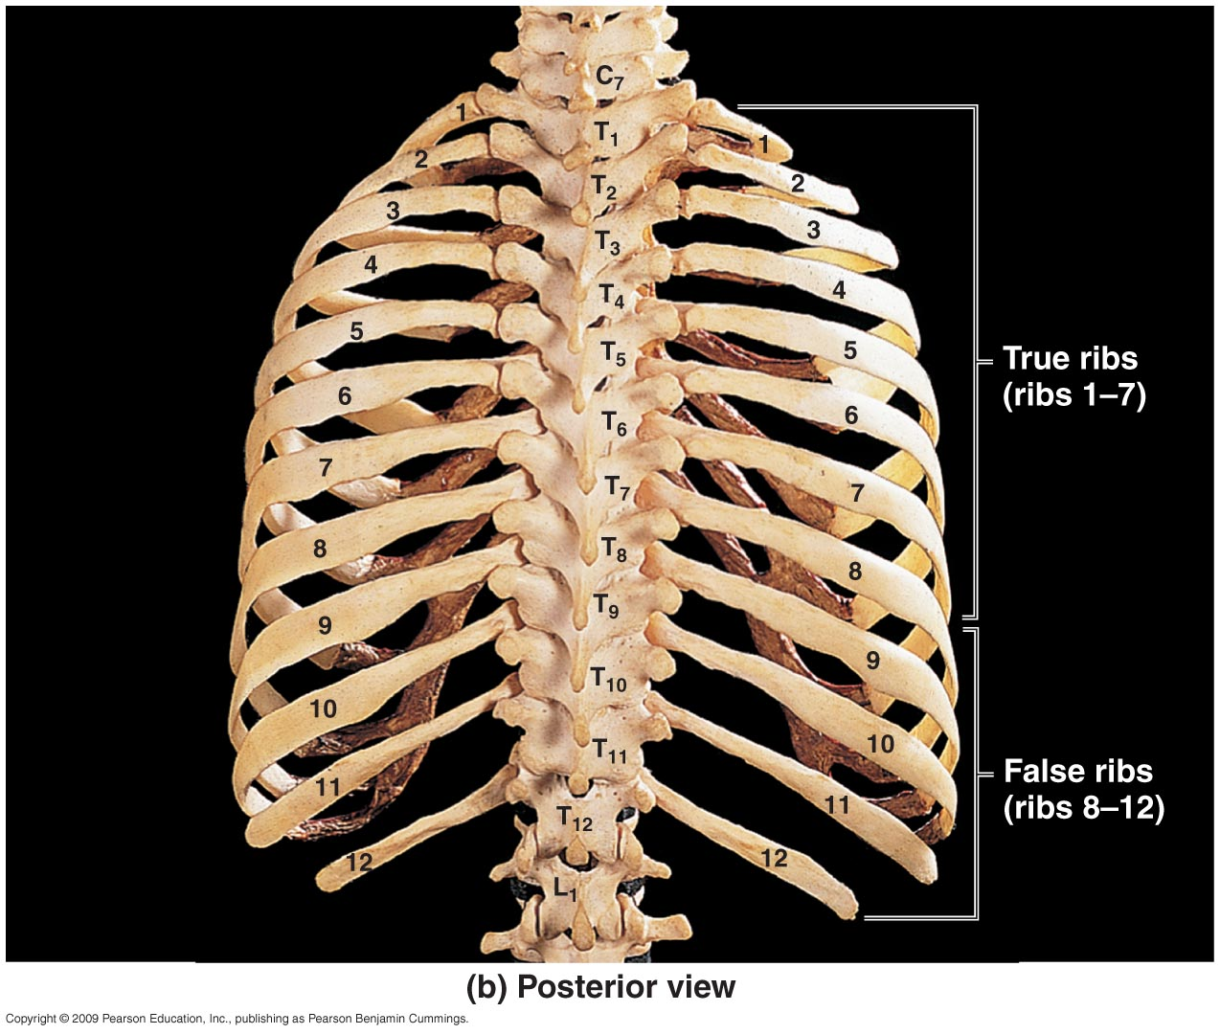
The Thoracic Cage
Figure 7–23b The Thoracic Cage.

Slide 49
The Thoracic Cage
Functions of the Thoracic Cage
Protects organs of the thoracic cavity
Heart, lungs, and thymus
Attaches muscles
For respiration
Of the vertebral column
Of the pectoral girdle
Of the upper limbs

Slide 50
The Thoracic Cage
Ribs
Are mobile
Can absorb shock
Functions of ribs
Rib movements (breathing):
affect width and depth of thoracic cage
changing its volume

Slide 51
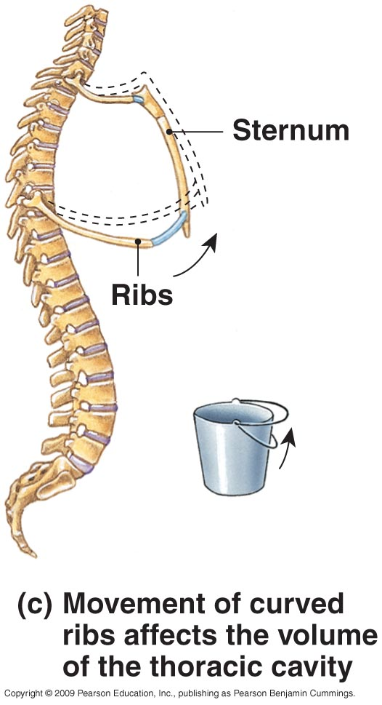
The Thoracic Cage
Figure 7–24c The Ribs.

Slide 52
The Thoracic Cage
Ribs (costae)
Are 12 pairs of long, curved, flat bones
Extending from the thoracic vertebrae
Ribs are divided into two types
True ribs
False ribs

Slide 53
The Thoracic Cage
Ribs 1–7 (true ribs)
Vertebrosternal ribs
Connected to the sternum by costal cartilages
Ribs 8–12 (false ribs)
Do not attach directly to the sternum
Vertebrochondral ribs (ribs 8–10)
Fuse together
Merge with cartilage before reaching the sternum
Floating or vertebral ribs (ribs 11–12)
Connect only to the vertebrae and back muscles
Have no connection with the sternum

Slide 54
The Thoracic Cage
Figure 7–23 The Thoracic Cage.

Slide 55
The Thoracic Cage
Structures of the Ribs
The head (capitulum)
At the vertebral end of the rib
Has superior and inferior articular facets
The neck
The short area between the head and the tubercle

Slide 56
The Thoracic Cage
Structures of the Ribs
The tubercle (tuberculum)
A small dorsal elevation
Has an auricular facet that contacts the facet of its thoracic vertebra (at T₁–T₁₀ only)
The tubercular body (shaft)
Attaches muscles of the pectoral girdle and trunk
Attaches to the intercostal muscles that move the ribs

Slide 57
The Thoracic Cage
Figure 7–24a The Ribs.

Slide 58
The Thoracic Cage
Figure 7–24b The Ribs.

Slide 59
The Thoracic Cage
The sternum
A flat bone
In the midline of the thoracic wall
Three parts of the sternum
The manubrium
The sternal body
The xiphoid process

Slide 60
The Thoracic Cage
Manubrium
The superior portion of sternum
Broad, triangular shape
Articulates with clavicles (collarbones)
Articulates with cartilages of first rib pair
Has a jugular notch, a shallow indentation between clavicular articulations

Slide 61
The Thoracic Cage
The sternal body
Is tongue-shaped
Attaches to the manubrium
Attaches to costal cartilages of ribs 2–7
The xiphoid process
Is the smallest part of the sternum
Attaches to the sternal body
Attaches to diaphragm and rectus abdominis muscles

Slide 62
The Thoracic Cage
Figure 7–23 The Thoracic Cage.

Slide 63
The Thoracic Cage
Development of the Sternum
The developing sternal body
Consists of four unfused bones
Completes fusion about age 25
Leaving transverse lines
The xiphoid process
Is the last part of sternum to fuse
Can easily be broken away

