Slide 1
SS6E4 & SS7E4
Personal
Finance
Money Management
Choices
© 2015 Brain Wrinkles

Slide 2
Standards
SS6E4 The student will explain personal money management choices in terms of income, spending, credit, saving, and investing.
SS7E4 The student will explain personal money management choices in terms of income, spending, credit, saving, and investing.
© 2015 Brain Wrinkles

Slide 3
SS6E4 & SS7E4
Personal
Finance
Money Management
Choices
© 2015 Brain Wrinkles

Slide 4
Money Management
Everyone makes choices about how to manage his or her money.
The personal money management choices that you make will have a significant impact on your life.
It is really important to develop good money habits sooner rather than later!
The process of projecting, organizing, monitoring, and controlling future income and expenses is known as personal finance.
© 2015 Brain Wrinkles

Slide 5
Money
Money is the medium of exchange used to buy goods and services.
There are several forms of money: currency (cash), coins, debit cards, and checks.
© 2015 Brain Wrinkles

Slide 6
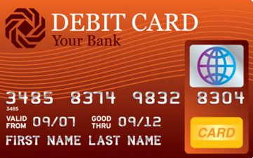
Forms of Money
Debit
Card
Coins
Check
Currency
© 2015 Brain Wrinkles

Slide 7
Income
People earn an income by giving their time and services to an employer in an exchange for money.
Income is the money that you make from your job.
Your income provides you with the money that you can save or spend on whatever you want.
© 2015 Brain Wrinkles

Slide 8
Spending
Your income provides you with the money that you can choose to spend now on goods and services.
When you spend your income, you are trading your money in exchange for goods or services.
© 2015 Brain Wrinkles

Slide 9
Budget
To help people make decisions about their income, a budget can be developed.
A budget is a saving-spending plan that is based on a person’s income and estimated expenses.
© 2015 Brain Wrinkles

Slide 10
Saving
You may also choose to save money from your income for the future.
Your savings is the amount of money that you have not spent after buying the things that you want or need.
It is a good idea to save money so that you have it in case of an emergency.
Typically, you put your savings into a bank account, but there are other ways that you can choose to invest your money.
© 2015 Brain Wrinkles

Slide 11
Investing
Investing is how you make your money grow, or appreciate, to gain a financial return.
You can increase your money by investing in many different ways: stocks and bonds, real estate, collectibles, businesses, etc.
Investing means postponing current consumption in order to pursue an activity with greater benefits in the future.
Basically, after a period of time, you should get more money than you put in due to interest.
© 2015 Brain Wrinkles

Slide 12
Credit
People use credit to buy something now and pay for it later.
When you buy something using credit, you have to pay back the money that you borrowed, plus an additional amount in interest.
Interest is a fee paid for the use of someone else’s money.
People who can borrow money with a low interest rate are said to have good credit, while those who cannot borrow such amounts are said to have bad credit.
© 2015 Brain Wrinkles

Slide 13
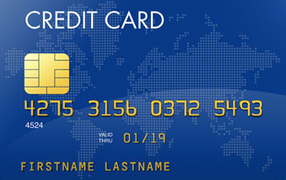
2 Forms of Credit
Bank Loan
Credit Card
© 2015 Brain Wrinkles

Slide 14
Credit
While credit is extremely useful to the economy, excessive borrowing can be a problem for people, businesses, and the government.
Credit should not be used to pay for goods or consumption in the present that were completely consumed in the past.
© 2015 Brain Wrinkles

Slide 15
Key Terms
Income: Money that you earn from working or gain from investments.
Spending: Trading money in exchange for goods or services.
Budget: A plan for saving and spending income.
Credit: Buying something now and paying for it (plus interest) later.
Saving: Money left over after buying what is needed and wanted.
Investing: Putting money to use in something that offers potentially profitable returns.
© 2015 Brain Wrinkles

