Slide 1
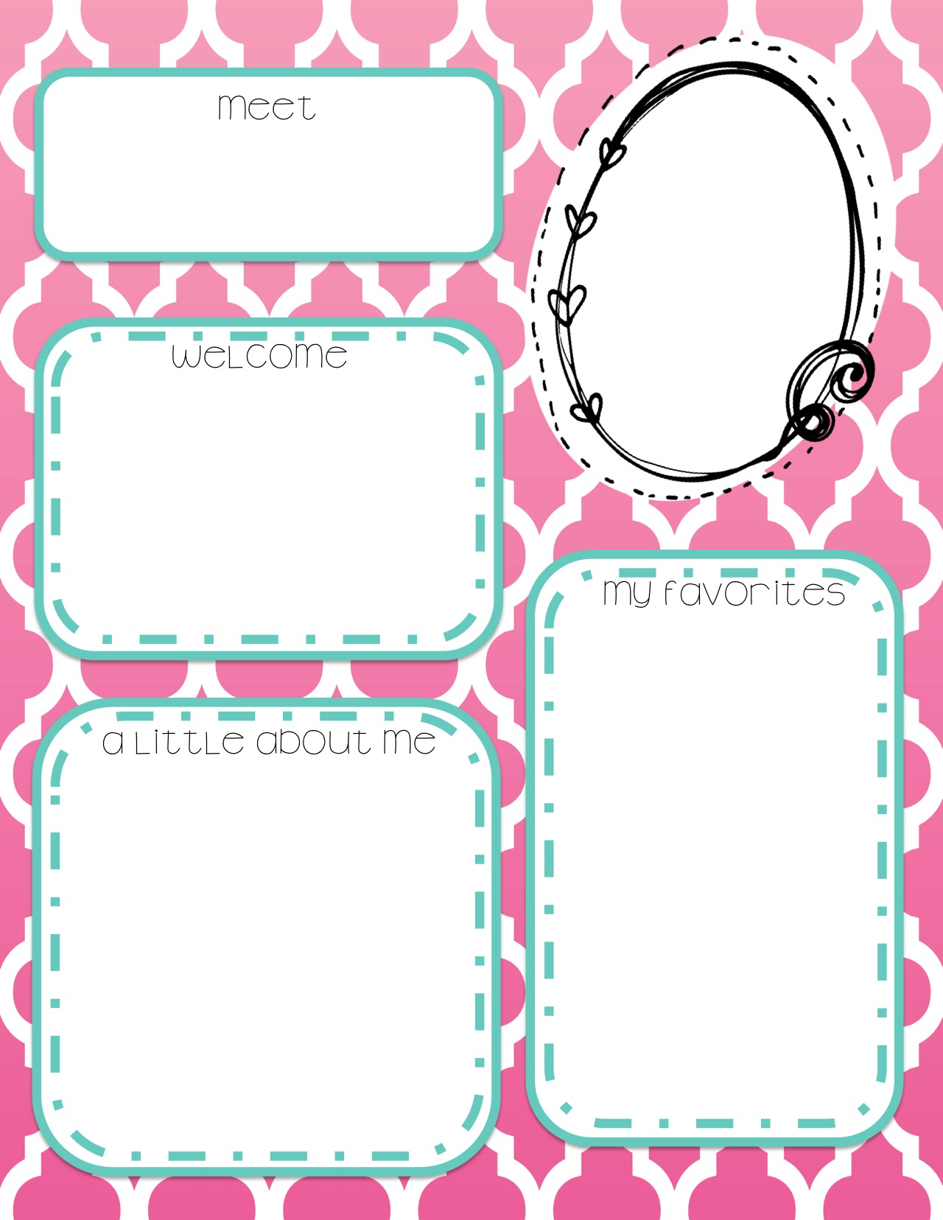
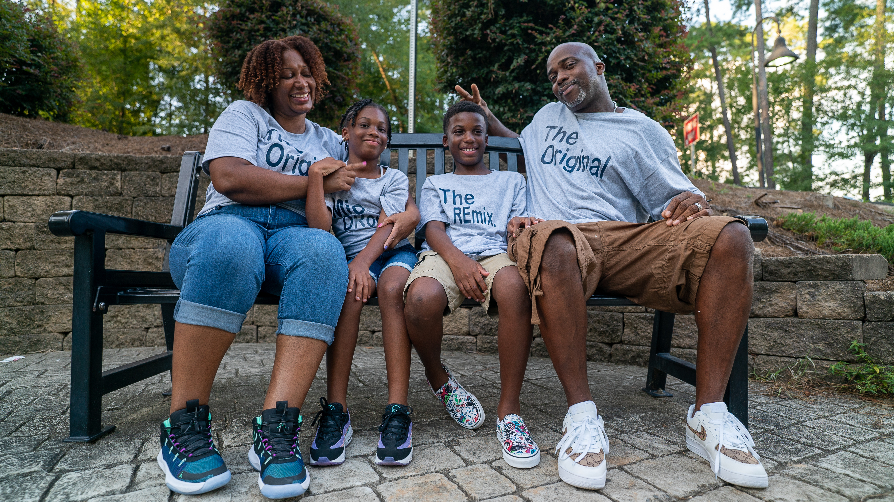
Mrs. Hoist
Hello I am happy that you are attending my ELA Class this year. My hope for this year is to overcome all obstacles that are being placed before us while continuing to uplift our spirits together.
For the Classroom
Respective Students
Attentive Students
Focused Students
Students ready to learn
Mrs. Hoist Favorites
Colors: Purple & Pink
Drink: Black Raspberry Ginger Ale
Hot Beverage: Mint Tea
Mrs. Hoist Favorite Shops
Target
Home Goods
Mrs. Hoist Favorite Eatery
Sole
Any sushi Restuarant
This year marks my 3rd year teaching. This is my 2nd career choice and I am so very happy that I made the change. I have now taught 6^{th,} 7th, and 8th grades for Language Arts. I have also taught Drivers Education at Augusta Tech for about 2 years. I loved working with young adults by helping them navigate their way through life through understanding.
I have been married for 10 years and have 4 beautiful children. I have a Masters Degree in Marketing and Finance with a 10 year background in executive management.

