Slide 1
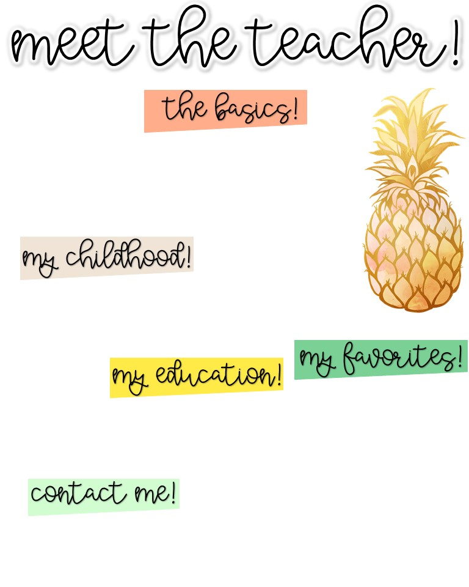
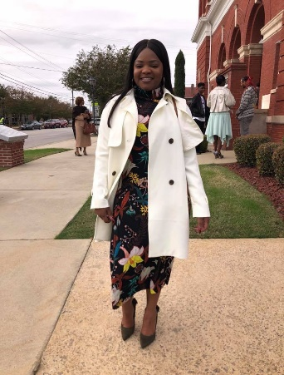
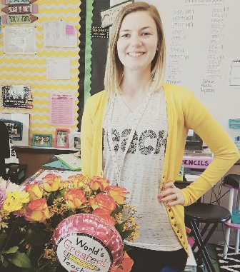
Ms. Rodnecia Walker
Hello! My Name is Ms. Rodnecia Walker! I am 33 years young! The 2023-2024 school year will make my 11th year teaching. I taught 3rd grade for four years and am currently the Gifted teacher at Blythe Elementary and Jamestown Elementary. In my free time I enjoy traveling with friends, family, and Gucci (My Yorkie). I am excited to make this my best year yet!
I grew up in a small town in Burke County; Sardis, Georgia. I attended SGA and Waynesboro Primary for Kindergarten through 2nd grade. I then attended Blakeney Elementary for 3rd grade through 5th grade. Next, I attended Burke County Middle School for grades 6th-8th. Finally, I attended Burke County High School where I graduated in 2009.
In December of 2014, I graduated with a Bachelors of Science in Elementary Education K-5 from Georgia Southern University (GSU). In May 2017, I graduated from GSU for the 2nd time with a Master’s Degree in Curriculum and Instruction. I graduated with a Specialist in Advanced Studies from Augusta State University (ASU) in December of 2024.
Food: Chicken
Movie: Notebook
Book: “Heaven is for real”
Color: Orange
Drink: Ginger Ale
Season: Fall
Sports: Football
Fast Food: Culvers
Singer: Rihanna
Hobby: Traveling
Subject: Social Studies
Store: Forever 21
Dessert: Ice cream
Candy: Snickers
Restaurant: Bonefish
Flower: Rose or tulip
Email: WalkeRo1@boe.Richmond.k12.ga.us
School Phone Number: (706)592-4090
You can also use Dojo to communicate!

