Slide 1
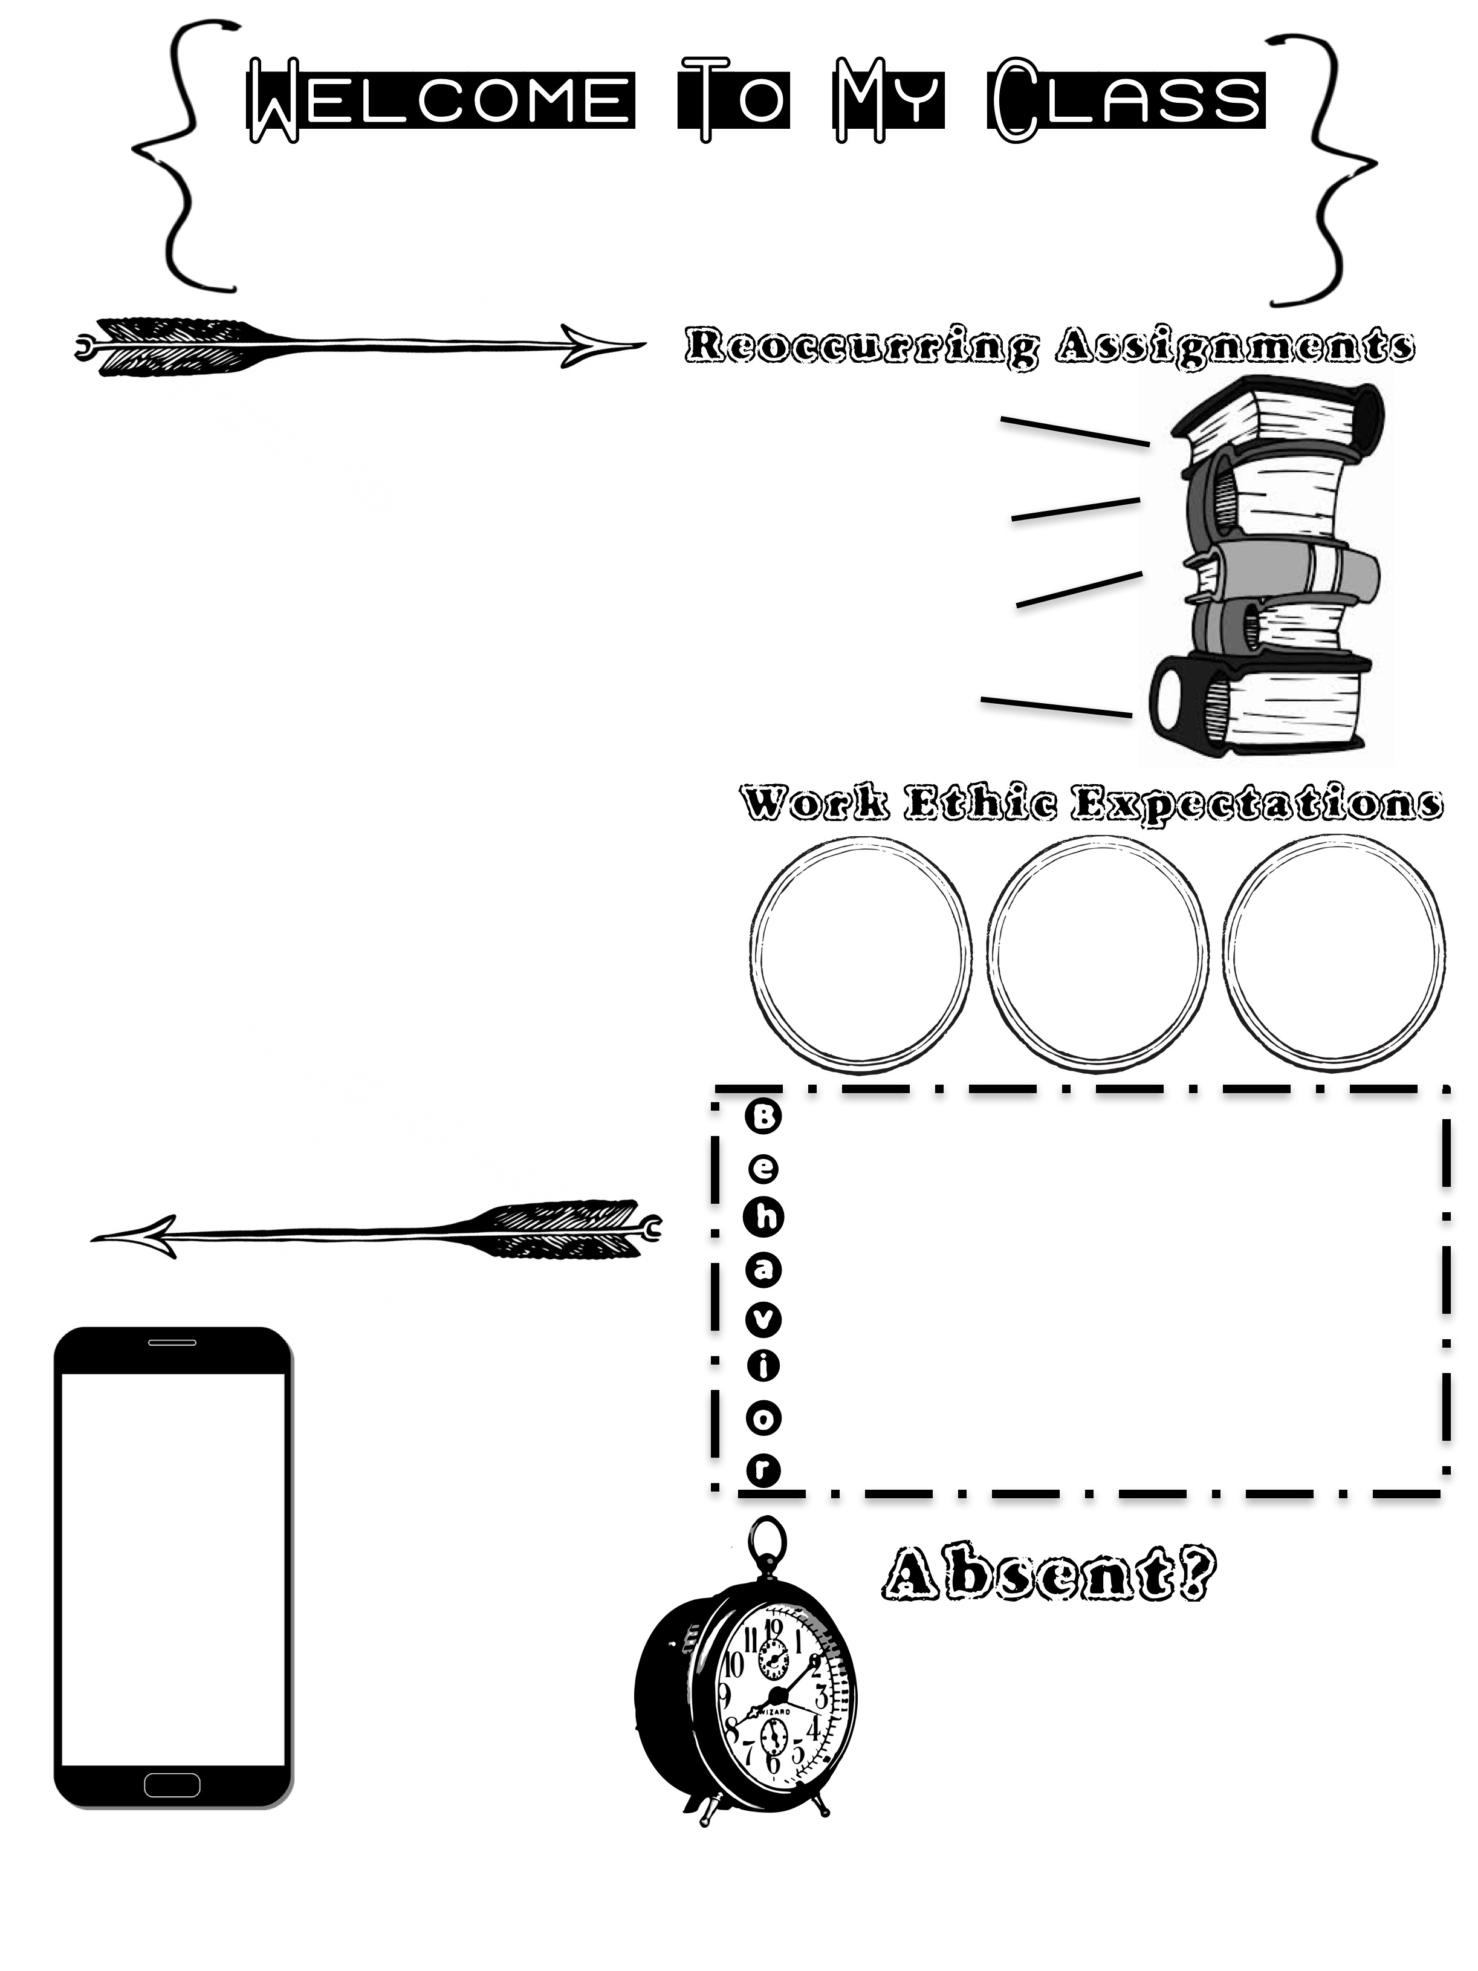
Mrs. Roberts-Kelly
Monte Sano Elementary 706-481-1813
Hello Hornets!
I am so glad to have you here in my classroom this year. I will support you in all areas. If you need help don’t hesitate to ask. Remember each day is an opportunity to do better than before! I will make sure you have every opportunity to succeed. I will just ask that you do your best everyday and give your best effort. I know that this year will be rewarding, and you will learn something new!
Read every night for 10 minutes or more!
Work on your math fluency facts!
Write a complete sentence every night!
Work on telling people how you feel.
Do Your Best!
Give your best effort!
Be Willing to do things over
Remain in your area with your mask on.
Ask for a break when you need one.
Verbal warning, time out, lose a privilege, parent contact, principals office
Rewards will be given for on task behavior as well as behavior improvement!
Please keep all electronics in your book bag turned off until you are home again. We will have computers and iPads available for assignment completion in school.
REMIND
Text to:
Message:
Please let me know if you will be out if you know ahead of time. All missed assignments will be available upon your return to school.

Slide 2
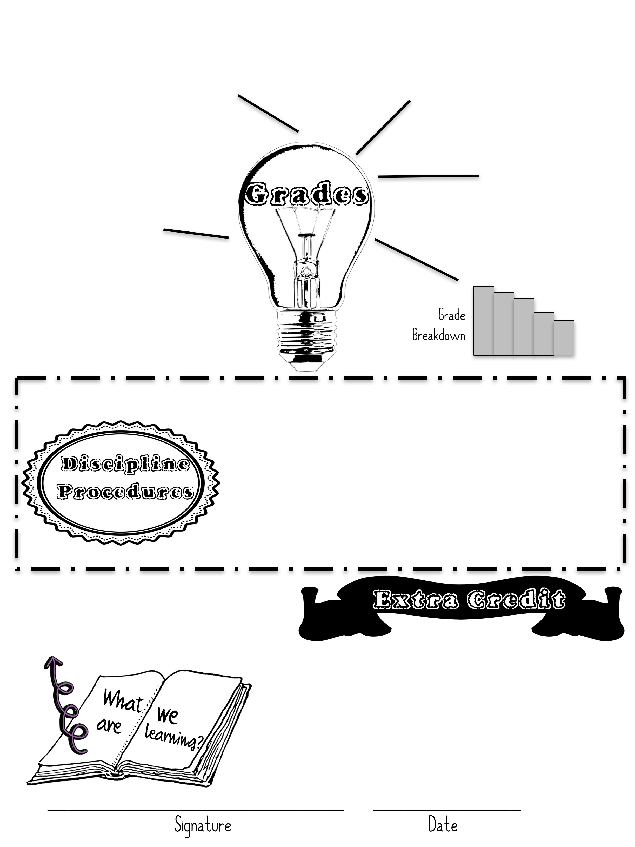
Answer in complete sentences!
Show your math work!
Make corrections if needed!
Take your time and do your best!
Daily Work 25%
Goal Progression 50%
Assessments 25%
Verbal Warning
Removed from task
Time Out
Loss of reward (partial)
Parent Contact
Principal referral
When you read a text practice telling the most important parts of that text- who, what, when, where, why, and how.
If you would like to complete extra credit let me know! I will work with you in all subjects!

