Slide 1
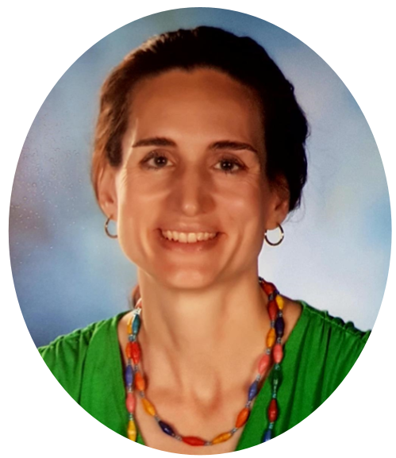
Meet Mrs. Horak
I’m so happy to meet you!

Slide 2
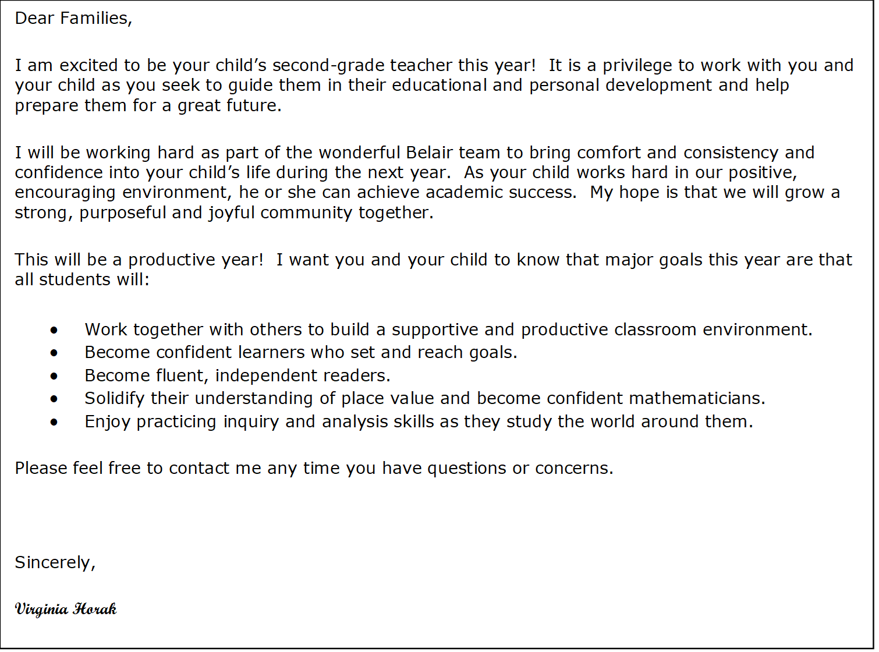

Slide 3
My sweet husband and I have five amazing children of our own, including three college students, a high schooler, and a spunky fifth-grader. It is my job to make sure we stay well-supplied with books from the library and get lots of time outside hiking and swimming. My family makes sure I do some singing and drawing, build robots, beef up my tech and construction skills, get chased by lizards, play exciting rounds of UNO, and eat plenty of homemade pizza and chocolate chip cookies. I grew up as an army brat and lived all over the U.S. and on a few different continents. After earning my B.A. and M.S., I spent 19 years living as an ex-pat in Germany. I recently moved to the Augusta area with my husband and children to be near my parents and siblings. I appreciate the kindness and openness I find everywhere in my new community!
About
Mrs. Horak

Slide 4
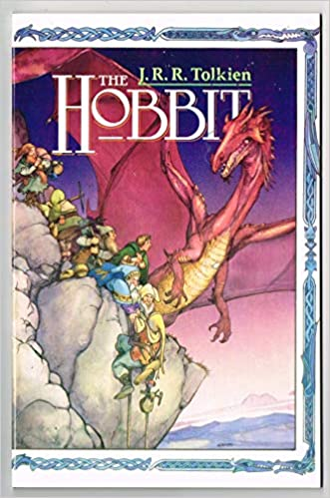
SOME of My Favorite Books

Slide 5
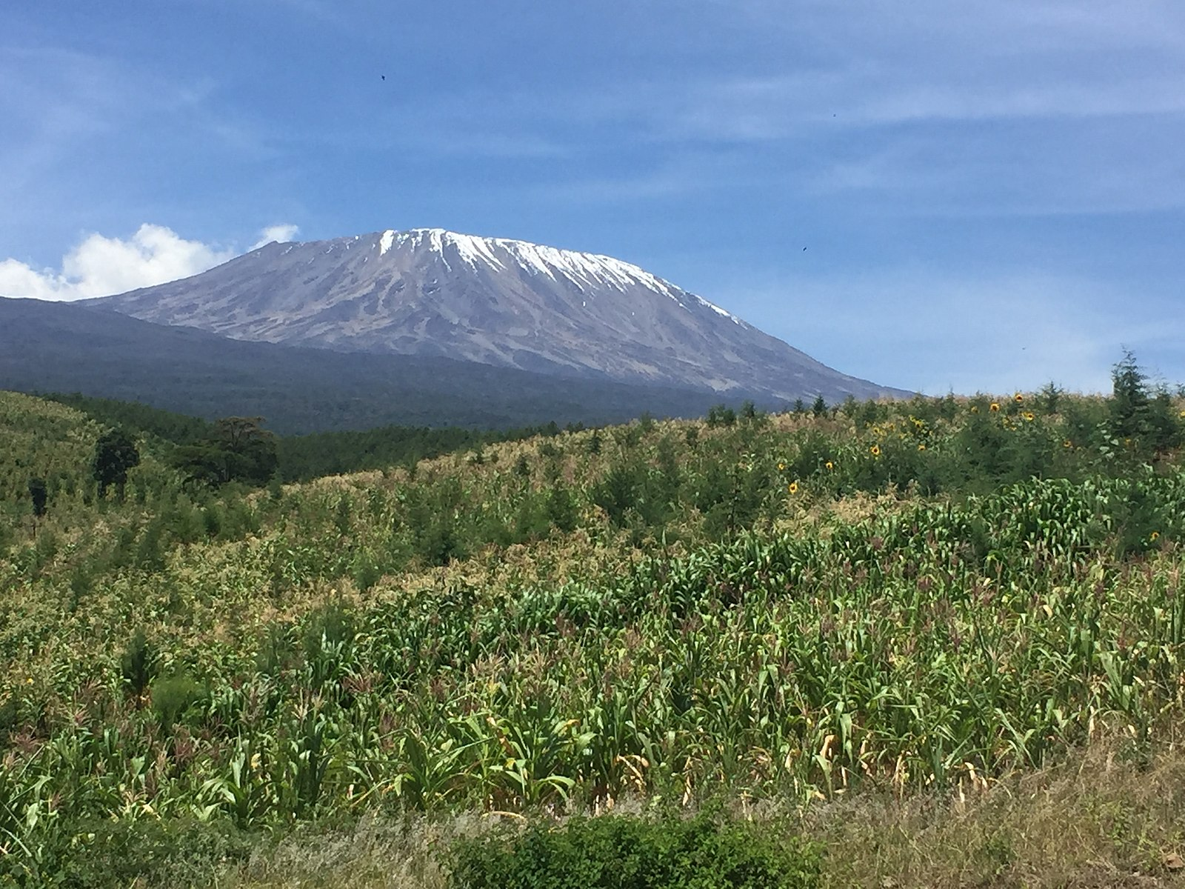
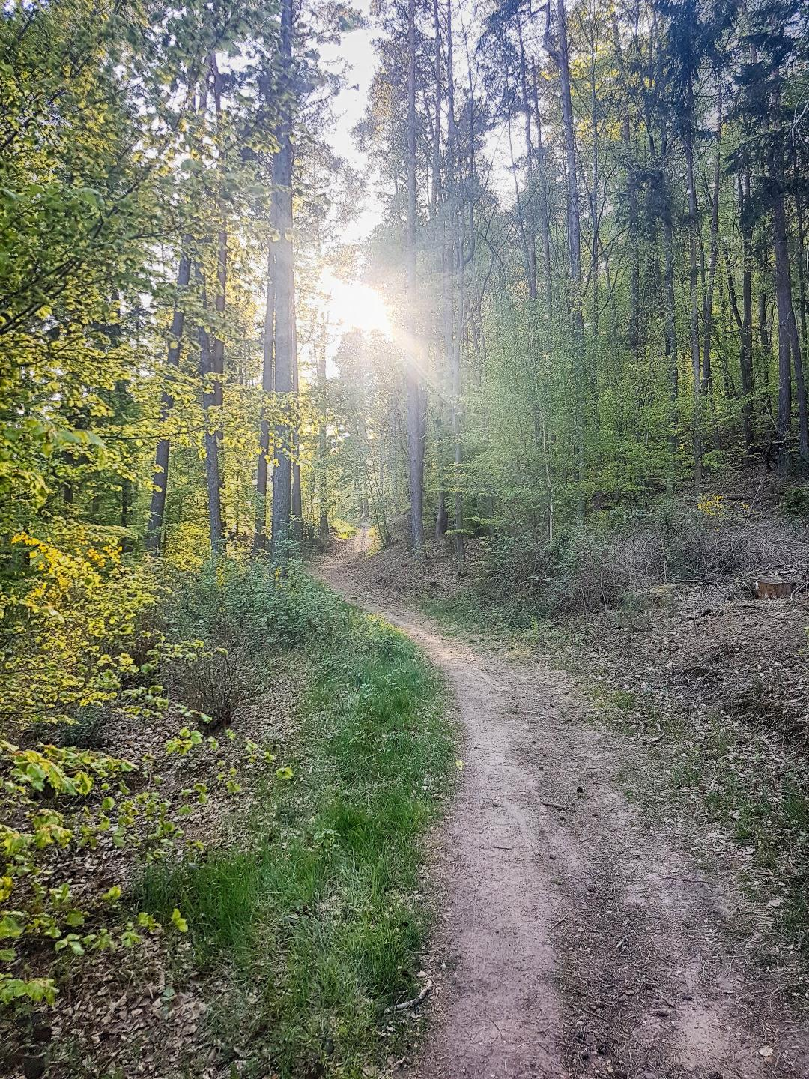
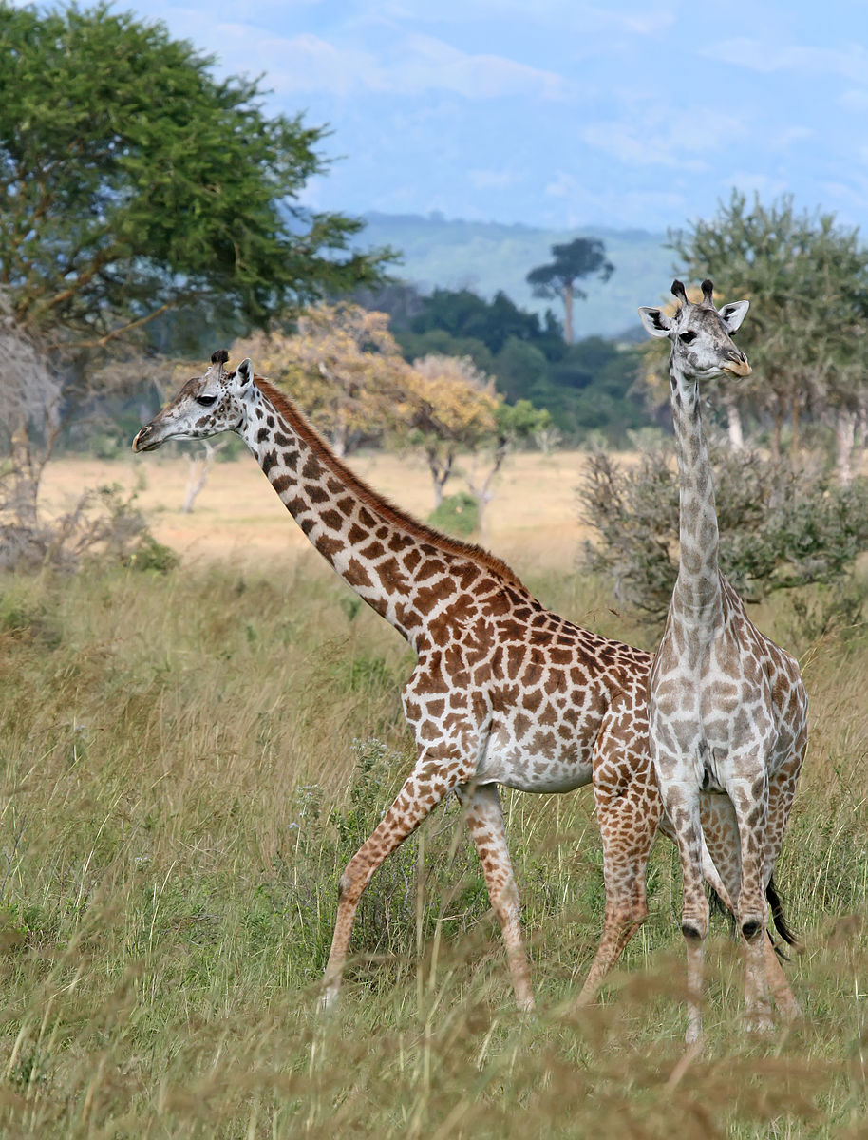
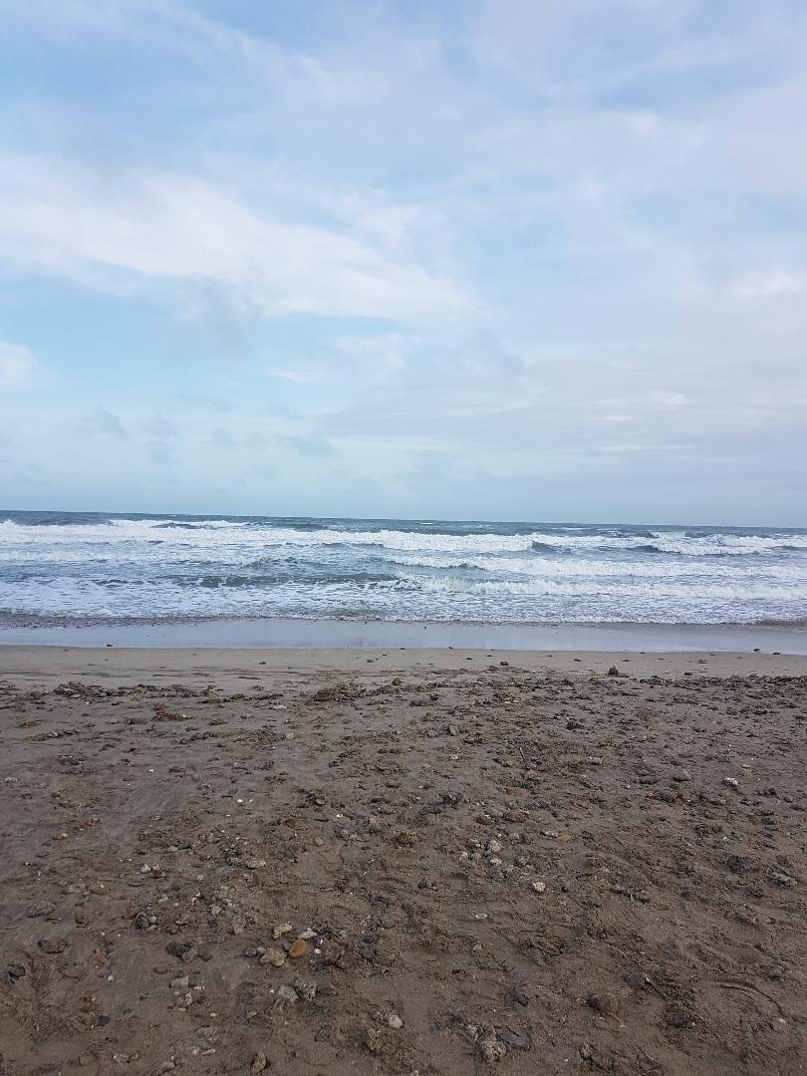
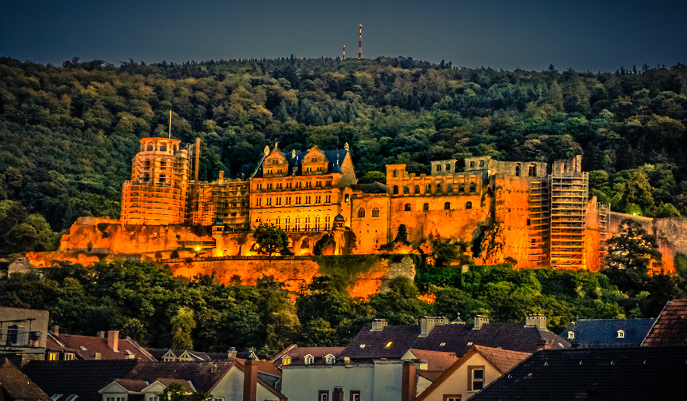
SOME of My Favorite Places
Hazie Kapfumvuti / CC BY-SA (https://creativecommons.org/licenses/by-sa/4.0)
Muhammad Mahdi Karim FacebookThe making of this document was supported by Wikimedia CH. (Submit your project!)For all the files concerned, please see the category Supported by Wikimedia CH.العربية | বাংলা | čeština | Deutsch | English | Esperanto | español | français | magyar | italiano | македонски | Nederlands | rumantsch | sicilianu | українська | +/− / GFDL 1.2 (http://www.gnu.org/licenses/old-licenses/fdl-1.2.html)
https://commons.wikimedia.org/w/index.php?title=File:Heidelberg_Castle_at_Night.jpg&oldid=255656591

Slide 6
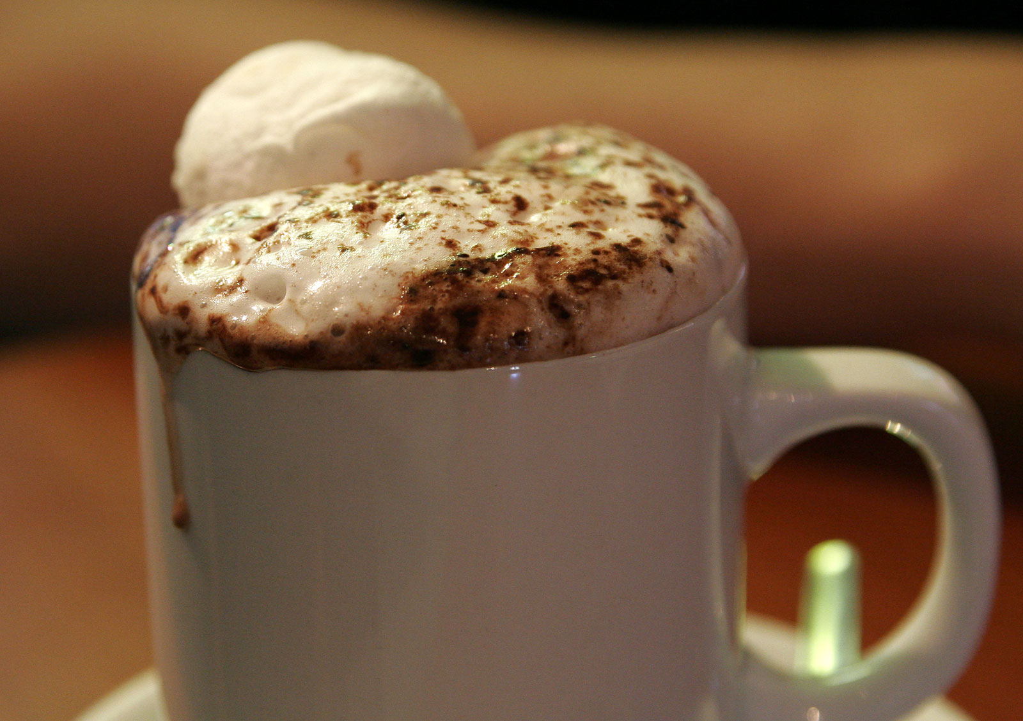
My Favorite Color
Favorite Beverages
Green
Judy Gallagher / CC BY (https://creativecommons.org/licenses/by/2.0)
Fir0002/Flagstaffotos

