Slide 1
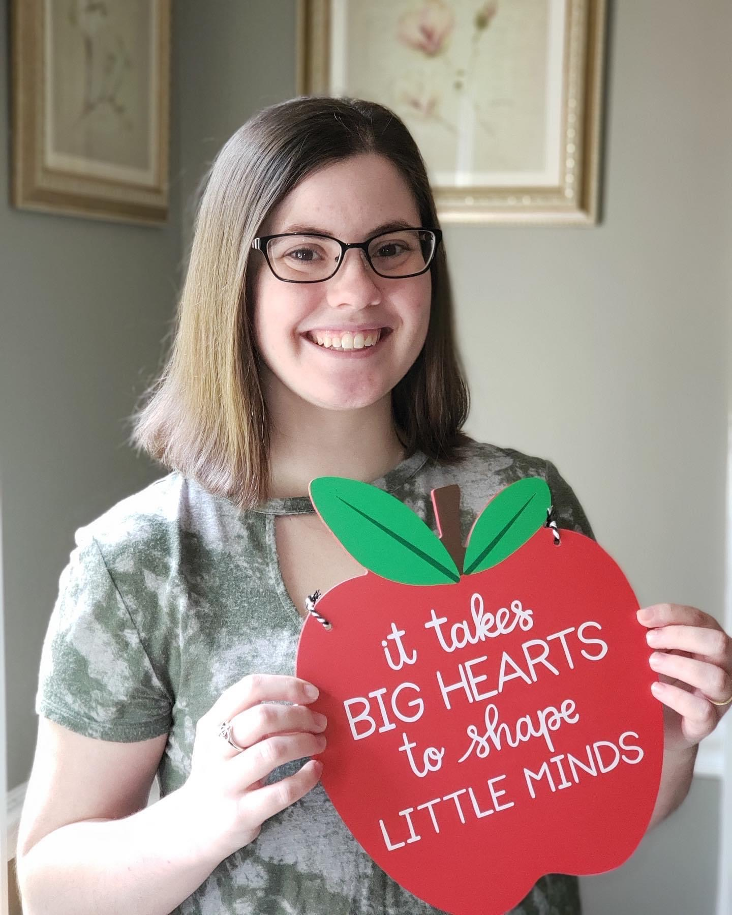
Meet Miss Welmaker
A Little About Me
Hello! I am so excited to be your child’s third grade teacher this year! I graduated from Augusta University with a Bachelor of Science in Elementary Education in the spring of 2020. This will be my third year of teaching and second year in third grade. A fun fact about me is that I had the opportunity to study abroad for two weeks in New Zealand! This is going to be a great year!
My Favorites
Drink: Sweet Tea, Dr. Pepper, Cherry Coke
Candy: Airheads
Restaurants: Chick-fil-la, Moes
Stores: Target, Amazon, Starbucks
Etc: Flowers, fruit smell candles
Contact
Email: welmaka@richmond.k12.ga.us
Phone: 706-771-2881
Class Dojo- I will use this for communication!

