Slide 1
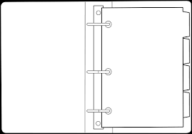
Mr. Jennings
Art Room
K-5 Grade Computer Science
How is my grade calculated?
jennibr1@boe.Richmond.k12.ga.us
Communication
Participation & Preparation
You are expected to participate and be prepared for class everyday with the items listed below. In addition, you are expected to come prepared for lab on designated class days (see Lab Procedures & Expectations).
Tests & Quizzes
You will be tested on each of the four modules, and given quizzes on the individual units within each module.
The following resources will always be offered before a test: study guides, review games, and extra help (can always be requested).
Content/ Modules
What is Computer Science
How to types
How to explore Microsoft 365
The important of used a computer
Binder Checks
Binder checks will be counted as a test/quiz grade. Binder checks will be random. Therefore, you are expected to keep an organized binder at all times. This should be an easy A, and help keep you organized!
Charged Chrome book
3 ring binder 1 inch
Dividers (we will label these at a later date)
* Filler paper College Rules
Pencils
Colored pencils/crayons
Red pen
Highlighter
Headphones
Class
Materials
Materials are due no later than Thursday, Sept. 5th, and will count as a homework grade.

