Slide 1
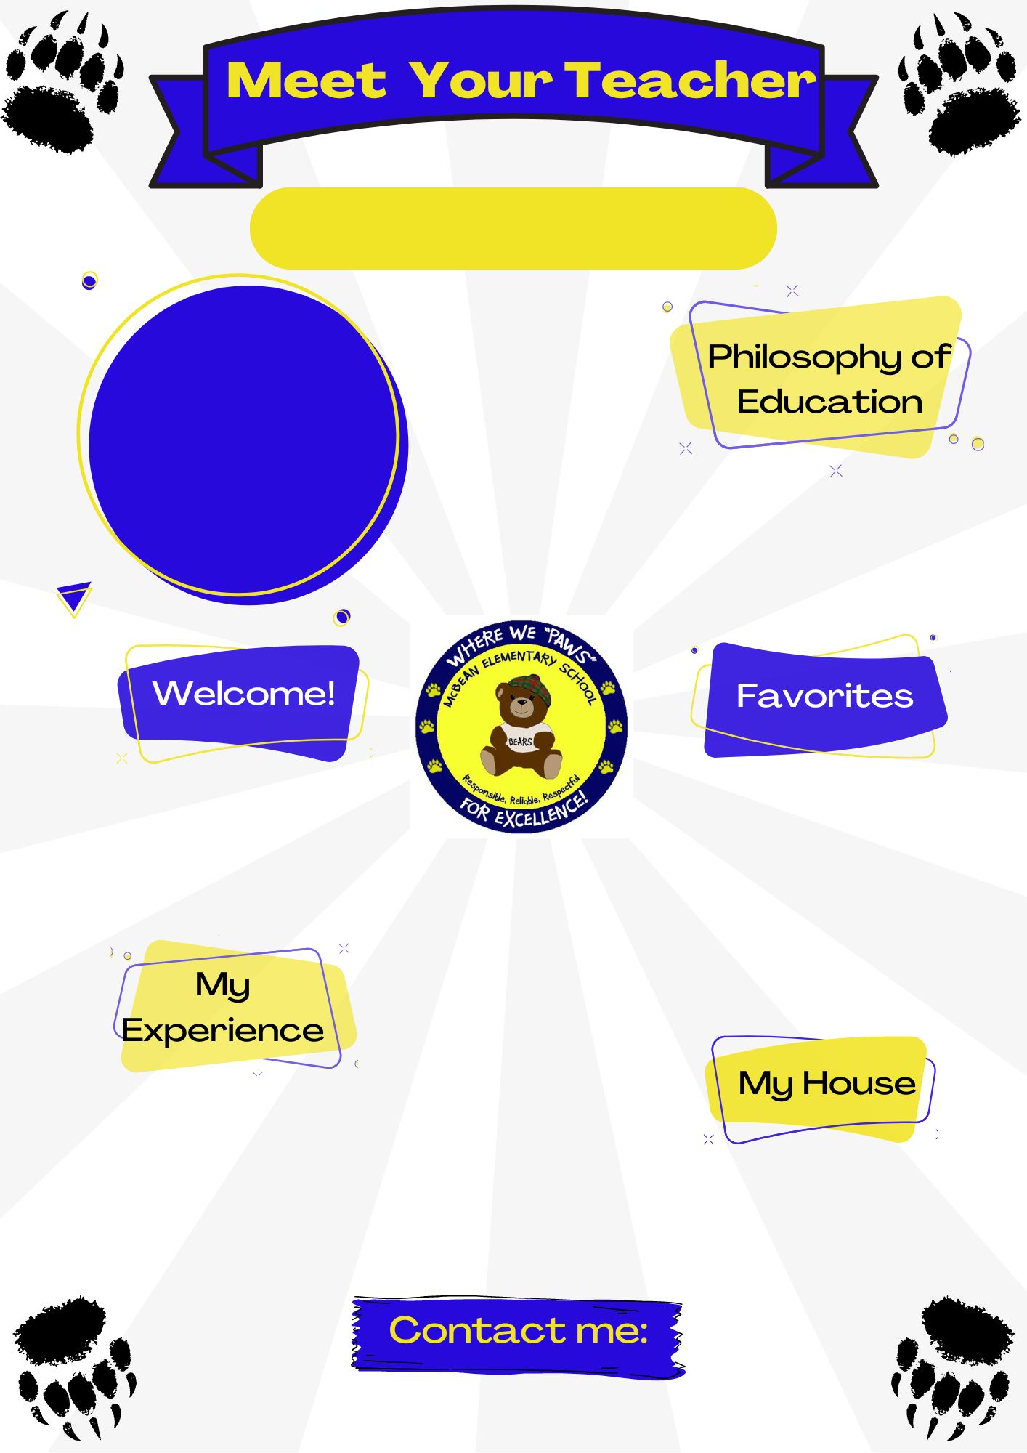
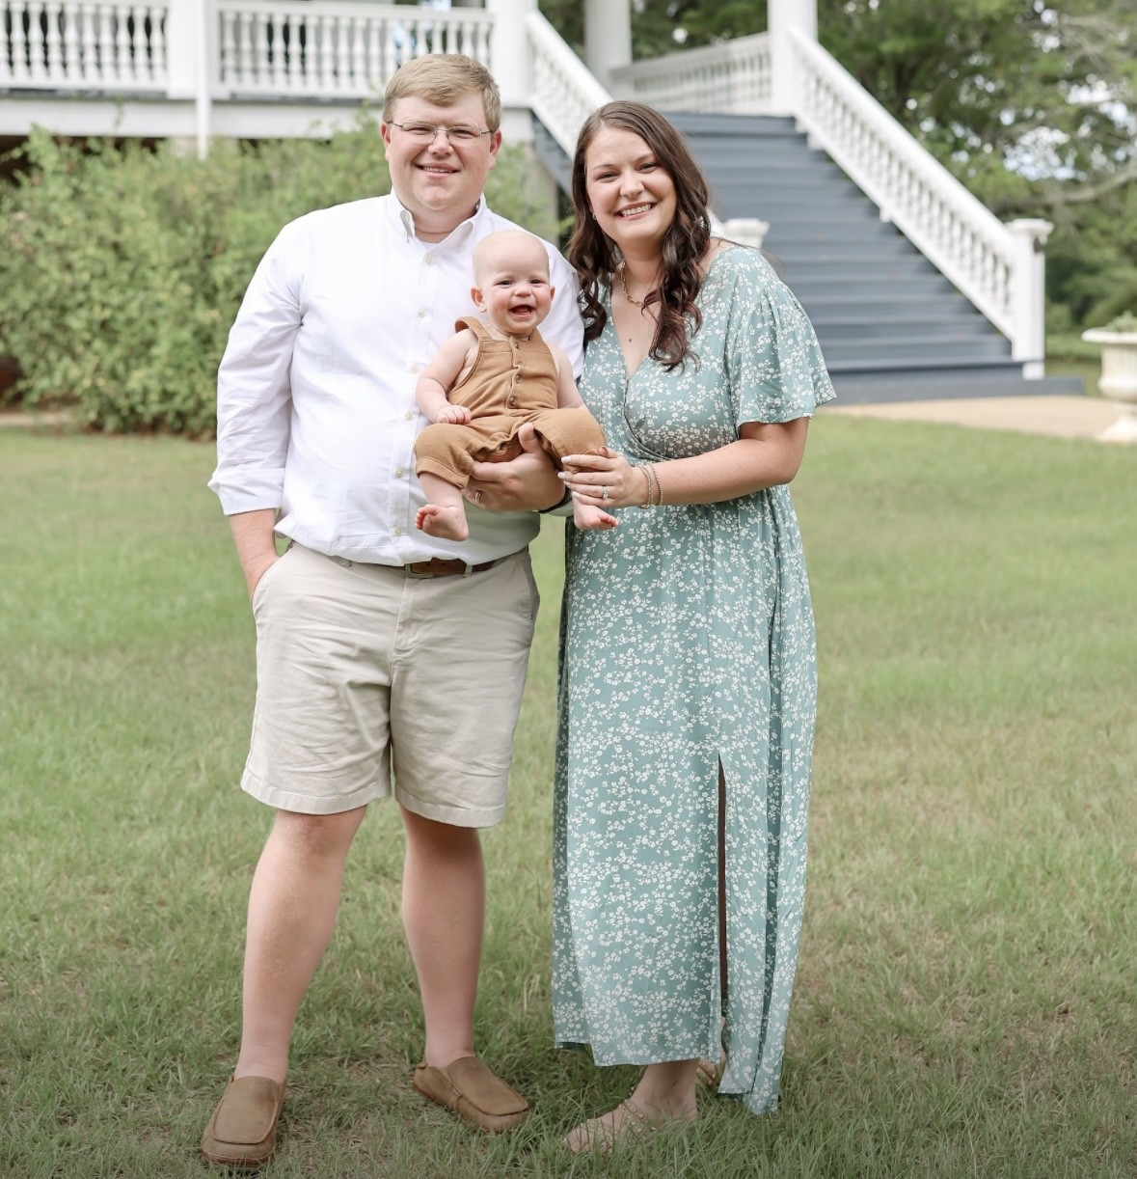
Mrs. Padgett
4th Grade Teacher
I believe every student has their own unique talents and skills. I believe by getting to know my students as individuals, I can find learning styles that work best for them, now and throughout their education.
Hello! My name is Daphne Padgett. I am the 4th grade Language Arts teacher here at McBean. This will be my 4th year teaching. I am looking forward to a great school year together!
Color: Pink
Animal: Cow
Hobby: Travel
Book: “Where the Red Fern Grows”
Movie: Narnia Series
Food: Popcorn
Drink: Coke Zero/ Coffee
Store: Target
This is my fourth year teaching. I graduated from Augusta University in 2022 with a Masters in Education. Go Jags!
padgeda@boe.richmond.k12.ga.us

