Slide 1
Science Fair
Let’s Get Ready!

Slide 2
Question
Scientific Method
Research
Hypothesis
Materials
Procedures & Variables
Data Collection
Analysis of Results
Conclusion

Slide 3
Question
This is the most important part of your investigation!
When choosing your question, start with what you are interested in.
Plants? Motion? Sound? Heat?
Keep in mind: some topics are not allowed to be tested for the science fair without running into trouble (animals, humans, food)
Take a few minutes to think about what topics you would consider…
If you cannot think of one now, just keep thinking. ☺ Something will come to you.

Slide 4
Question
If you have your topic, let’s think about something you would like to test about your topic.
If it helps, think of a problem you would like to solve, either for yourself or someone else.

Slide 5
Question
Example: Teachers LOVE their coffee! When we make our coffee in the morning, sometimes it gets cold before we can finish drinking it. Maybe if we used a different cup, the coffee would stay warmer longer!
Our topic here would be heat. We will be testing which type of cup would keep coffee warmer for a longer period of time.
When constructing your question, you should follow this format: How will (what you are changing) effect (what you are measuring)?
Write down how you should construct the question.

Slide 6
Pregunta!!
Ejemplo: ¡A los maestros les ENCANTA su café! Cuando hacemos nuestro café por la mañana, a veces se enfría antes de que podamos terminar de beberlo. ¡Tal vez si usáramos una taza diferente, el café se mantendría más caliente por más tiempo!
Nuestro tema aquí sería el calor. Probaremos qué tipo de taza mantendrá el café caliente durante más tiempo.
Al elaborar su pregunta, debe seguir este formato: ¿Cómo afectará (lo que está cambiando) (lo que está midiendo)?
Escribe cómo debes construir la pregunta.

Slide 7
Question
Our question:
How will the material of cup effect the rate at which hot coffee will cool?

Slide 8
Nuestra pregunta:
​
¿Cómo afectará el material de la taza la velocidad a la que se enfriará el café caliente?

Slide 9
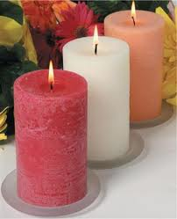
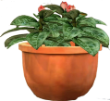
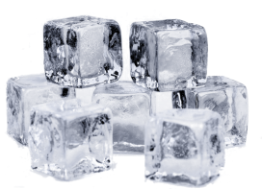
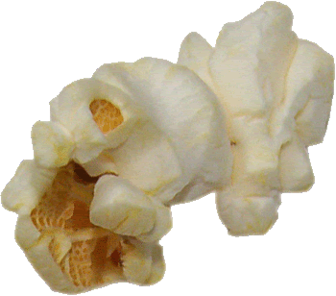
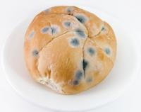
Science Fair Topic Ideas
Do white candles burn faster than colored candles?
Do different types of soil affect plant growth?
Does the temperature of water alter the freezing time?
Do different brands of popcorn leave more unpopped kernels?
Does temperature effect the growth of mold on bread?

Slide 10
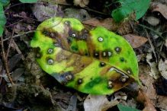


More Ideas…
Do leaves from different trees decompose at different rates?
Are some brands of paper towels more or less absorbent than others?
Is there a battery that outlast others?

Slide 11

Science Fair is NOT…
How to build a ….
How to show a …..
Research Report
EXAMPLES OF “DO NOTS”:
Do not build a model volcano and explode
Do not write a report about an ecosystem
Do not show how to make a model rocket launch

Slide 12
Helpful Websites
http://www.kids-fun-science.com/easy-science-experiments.html
http://chemistry.about.com/od/sciencefairprojects/a/sciproelem.htm
http://www.sciencefairsanity.com/home/sci/smartlist_9/free_elementary_science_fair_projects_3rd___5th_gr.html
http://www.hometrainingtools.com/elementary-project-ideas/a/1308/

