Slide 1
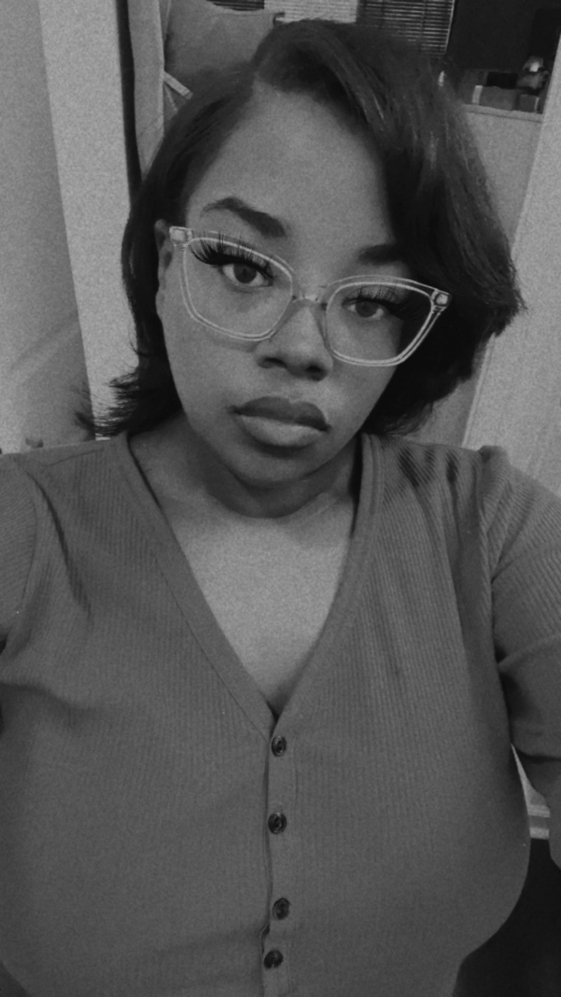
A Few of my
Favorite Things
Candy: Take 5
Drink place: Starbuck’s
Restaurant: Long Horn’s
Place to shop: Dollar Tree
Hi, I am Ms. Elam, and
I will be your child’s second grade teacher. This my 3rd year at Hains and my 2nd year teaching. I was born and raised in Augusta, Ga. I am currently pregnant with my 1st child, and I am excited to be a new mom. I decided to teach because I love children and I want to help them reach their goals.
Contact Info
Phone: (706) 951-3247
Email: ElamDa@BOE.Richmond.k12.ga.us
"Good teachers are the ones who can challenge young minds without losing their own." –Unknown

