Slide 1
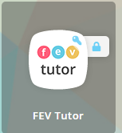
Go to Launchpad: Click It

