Slide 1
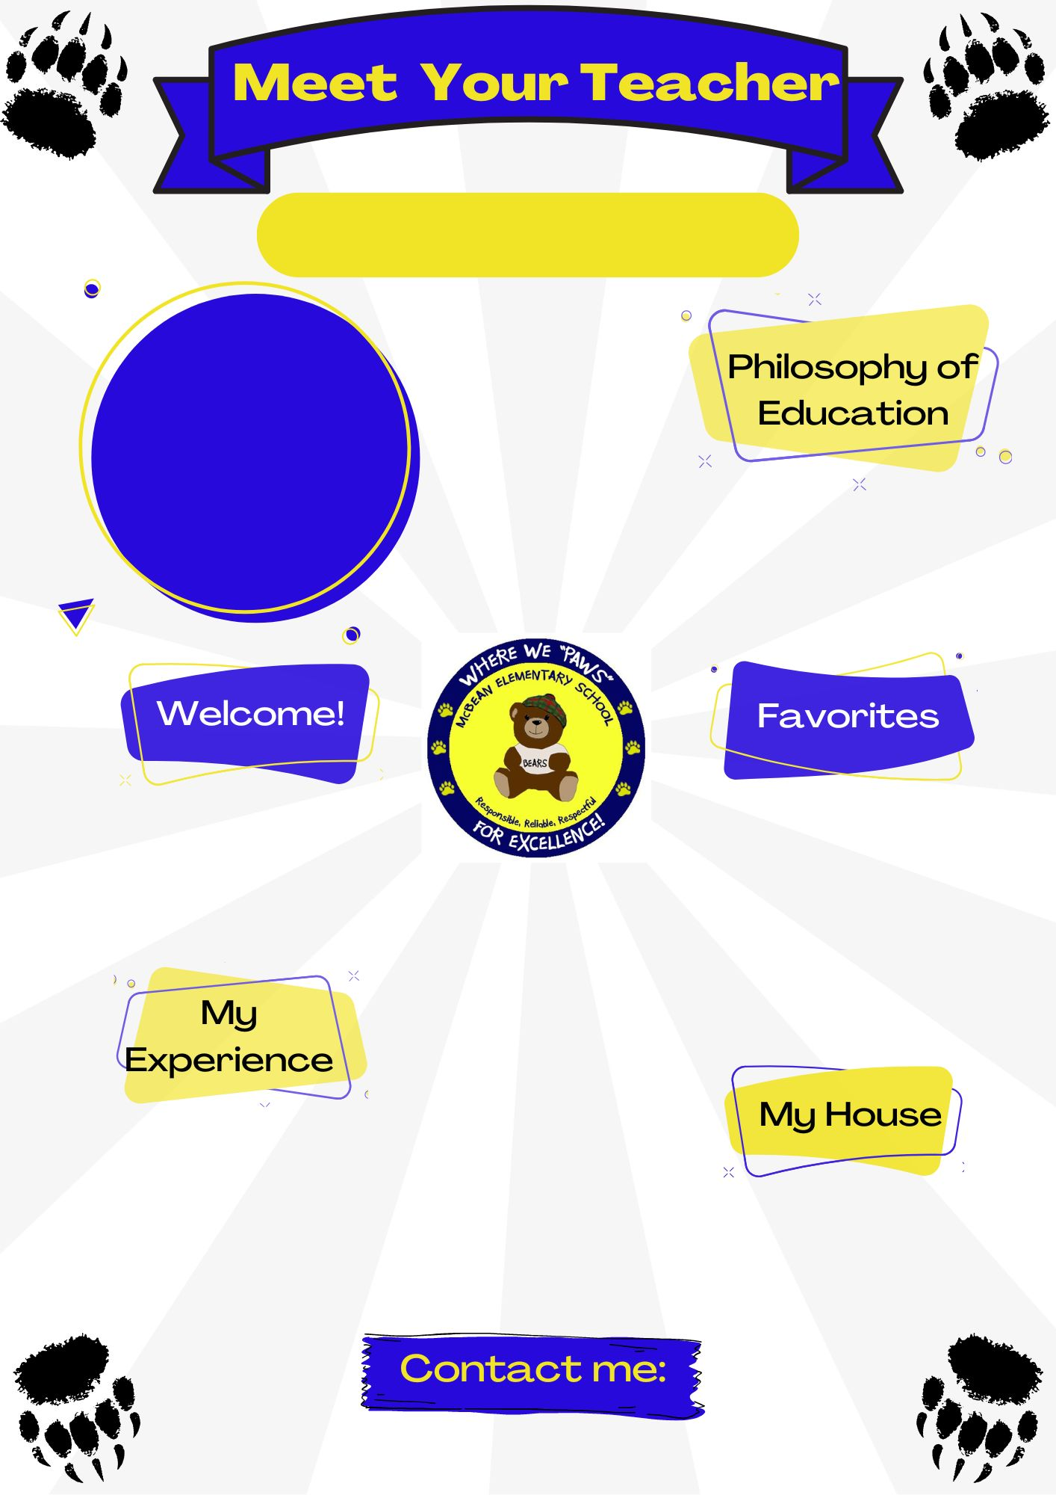
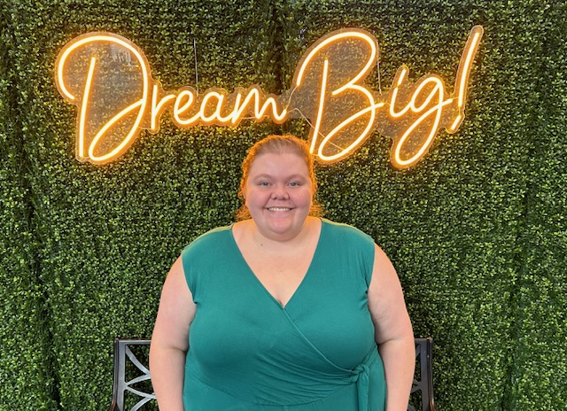
Ms. Valentie
Teacher
I believe that education should be equitable. Every student should have the same opportunity to learn.
Hello! Welcome to the 1st grade. I am super excited for this year, and can’t wait to meet all of you!
Color(s): Yellow
Animal(s): Guinea Pigs
Hobby: Baking and reading
Sport: softball
Book: Henny Penny
Movie: The Little Mermaid
Food: Pickles
Drink: Snapple
This is my third year teaching, and my second year teaching 1st grade. I am currently enrolled in the Masters program for early childhood education at Augusta University!
Valench@boe.Richmond.k12.ga.us

