Slide 1
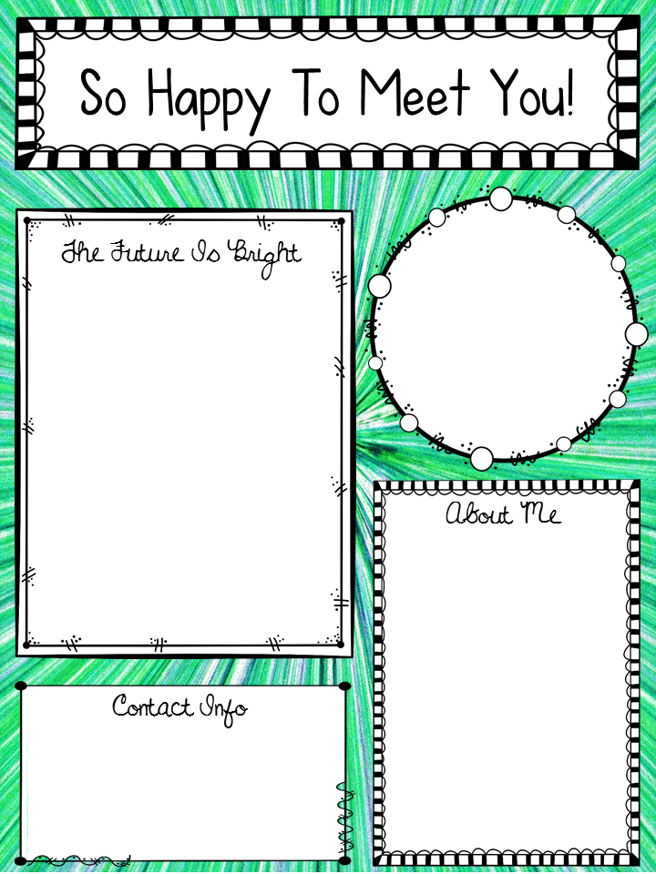

Hello and Welcome to ARC! I am Ms. Valencia Archie and I will be your math teacher for the 2024-25 school year. As your math teacher, my goals are bridge learning gaps and expand your knowledge of the math content. During this course, you may notice some familiar content. You will also be introduced to some new ones. All I ask is that you to come to class eager and ready to learn. Let’s have a great year.
- Ms. Archie
Education
  Grand Canyon University- Bachelors in Middle Grades Mathematics
  Walden University- Masters in Math and Science K-8
  Brenau University-
  Ed. S in Math & Science
8th yr. teaching.
I LOVE MATH!!!
I’m a Boy Mom!!
Favorite Color – Green
Email: archiva@boe.Richmond.k12.ga.us
Phone: (706) 737-7152

