Slide 1
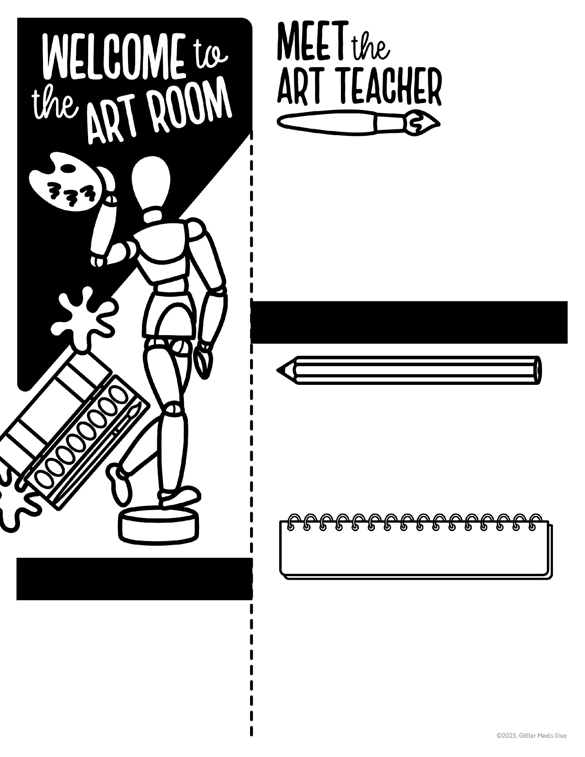
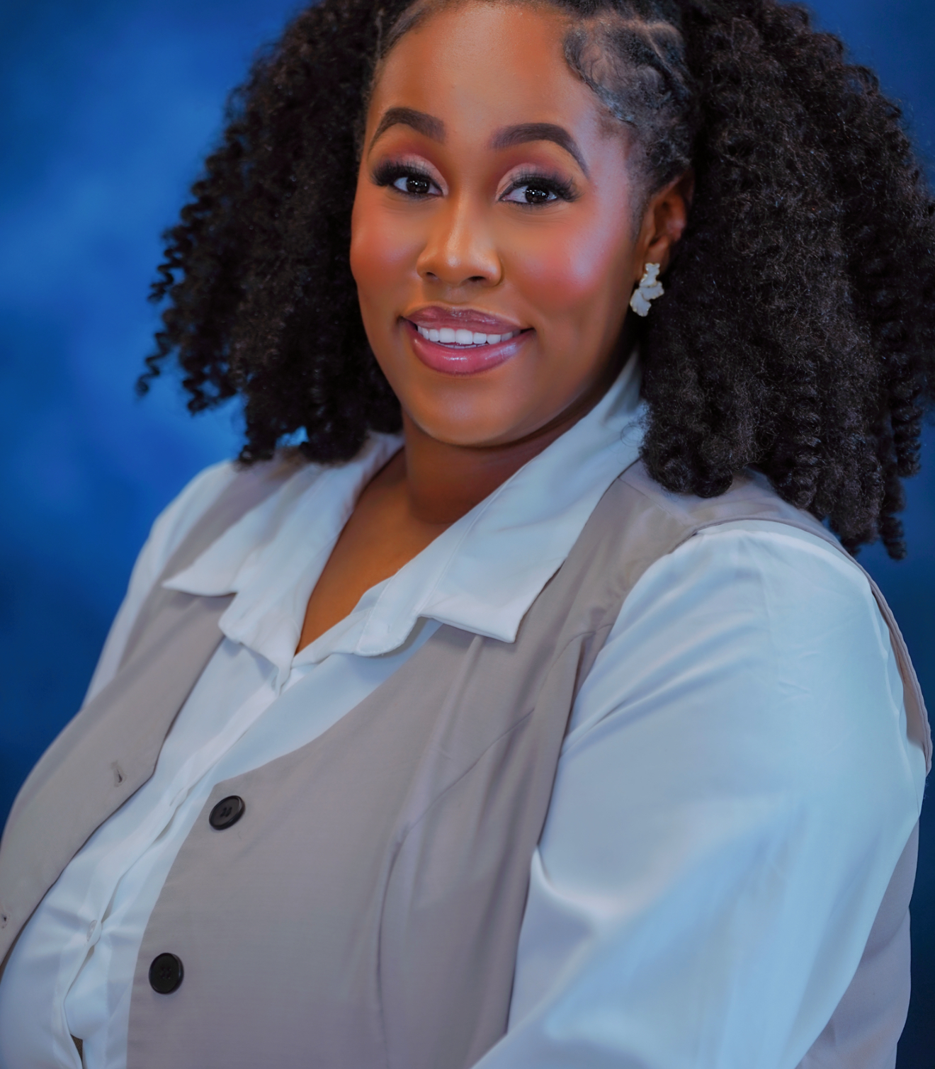



Hello,
My name is Ms. Evyn Boyd! I will be your students Art Teacher this year here at Hephzibah Middle School. This will be my first year teaching middle school but my 9 year as a teacher. I enjoy making art and all the things you can create! My favorite artist is Vincent Von Gogh. I love how he captures life in all of his art pieces. I am excited to teach art this year. If you have any questions or concerns please do not hesitate to reach out!
COLOR: Red
HOLIDAY: Thanksgiving
FOOD: Cheeseburger Rice
HOBBY: Painting
BOOK: The Summer I Turned Pretty
MOVIE: Wicked
SEASON: Fall
STORE: Hobby Lobby
SPORT: Cheerleading
SMELL: Peaches
ANIMAL: Butterfly
GAME: Trouble
SUPPLIES
MARKERS
CRAYONS
COLOR PENCILS
PENCILS
boydev@boe.Richmond.k12.ga.us

