Slide 1
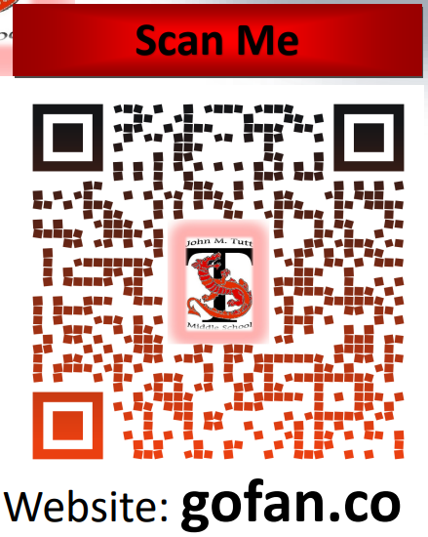
Dr. Cristi Cole Athletic Director & In-School Suspension Teacher
TMS Athletics
ATTENTION!
All Middle School athletic events will require a ticket.
Purchase Tickets via GoFan
TUTT MIDDLE.pdf
Football & Cheerleading Tryouts will occur in August. Specific are located in the Tryout Tab. See information below for all needed documentation. Students must be cleared prior to ANY attendance or participation.
To be eligible for play students must have a physical packet completed prior to attending practice/play. Submit completed packets before tryouts to be verified/cleared. The forms are posted on Tutt’s website.
The Physical Packet (Includes 11 pages):
Athletes Checklist
History Form
Physical Form
Clearance Form
Athletic Roster
Parent Permission Form
Student/Parent Concussion Form – (for each sport played)
Interscholastic Contract
Awareness of Football Risk Form - (Football Only)
Cardiac Form – (for each sport played)
Emergency Medical Card
***ATHLETE MUST ALSO PROVIDE THE FOLLOWING ITEMS:
Copy of Insurance Card (front & back)
Academic Clearance - (Athletic Director)
Copy of last Report Card
Contact Information
colecr@boe.Richmond.k12.ga.us
Tutt’s # 706-737-7277
Room #128

