Slide 1
S. Ahmad Mikell
S. A. Mikell & Company
Aiken, SC
You Are Not Your Label
(History, Hip Hop and Thriving in America)

Slide 2
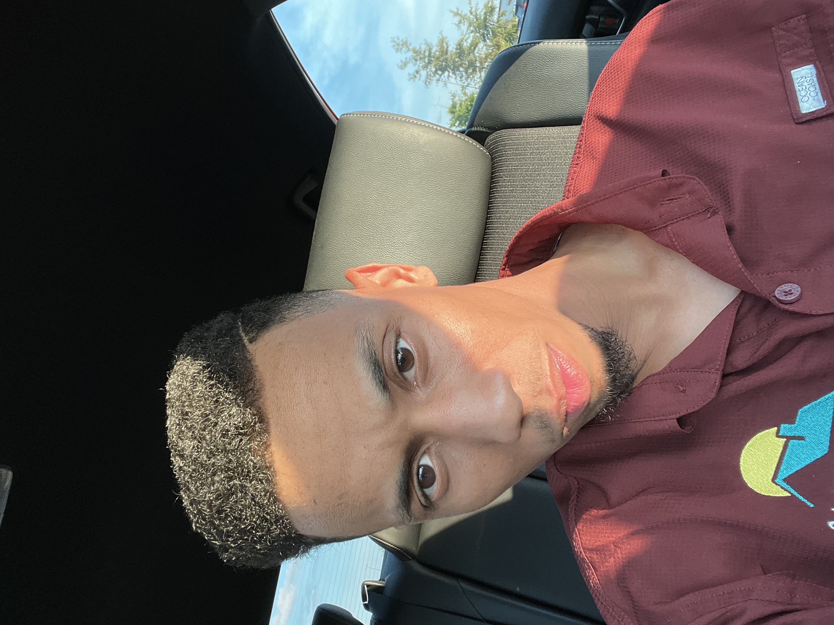
Background
Raised in a single parent household
Worst School System in the State of SC
Most Impoverished area in SC
https://www.youtube.com/watch?v=6xL8Sphn9zA&feature=emb_title

Slide 3
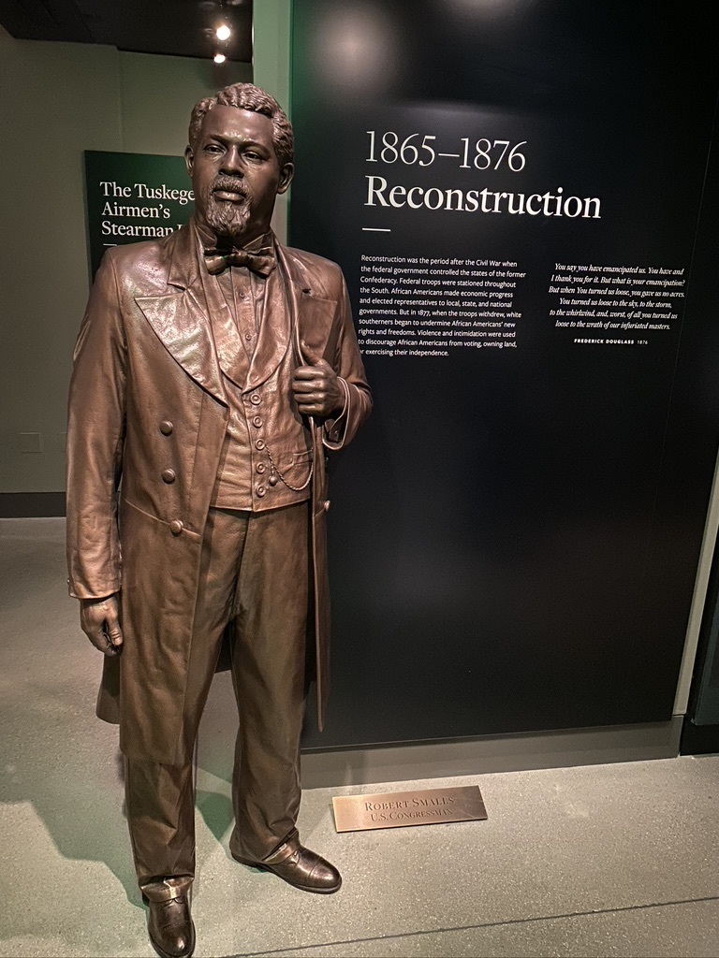
4 Parts to Level Ball Playing Field (Bonus Trivia Question)
Education
Financial Literacy
Job Selection/Career Selection
Entrepreneurship
An escaped slave and a Civil War hero, ____________ served five terms in the U.S. House, representing a South Carolina district described as a “black paradise” because of its abundant political opportunities for freedmen.

Slide 4
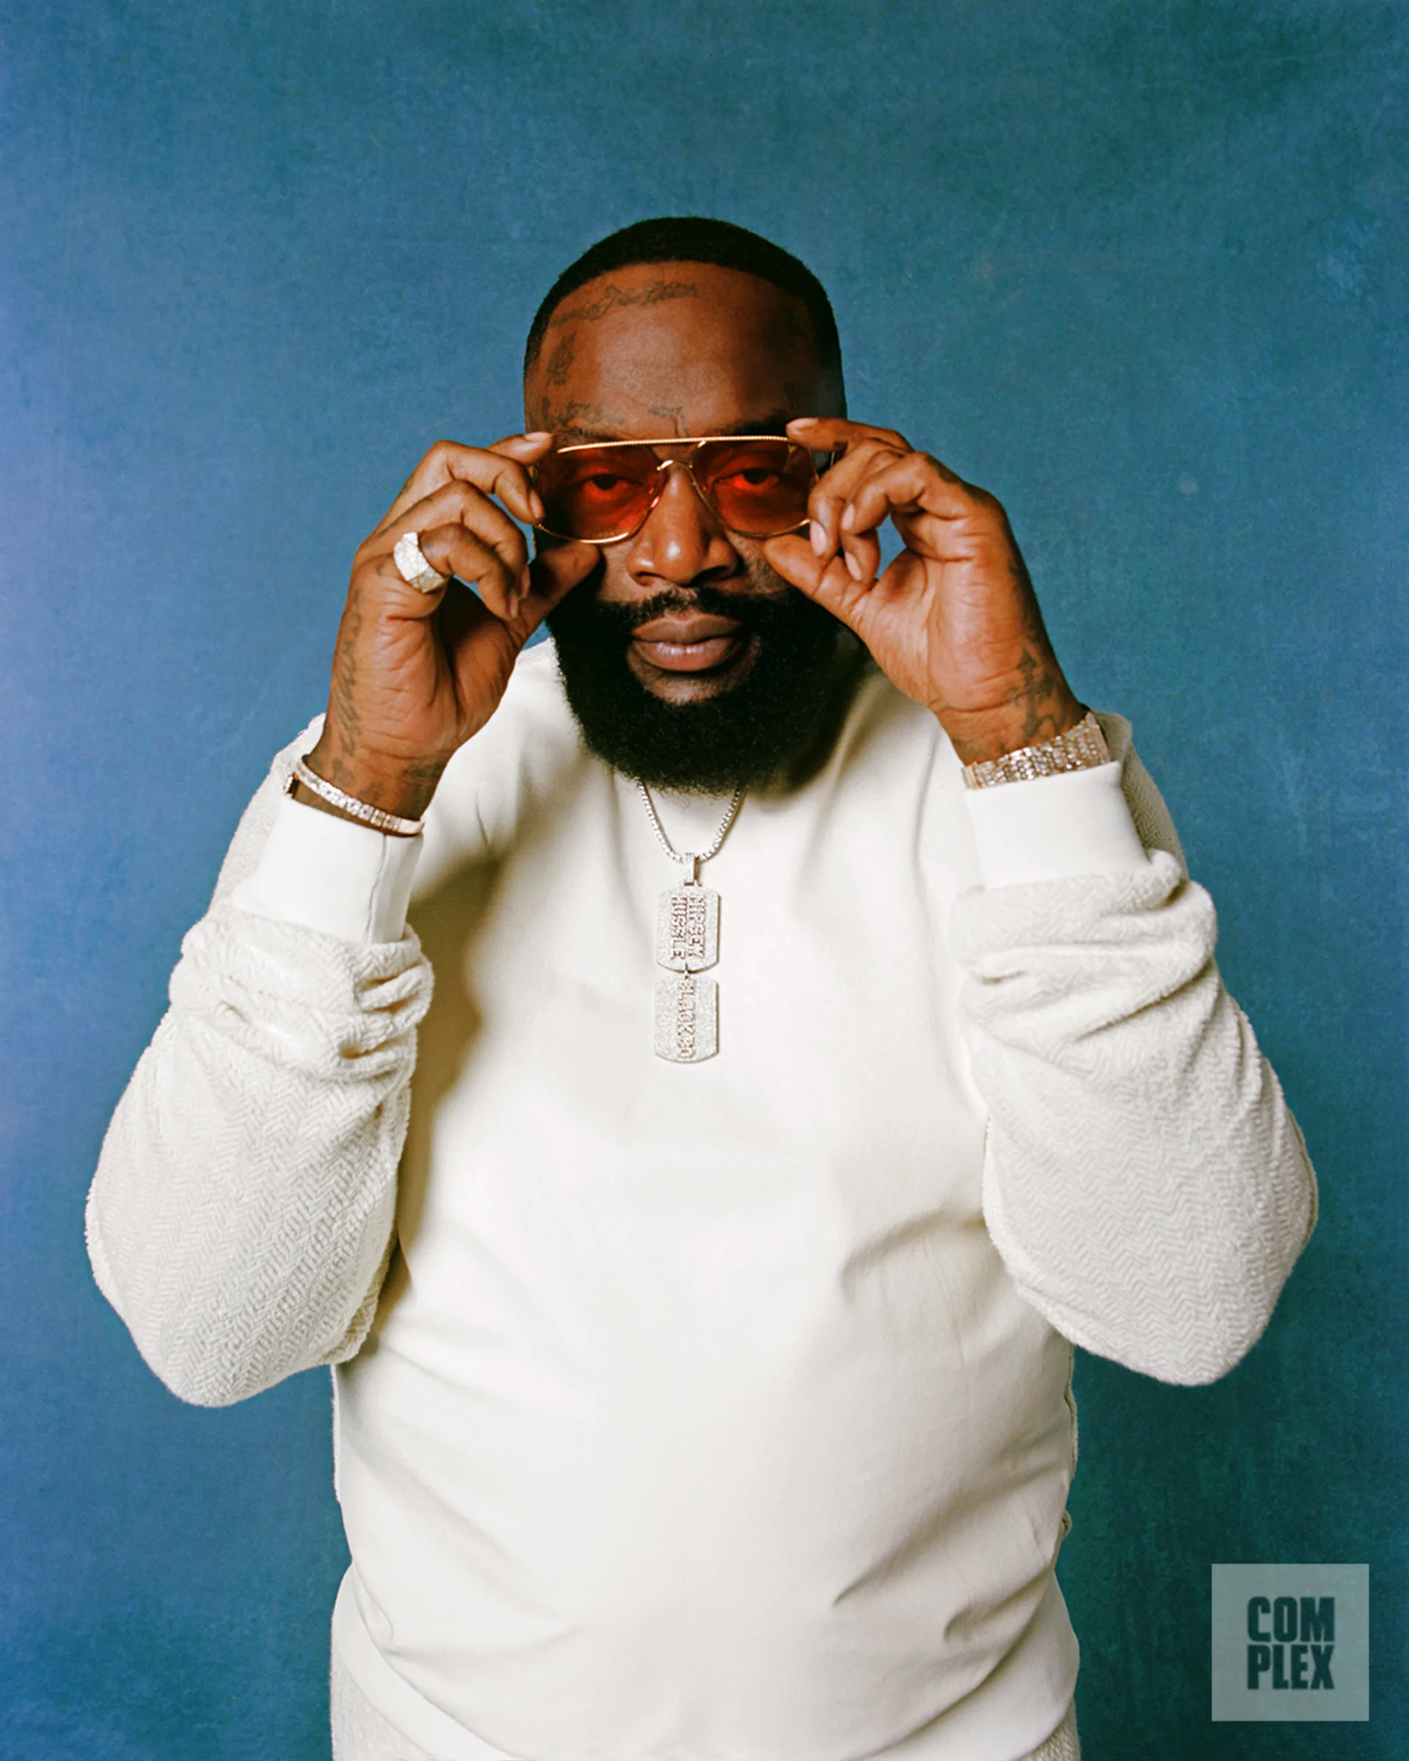
Education
“Education is the passport to the future, for tomorrow belongs to those who prepare for it today.” – Malcolm X
While it’s safe to say that no one knows what will happen tomorrow, having an education under your belt will open the door to more opportunities. These job opportunities are also likely to pay more with more education, so what you do today in terms of education will surely prepare you for what’s yet to come.
“Smart is the new gangster” – Rick Ross

Slide 5
Financial Literacy
1. “The number one problem in today’s generation and economy is the lack of financial literacy.” – Alan Greenspan
2. “The key factor that will determine your financial future is not the economy; the key factor is your philosophy.” – Jim Rohn
3. “Money without financial intelligence is money soon gone.” – Robert Kiyosaki
In the words of Lil Baby and 42 Dugg – We Paid

Slide 6
Job Selection - Career
How “Liking” Your Job Will Help You Succeed
Steve Jobs stood in front of the 2005 Stanford graduating class and said, “”the only way to do great work is to love what you do,” but how does enjoying your work really lead to success in the workplace?
Being happy at work and loving what you do is an overall productivity booster and enhances performance. People who enjoy their jobs are more likely to be optimistic, motivated, learn faster, make fewer mistakes, and better business decisions.
In the Words of Young Dolph - Rule number one (what's that?), get the money first (okay) Rule number two (what?), don't forget to get the money (ayy) Play by these rules and everything will be okay

Slide 7
Entrepreneurship
Investopedia describes four ways entrepreneurs benefit society:
Economic growth: The success of the products and services created and sold by entrepreneurs cascades to other businesses and markets.
Wealth generation: Entrepreneurs frequently target new markets and tap audiences outside the focus of established firms. This creates new sources of revenue and profits.
Social change: The innovative goods and services entrepreneurs offer reduce dependence on outdated processes and technologies. One example is the way smartphones have affected how businesses communicate with customers, employees, and partners.
Community development: Entrepreneurs foster a sense of community among people with common goals and interests, whether in a single neighborhood or across continents. Their products and services contribute to the communities’ social and economic well-being.

Slide 8
Final Thoughts
Dream Big – Core of Success
Imagination is Everything
Don’t let anyone play about your vision
Show Gratitude – there is joy in the journey
Don’t be afraid to fail, failure is part of the process

