Slide 1
SEASONS
Ms. Edwards
One Year in 40 seconds
Notes:
Instructional Approach(s): Show the video clip. Give the students about 20-30 seconds to “think” on their own and then have them “pair” to discuss. Partners can be determined by the students or the teacher can provide more specific directions such as turn to the person directly in front/behind you or to the right/left of you, etc. It may be necessary to have a group of three if you have an uneven number of students. Do not allow more than 1 minute of discussion time. The teacher should be walking around listening and redirecting discussions as needed. The teacher can briefly discuss student responses.

Slide 2

Essential Question:
What are the reasons for the seasons?
Standard:
S6E2c. Relate the tilt of the earth to the distribution of sunlight throughout the year and its effect on climate.
Notes:
Instructional Approach(s): The teacher should introduce the essential question of the lesson and the standard that aligns to the essential question.

Slide 3
Important Vocabulary
The Earth’s Axis is the imaginary vertical line around which the Earth spins
The Earth rotates on its axis once every 24 hours causing day and night (rotation)
The Earth revolves around the Sun once every year (revolution)
The Earth follows a path around the Sun known as an orbit
http://www.britannica.com/EBchecked/topic/175962/Earth/images-videos/159380/earth-earths-rotation-on-its-axis-and-its-revolution-around-the-sun
Notes:
Instructional Approach(s): The teacher should review each of the vocabulary words that students should already know in order to apply them in the lesson.

Slide 4
Important Vocabulary
A hemisphere is a half of the Earth
The Earth can be divided into four hemispheres: Eastern Hemisphere, Western Hemisphere, Northern Hemisphere, and Southern Hemisphere
Notes:
Instructional Approach(s): The teacher should review/introduce hemisphere as another important vocabulary term needed for the lesson.

Slide 5
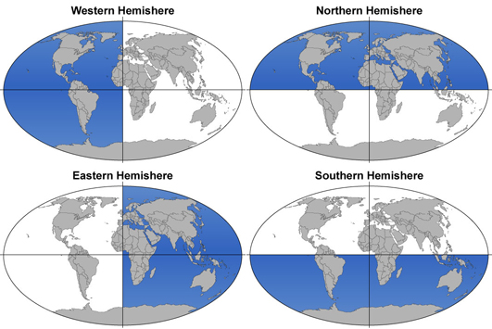
Notes:
Instructional Approach(s): The teacher should use the diagrams to illustrate the four hemispheres.

Slide 6
What are Seasons?
Seasons are short periods of climate change caused by changes in the amount of solar radiation (sunlight) an area receives.
Notes:
Instructional Approach(s): The teacher should pose the question to the class What are Seasons? And listen to a few student responses. After a brief time, click the mouse to show the definition of seasons. The students should answer the question “what are seasons?” on their notes.

Slide 7
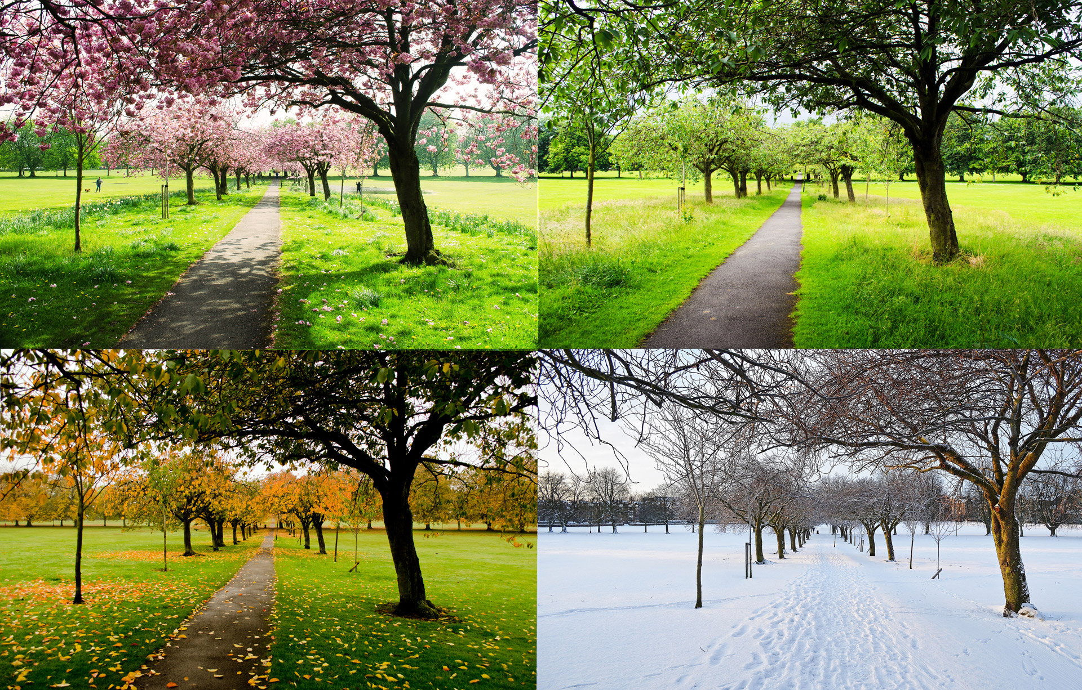
Four Main Seasons
Spring
Summer
Fall
Winter
Notes:
Instructional Approach(s): The teacher may ask the class to identify the four main seasons or just click through the animated slide.

Slide 8
Reasons for the Seasons
It is the tilt of the Earth and its revolution around the Sun that causes seasons
Notes:
Instructional Approach(s): The teacher should pose the statement first, “reasons for the seasons”. Ask for student responses on what the answer may be for the seasons. Soon after, click the mouse to show the reasons for the seasons. Students should record the important information on their notes.

Slide 9
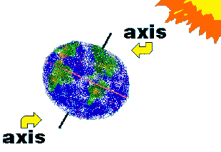
The Earth’s axis is tilted 23.5°
Notes:
Instructional Approach(s): The teacher should present the slide and the students should record information about the tilt of the Earth on their notes.

Slide 10
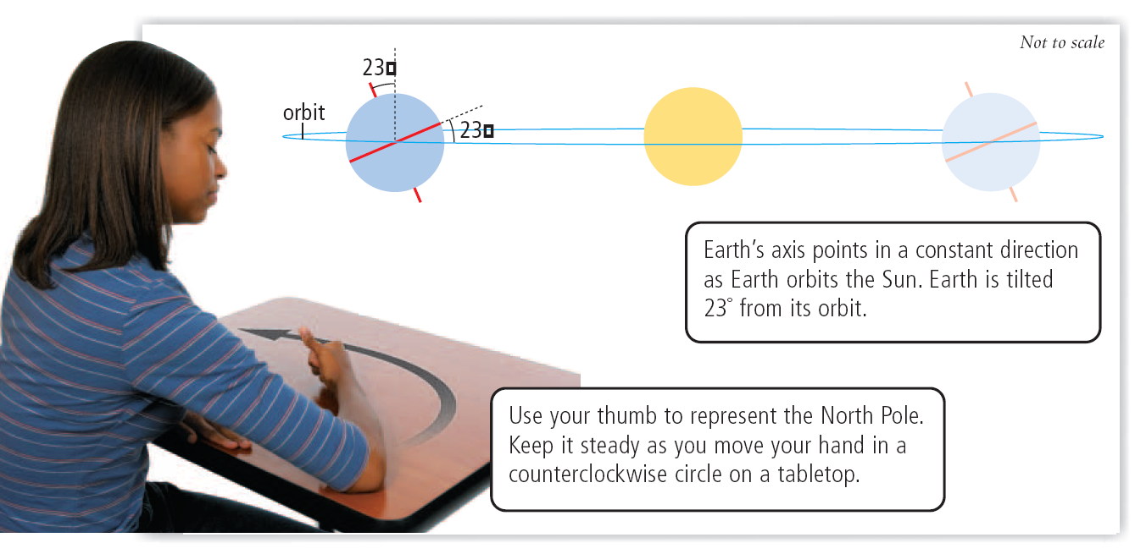
Notes:
Instructional Approach(s): The teacher may want to have each student conduct this simple demonstration at their desk to show how the Earth remains tilted on its axis while it rotates around the Sun.

Slide 11
Reasons for the Seasons
The Earth’s tilt also causes the Sun’s radiation to strike the hemispheres at different angles.
Notes:
Instructional Approach(s): The teacher should present the information on the slide while the students record the important information on their notes.

Slide 12
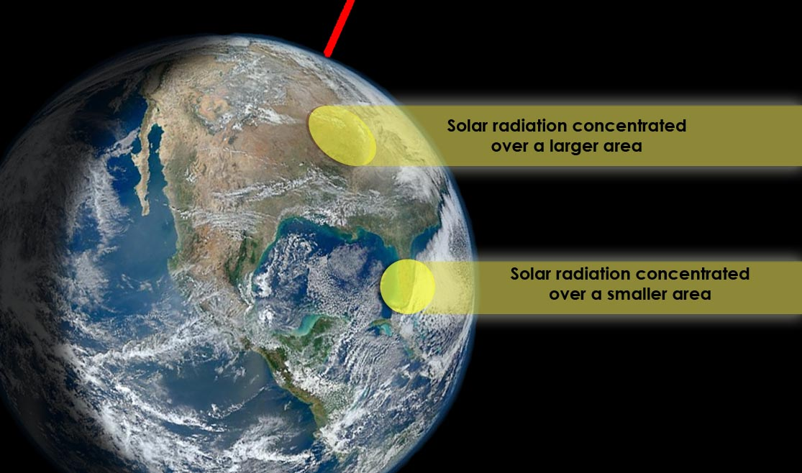
Notes:
Instructional Approach(s): The teacher should use the image to illustrate the different concentrations of sunlight (because of the different angles) hitting the Earth’s surface.

Slide 13
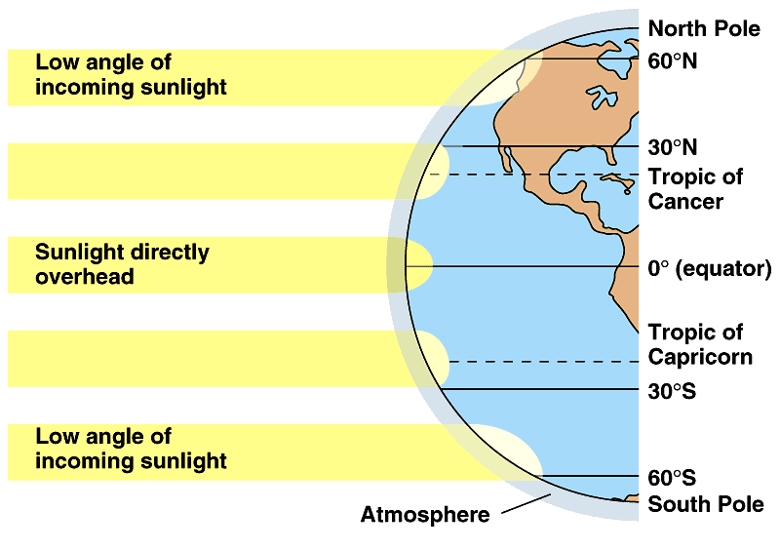
Areas at a higher angle (closer to 90°) receive more total solar radiation (sun rays) than areas where sunlight strikes at a lower angle.
Add these statements to the diagram on your notes
Notes:
Instructional Approach(s): The teacher should present the information on the slide while the students record the important information on their notes and the diagram.

Slide 14
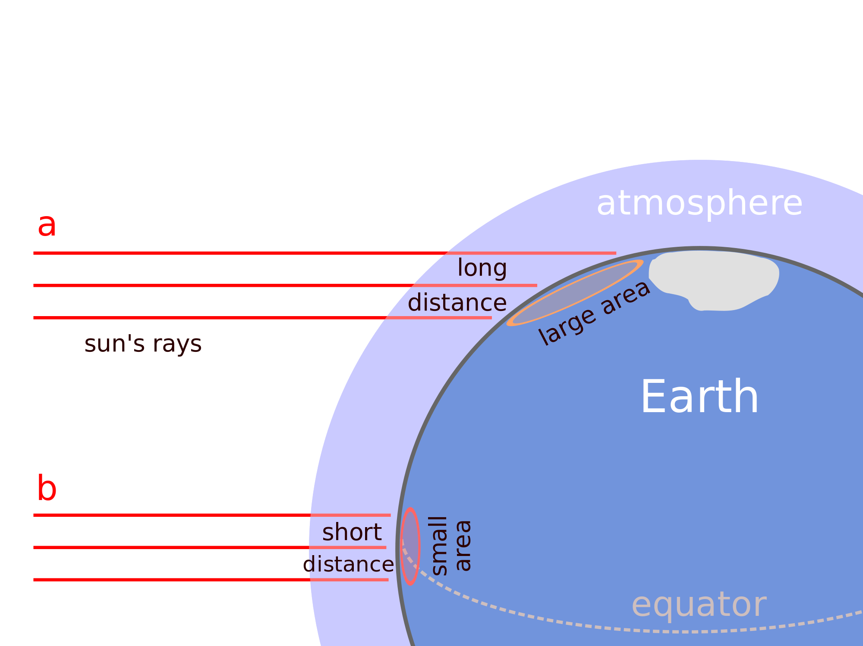
Which area (a or b) experiences greater solar radiation? Why?
Notes:
Instructional Approach(s): The question can be done as a class, individually, or in pairs. The students should respond that “B” experiences greater solar radiation because it receives direct sunlight from a shorter distance; therefore, it is stronger than areas where there is a higher angle and the sunlight is spread out over a longer distance.

Slide 15
Reasons for the Seasons
Summer occurs in the hemisphere tilted toward the Sun, when its radiation (sunlight) strikes Earth at a higher angle
The number of daylight hours is greater for the hemisphere experiencing Summer
The hemisphere receiving less radiation (sunlight) experiences Winter.
Notes:
Instructional Approach(s): The teacher should present the information on the slide while the students record the important information on their notes.

Slide 16
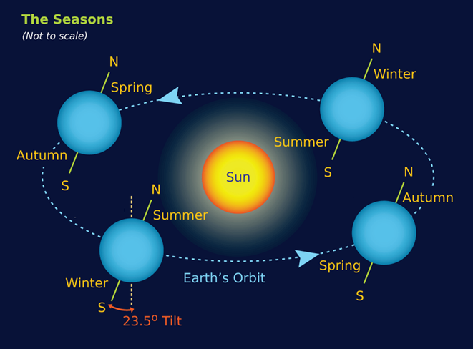
Notes:
Instructional Approach(s): The teacher should use the diagram to illustrate that seasons depend on the hemisphere of the Earth that is turned toward and away from the Sun.

Slide 17
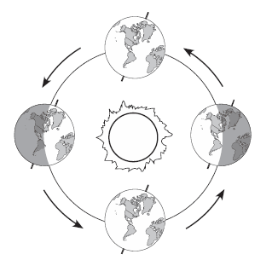
Identifying the
Seasons
Step 3: For each position of the Earth, identify the season for both the Northern Hemisphere and the Southern Hemisphere and WHY.
Step 1: Draw imaginary lines to separate the Northern/Southern Hemispheres (not exact).
Step 2: Put a “N” and “S” to identify the hemispheres.
Northern Hemisphere is Spring and Southern Hemisphere is Fall. Neither Hemisphere is tilted directly towards the Sun.
N
S
Northern Hemisphere is Summer and Southern Hemisphere is Winter because the Northern Hemisphere is tilted towards the Sun.
Northern Hemisphere is Winter and Southern Hemisphere is Summer because the Southern Hemisphere is tilted towards the Sun.
N
N
S
S
N
S
Northern Hemisphere is Fall and Southern Hemisphere is Spring. Neither Hemisphere is tilted directly towards the Sun.
Notes:
Instructional Approach(s): The teacher should use the animated slide to guide students in labeling the seasons on the diagram in their notes. The slide provides step by step instructions for the students. The teacher should click through the slide for each step.

Slide 18
If the Earth was not tilted…
There would no longer be seasons as we know them. The temperature and precipitation pattern would not vary much. It would still be warm at the equator and cold at the poles.
Across the Earth it would be like it is in the middle of fall or spring but it would last all year every year. Areas today that have wet, dry, warm and cold seasons would have a fairly constant weather all year whether it be wet, dry, warm and/or cold.
Notes:
Instructional Approach(s): The teacher should present the information on the slide.

Slide 19
Animations
Astronomy Education at the University of Nebraska-Lincoln
Notes:
Instructional Approach(s): The teacher should show the animations to reinforce cause of the seasons.

Slide 20
Study Jams: Seasons
Notes:
Instructional Approach(s): Students should watch the short video to reinforce seasons.

Slide 21
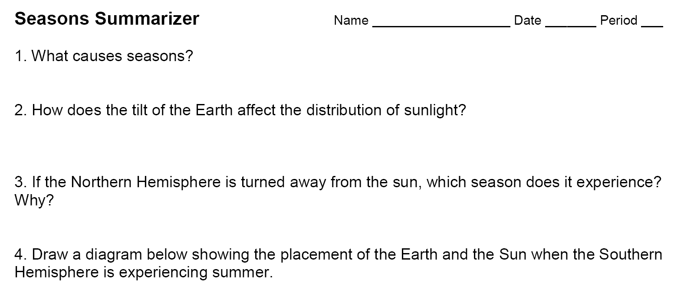
Seasons Summarizer
Notes:
Instructional Approach(s): Each student should complete the summarizer. The teacher should use the summarizer to determine the level of student mastery and if differentiation is needed.

