Slide 1
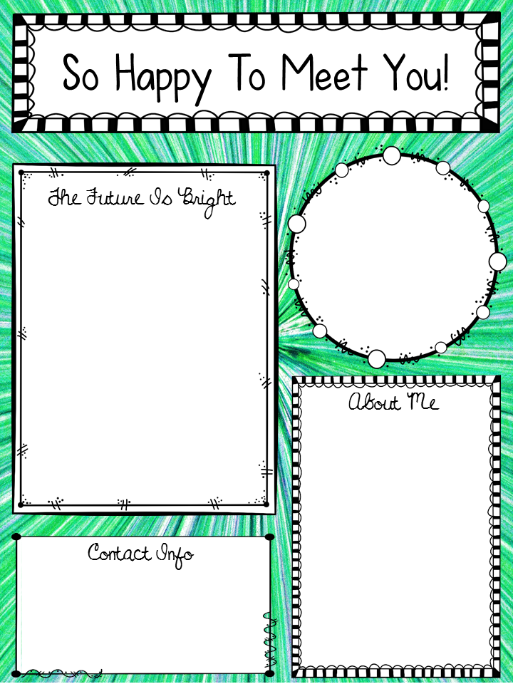
Hello and Welcome to 6th Grade! I am Ms. Valencia Archie and I will be your math teacher for the 2023-24 school year. As your math teacher, my goals are bridge learning gaps and expand your knowledge of the math content. During this course, you may notice some familiar content. You will be introduced to some new ones. All I ask is that you to come to class eager and ready to learn. Let’s have a great year.
- Ms. Archie
Education
Grand Canyon University- Bachelors in Middle Grades Mathematics
Walden University- Masters in Math and Science K-8
Brenau University-
Ed. S in Math & Science
7th yr. teaching.
I LOVE MATH!!!
I’m a Boy Mom!! (4)
Email: archiva@boe.Richmond.k12.ga.us
Phone: 706-796-4944

