Slide 1
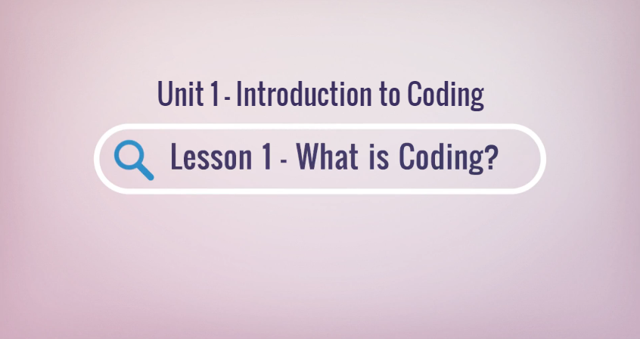

Slide 2
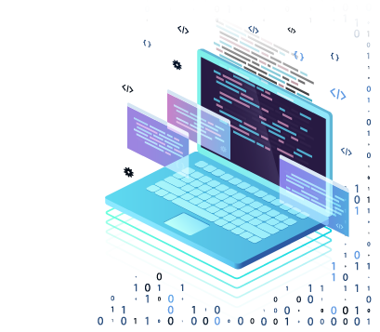
Objectives
Define terms: program, code, binary.
Define the role of coding in computing.
Identify various programming languages.

Slide 3





Can you put these steps in order?
Correct – You’re already thinking like a programmer!
4
1
2
3
5
Notes:
Have students answer before clicking to reveal the answer. Remind students that by putting the steps in order, and working to solve problems, they are already thinking like a programmer!

Slide 4
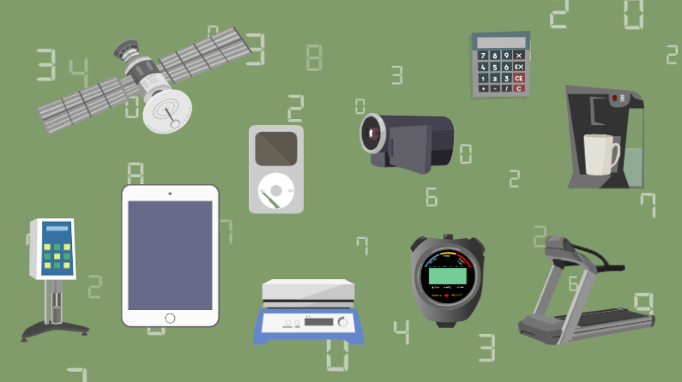
Can you name some items we use that run by code?
These are just a few of the millions of examples. Code is everywhere and is usually running behind the scenes without you knowing it.
When you are typing words into a search engine, how do you think the computer finds what you are looking for? CODE!
Notes:
Have students answer before clicking to reveal.
Answers may include:
Internet
Televisions
Smartphones
Refrigerators
Smartcars

Slide 5
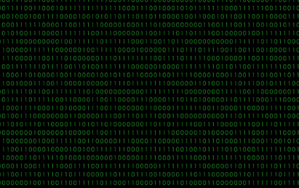
Binary Code
Binary code is the language that computers use to communicate; it is how they send, receive and store information.
Binary code consists of ones and zeros.
This is the word HELLO written in binary code:
H
E
L
L
O
01001000 01100101 01101100 01101100 01101111
Notes:
Ask students if they can read what the code says before revealing the word HELLO.
Discuss how they feel about the fact that this is computer language and that computers read this language very quickly.

Slide 6
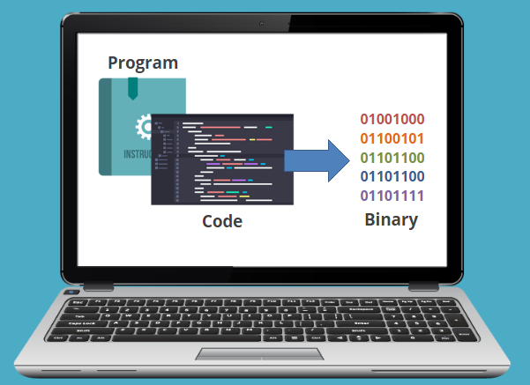
Programs
Programs are the way humans give computers instructions.
A program or code is a set of instructions given to a computer.
Coding is writing the program in a specific language. There are many different coding languages.
The computer takes the code and converts it into binary to understand the instructions.

Slide 7

Programming Languages
Programming language varies just like human language does.
HTML:
Stands for Hypertext Markup Language
Used to create web pages and web applications
Notes:
Ask students if they have ever seen a programming language or what experience they have with it.

Slide 8
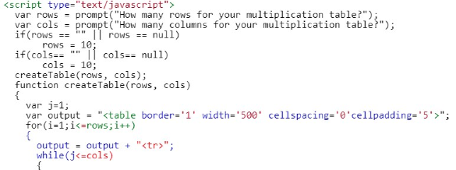
Programming Languages
Programming language varies just like human language does.
Javascript:
High-level programming language
Commonly embedded in HTML to enhance web pages
Notes:
Ask students if they have ever seen a programming language or what experience they have with it.

Slide 9
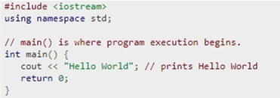
Programming Languages
Programming language varies just like human language does.
C++:
General-purpose programming language
One of the top, go-to languages
Notes:
Ask students if they have ever seen a programming language or what experience they have with it.

Slide 10
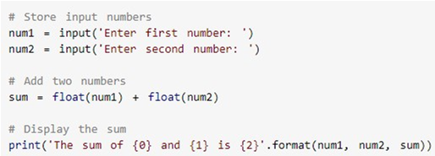
Programming Languages
Programming language varies just like human language does.
Python:
One of the most powerful, easy-to-read languages
Looks the most like regular English
Notes:
Ask students if they have ever seen a programming language or what experience they have with it.

