Slide 1
9.1 What is Radioactivity?
I can:
-recognize the meaning of radioactive.
-recognize that through radioactive decay, the unstable nucleus emits radiation in the form of very fast-moving particles and energy to produce a new nucleus, thus changing the identity of the element and nuclei that undergo this process are said to be radioactive.
-construct a graph that shows that radioactive decay is unique and constant and use that graph to determine the half-life for a radioisotope.

Slide 2
Nuclear Radiation
Radioactivity: the process by which an unstable nucleus emits one or more particles or energy in the form of electromagnetic radiation. (it just wants to become stable)
Nuclear decay
isotopes: different numbers of protons than neutrons.
Nuclear Radiation: the particles that are released from the nucleus during radioactive decay.
Do not confuse this with light radiation.
Can be very harmful to the materials that absorb the radiation.

Slide 3
When a radioactive nucleus decays, the nuclear radiation leaves the nucleus.

Slide 4
Alpha particles (+) consist of protons and neutrons.
Uranium is a radioactive element that occurs in 3 isotope forms.
Energy source in nuclear power plants.
U 234, U 235, U 238, U
Responsible for most of the heat in Earth’s core.
U 238 undergoes nuclear decay by emitting positively charged particles (Rutherford)
Alpha particles (2 protons and two neutrons… He): positively charged atom that is released in the disintegration of radioactive elements and that consists of two protons and two neutrons.
So massive they barely travel through a piece of paper.
Pull electrons from other matter, thus losing energy as it passing through.

Slide 5
Beta particles (-)
Travels through matter that alpha particles do not.
Only released during certain types of radioactive decay.
Fast moving
When neutrons decay, they form a proton and electron.
Electron has little mass and is ejected from nucleus at high speed
Easily go through paper, but stopped by aluminum or wood.
Like alpha particles, they ionize atoms which slows them down.

Slide 6
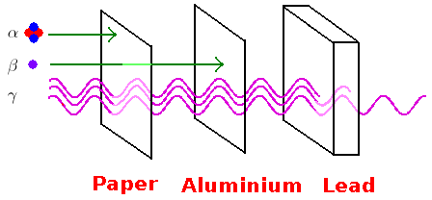
Gamma rays are very high energy
More penetrating than beta particles
Gamma ray: the high-energy photon emitted by a nucleus during fission and radioactive decay.
Unlike beta and alpha, they are not made of matter.
Photons
Have more energy than light or X-rays
Pose highest danger to health

Slide 7
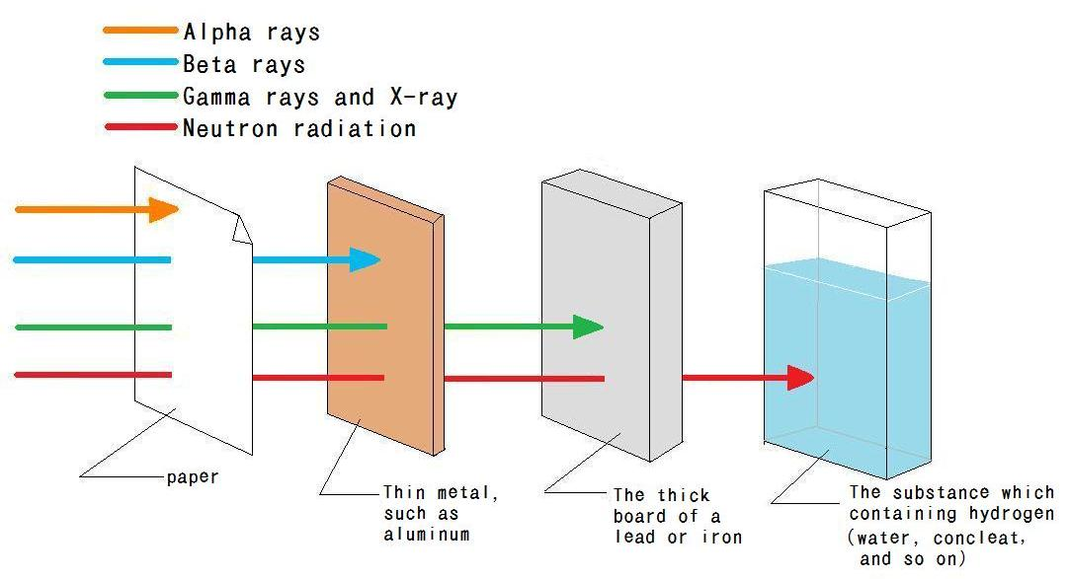
Neutron radioactivity may occur in an unstable nucleus
Neutron are not charged, therefore do not ionize matter.
Can travel the furthest of all three previously mentioned forms of radioactivity.

Slide 8
Nuclear Decay
When unstable nuclei emit alpha or beta particles, # of proton and neutrons change.
Radium-226→Radium-222
A nucleus gives up two protons and two neutron during alpha decay
A nucleus gains a proton and loses a neutron during beta decay.

Slide 9
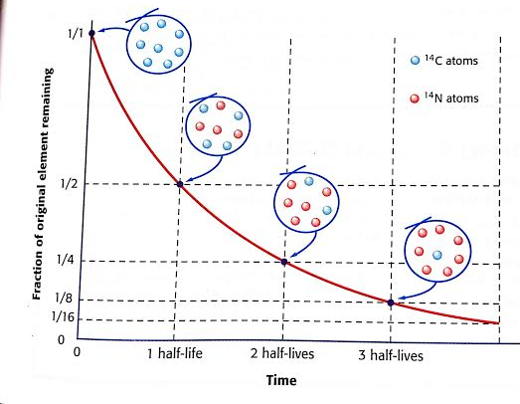
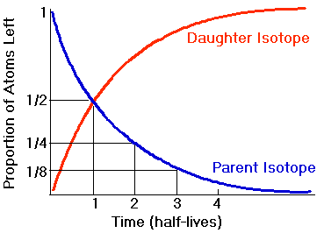
Radioactive Decay Rates
Half-life: the time required for half of a sample of a radioactive substance to disintegrate by radioactive decay.
Parent v. daughter material (penny example)

Slide 10
Half-Life is a measure of how quickly a substance decays. (Fractions)
½,1/4,1/8,1/16,1/32,1/64…
Depends on stability of nucleus.
Potassium-40=rocks
Carbon-14=more recent materials

Slide 11
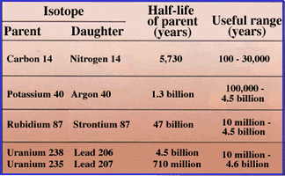

Slide 12
Half-life Practice
The half-life of iodine-131 is 8.1 days. How long will it take for three-fourths of a sample of iodine-131 to decay?
Radon-222 is a radioactive gas with a half-life of 3.82 days. How long would it take for fifteen-sixteenths of a sample of radon-222 to decay?
Uranium-238 decays very slowly, with a half-life of 4.47 billion years. What percentage of a sample of uranium-238 would remain after 13.4 billion years?

