Slide 1
Welcome to Ms. Lytch’s Openhouse
Lake Forest Hills Elementary
3140 Lake Forest drive
Augusta, ga 30909

Slide 2
Your Teachers
Ms. Lytch-Autism/MOD classroom
8 Years experience in ED
20 years of exp with disabled/Mentally challenged
Hobbies: Baking, fishing & gardening
Mr. Green-Paraprofessional
15 years experience in ed
Hobbies: cooking & Home projects

Slide 3
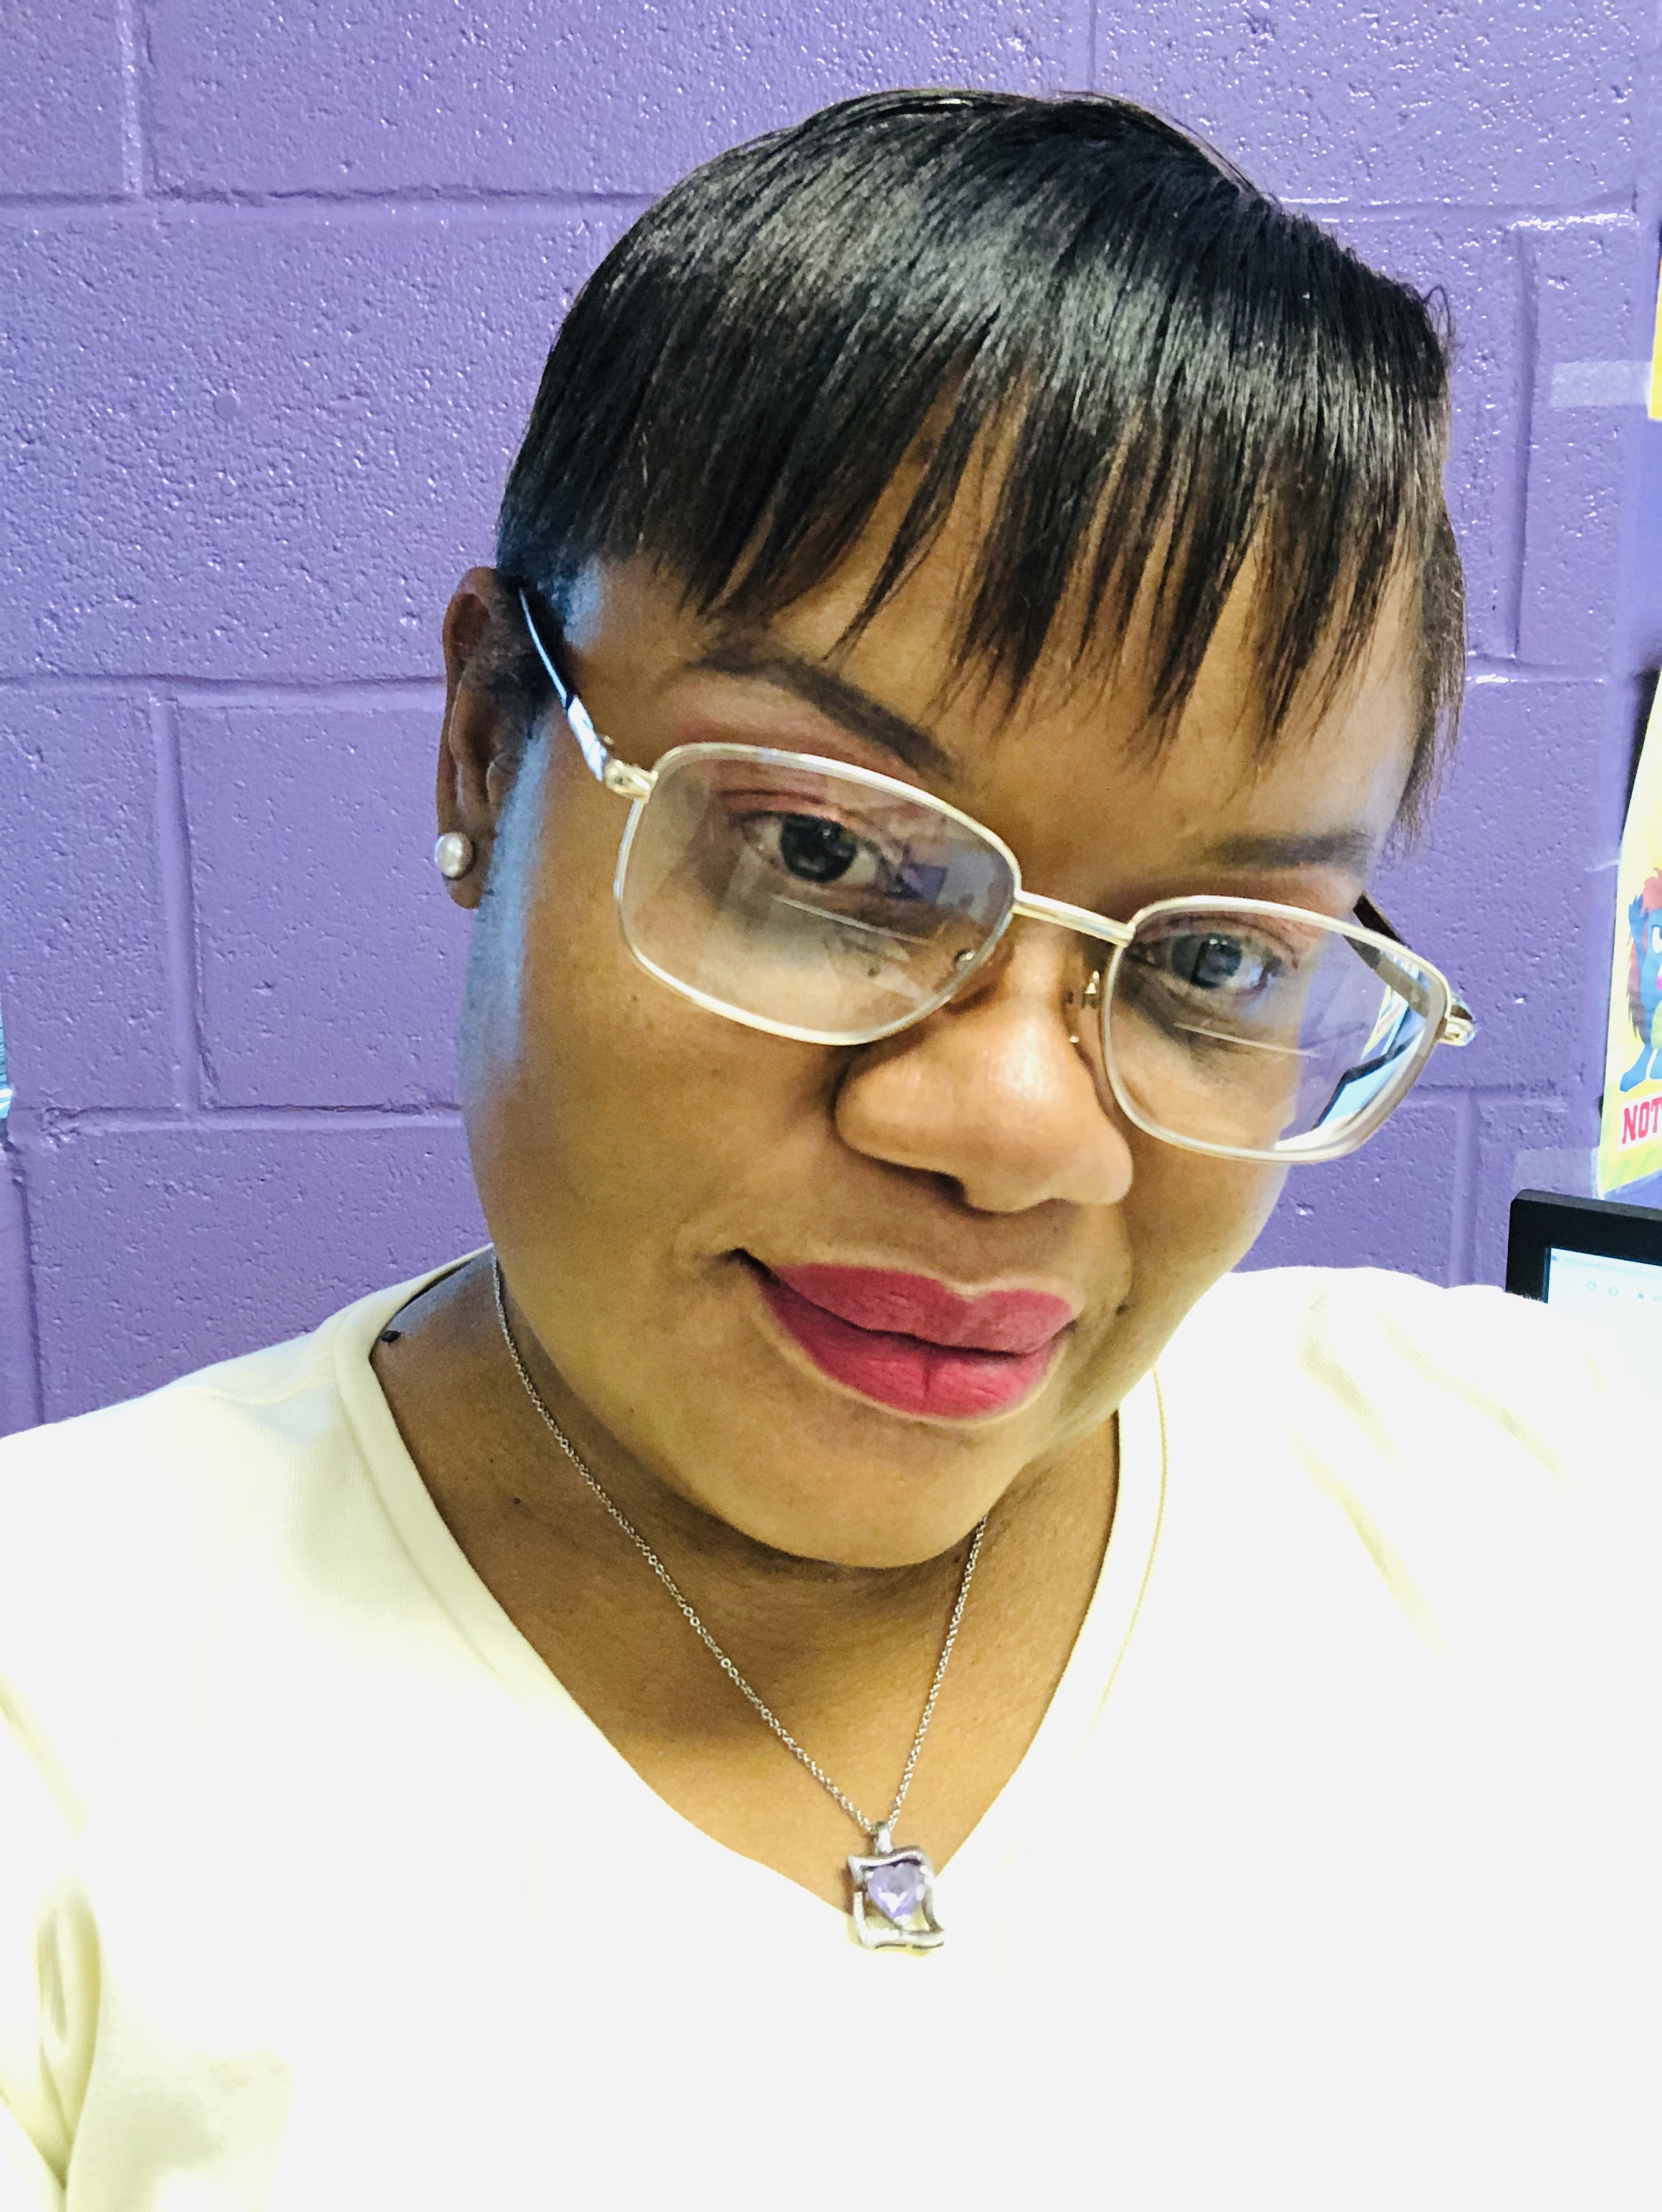
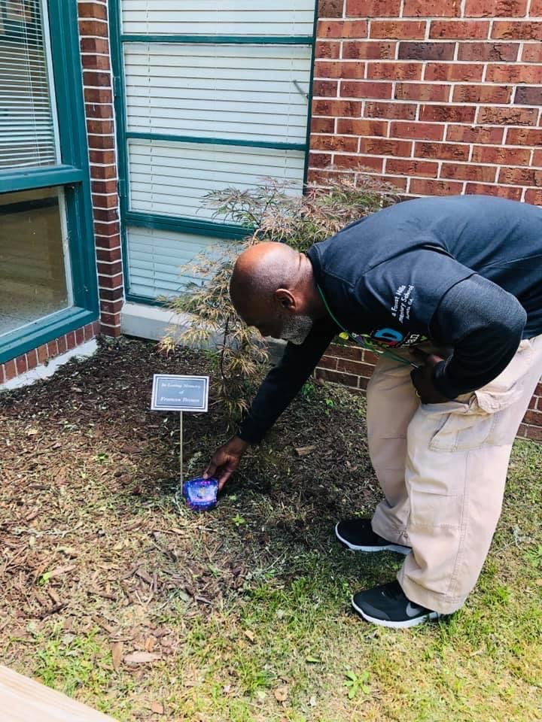
Ms. Lytch and Mr. Green

Slide 4
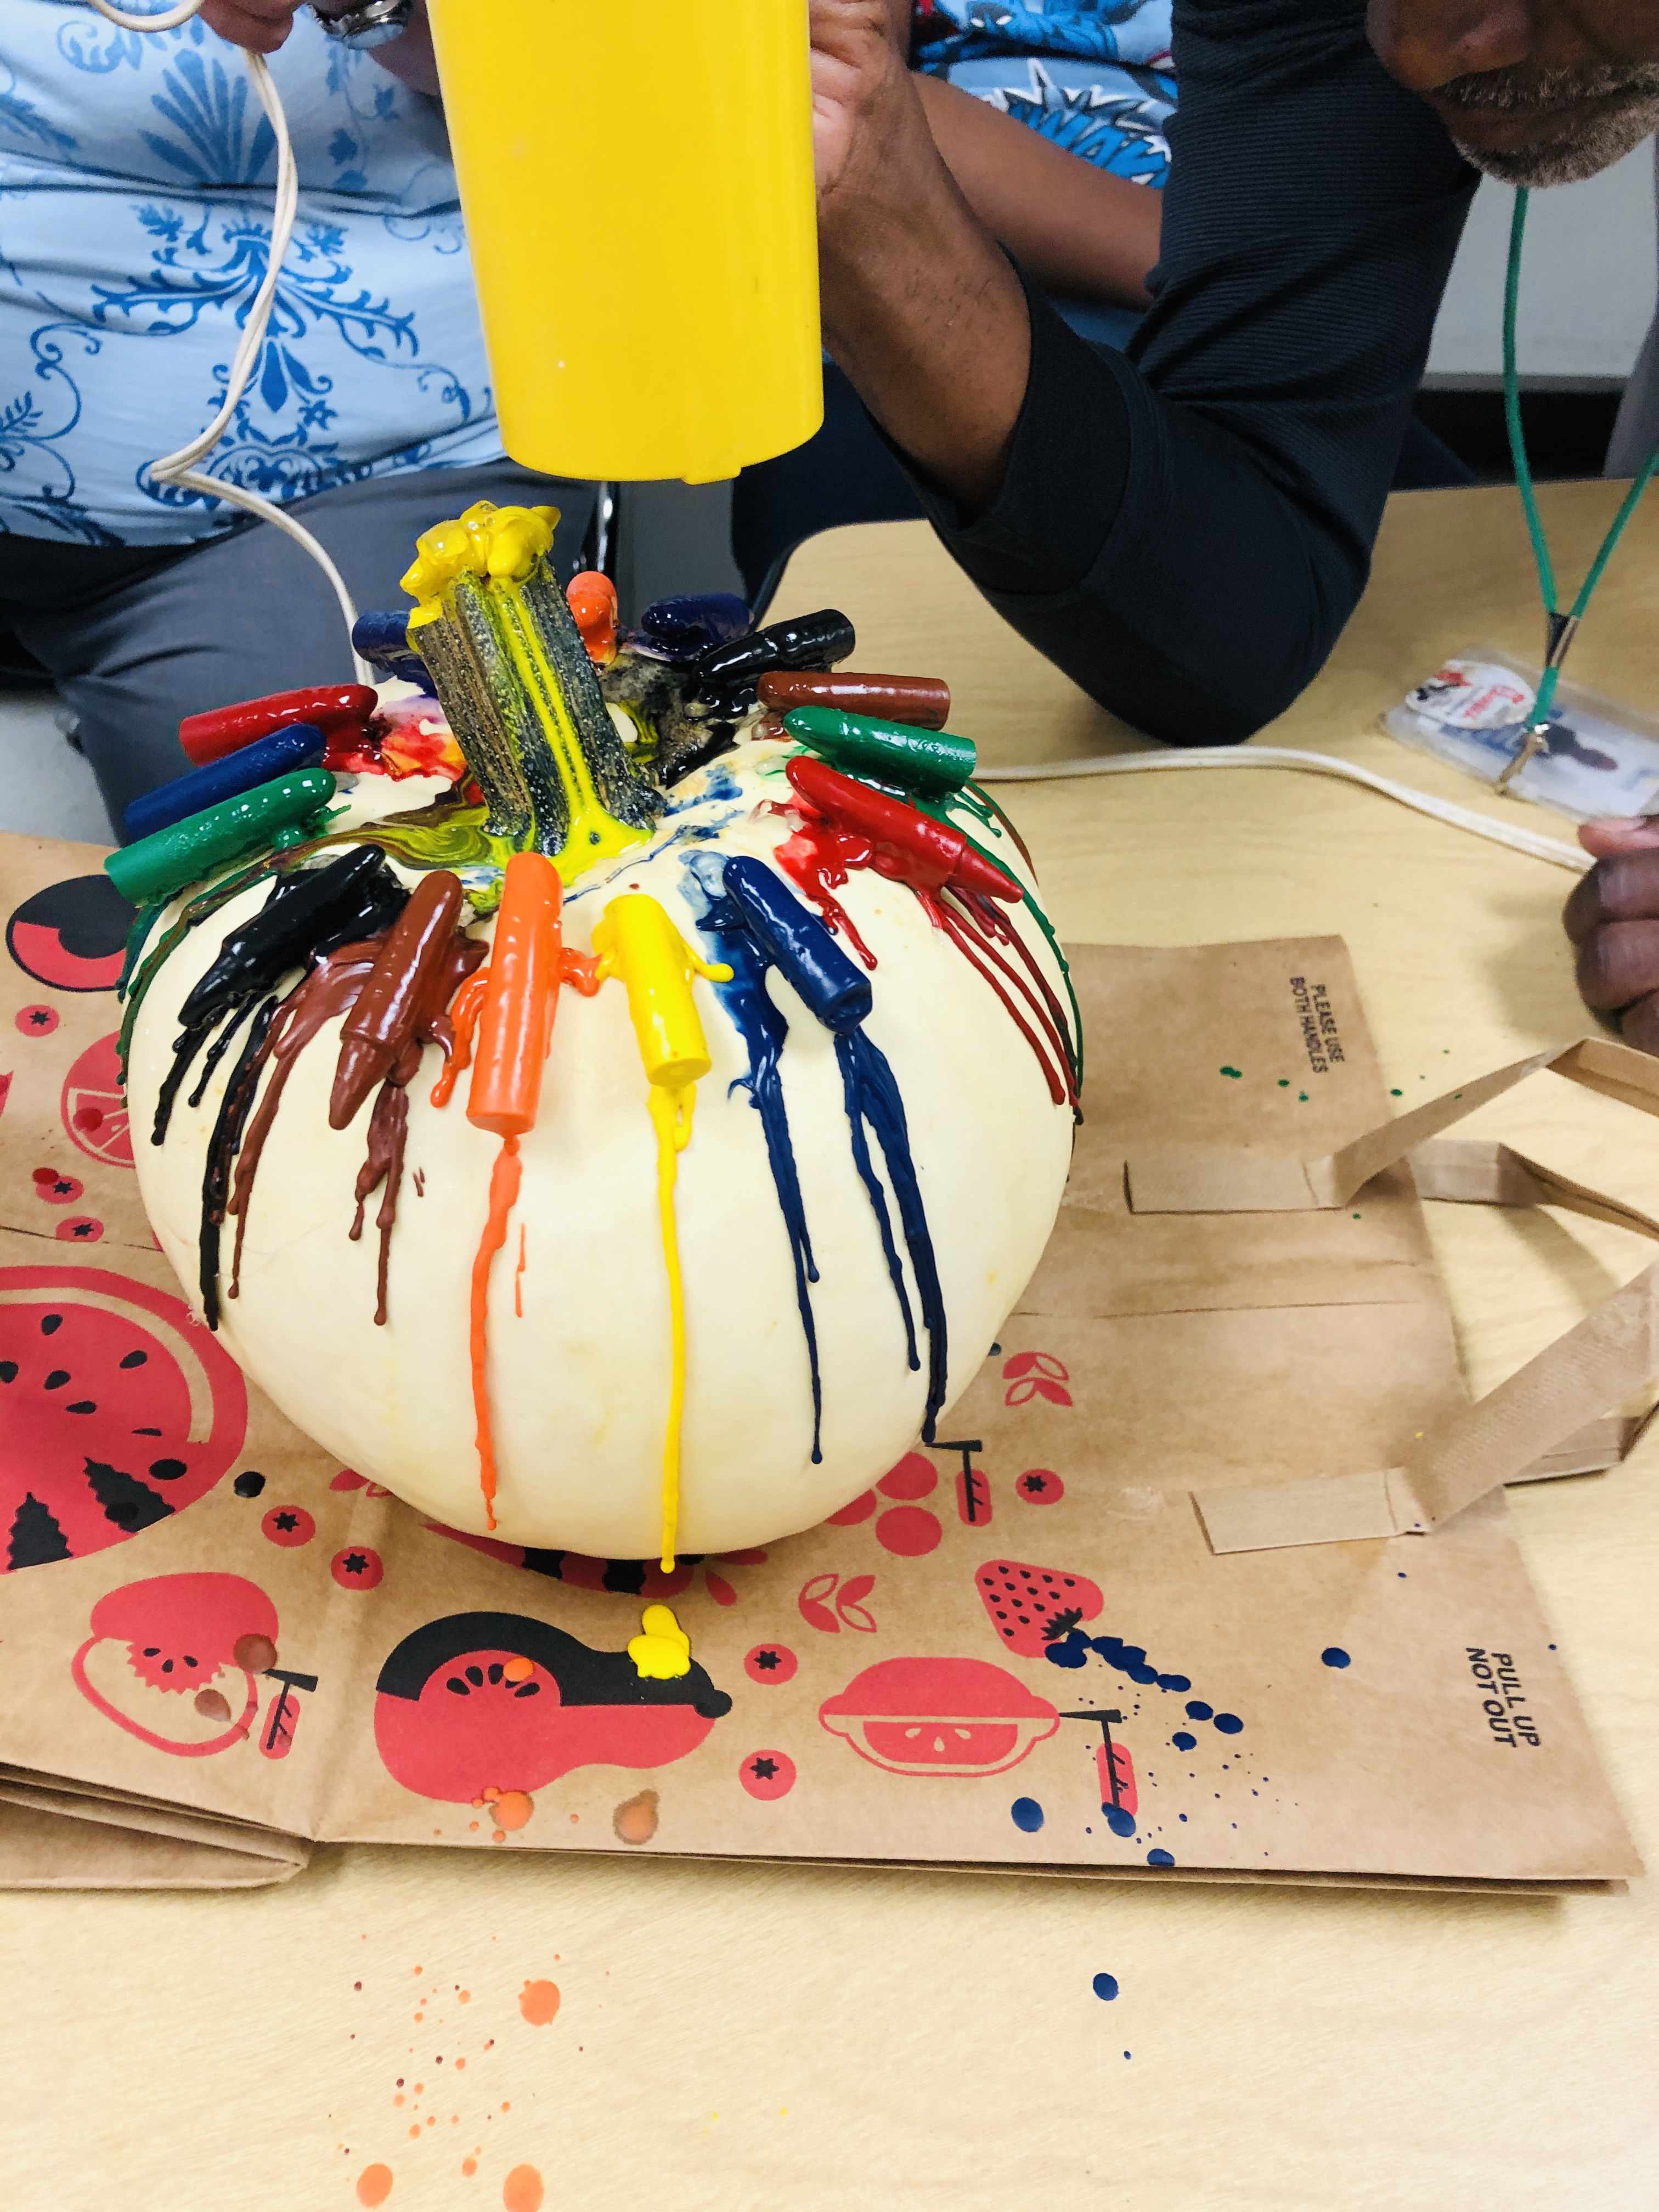
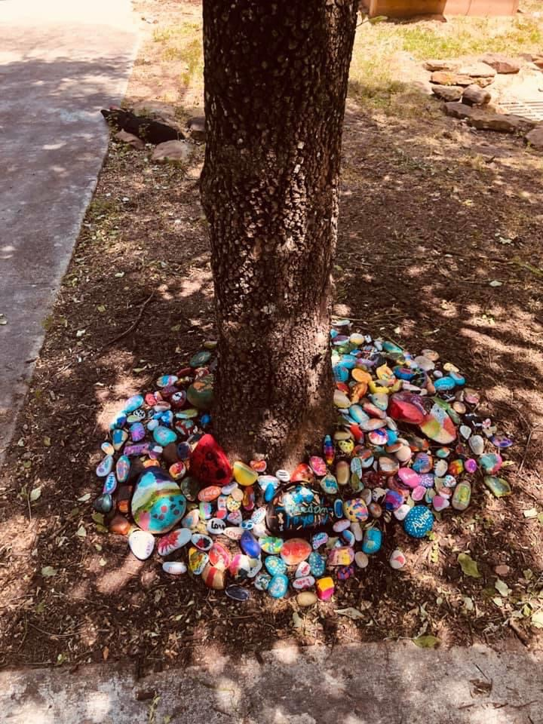
Some of Our Class Projects

Slide 5
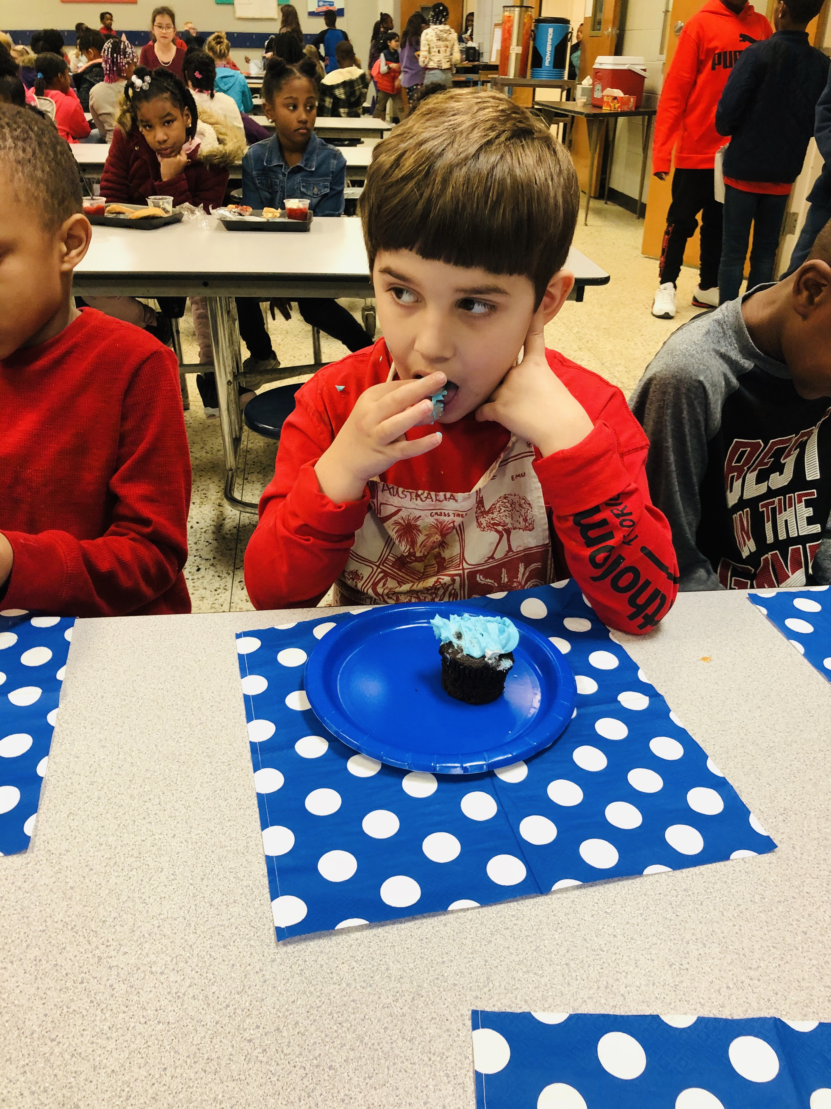
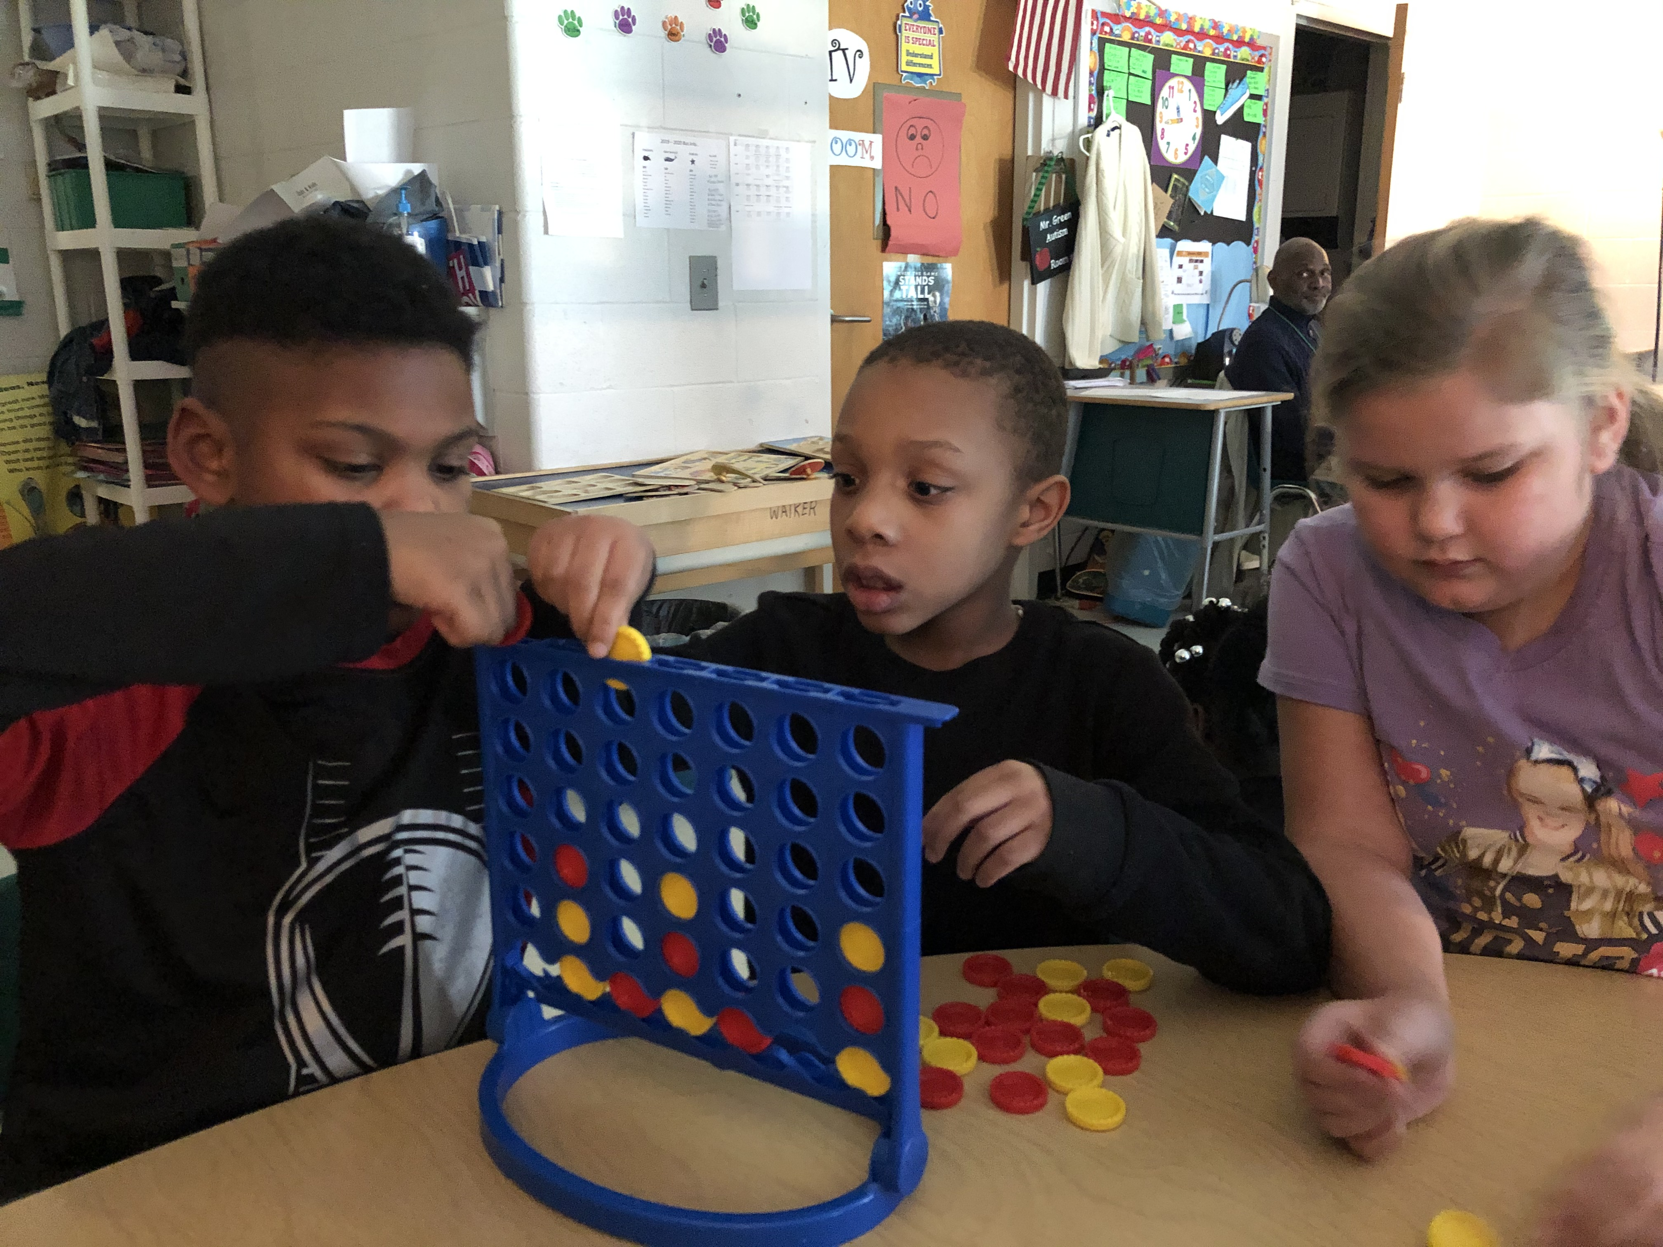
Our Class

Slide 6
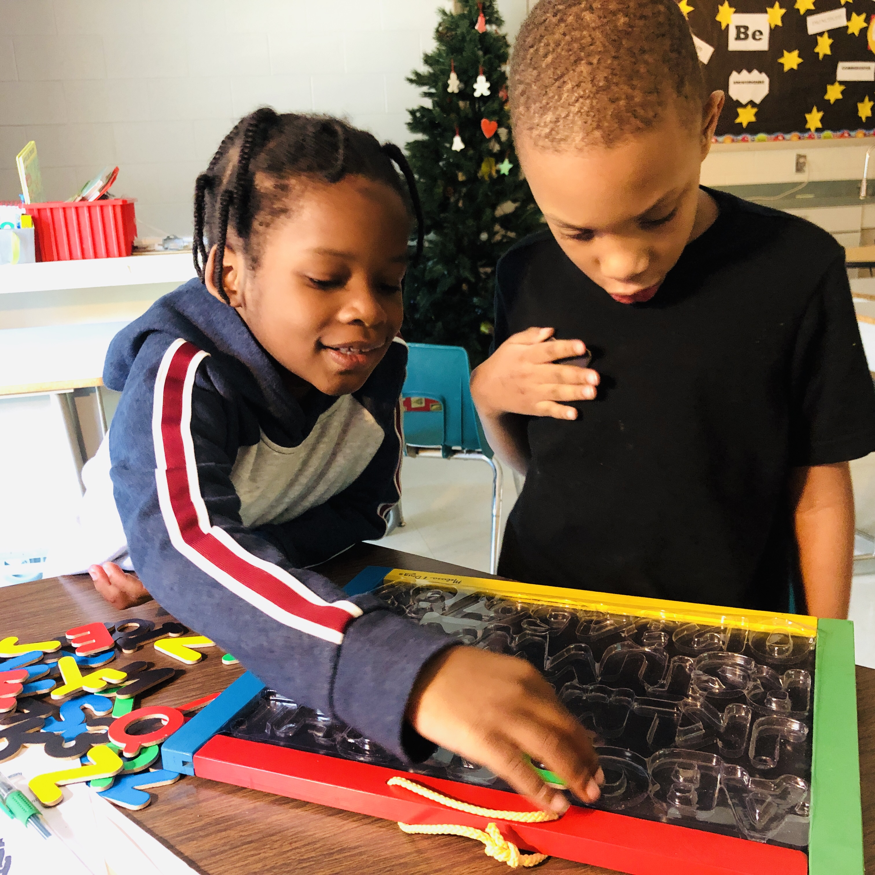
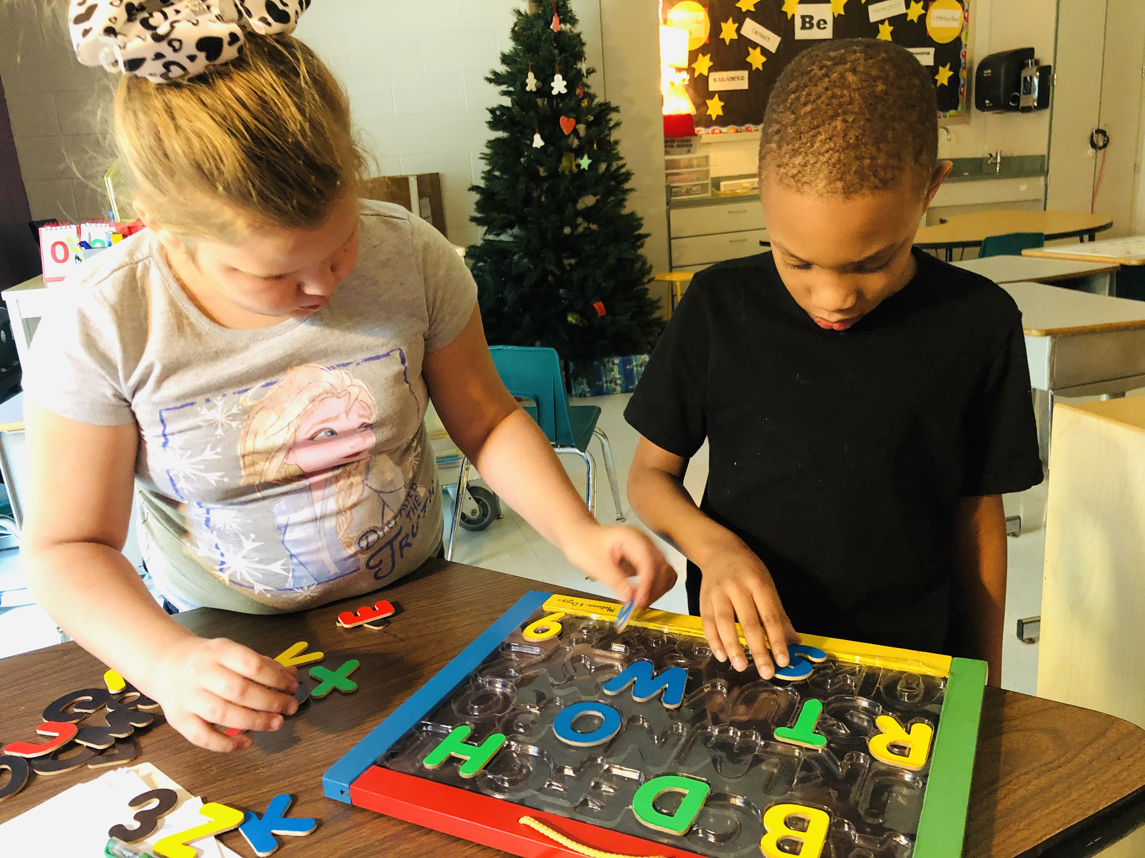
More of our class

Slide 7
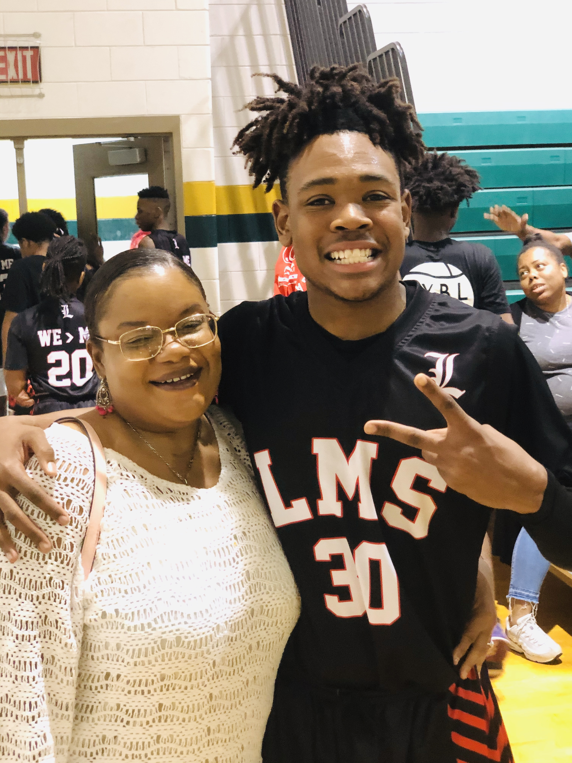
Lake Forest Graduate
Ms. Lytch’s Basketball Player

Slide 8

Welcome I-Movie

Slide 9
Class Lists are located on the Lake Forest Hills website

Slide 10
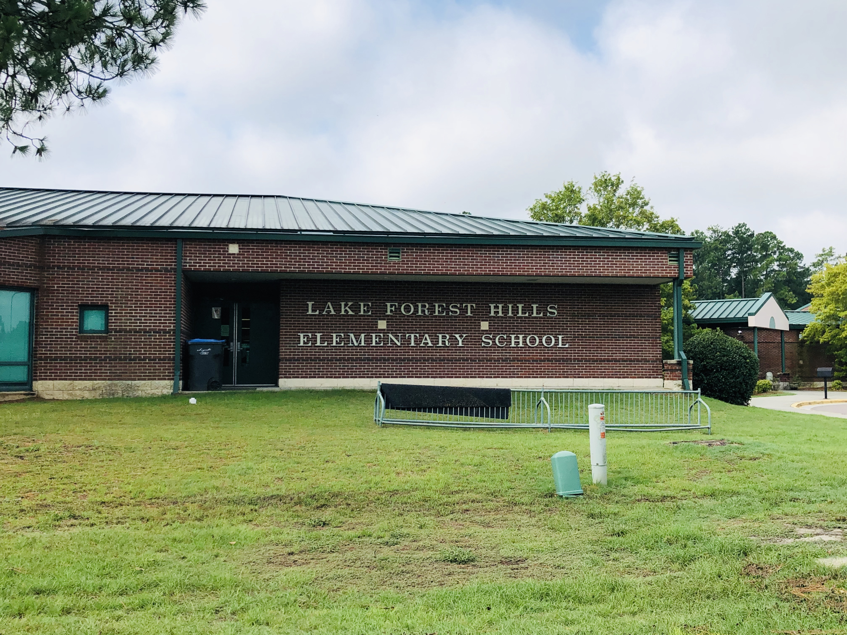
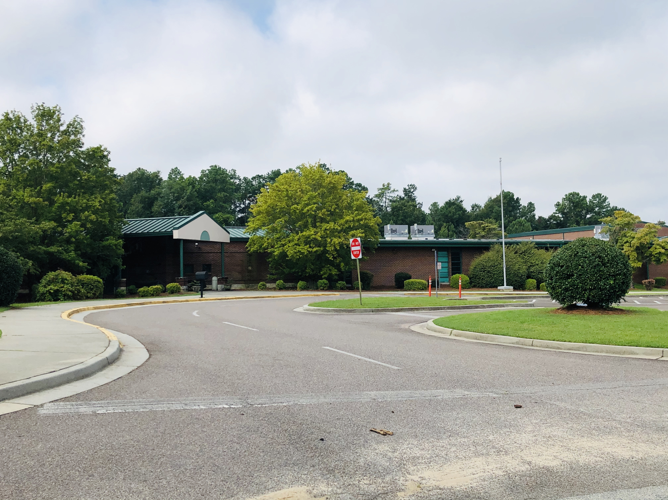
Our School

Slide 11

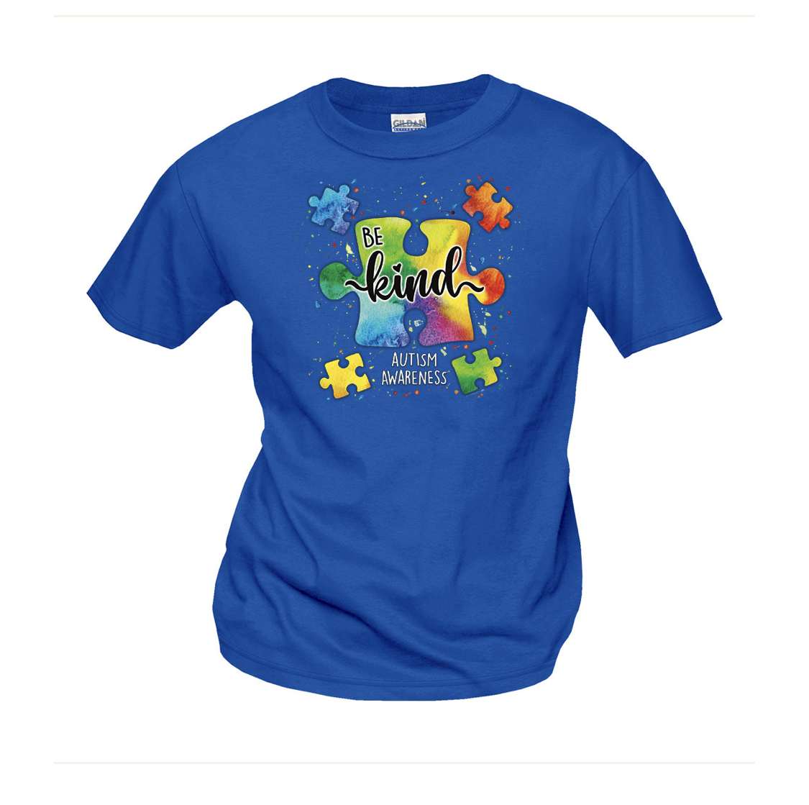
Our class is about being kind and understanding that everyone is unique with their own special powers…

Slide 12
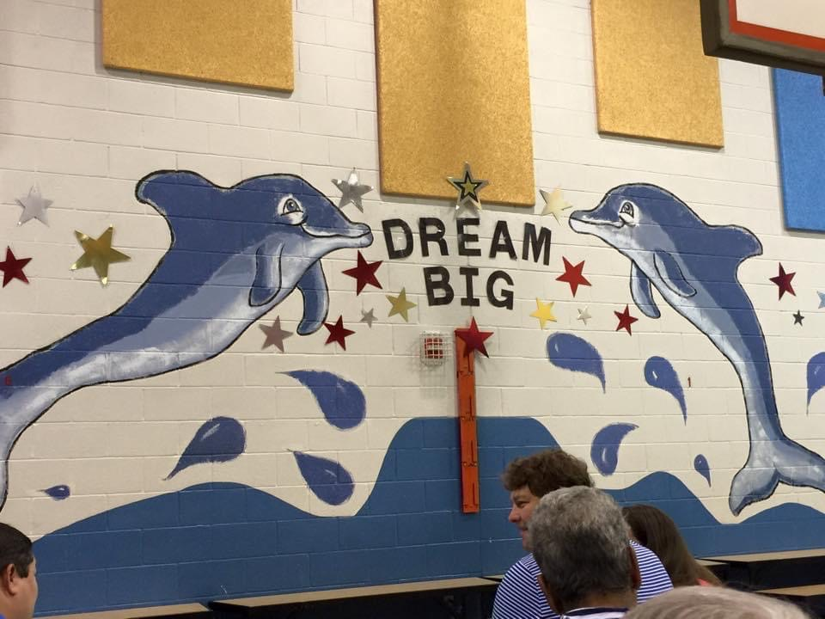
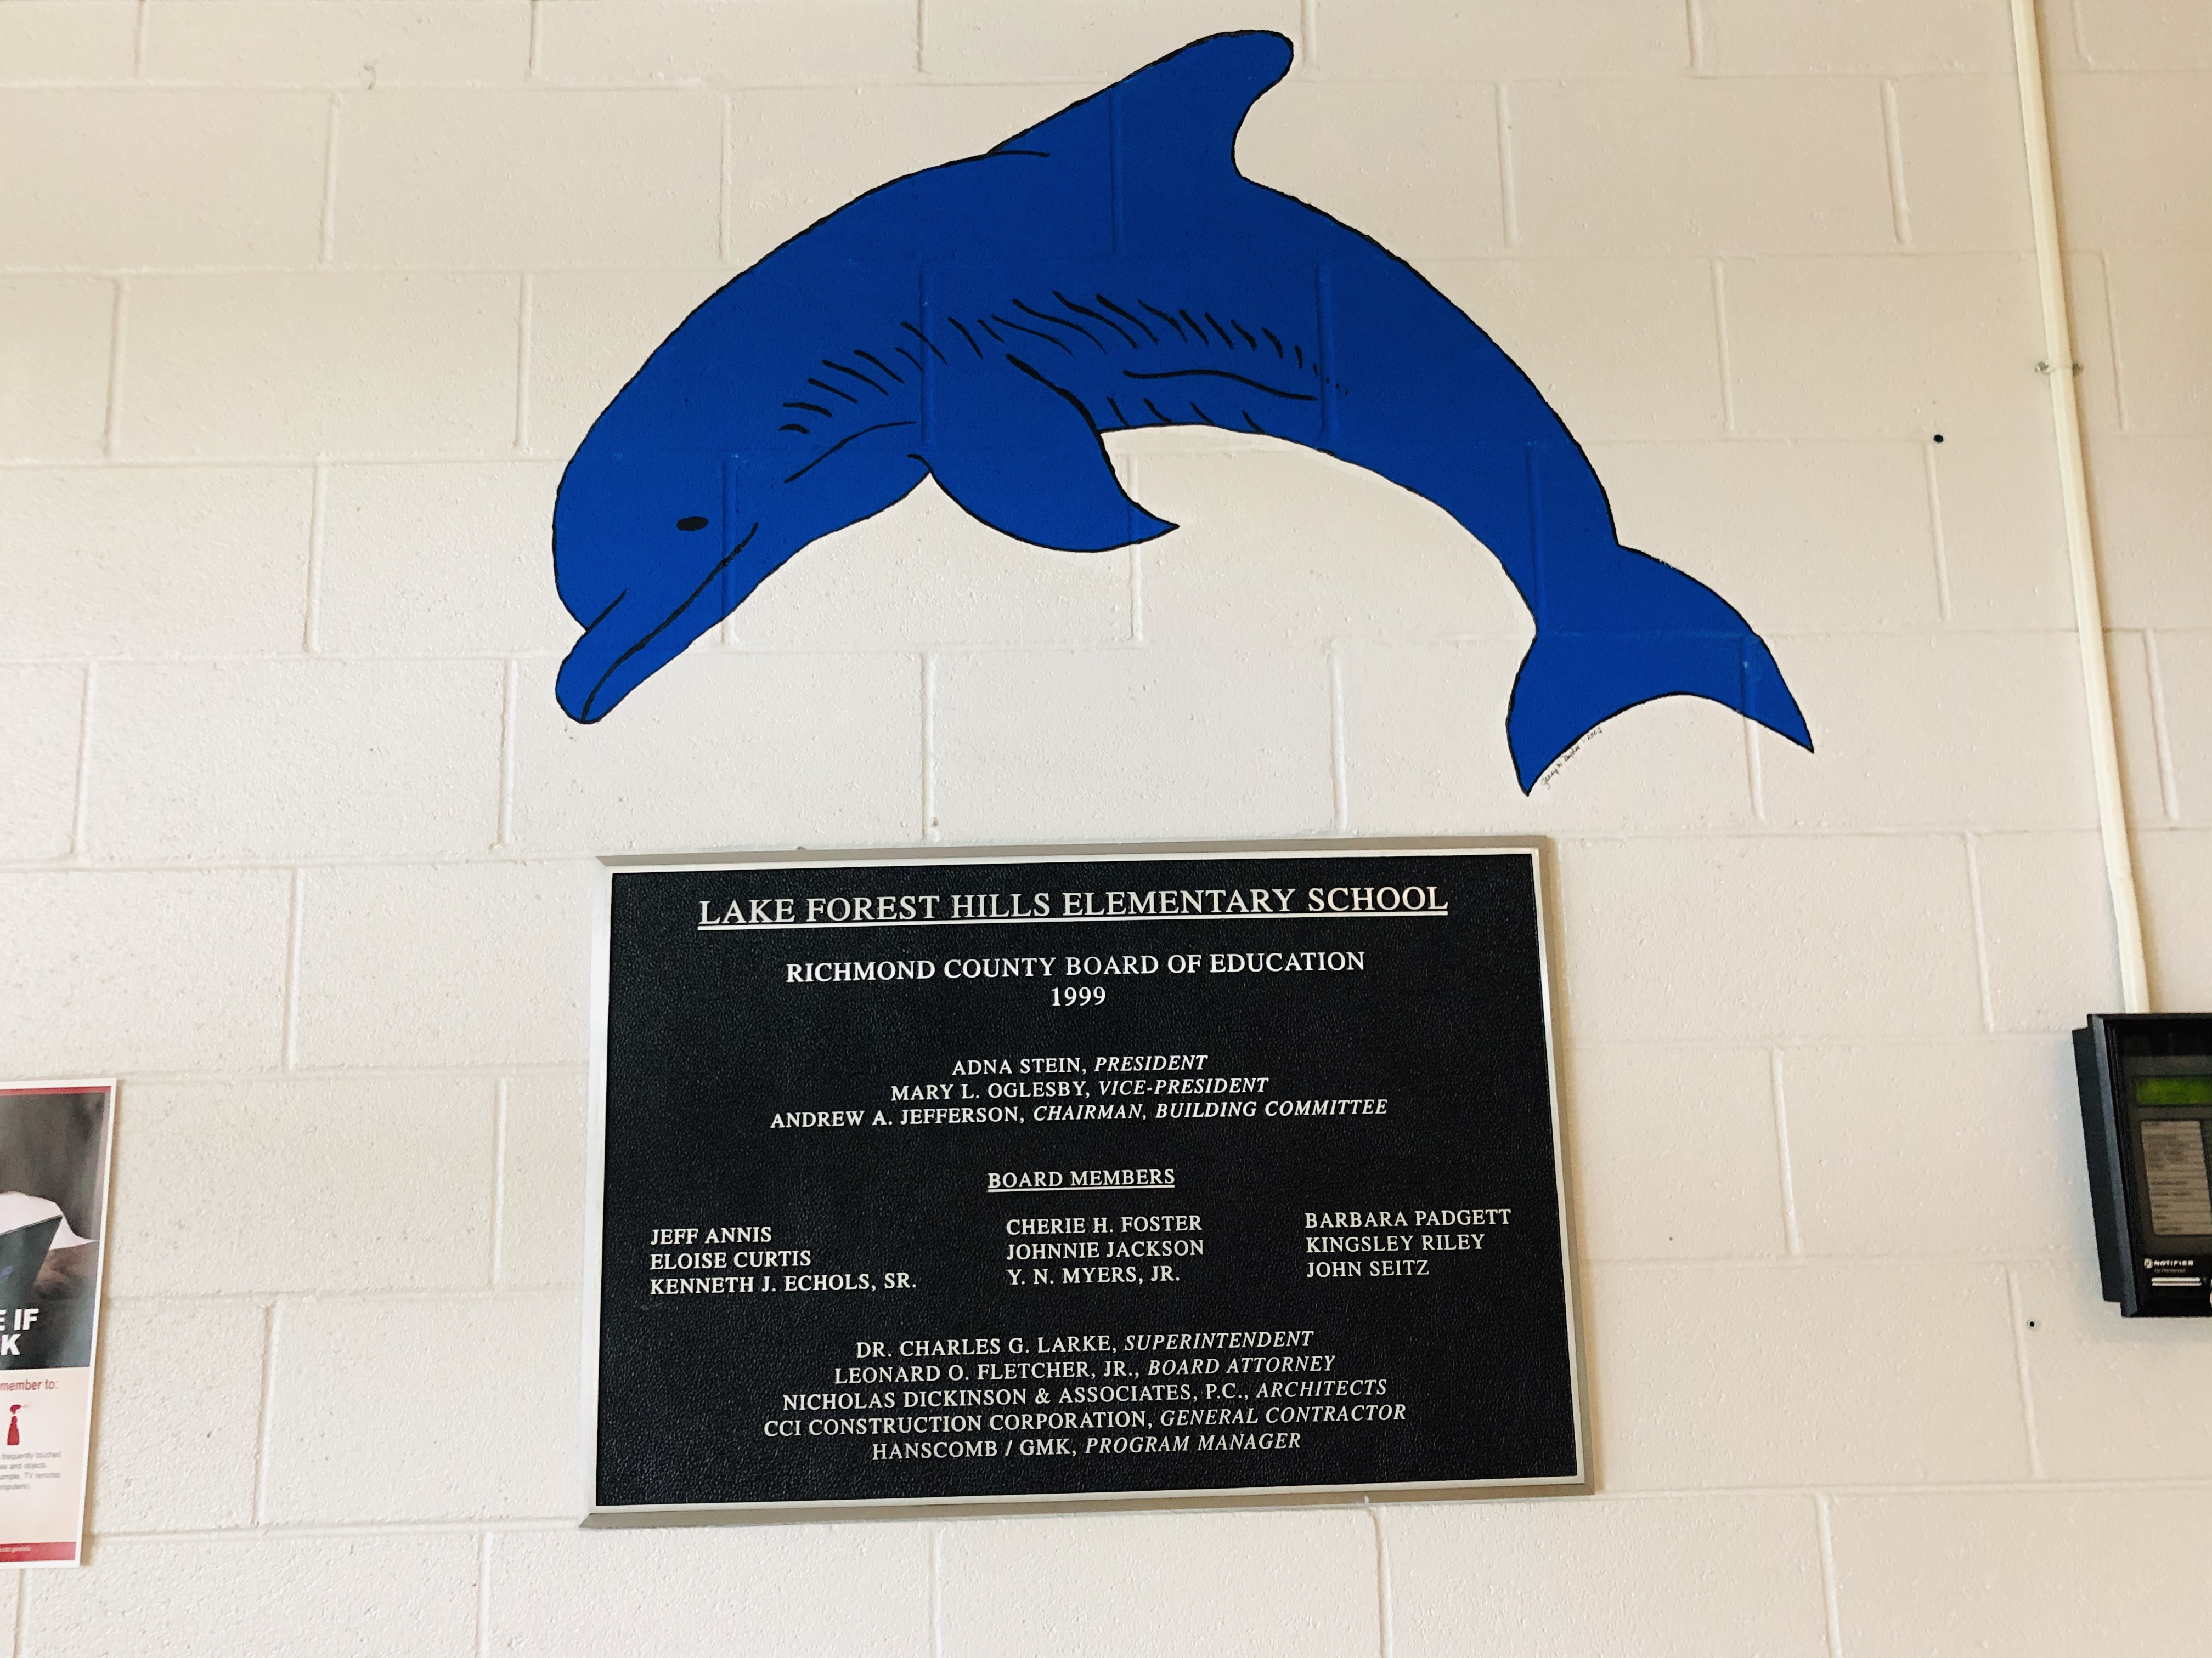
Dreams are real with Dolphin Pride

Slide 13
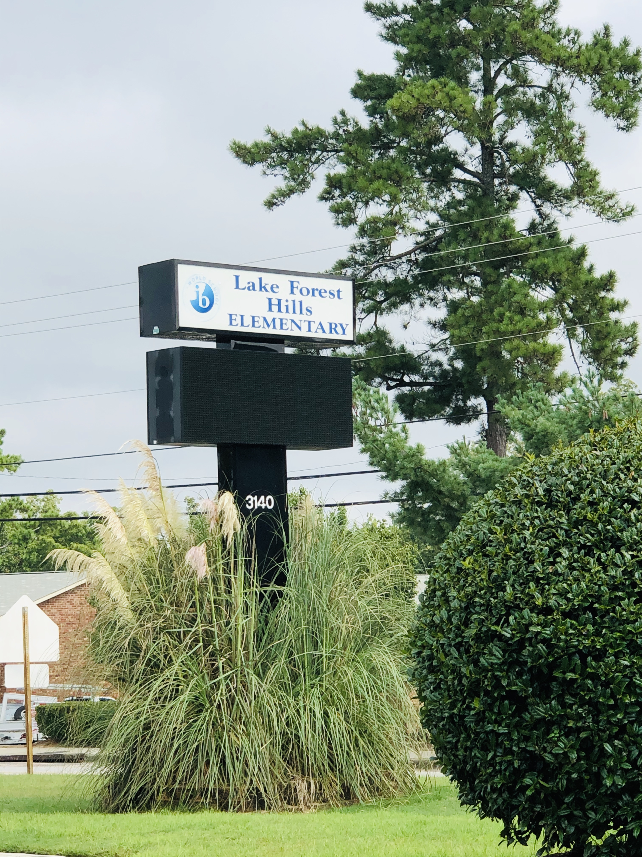
Welcome to LFH

