Slide 1
Lessons for the Week of March 30th – April 3rd, 2020
Language Arts, Math, and Social Studies

Slide 2
Message from me to you!
Hi everyone!
First off, I want to give a shout out to all my students that are working so hard at home. You're doing your paper packets, Khan Academy lessons, IReady minutes, and some of your parents are giving you extra cool assignments. I think it's awesome! I'm super proud. Those of you doing your Khan Academy lessons, give yourself a pat on the back because you all are passing every single one! I'm not sure when we will get to meet again in the classroom, but I want you to keep on doing your best. I know some of you don't have computers, so I'm going to keep giving you options for pencil and paper assignments also. I hope to see you soon. I miss you ALL!!!!

Slide 3
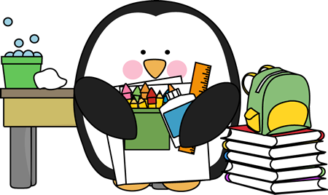

Slide 4
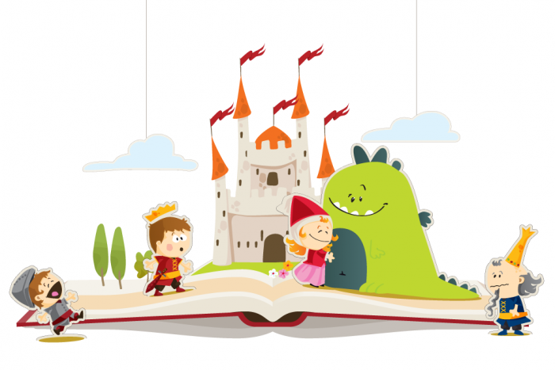
Language Arts- Here are the topics we're going to go over today.
Reading
Phonics
Writing
Grammar

Slide 5
This week we are going to continue comparing and contrasting two versions of the same story!

Slide 6
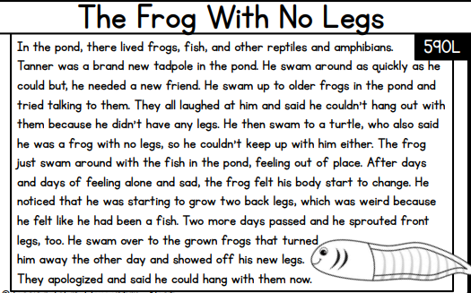
Read the two passages on the next two slides. Then answer the questions on the next slide.

Slide 8
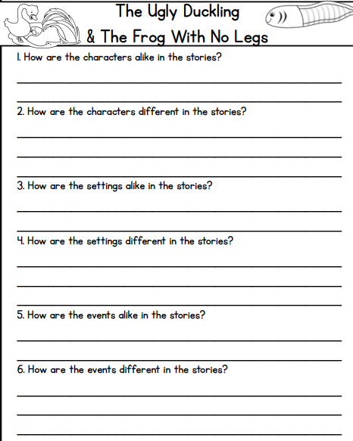

Slide 9
Phonics
Look at the word badly. The root word of badly is bad, which is an adjective that describes something. When we add -ly to the word bad, we make an adverb, which is a word that tells how something is done. Adverbs describe verbs, adjectives, and other adverbs.
Ways that you could use the word badly would be: The dog behaved badly when he tore up my mom's pillow. The word badly is being used to describe how the dog was behaving.
If you don't remember adverbs, listen to this song.
https://www.youtube.com/watch?v=14fXm4FOMPM

Slide 10
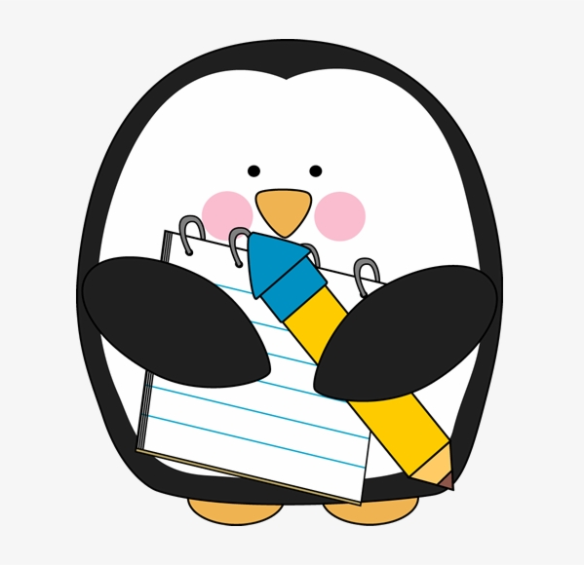
Writing – Narratives!
Look at the new packet posted in my homework/distance learning section of my webpage.
Take your time. Your story does not have to be finished in one day. You may want to take the time today to brainstorm ideas.

Slide 11
Grammar- Context Clues
I was flabbergasted when I saw my friend's shocking new blue hair! I was totally not expecting that! I was so surprised!
Use context clues to figure out what the underlined word means.
Flabbergasted means surprised

Slide 12
Today's Assignments
The Ugly Duckling and Frog with No Legs comprehension questions
Begin writing a story/brainstorming
Do a lesson on I-ready or a Khan Academy lesson (I added in reading options)
Don't forget to be reading!!

Slide 13
Math- Here's math for today
Math is review for this week.
Watch a Video Each Day.
All About Shapes Review
Polygons
Equal Parts
3-D Shapes
Longer Video on 3-D Shapes
Partitioning Shapes <-- From last week

Slide 14
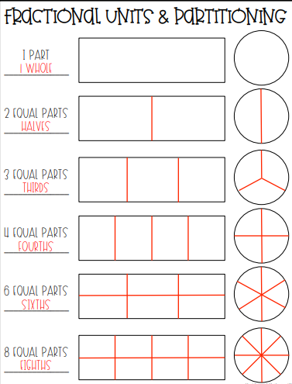
Geometry Click this link and then scroll down until you see the two shapes games on the bottom right side.
To split a shape into fractions, all parts must be equal (the same size). If a shape is not split into same sized parts, you cannot call them fractions.

Slide 15
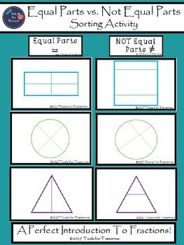
Geometry Posters

Slide 16
Today's Assignments
1. Complete your math review from your packet for today. You were given 4 weeks worth of review work in your first packet. You should also have seen a new packet underneath this the link to this powerpoint giving you some more geometry review.
2. Login to Khan Academy and complete a lesson or choose a math worksheet to print out/do on a separate sheet of paper from the I-Ready at home packet. (You can find it on my webpage in the "Free Websites for Extra Practice" section.)
*Don't forget to be getting your I-Ready minutes this week!*

Slide 17
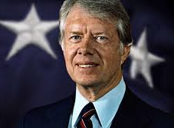
Social Studies
This week we are going to begin talking about Jimmy Carter. In your packet from school, you were already given some information on him. This week, I'm going to provide you videos and websites to learn more about Jimmy Carter and his life accomplishments.

Slide 18
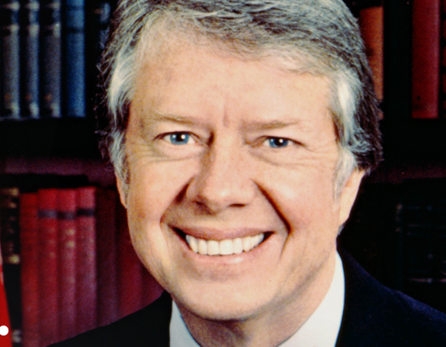
Today's Videos
Jimmy Carter Facts!
Jimmy Carter- Presidential Minute
Watch these two videos. On a separate sheet of paper, you can write down facts you learned from the videos. You should have at least five facts today.

Slide 20
Language Arts- Here are the topics we're going to go over today.
Reading
Phonics
Writing

Slide 21
Reading Skill- Compare and contrast two versions of the same story

Slide 22
Reading
Listen to these two stories then compare and contrast them using a venn diagram.
The Ugly Duckling Read Aloud
The Uglified Duckling Read Aloud
How are the books similar? How are they different?

Slide 23
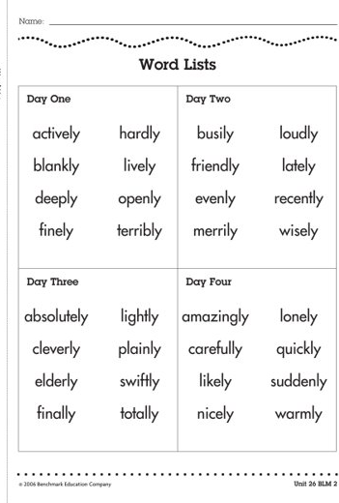
Phonics
Practice by reading over these words.
Try using a few in a sentence.

Slide 24
Writing – Narratives!
Look at the new packet posted in my homework/distance learning section of my webpage.
Continue your story from yesterday. Remember to have details. Look at the next slide to see the difference between writing that has details and writing that has missing details.

Slide 25
Look at the different writing pieces.
Story 1
Story 2
Yesterday I went to the store. My mom and I needed some food. First, we went to the store. Next, we put our food in our cart. Then, we bought our food. Finally, we took our food home.
This past Tuesday, I went Walmart with my mom. We needed milk, eggs, sugar, and butter to make a cake. First, I went to the baking aisle to get the sugar. Next, I went to the dairy section to get the milk, eggs, and butter. After, we put our food in our cart we got in line. The line was short, and our cashier was very nice. Finally, we brought our food home to make our cake!
**Which one has more details? Which story gives you clear picture of what happened? **

Slide 26
Today's Assignments
Reading - Complete a double bubble for the two stories you had heard today. Listen to them again if you don't remember them.
Writing- Continue your story
Student Choice – IReady Lesson, 15 minutes of reading, or packet work
*Remember to read every day!*

Slide 27
Math- Here's math for today
Math is review for this week.
Watch a Video Each Day.
All About Shapes Review
Polygons
Equal Parts
3-D Shapes
Longer Video on 3-D Shapes
Partitioning Shapes <-- From last week

Slide 28
Geometry Click this link and then scroll down until you see the two shapes games on the bottom right side.
To split a shape into fractions, all parts must be equal (the same size). If a shape is not split into same sized parts, you cannot call them fractions.

Slide 29
Today's Assignments
1. Complete your math review from your packet for today. You should have seen a new packet underneath this the link to this powerpoint.
2. Login to Khan Academy and complete a lesson or choose a math worksheet to print out/do on a separate sheet of paper from the I-Ready at home packet. (You can find it on my webpage in the "Free Websites for Extra Practice" section.)
*Don't forget to be getting your I-Ready minutes this week!*

Slide 30
Social Studies
For social studies today you can do the comprehension page of your packet.

Slide 32
Language Arts- Here are the topics we're going to go over today.
Reading
Phonics
Writing
Grammar

Slide 33
Reading Skill- Compare and contrast two versions of the same story *No new stories today! :) For reading today, work on your packet or Khan Academy

Slide 34
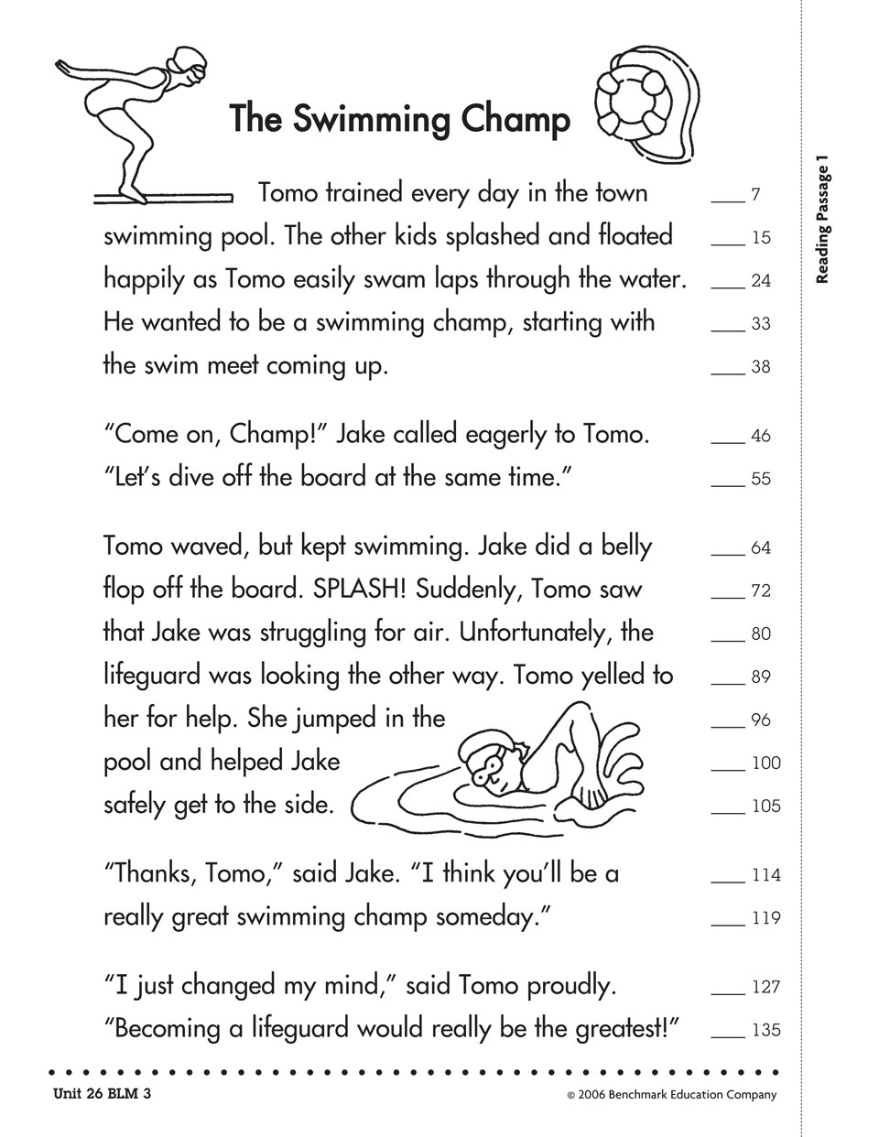
Today's Phonics
Find all of the –ly adverbs

Slide 35
Writing – Narratives!
Work towards finishing this week's story

Slide 36
Grammar- Context Clues
Margie felt timid. She started at a new school where she didn't know anyone. She nervously sat at her seat and quietly waited for new friends to come say hello.
What does timid mean?
Timid means shy.

Slide 37
Today's Assignments
IReady Lesson or Khan Academy
Packet work
*Remember to read every day!*

Slide 38
Math- Here's math for today
Geometry Lesson
Math Video To Watch
For review, watch the videos
from my partitioning
rectangles section (webpage).

Slide 39
Geometry Lesson
Remember: To split a shape into fractions, all parts must be equal (the same size). If a shape is not split into same sized parts, you cannot call them fractions.

Slide 40
Social Studies
Look at this website to learn more about Jimmy Carter.
All About Jimmy Carter - Carter Foundation
If you have a printer at home, print out the Jimmy Carter Research graphic organizer and write down facts about him in the bubbles. If you don't, you can write down new facts you learned about him on a new sheet of paper or the paper you used earlier this week.

Slide 42
Language Arts- Here are the topics we're going to go over today.
Reading
Phonics
Writing
Grammar

Slide 43
Reading Skill- Compare and contrast two versions of the same story

Slide 44
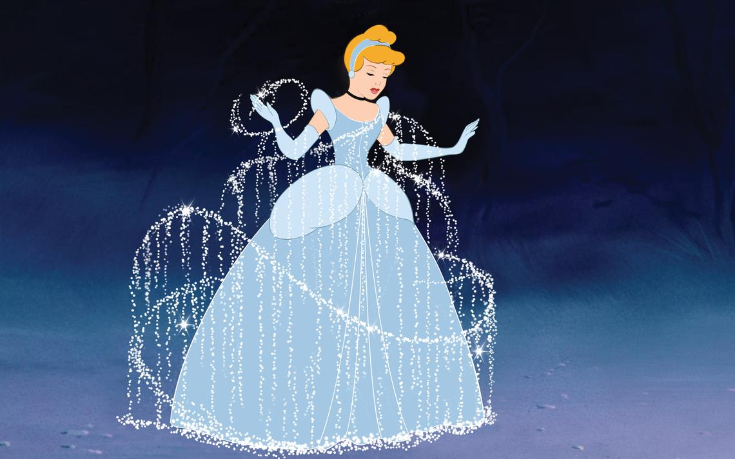
Books of the day!
Disney's Cinderella
Adelita: A Mexican Cinderella Story
How are the books the same? How are the different?

Slide 45
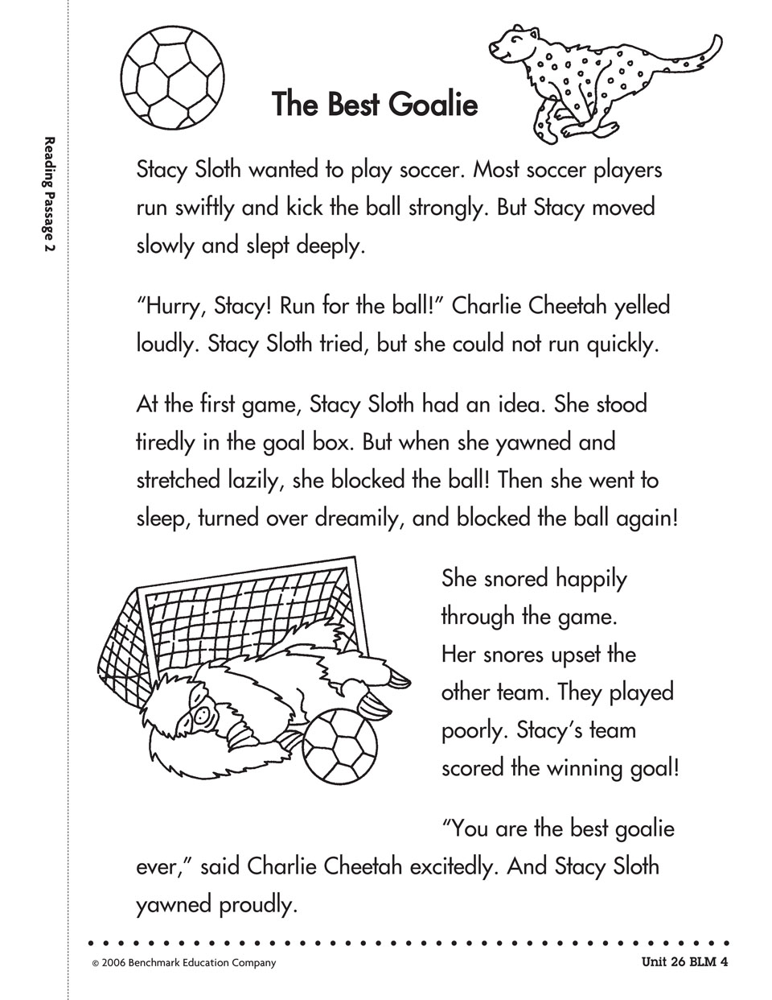
Phonics!
Try to find all the words that are ly adverbs!

Slide 46
Grammar- Context Clues
Keeping it simple today!
Flocabulary Video About Context Clues

Slide 47
Today's Assignments
Complete the worksheet from this week's packet on today's two stories.
IReady Lesson or Khan Academy Lesson
*Remember to read every day!*

Slide 48
Math- Here's math for today
Geometry Lesson
Math Video To Watch

Slide 49
Geometry Lesson Thursday's Math Video

Slide 50
Today's Assignments
1. Complete your math review from your packet for today.
2. Login to Khan Academy and complete a lesson or choose a math worksheet to print out/do on a separate sheet of paper from the I-Ready at home packet. (You can find it on my webpage in the "Free Websites for Extra Practice" section.)
*Don't forget to be getting your I-Ready minutes this week!*

Slide 51
Social Studies
If you have a computer at home, complete the Jimmy Carter time line. If you do not, do some google searches and learn more about our 39th president.
How do you think he's a great leader?

Slide 53
Alright Kids! We are keeping it simple this Friday!!
I challenge you to complete your narrative for this week, your math review for today, and an I-Ready lesson or a book if you cannot get on I-Ready.
If you don't have access to internet, work on your packet. Remember if you cannot print them, you can always answer the questions on a separate sheet of paper.

