Slide 1

Lessons for the Week of March 23rd –27th, 2020
Language Arts, Math, and Science (next week Social Studies)

Slide 2

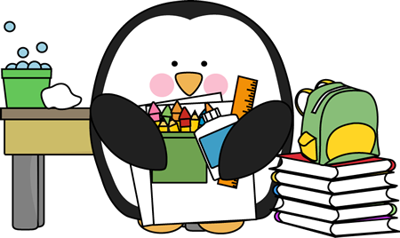

Slide 3
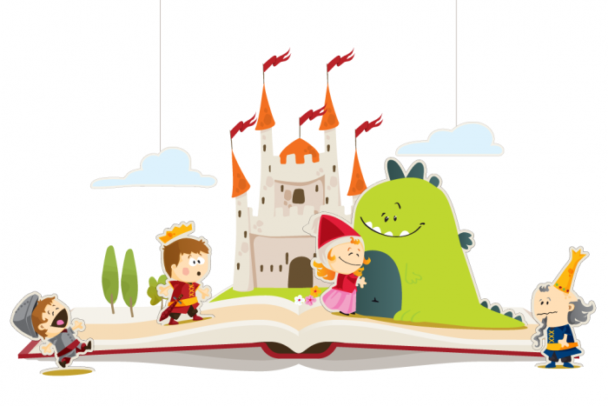
Language Arts- Here are the topics we're going to go over today.
Reading
Phonics
Writing
Grammar

Slide 4
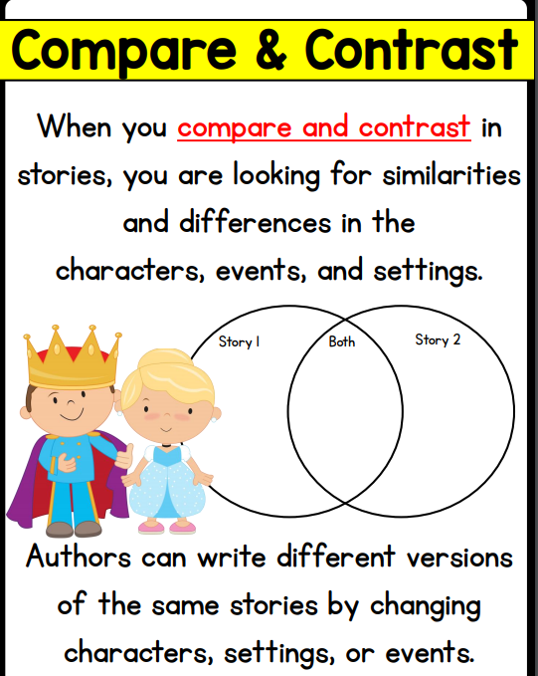
Reading Skill- Compare and contrast two versions of the same story

Slide 5
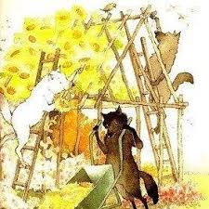
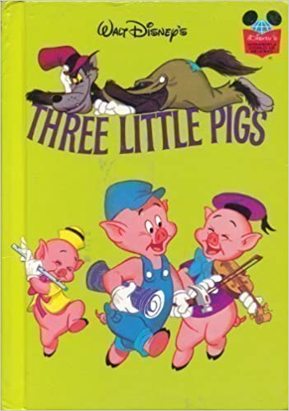
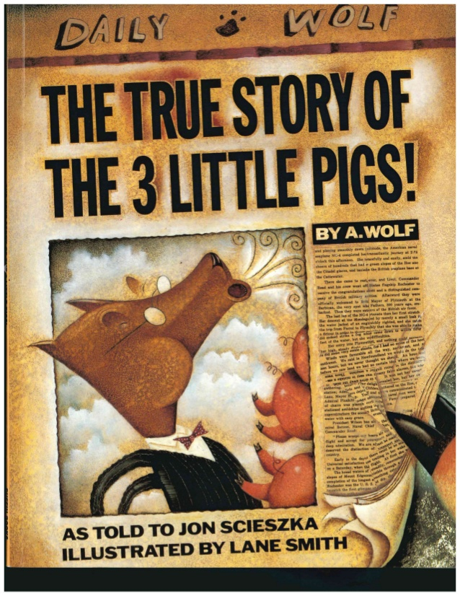
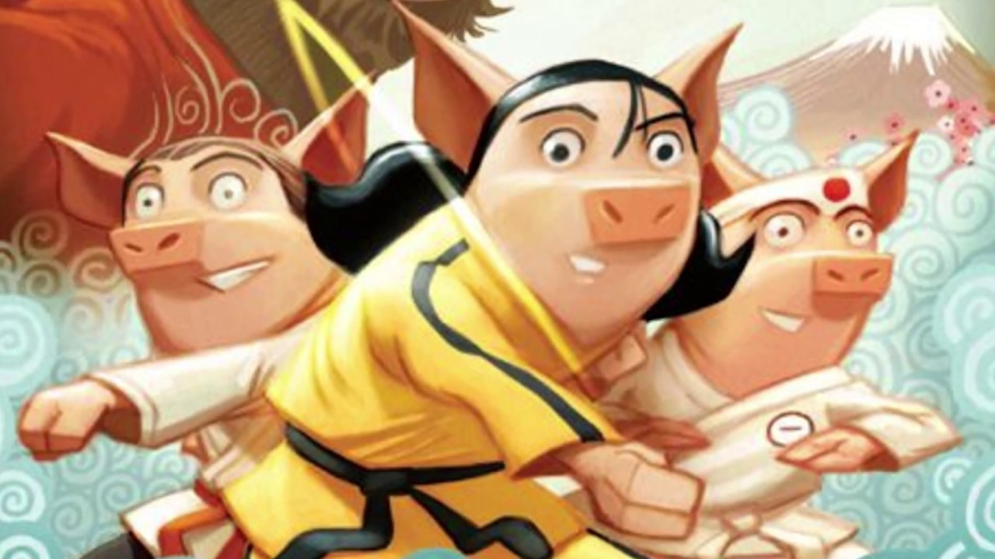
Reading
Before we left for home learning, we read three books: The Three Little Pigs, The Three Little Wolves and the Big Bad Pig, and The True Story of the Three Little Pigs. Today I have a new story for you, The Three Ninja Pigs. Below you will see the links to the books we have already read just in case you need a reminder and our new story.
The Three Little Pigs
The Three Little Wolves (the version you all like the funny reader)
The True Story of the Three Little Pigs
The Three Ninja Pigs

Slide 6
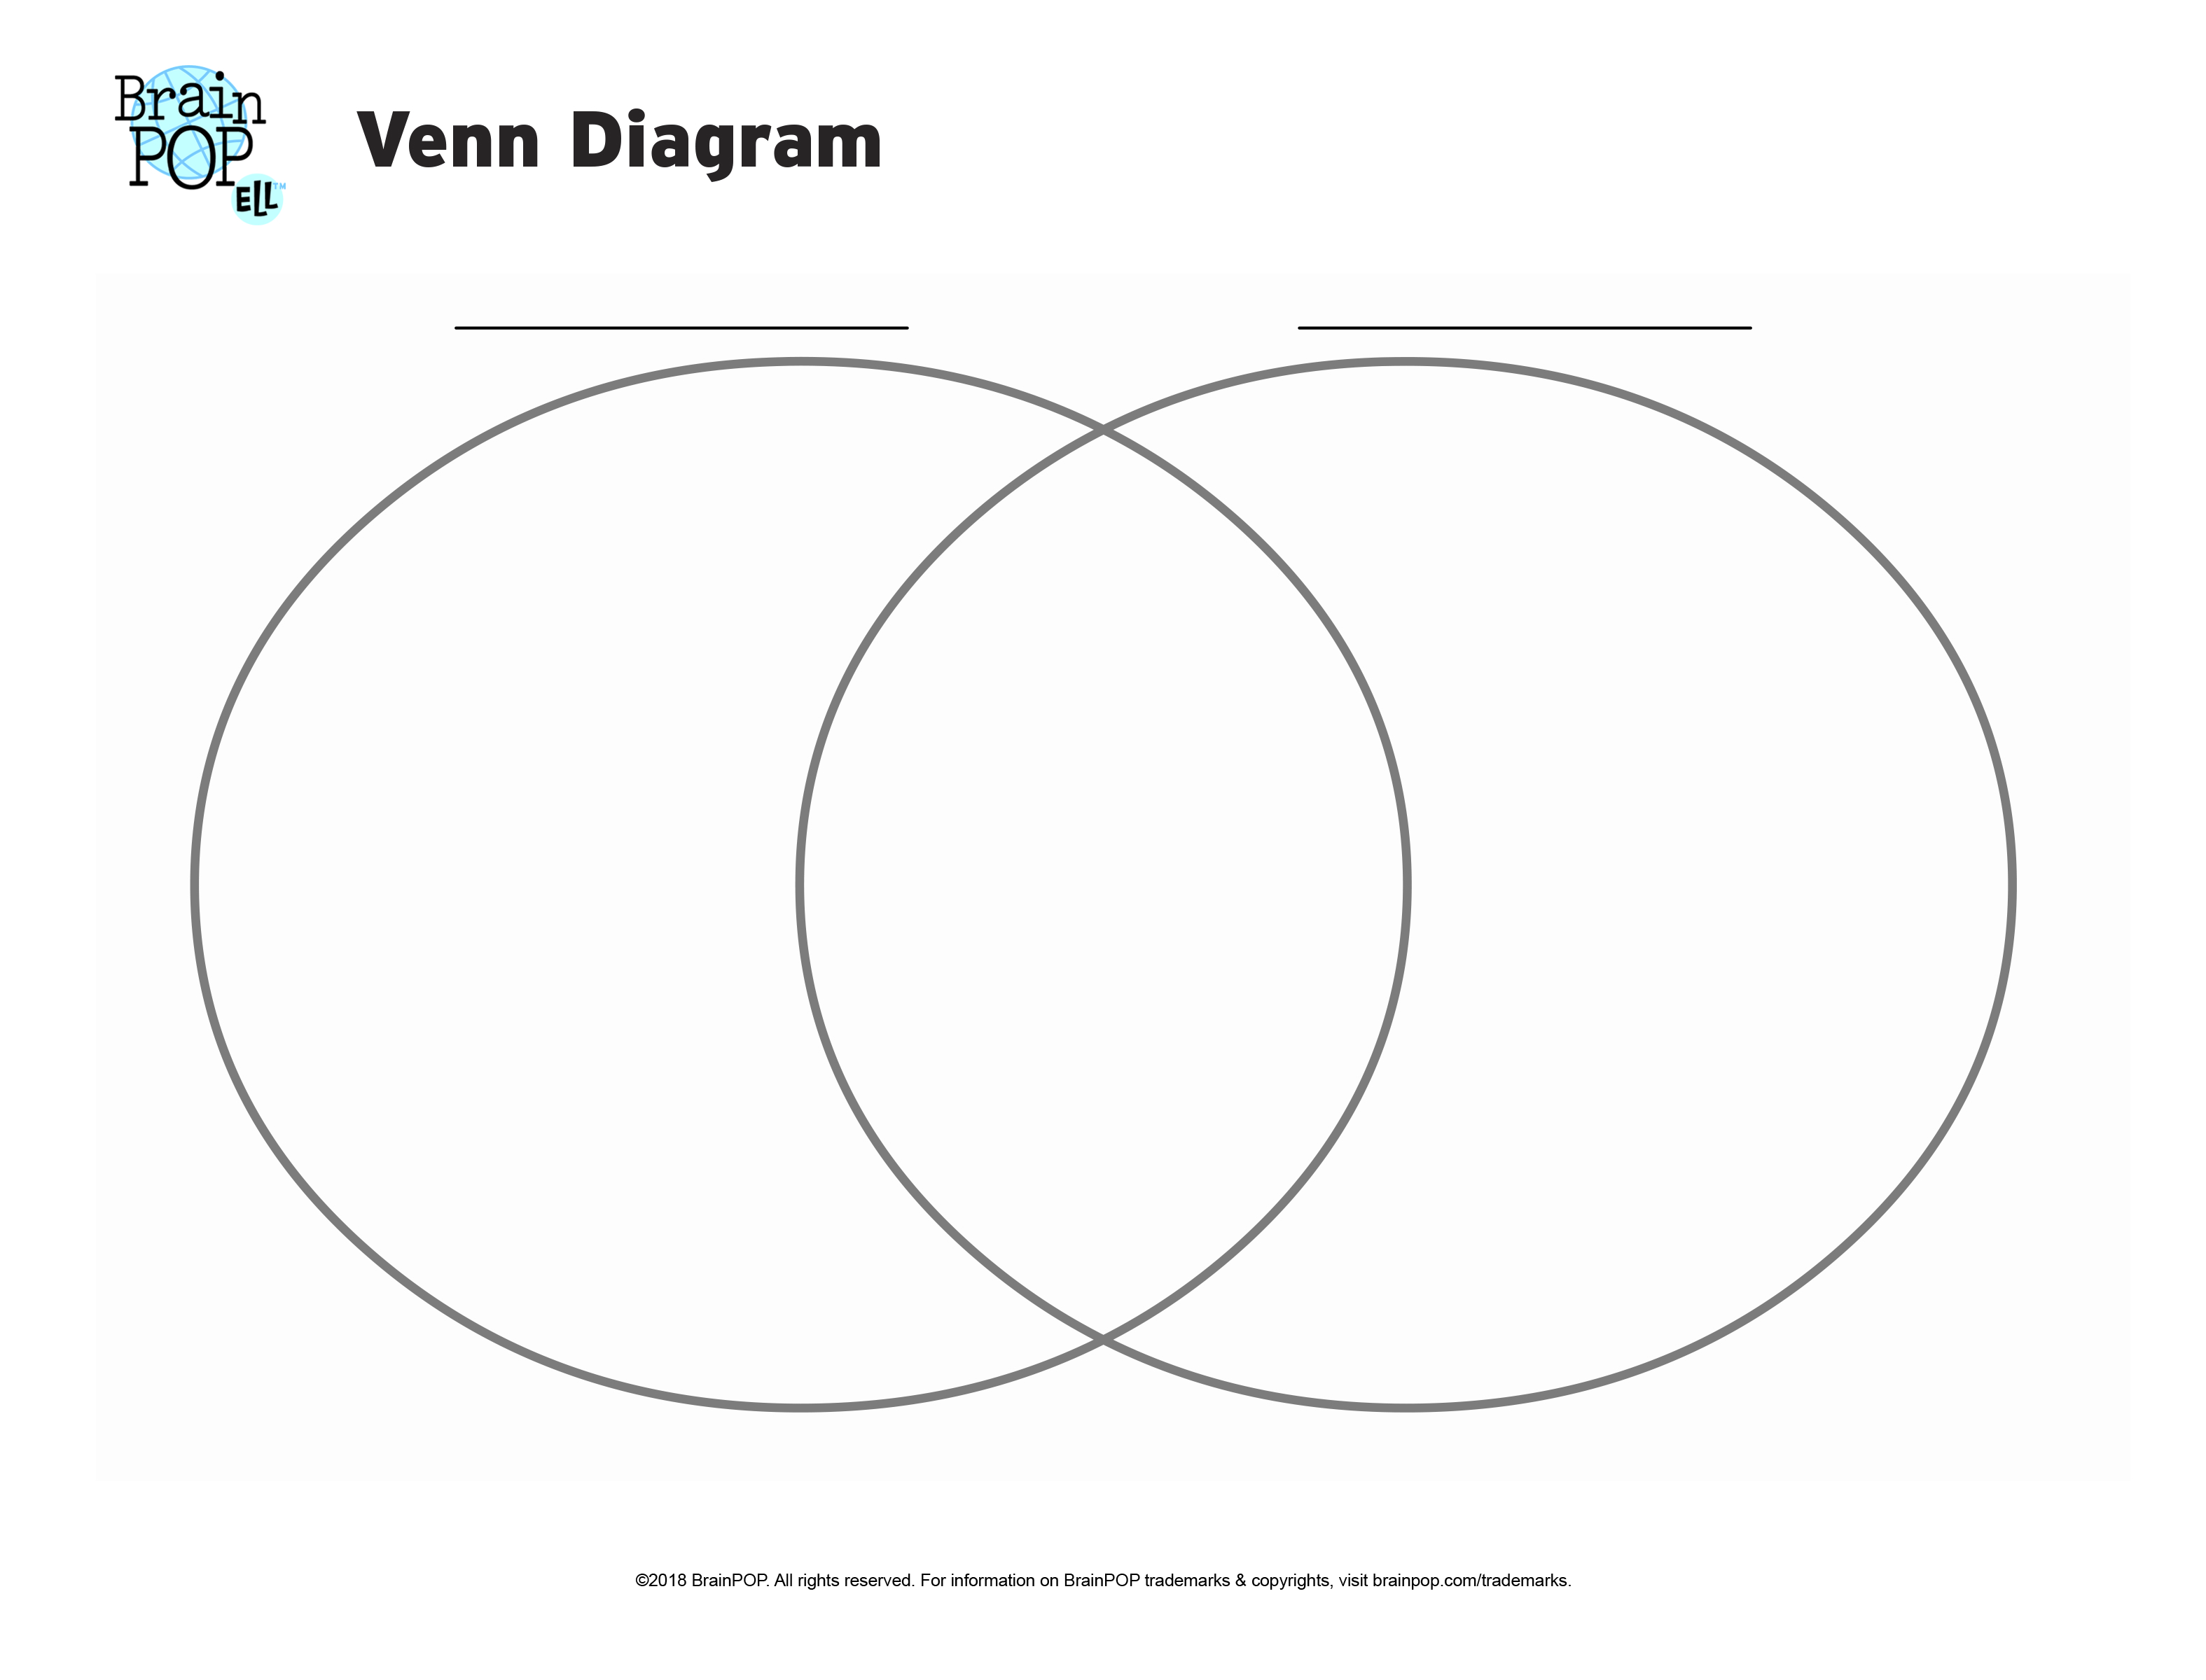
Compare and contrast your favorite two versions of the Three Little Pigs using a venn diagram

Slide 7
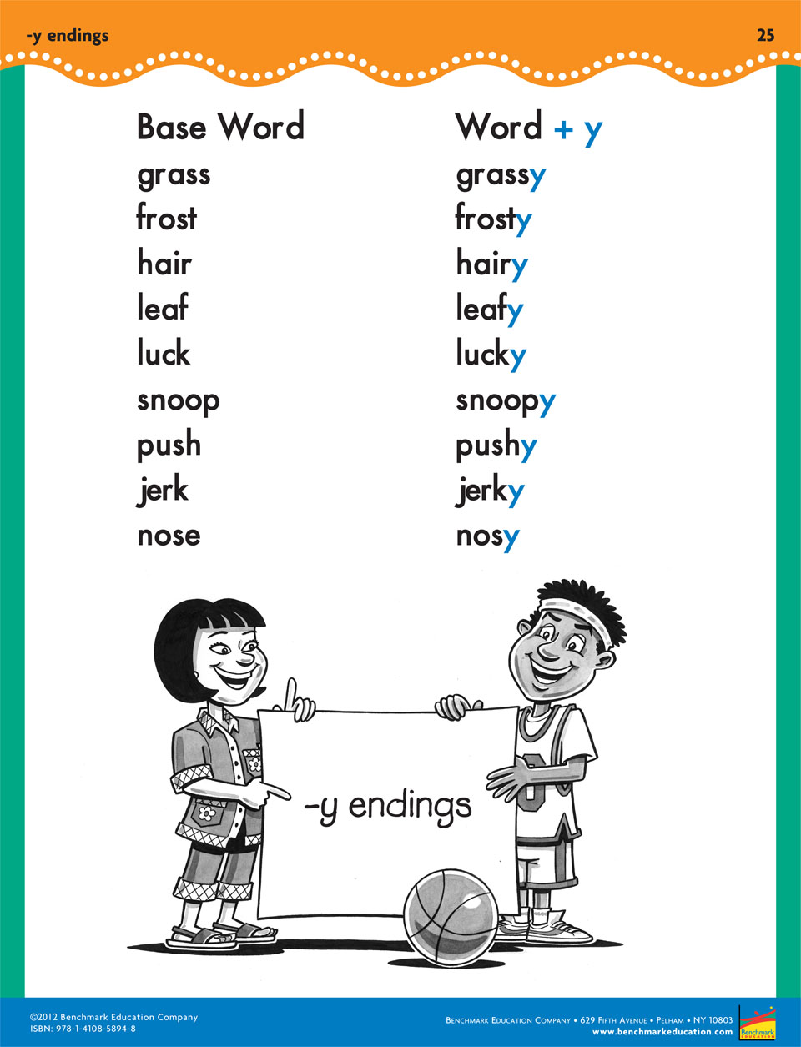
Phonics
Look at the first set of words. The root word of grassy is grass, which is a noun that names something. When we add the "y", we are turning it into a describing word (an adjective). The word grassy can be used to describe a hill covered in grass. Example: We had a picnic on the grassy hill.
As you look at the other words in the poster, try to think of ways you can use the "y" words in sentences.

Slide 8
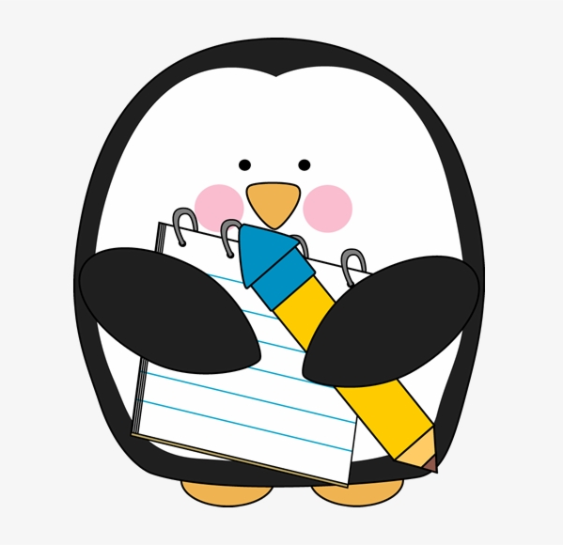
Writing – Narratives!
Writing Personal Narratives! We've done this before, so why not do it again?!
Ok kids, we have written narratives before. So by now we should be pros! Just in case you forgot, there's some reminder videos. Start with steps one and two today from episodes one and two.

Slide 9
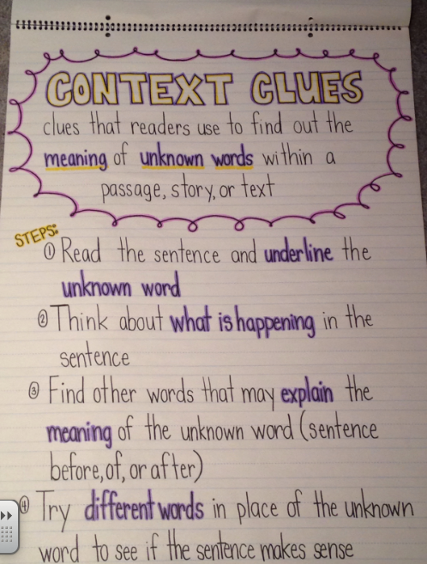
Grammar- Context Clues
Log into Sadlier Connect, Click on the "Common Core Progress 2nd Grade" book and complete the Unit 7 Activity for Determining Word Meanings (first lesson in Unit 7)
Sadlier Login For All Students
Username: SadlierStudent
Password: ReadyToLearn!

Slide 10
Today's Assignments
Complete a double bubble for the two stories you had heard today. Listen to them again if you don't remember them.
Writing- start up a story! Complete the steps from episodes one and two from today's videos. (*Just like in class, put your work where you will find it tomorrow so you can do the steps from episodes three and four.*)
Student Choice – IReady Lesson, 15 minutes of reading, or packet work

Slide 11

Math- Here's math for today
Geometry Lesson
Math Video To Watch

Slide 12
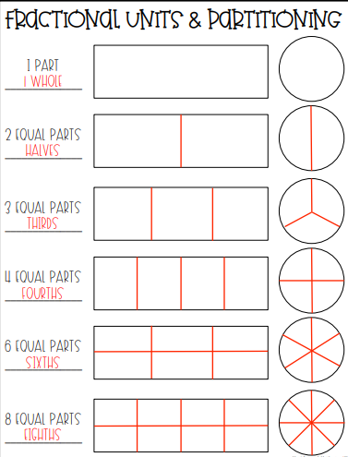
Geometry Lesson
To split a shape into fractions, all parts must be equal (the same size). If a shape is not split into same sized parts, you cannot call them fractions.

Slide 13
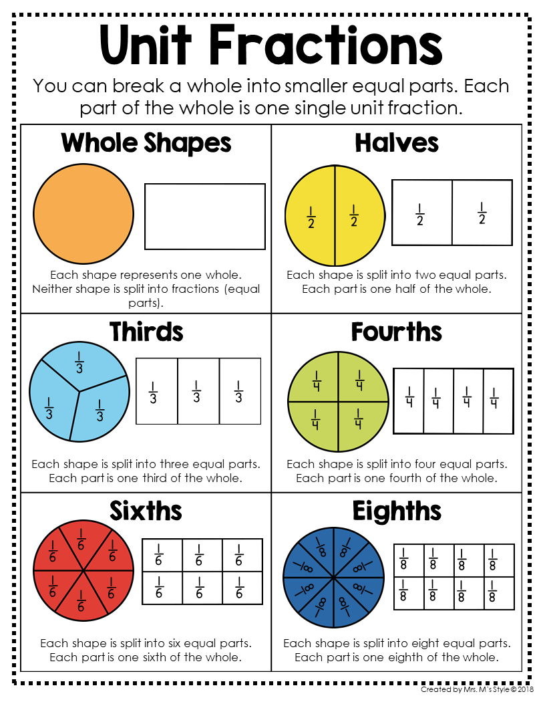
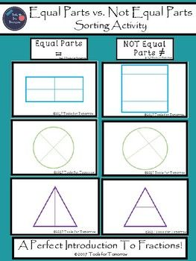
Geometry Lesson

Slide 14
Math Video
Partitioning Shapes Into Equal Parts
Watch this video to understand how equal parts works.
Think of these questions as you're listening
What is a fraction?
What shapes did you get when the rectangle was split into two pieces?
What does the number on the bottom mean when you're writing down a fraction?

Slide 15

Today's Assignments
1. Complete your math review from your packet for today.
2. Remember shapes? Go on a shapes hunt around your house! Look for rectangular prisms, spheres, cones, cylinders, and other shapes. Write down the object and what shape it is on a separate sheet of paper.
3. Student's Choice – Work on a geometry worksheet from your packet or study your math facts using first in math or go over your flash cards
Don't forget to do a I-ready lesson today!

Slide 16
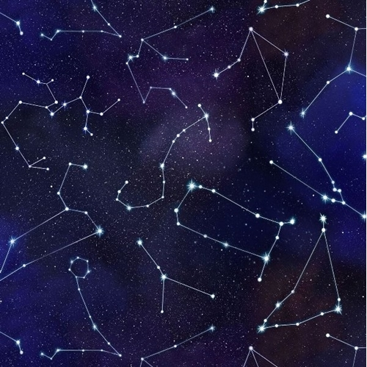
Science
This week's topic is stars and constellations.

Slide 17
Stars
Today We Are Reading About Stars - Read all about them and look at the cool pictures! Then try out the quiz.
(you can make a free account)

Slide 18


Slide 19
Language Arts- Here are the topics we're going to go over today.
Reading
Phonics
Writing
* Grammar free today!*

Slide 20
Reading Skill- Compare and contrast two versions of the same story

Slide 21
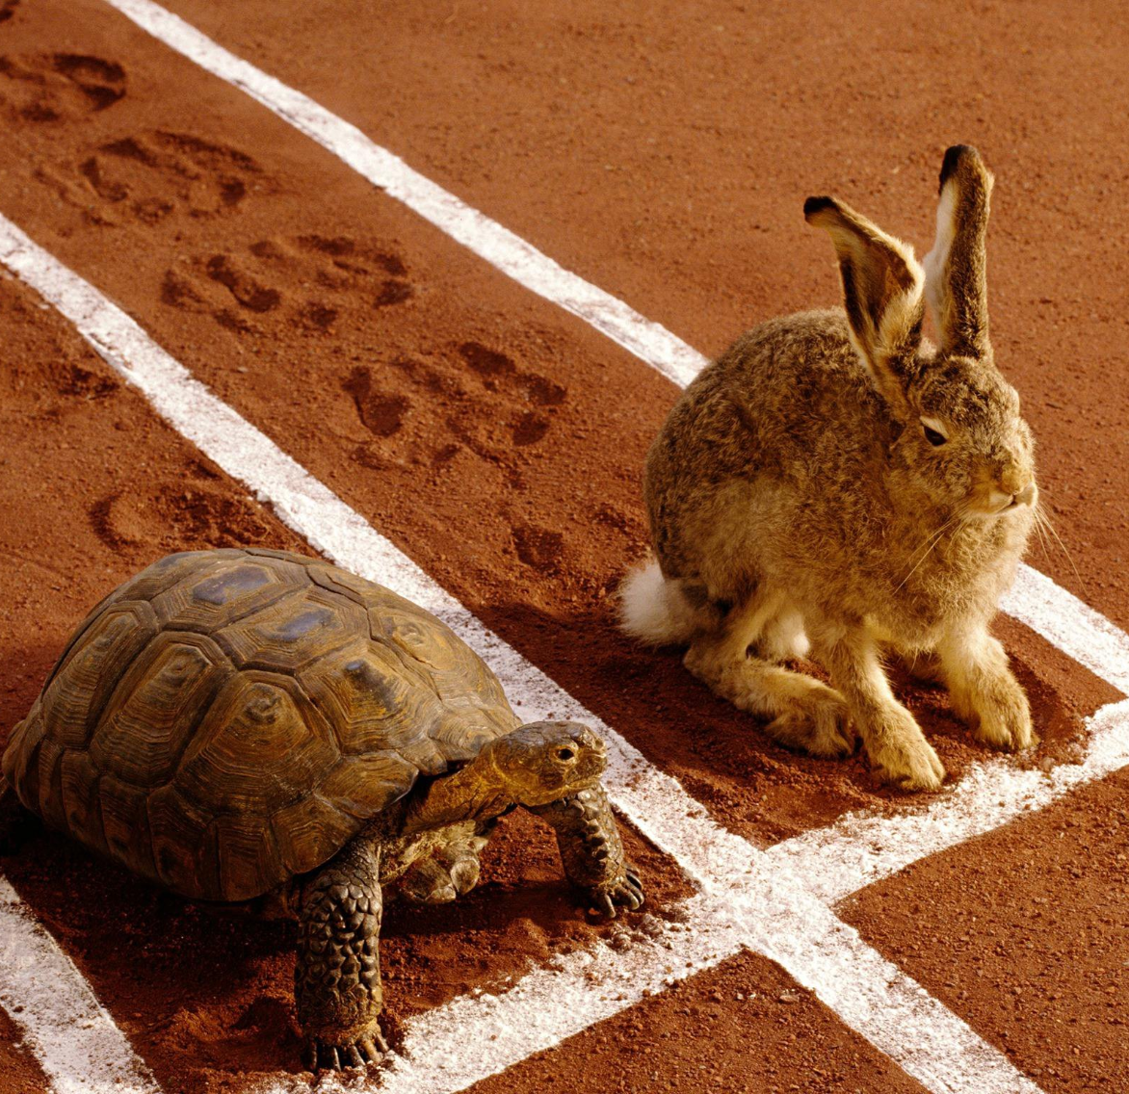
Reading
Listen to these two stories then compare and contrast them using a venn diagram.
The Tortosie and the Hare
The Really Groovy Story of the Tortoise and the Hare
How are the books similar? How are they different?

Slide 22
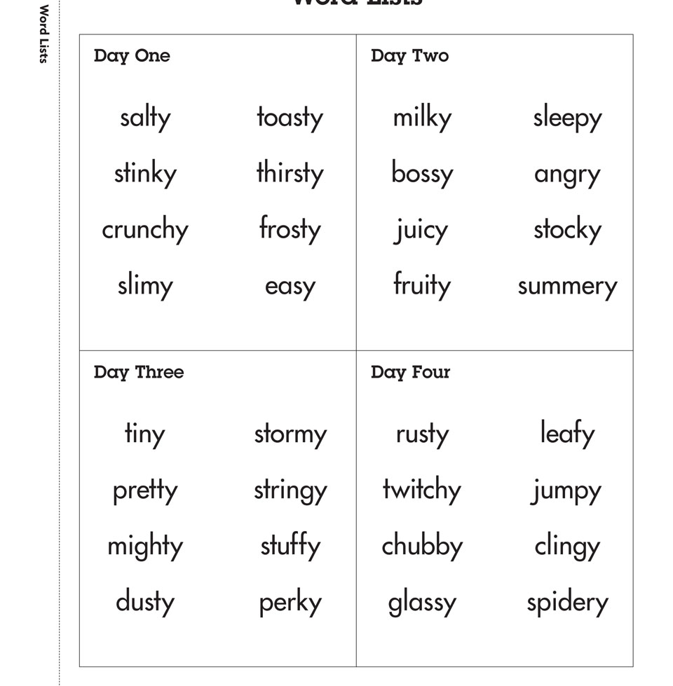
Phonics
Y Ending Video (skip the first 30 seconds for the advertisement)
Practice by reading over these words.
Try using a few in a sentence.

Slide 23
Writing – Narratives!
Continue with your narratives. Watch these videos if you need a review.
Watch episodes 3 and 4, and keep on writing. Remember the important things that you need to have a great narrative: characters, setting, details, and a clear beginning, middle and end.

Slide 24
Today's Assignments
Complete a double bubble for the two stories you had heard today. Listen to them again if you don't remember them.
Writing- Keep on writing! Complete the steps from episodes three and four from today's videos.
Student Choice – IReady Lesson, 15 minutes of reading, or packet work
*Remember to read every day!*

Slide 25
Math- Here's math for today
Geometry Lesson
Math Video To Watch
For review watch the videos
in my section for help
understanding 2d and 3d
shapes section (webpage).

Slide 26
Geometry Lesson
Remember: To split a shape into fractions, all parts must be equal (the same size). If a shape is not split into same sized parts, you cannot call them fractions.

Slide 27
Geometry Lesson
Today's Video

Slide 28
Today's Assignments
1. Complete your math review from your packet for today.
2. Login to Khan Academy and complete a lesson or choose a math worksheet to print out/do on a separate sheet of paper from the I-Ready at home packet. (You can find it on my webpage in the "Free Websites for Extra Practice" section.)
3. Study your flashcards. If you don't have any, you can make some. Or if you have access to launchpad, practice your facts on First in Math.
*Don't forget to be getting your I-Ready minutes this week!*

Slide 29
Science
This week's topic is stars and constellations.

Slide 30
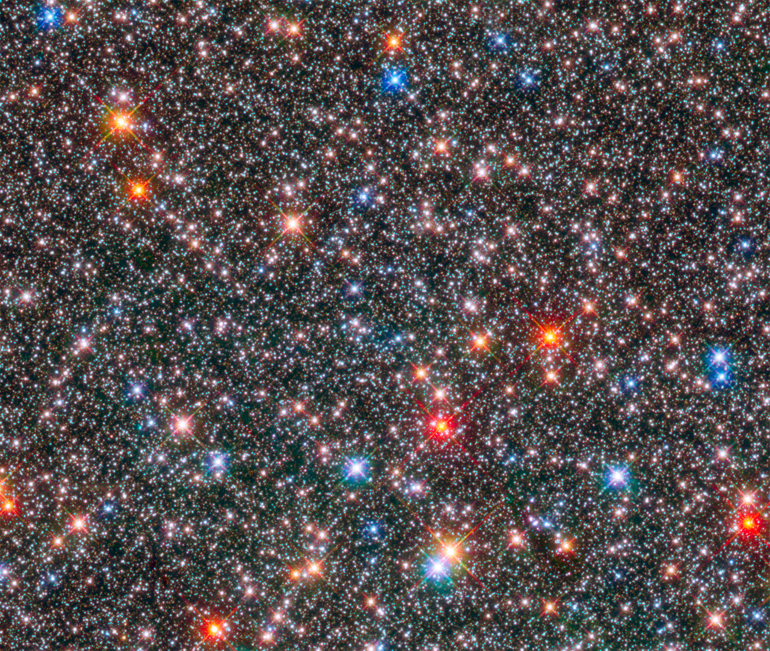
Today's we'll review stars and constellations
Stars and Constellations
As you watch the video, write down 5 new facts about stars and constellations.

Slide 31


Slide 32
Language Arts- Here are the topics we're going to go over today.
Reading
Phonics
Writing
Grammar

Slide 33
Reading Skill- Compare and contrast two versions of the same story

Slide 34
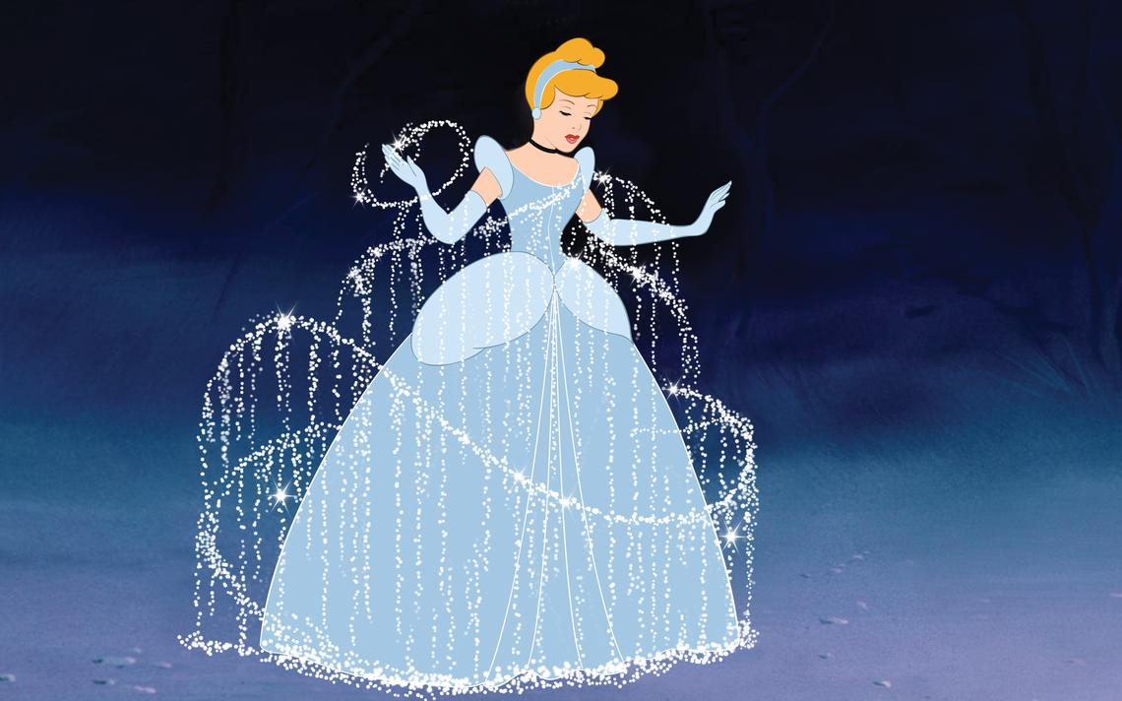
Books of the day!
Disney's Cinderella
Seriously, Cinderella Is So Annoying
How are the books the same? How are the different?

Slide 35
Today's Phonics
We're going to keep it simple today! Try to read some of the words from day two and then put them into sentences!

Slide 36
Writing – Narratives!
Continue writing your narrative. Follow along with the instructions of today's episodes to continue.
Watch episodes 5 and 6, and keep on writing.
And remember....details, details, DETAILS!!!

Slide 37
Grammar- Context Clues
Margie felt timid. She started at a new school where she didn't know anyone. She nervously sat at her seat and quietly waited for new friends to come say hello.
What does timid mean?
Timid means shy.

Slide 38
Today's Assignments
Complete a double bubble for the two stories you had heard today. Listen to them again if you don't remember them.
Writing- Keep on writing! Complete the steps from episodes five and six from today's videos.
IReady Lesson
Packet work
*Remember to read every day!*

Slide 39
Math- Here's math for today
Geometry Lesson
Math Video To Watch
For review, watch the videos
from my partitioning
rectangles section (webpage).

Slide 40
Geometry Lesson
Remember: To split a shape into fractions, all parts must be equal (the same size). If a shape is not split into same sized parts, you cannot call them fractions.

Slide 41
Geometry Lesson
Math Book About Halves!

Slide 42
Today's Assignments
1. Complete your math review from your packet for today.
2. Login to Khan Academy and complete a lesson or choose a math worksheet to print out/do on a separate sheet of paper from the I-Ready at home packet. (You can find it on my webpage in the "Free Websites for Extra Practice" section.)
3. Solve the riddle: What Shape Am I? I have 6 sides, 6 verticies, and 6 angles. If you split me in half, you will have two trapaziods. Who am I?
After you solve this riddle, try to make up one of your own.
*Don't forget to be getting your I-Ready minutes this week!*

Slide 43
Science
This week's topic is stars and constellations.

Slide 44
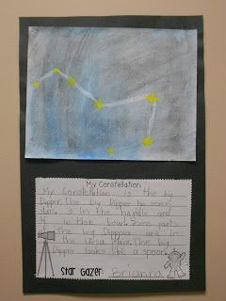
Today's topic is constellations
What is a constellation?
After you watch this video, get your crayons, markers, or whatever art supplies you're allowed to use at home to make a picture of the night sky. In your picture make a constellation and make up story about it. Look to the left to see an example of a picture you can make (but not copy).

Slide 45


Slide 46
Language Arts- Here are the topics we're going to go over today.
Reading
Phonics
Writing
Grammar

Slide 47
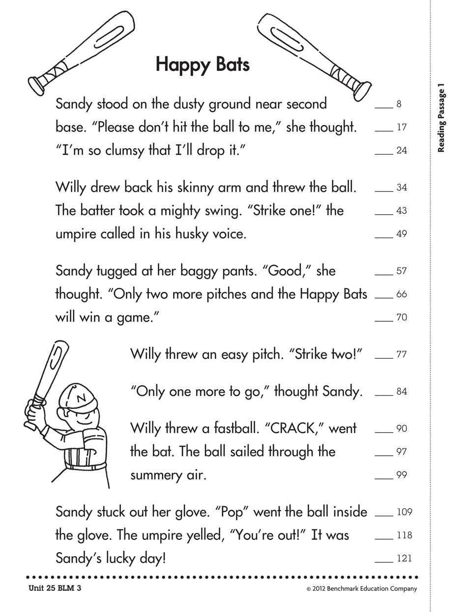
Phonics!
Try to find all the words that y steals e's long sound!

Slide 48
Reading Skill- Compare and contrast two versions of the same story

Slide 49
Writing – Narratives!
Continue writing your narrative. Follow along with the instructions of today's episodes to continue.
Watch episodes 7 and 8, and keep on writing.
And remember....details, details, DETAILS!!!

Slide 50
Grammar- Context Clues
Keeping it simple today!
Flocabulary Video About Context Clues

Slide 51
Today's Assignments
Complete a double bubble for the two stories you had heard today. Listen to them again if you don't remember them.
Writing- Keep on writing! Complete the steps from episodes seven and eight from today's videos.
IReady Lesson
Packet work
*Remember to read every day!*

Slide 52
Math- Here's math for today
Geometry Lesson
Math Video To Watch

Slide 53
Geometry Lesson
Thursday's Math Video

Slide 54
Today's Assignments
1. Complete your math review from your packet for today.
2. Login to Khan Academy and complete a lesson or choose a math worksheet to print out/do on a separate sheet of paper from the I-Ready at home packet. (You can find it on my webpage in the "Free Websites for Extra Practice" section.)
*Don't forget to be getting your I-Ready minutes this week!*

Slide 55
Science
Keeping science simple today by continuing your assignments from your packets. If you have already finished all your science work, here's an outer space Bill Nye video to watch.
Bill Nye- Outer Space

Slide 56


Slide 57
Alright Kids! Welcome to Fun Friday!!
As you all know Friday is usually our test day. So here's what I would like from you:
I challenge you to complete your narrative for this week, your math review for today, and an I-Ready lesson or a book if you cannot get on I-Ready.
Now for the fun part of this fun friday; earlier this week we read two versions of Cinderella. Today your assignment is to watch the Cinderella movie and compare the movie to the book. If you don't have access to the movie, you can watch The Little Mermaid and listen to the story or The Beauty and The Beast and listen to the story.
Of if you don't have access to any of those movies, here are two links for a cartoon of The Three Little Pigs to compare to your story from Monday.
Disney 3 Little Pigs
Looney Tunes 3 Little Pigs

