Slide 1
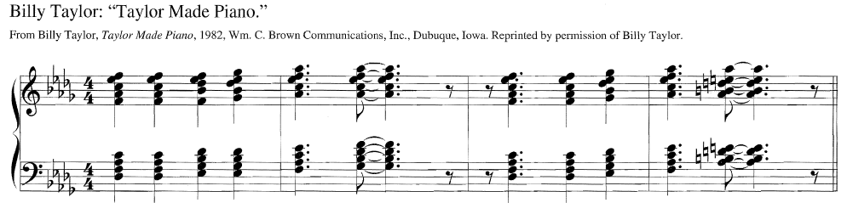
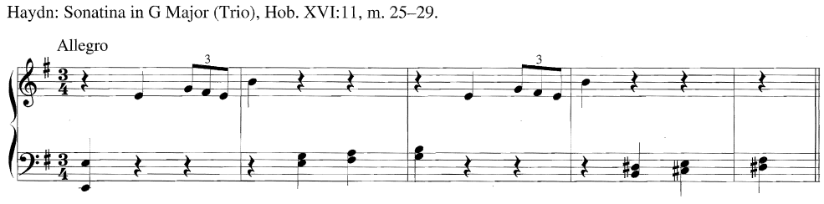
Texture
The way melody, harmony, and rhythm are woven together.
How dense?
Thick
Thin

Slide 2
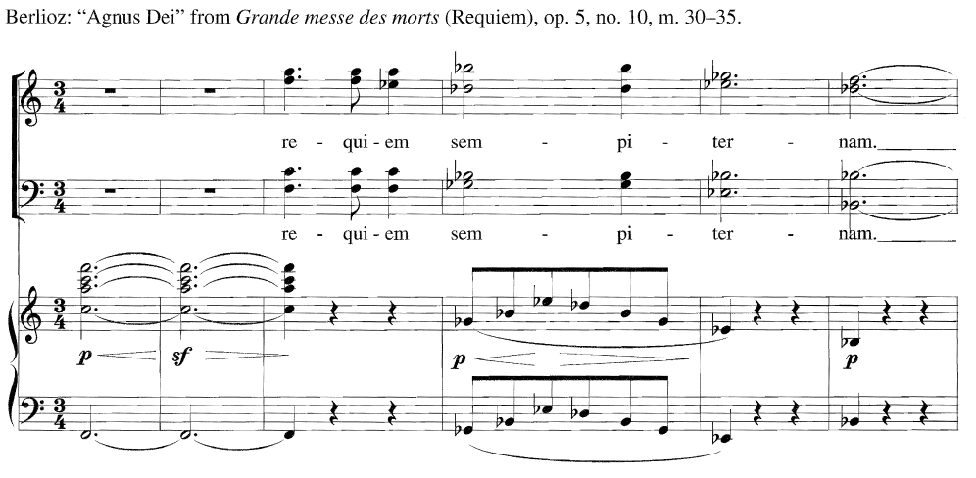
Range
Distance between the highest and lowest intervals.
Wide

Slide 3
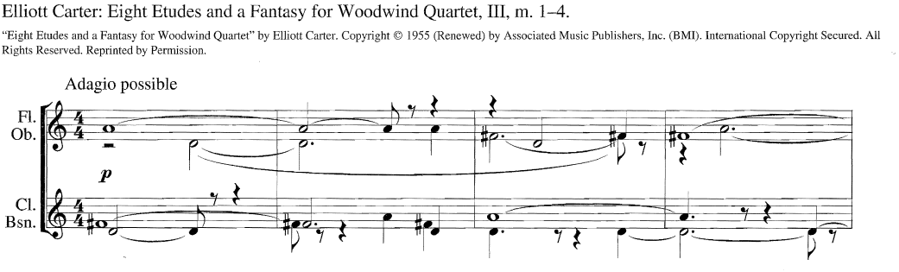
Range
Distance between the highest and lowest intervals.
Narrow

Slide 4
Types of Texture
Monophonic
Single melodic line.
Polyphonic
Homophonic
Chordal
Heterophonic

Slide 5
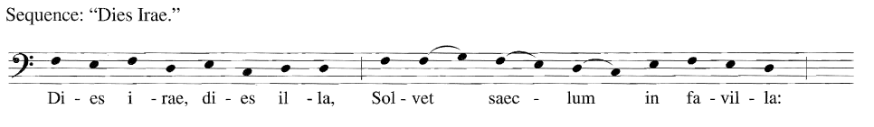
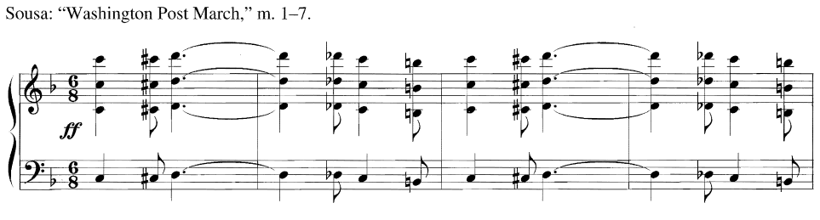
Types of Texture
Monophonic
Single melodic line.

Slide 6
Types of Texture
Monophonic
Single melodic line.
Polyphonic
Two or more lines moving independently of each other, or in imitation.
Polyphonic
Chordal
Heterophonic

Slide 7
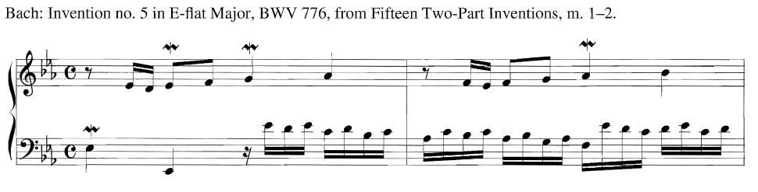
Types of Texture
Polyphonic
Two or more lines moving independently of each other, or in imitation.

Slide 8
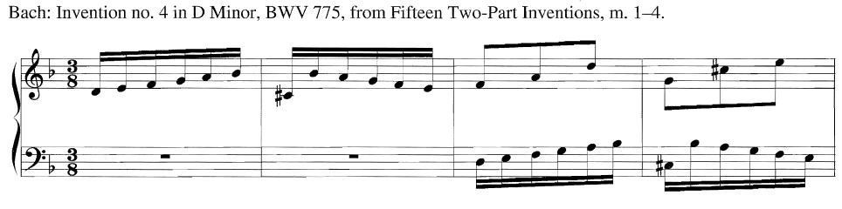
Types of Texture
Polyphonic
Two or more lines moving independently of each other, or in imitation.

Slide 9
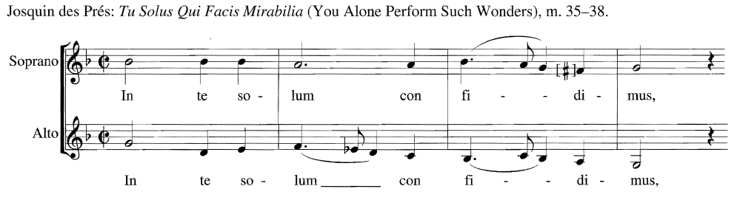
Types of Texture
Polyphonic
Two or more lines moving independently of each other, or in imitation.

Slide 10
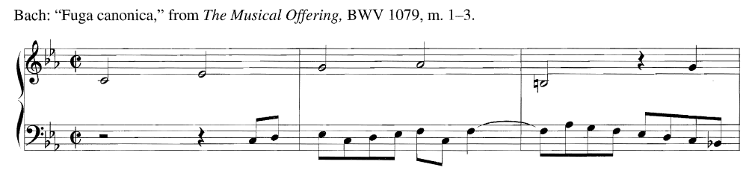
Types of Texture
Polyphonic
Two or more lines moving independently of each other, or in imitation.

Slide 11
Types of Texture
Monophonic
Single melodic line.
Polyphonic
Two or more lines moving independently of each other, or in imitation.
Melody and accompaniment. Accompaniment = rhythmic & harmonic support.
Homophonic
Chordal
Heterophonic

Slide 12
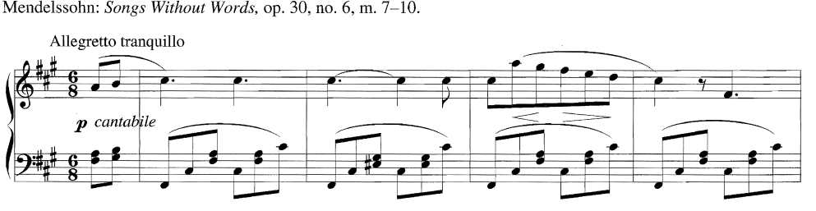
Types of Texture
Melody and accompaniment. Accompaniment = rhythmic & harmonic support.
Homophonic

Slide 13
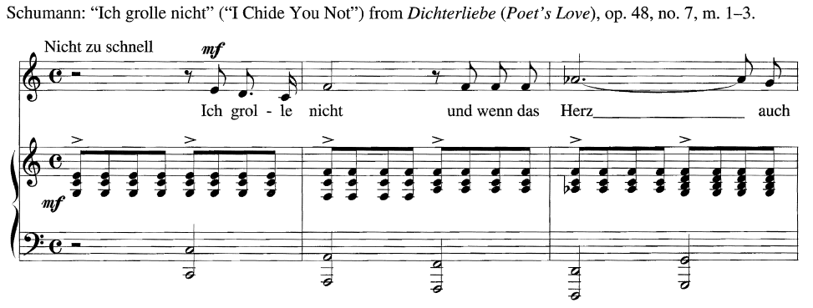
Types of Texture
Melody and accompaniment. Accompaniment = rhythmic & harmonic support.
Homophonic

Slide 14
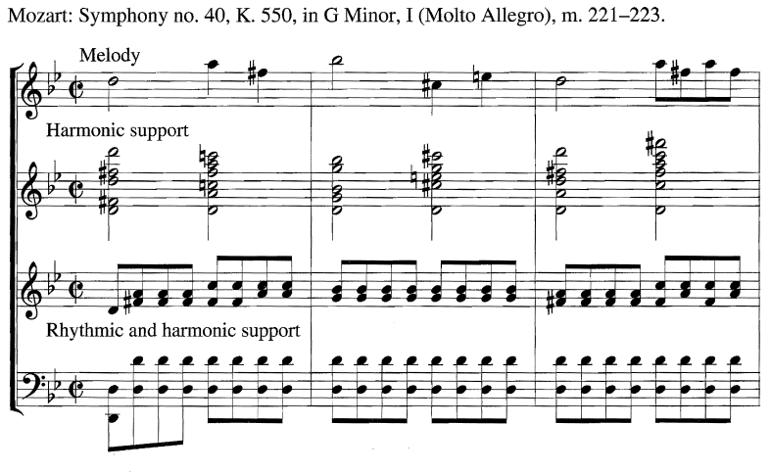
Types of Texture
Melody and accompaniment. Accompaniment = rhythmic & harmonic support.
Homophonic

Slide 15
Types of Texture
Monophonic
Single melodic line.
Polyphonic
Two or more lines moving independently of each other, or in imitation.
Melody and accompaniment. Accompaniment = rhythmic & harmonic support.
Homophonic
Also homorhythmic – similar rhythm in all parts. Hymnic, may not have melody
Chordal
Heterophonic

Slide 16
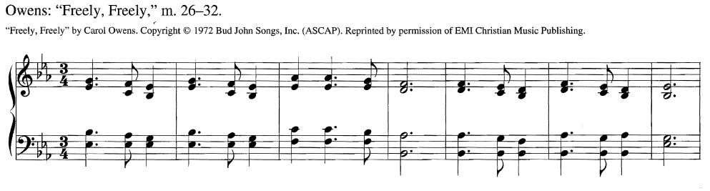
Types of Texture
Also homorhythmic – similar rhythm in all parts. Hymnic, may not have melody
Chordal

Slide 17
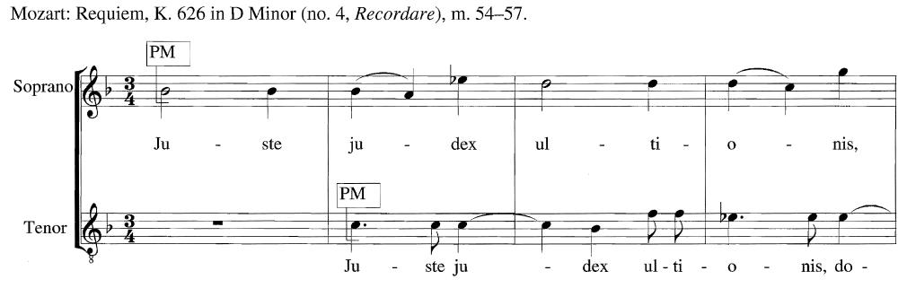
Textual Elements
Primary Melody (PM)
Most important melodic line(s) in a piece of music.
Homophonic – usually one
Polyphonic – may be more than one

Slide 18
Types of Texture
Monophonic
Single melodic line.
Polyphonic
Two or more lines moving independently of each other, or in imitation.
Melody and accompaniment. Accompaniment = rhythmic & harmonic support.
Homophonic
Also homorhythmic – similar rhythm in all parts. Hymnic, may not have melody
Chordal
Heterophonic
Single melodic line, multiple variations at same time.

Slide 19
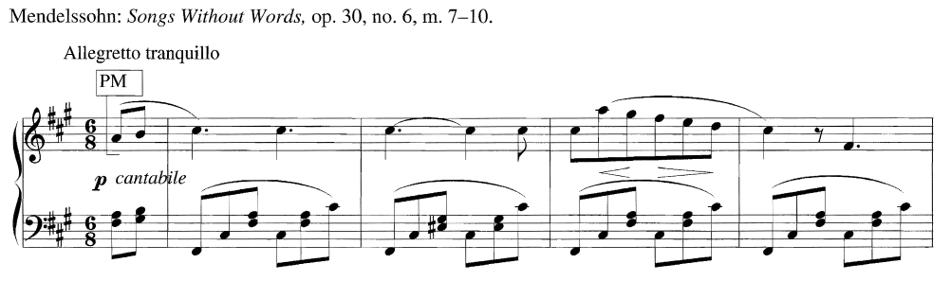
Textual Elements
Primary Melody (PM)
Most important melodic line(s) in a piece of music.
Homophonic – usually one
Polyphonic – may be more than one

Slide 20
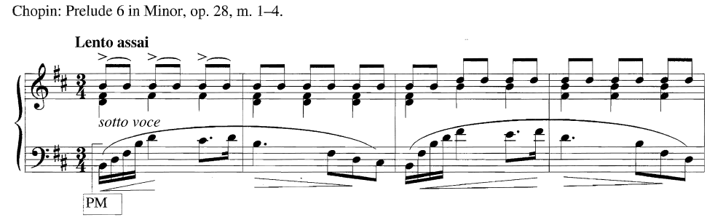
Textual Elements
Primary Melody (PM)
Most important melodic line(s) in a piece of music.
Homophonic – usually one
Polyphonic – may be more than one

Slide 21
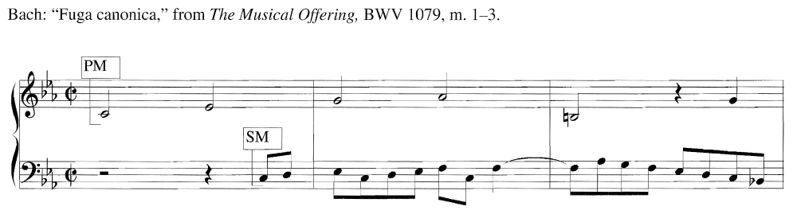
Textual Elements
Secondary Melody (SM)
A melodic line that is not as important as the PM.

Slide 22
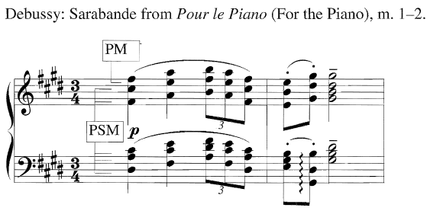
Textual Elements
Parallel Supporting Melody (PSM)
Melodies similar in contour to PM, often keep a parallel interval relationship.

Slide 23
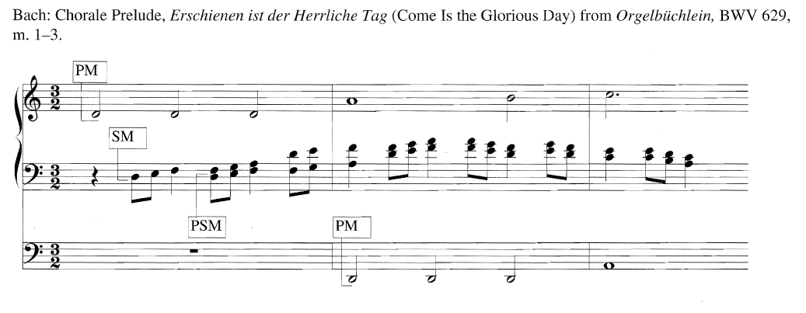
Textual Elements
Parallel Supporting Melody (PSM)
Melodies similar in contour to PM, often keep a parallel interval relationship.

Slide 24
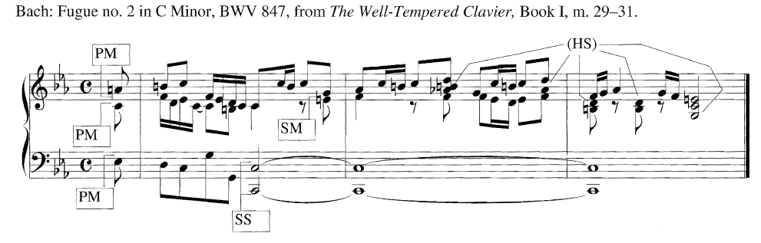
Textual Elements
Static Supports (SS)
Sustained chords, pedal tones, repeated melodic or rhythmic figures.

Slide 25
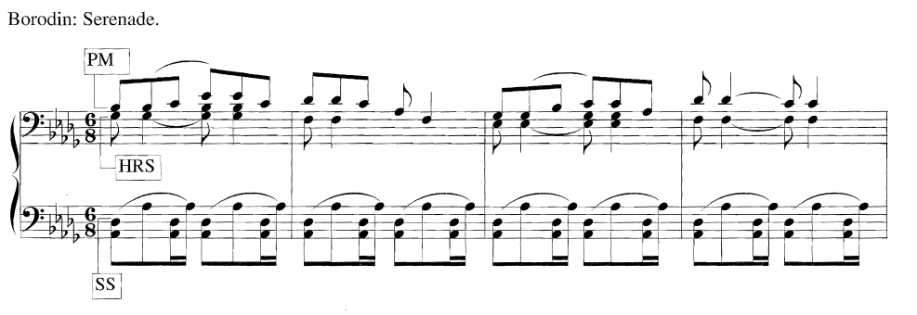
Textual Elements
Static Supports (SS)
Sustained chords, pedal tones, repeated melodic or rhythmic figures.

Slide 26
Textual Elements
Harmonic and Rhythmic Support (HS, RS, HRS)
Textural elements that support the melody rhythmically, harmonically, or both.

Slide 27
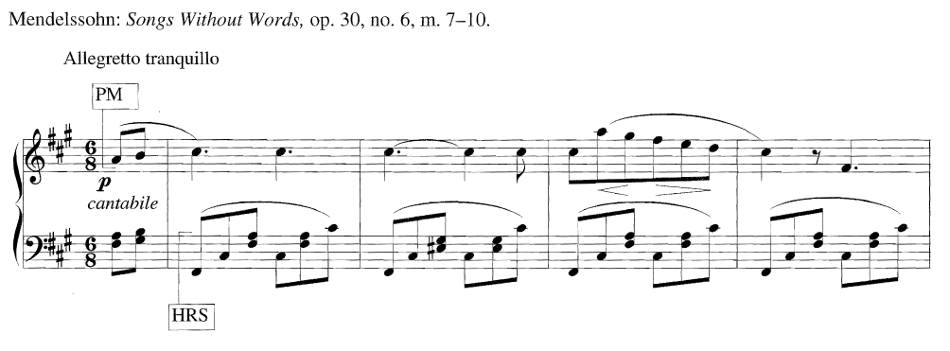
Textual Elements
Harmonic and Rhythmic Support (HS, RS, HRS)
Textural elements that support the melody rhythmically, harmonically, or both.

Slide 28
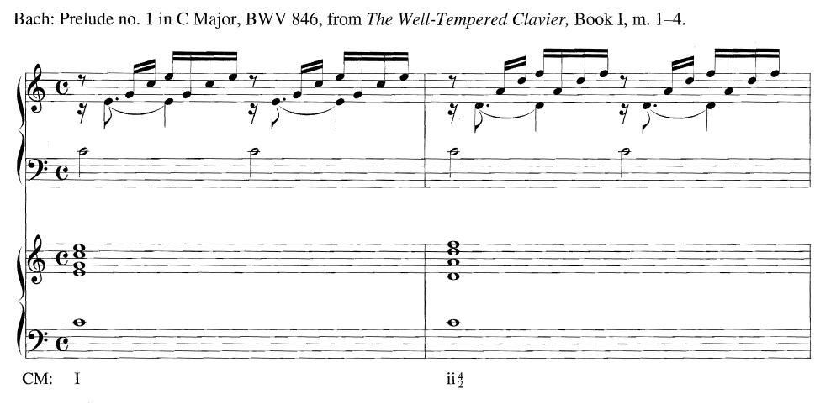
Textual Reduction

Slide 29
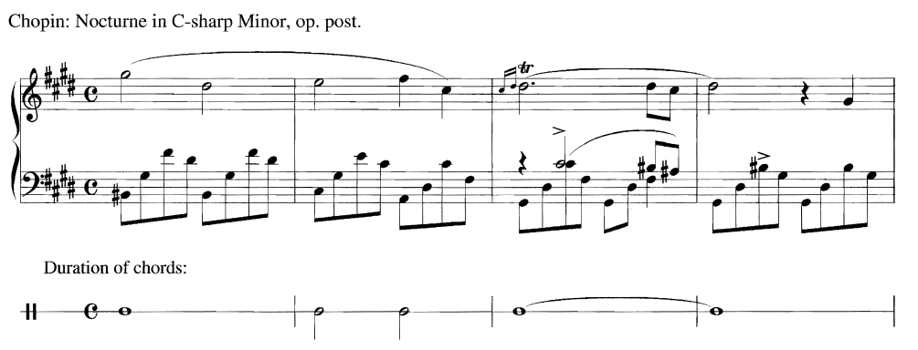
Textual Reduction

Slide 30
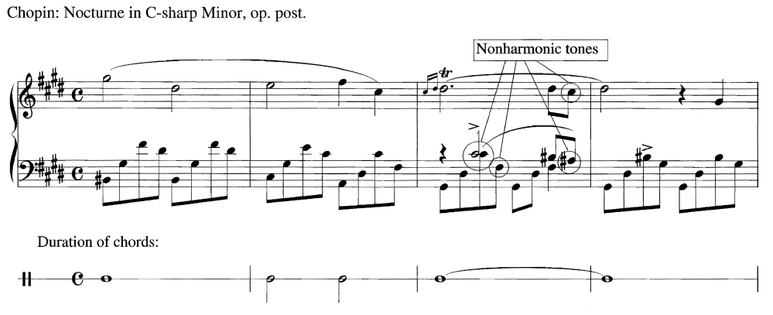
Textual Reduction

Slide 31
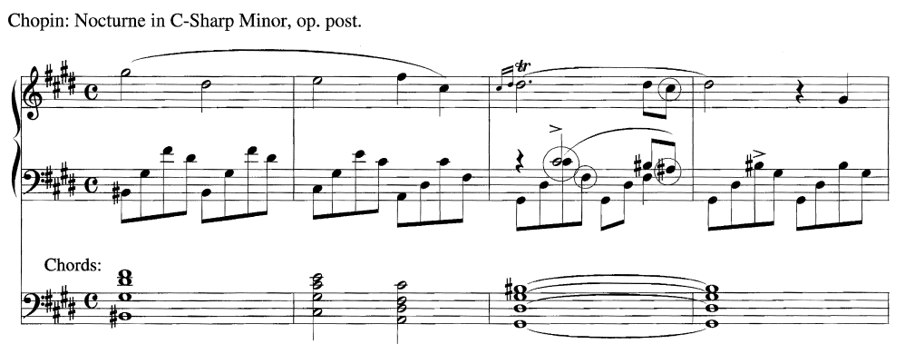
Textual Reduction

