Slide 1
August 8, 2019
Take out some paper for note-taking.
“Have you ever taken a photo of a friend and it came out badly?”

Slide 2
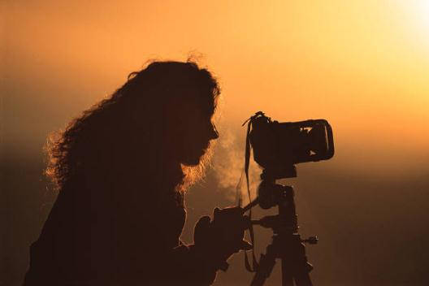
Camera Basics
Using a Camera

Slide 3
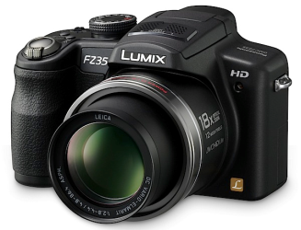
Types of Cameras
Still Cameras
Fixed Lens Cameras
Lens is not interchangeable (removable)
Variable zoom, controlled by servo controller
User friendly, less manual
features
Less expensive (<$500)

Slide 4
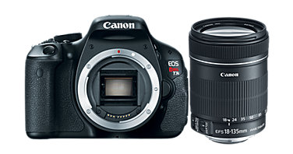
Types of Cameras
Still Cameras
Single Lens Reflex (SLR)/Digital SLR
Lens is interchangeable (removable)
Professional quality, more manual features
More expensive ($500+)
Lenses often sold separately

Slide 5
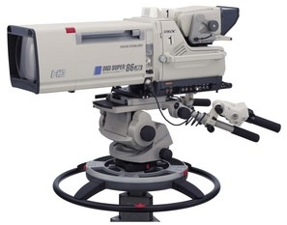
Types of Cameras
Video Cameras
Studio Camera
Designed for studio use only
Very expensive ($50,000+)
Very high quality
Not used to record audio
No built-in recorder
Camera Control Unit separate
Color balance, iris and other controls not adjusted on camera
Heavy and difficult to transport
Requires a pedestal mount

Slide 6
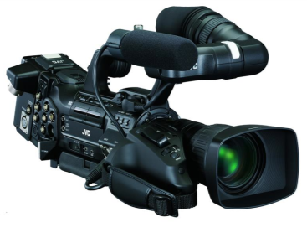
Types of Cameras
Video Cameras
Camcorder
Used for field production (outside studio)
Portable and durable
Records to tape, card, or built-in hard drive
Records audio
Built-in microphone
High quality audio inputs
Various types of camcorders
Professional (ENG) – ($10,000+)
Consumer – ($300+)
Prosumer – ($3000-10,000)

Slide 7
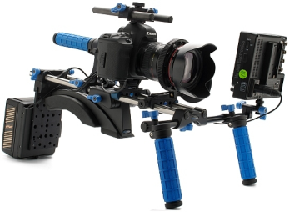
Types of Cameras
HDSLR Cameras
Growing popularity of using DSLR cameras for shooting HD video
Lens is interchangeable (removable)
Lenses give more cinematic look
Cameras often shoot multiple frame rates
Requires more accessories
for quality video capture
Audio capture (microphone)
Mounting device (video rig)
Follow focus
External video screen

Slide 8
August 9, 2019
Take out some paper for note-taking.
Warm up:
Name the types of cameras we discussed yesterday. Give an example of each.

Slide 9
Resolution
Digital images are made up of pixels
The more pixels, the higher quality the image
Higher resolution images take up more digital space on the storage device (memory card, videotape, hard drive, etc.)
Measured in pixel columns by pixel rows
640x480 – analog standard definition video
1920x1080 – high definition (HD) video
2048x1536 – 3,145,728 pixels (3.1 megapixels)
DPI – dots per inch
Measures the density of dots per inch in a digital print
The higher the dpi, the better quality the print
Examples: 72, 96, 150, 300 dpi
Images for print should be created at 300 dpi, text at 400 dpi

Slide 10
Resolution
72 dpi
300 dpi

Slide 11
Camera Controls
Cameras have a number of different functions.
Some settings are found only on still cameras, some on video cameras or some on both
The following controls may be automatically or manually adjusted
Manual means the operator adjusts the camera
Automatic means the camera selects the best setting for the given conditions.

Slide 12
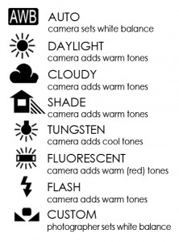
Camera Controls
White balance (still and video cameras)
Gives the camera a “true white”, adjusting all other colors accordingly.
As lighting changes from one location to another, WB should be adjusted
May have multiple modes for white balance
Auto WB
Indoor WB
Outdoor WB
Manual (custom) WB
When in manual mode the symbol often blinks when it needs setting and is solid when WB is set
Manually set WB by zooming in or focusing on a white surface
“white balance” icons on
many still cameras

Slide 13
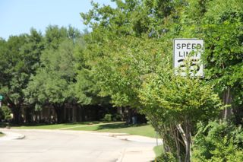
White Balance
The picture (right) shows an outdoor scene with indoor white balance settings. (Note the blue tint)
The picture (left) shows an outdoor scene with proper outdoor white balance settings.

Slide 14
Camera Controls
ISO aka “Film Speed” (still cameras)
Determines how sensitive the camera’s image sensor is to light
The lower the ISO, the slower the speed
Lower ISO when possible
High ISO results in more grainy photos
Common ISOs are 100, 200, 400 and 800
ISO setting recommendations
100-200: outdoors, sunny conditions
400-800: outdoors, cloudy conditions
1600: night time, low light

Slide 15
Camera Controls
Iris (still and video cameras)
The iris controls the amount of light entering into the lens
The lower the light conditions, the wider the aperture (opening) should be
Iris is measured in f-stops
f/1.4, f/2, f/2.8
As f-stop numbers get larger, the aperture gets smaller (and vice-versa)

Slide 16
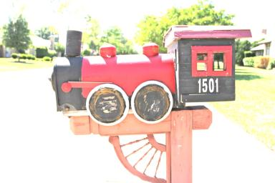
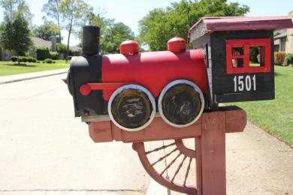
Iris
The picture (right) shows an outdoor scene with an improper iris setting.
The picture (left) shows an outdoor scene with a proper iris setting.

Slide 17
Camera Controls
Shutter speed (still and video cameras)
Allows for shooting of fast moving objects without blurring
The faster the subject, the faster the speed
Measured in fractions of a second
1/60 (of a second) – slow shutter
1/2,000 - fast shutter
The faster the shutter speed, the less light the camera lens allows in

Slide 18
August 12, 2019
Warm-up:
Why is it important to ‘white balance’?
What is the purpose of the iris?

Slide 19
Shutter Speed
The difference between these two photographs is shutter speed. The bottom photo shows a faster shutter speed than the top. The pinwheel (which is moving) is clear and seems to be frozen in mid-air.

Slide 20
Camera Controls
Gain (video cameras)
Boosts the video signal in low light conditions.
Gain affects resolution.
Gain creates “video noise”
The higher the gain, the lower the resolution.
Gain is measured in decibels
+6 dB, +9 dB, +12 dB

Slide 21
Gain
The picture below shows how boosting the gain gives the appearance of more light, but adds video noise, making it look “grainy”.

Slide 22
Camera Controls
ND Filter (Neutral Density Filter)
Filters out bright sunlight to avoid overexposure
May be a camera setting (video)
May be an actual filter placed on the front of the lens (photo)

Slide 23
Camera Controls
Focal Length
Distance from lens to imaging sensor
Determines the picture’s angle of view (magnification)
As focal length increases
Angle of view becomes more narrow
Less elements are visible
Zoom (increase in focal length)
May be controlled with the servo zoom control on the camera or by manipulating the lens (DSLR)
Zoom may be measured in millimeters (photography) or “power” (video)

Slide 24
Camera Controls
Optical zoom – focal length changes
No quality loss when going wide to narrow
Digital zoom – focal length doesn’t change, the camera enlarges the image
Pixels are enlarged
Loss of quality
To determine optical zoom power, divide the zoom setting by the widest setting, ie 500mm/50mm = 10x
If a lens has a zoom range of 18mm – 270mm…
18-35mm (1-2x ) = wide angle
36-70mm ( 3-4x) = normal angle
135-270mm (7-15x) = telephoto

Slide 25
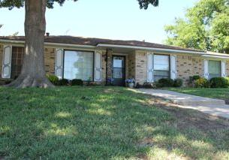
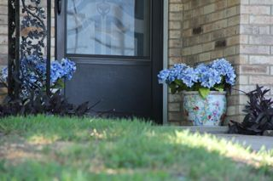
Zoom
The photos below show the difference between optical zoom (left) and digital zoom (right). Notice the pixilation on the digital zoom.
Wide Angle (no zoom)
Optical Zoom (approx. 7x)
Digital Zoom

Slide 26
August 13, 2019
Warm-up:
What is the difference between ‘optical zoom’ and ‘digital zoom’?

Slide 27
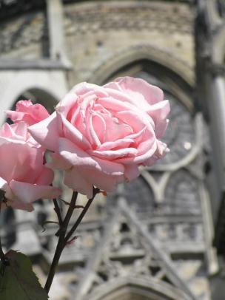
Camera Controls
Focus (both still and video)
Sharpness or clarity of an image
Manually adjusted with the focus ring located on lens
Selective focus
Creates variety, interest and emphasis in the shot
Must be zoomed in (the farther, the more dramatic)
Must have significant distance between foreground and background
Rack focus
Focus is shifted while recording video
In selective focus, we have a foreground subject in focus (rose) and a subject in the background (church) out of focus.

Slide 28
Camera Controls
Focus (cont.)
MOD – minimum object distance
This is the point at which a lens is too close to the subject to focus
MOD can be decreased (ie from six inches to three inches) with a macro, allowing the camera to focus at a closer distance
Macro may be a lens attachment or a setting on the camera
“macro” icon on many
still cameras

Slide 29
Camera Controls
This picture was taken with macro settings. Notice the contrast in focus between the foreground (close to the camera) and background.

Slide 30
Basic Camera Care
Handle the camera with care
Do not point the lens at the sun, bright lights or bright reflections for an extended period of time
Do not clean the camera or the lens with solvents, liquids, or chemicals
Use clean, dry cloth for camera; lens cloth for lenses
Do not touch a camera lens
Keep covered when not in use
Do not operate or store equipment in extreme temperatures or weather

