Slide 1
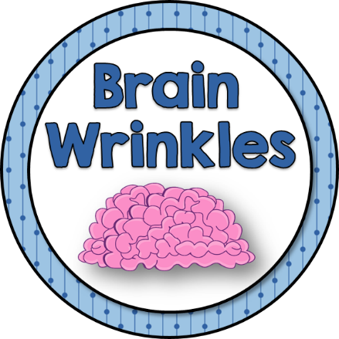
Australia’s
Government
A Federal Parliamentary Democracy
© 2014 Brain Wrinkles

Slide 2
Standards
SS6CG6 The student will compare and contrast various forms of government.
a. Describe the ways government systems distribute power: unitary, confederation, and federal.
b. Explain how governments determine citizen participation: autocratic, oligarchic, and democratic.
c. Describe the two predominant forms of democratic governments: parliamentary and presidential.
SS6CG7 The student will explain the structure of the national government of Australia.
a. Describe the federal parliamentary democracy of Australia, distinguishing form of leadership, type of legislature, and the role of the citizen in terms of voting and personal freedoms.
© 2014 Brain Wrinkles

Slide 3
Teachers
Print off the following slide for each student.
Have the students glue (or tape) the left side, “Australia’s Government” to their Interactive Notebook. They will cut along the lines of the right side (between each topic) so that they are flaps.
The students will write facts/definitions inside of each flap while discussing the presentation.
© 2014 Brain Wrinkles

Slide 4
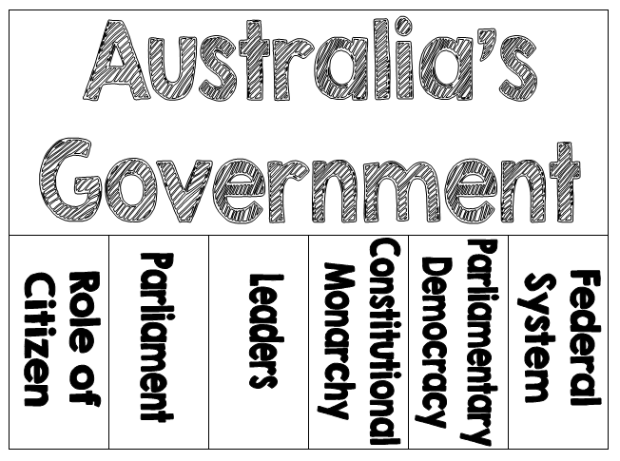
© 2014 Brain Wrinkles

Slide 5
Teachers
Print off the following slide for each student.
Have the students complete the Anticipation Guide BEFORE the presentation to gauge what they already know about Australia’s government.
*There are also economic-related questions in this guide, but the notes in this presentation are government-related only. I have an “Australia’s Economy” file in my store if you’re interested.
© 2014 Brain Wrinkles

Slide 6
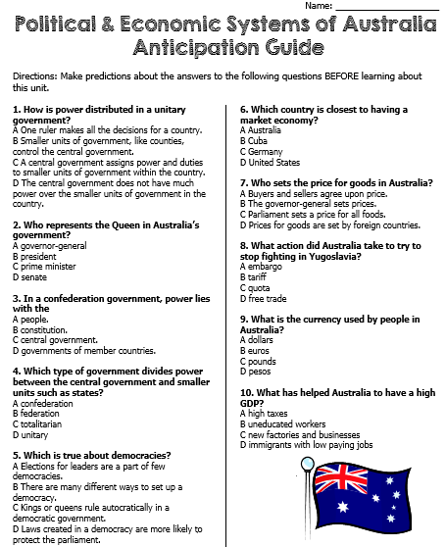
© 2014 Brain Wrinkles

Slide 7
Australia’s
Government
A Federal Parliamentary Democracy
© 2014 Brain Wrinkles

Slide 8
Let’s Review
Government Systems – Who has the power?
Unitary--power is held by one central authority
Confederation--association of independent states that agree to certain limitations on their freedoms by joining together
Federal--power is divided between central authority & several regional authorities
Which system does Australia have?
© 2014 Brain Wrinkles

Slide 9
Let’s Review
Government Types – how do citizens participate?
Autocracy-- 1 person possesses unlimited power & citizens have limited role in government
Oligarchy-- small group exercises control & citizens have limited role in government
Democracy--supreme power is vested in the people & exercised by them directly or indirectly though a system of representation involving free elections
Which type does Australia have?
© 2014 Brain Wrinkles

Slide 10
Let’s Review
Two Types of Democratic Governments:
Parliamentary– citizens elect members of Parliament, and then the members select the leader
Leader works with or through the legislature
Presidential--system of government in which the leader is constitutionally independent of the legislature; citizens directly elect leader
Leader works separate from legislature
Which type does Australia have?
© 2014 Brain Wrinkles

Slide 11
Australia’s
Government
Federation (federal system)
Constitutional Monarchy
Parliamentary Democracy
© 2014 Brain Wrinkles

Slide 12
Parliament House in Canberra is home to Australia’s government.
© 2014 Brain Wrinkles

Slide 13
Inside Parliament House
© 2014 Brain Wrinkles

Slide 14
Federal System
Australia has a federal system, which means that the national government and the state governments SHARE power.
There are 6 states and 2 territories in Australia.
© 2014 Brain Wrinkles

Slide 15
© 2014 Brain Wrinkles

Slide 16
Constitutional Monarchy
Constitutional Monarchy- A monarch inherits the right to rule but is limited by laws and a law making body elected by the people.
Australia’s constitution lists the powers of the government.
The British monarchy, a king or queen, is the head of state. However, since the monarchy does not live in Australia, he or she chooses a governor-general to act in his or her place…
© 2014 Brain Wrinkles

Slide 17
Leadership
1. Head of State: Monarch of the United Kingdom (presently, Queen Elizabeth II); little political power
2. Governor General: stands in for the monarch
3. Prime Minister: holds the most political power; works closely with the legislature
© 2014 Brain Wrinkles

Slide 18
Her Majesty
Queen Elizabeth II
© 2014 Brain Wrinkles

Slide 19
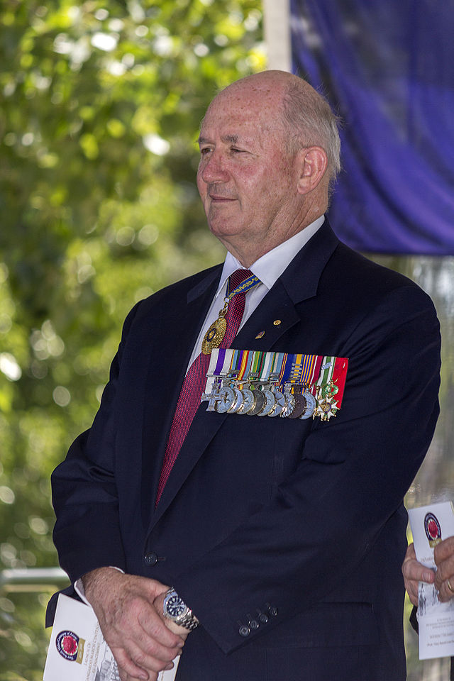
His Excellency The Honorable
Sir Peter Cosgrove
Governor General
© 2014 Brain Wrinkles

Slide 20
The Honorable
Anthony “Tony” Abbott
Prime Minister
© 2014 Brain Wrinkles

Slide 21
How Leaders Are Chosen
Governor General: appointed by the monarch on the advice of the Prime Minister; the Constitution does not set a length of term but most serve for 5 years
Prime Minister: is the leader of the majority party in the House of Representatives; indirectly elected by the people
© 2014 Brain Wrinkles

Slide 22
Legislature
Legislature = the central authority of a government
Australia’s legislature is called Parliament.
The citizens of Australia vote for members of Parliament.
Members of Parliament belong to many different political parties.
© 2014 Brain Wrinkles

Slide 23
Parliament
House of Representatives (150 seats): Australia is divided into areas called electorates; people living in each electorate vote for a person to represent them in Parliament.
The elected person becomes the member of parliament of the House of Representatives for that area.
Senate (76 seats): People from each state and the 2 territories elect people to be their senators
© 2014 Brain Wrinkles

Slide 24
House of Representatives
© 2014 Brain Wrinkles

Slide 25
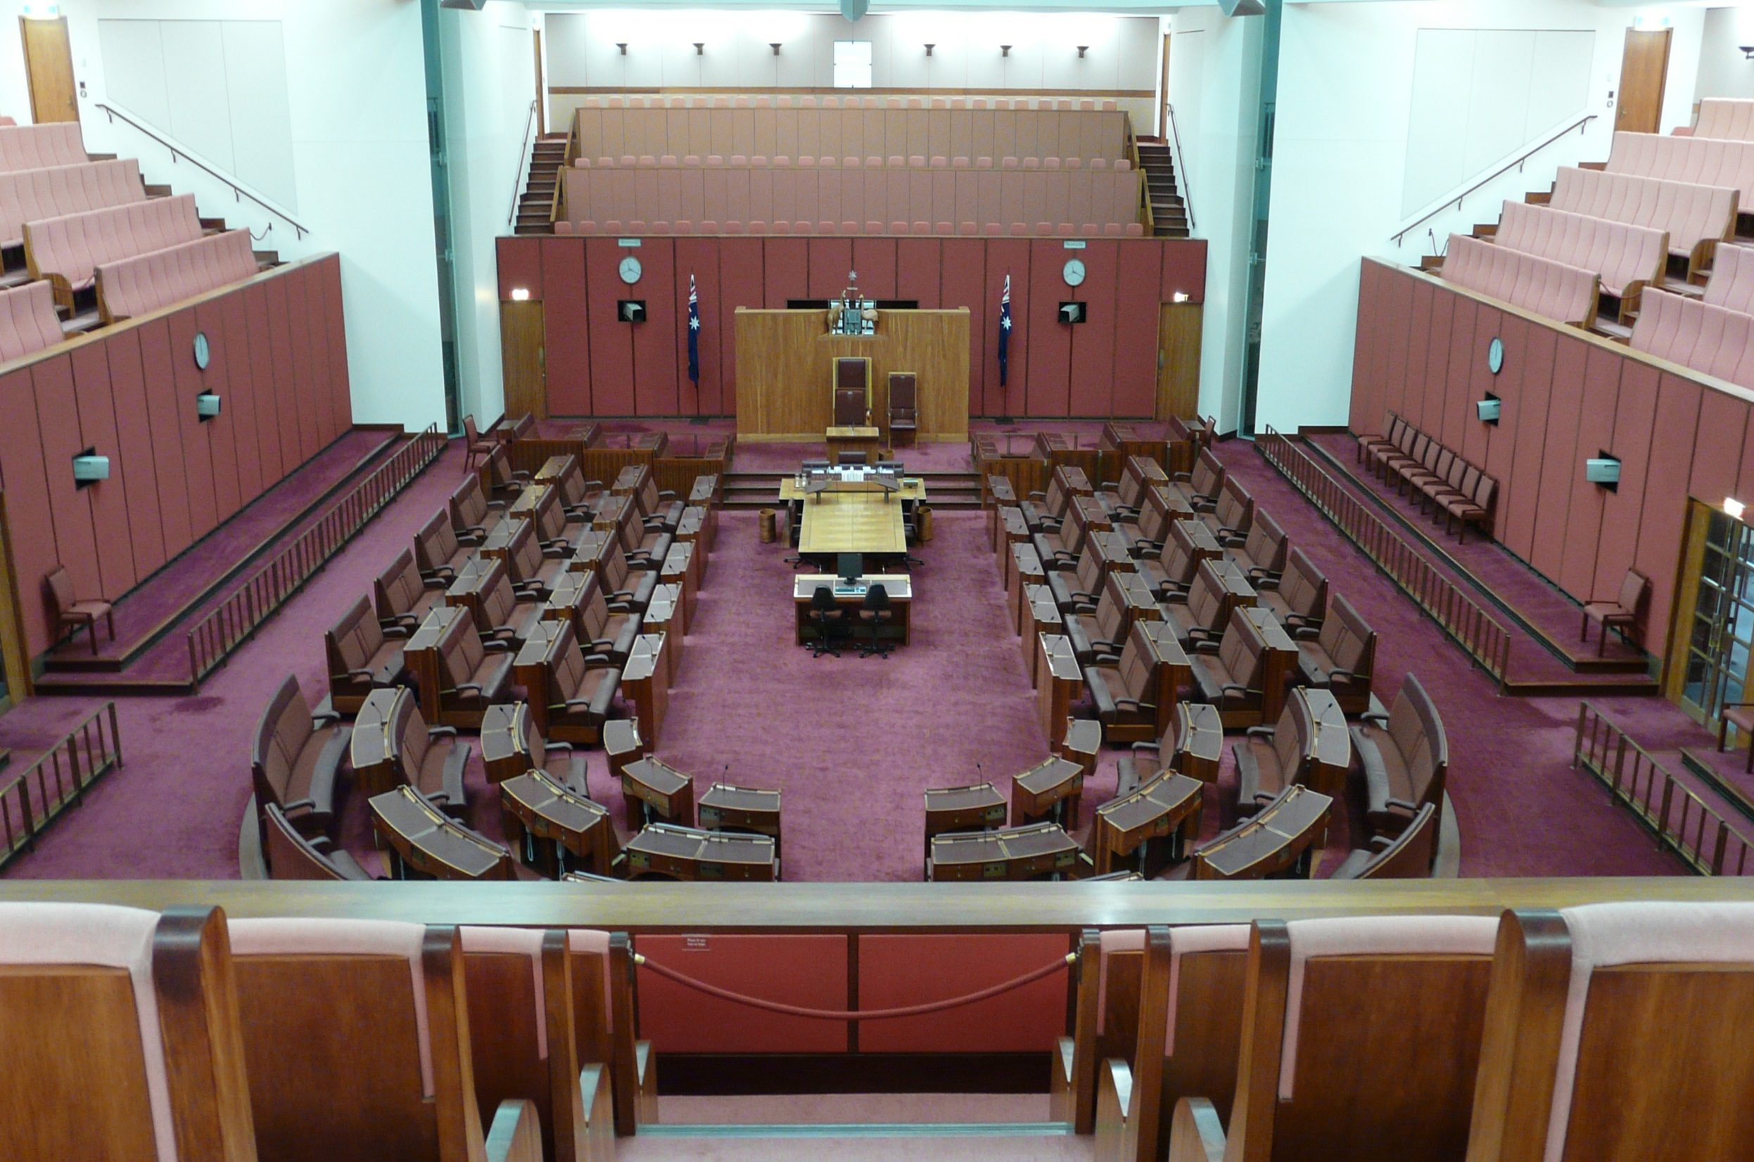
Senate
© 2014 Brain Wrinkles

Slide 26
Parliamentary
Democracy
Whichever political party has the most members in the legislature selects the Prime Minister.
This is the major difference between a Presidential Democracy and a Parliamentary Democracy!
Parliamentary Democracy – legislature (Parliament) chooses Head of Government (Executive Leader)
Citizens vote for members of Parliament, members choose the Prime Minister.
© 2014 Brain Wrinkles

Slide 27
Role of the Citizen
Citizens who are 18 - 70 are required by law to vote.
As a democracy, its citizens must participate in voting and elections:
They elect members of Parliament.
They elect regional government officials (state governors).
They also vote on specific issues.
© 2014 Brain Wrinkles

Slide 28
Branches of
Government
Australia has 3 Branches of Government just like any other Democratic Country.
Executive Branch – this is the Prime Minister
Legislative Branch – this is Parliament. Parliament is made up of two groups: the House of Representatives and the Senate
Judicial Branch – made up of all the courts in Australia
© 2014 Brain Wrinkles

Slide 29
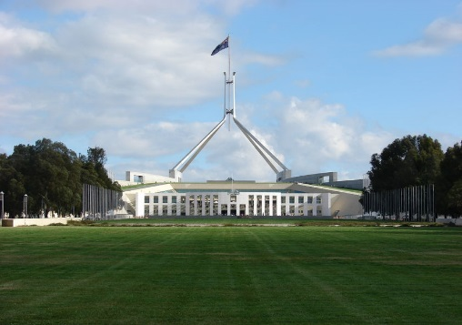
HOUSE OF REPRESENTATIVES
© 2014 Brain Wrinkles

Slide 30
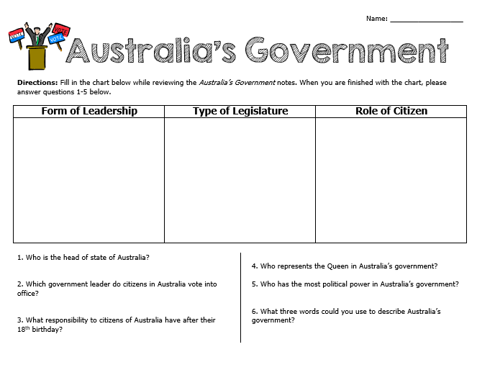
© 2014 Brain Wrinkles

Slide 31
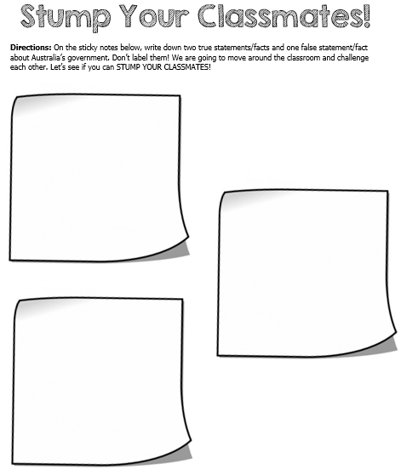
© 2014 Brain Wrinkles

Slide 32
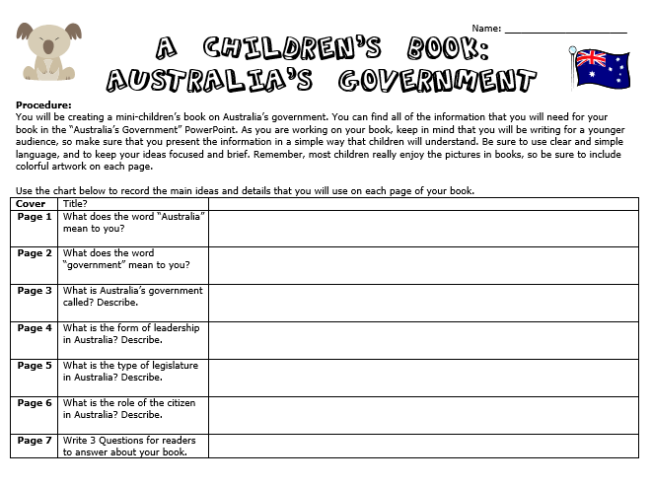
© 2014 Brain Wrinkles

Slide 33
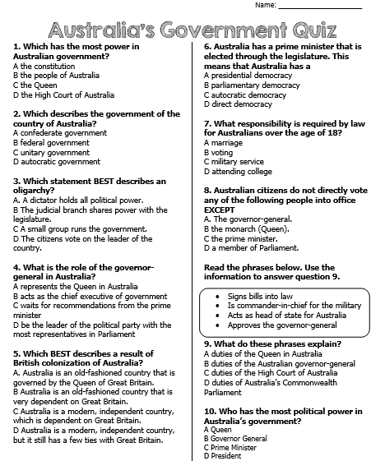
© 2014 Brain Wrinkles

Slide 34
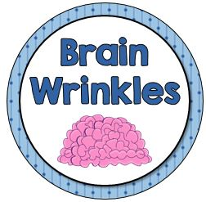
Thank You!
Thank you so much for downloading this file. I sincerely hope you find it helpful and that your students learn a lot from the Warm-Ups! I look forward to reading your feedback in my store.
If you like this file, you might want to check out some of my other products that offer fun & engaging activities.
Best of luck to you in the upcoming school year,
Ansley at Brain Wrinkles
© 2014 Brain Wrinkles

Slide 35
Terms of Use
© 2014 Brain Wrinkles. Your download includes a limited use license from Brain Wrinkles. The purchaser may use the resource for personal classroom use only. The license is not transferable to another person. Other teachers should purchase their own license through my store.
This resource is not to be used:
By an entire grade level, school, or district without purchasing the proper number of licenses. For school/district licenses at a discount, please contact me.
As part of a product listed for sale or for free by another individual.
On shared databases.
Online in any way other than on password-protected website for student use only.
© Copyright 2014. Brain Wrinkles. All rights reserved. Permission is granted to copy pages specifically designed for student or teacher use by the original purchaser or licensee. The reproduction of any other part of this product is strictly prohibited. Copying any part of this product and placing it on the Internet in any form (even a personal/classroom website) is strictly forbidden. Doing so makes it possible for an Internet search to make the document available on the Internet, free of charge, and is a violation of the Digital Millennium Copyright Act (DMCA).
Thank you,
Ansley at Brain Wrinkles
Clipart, fonts, & digital papers for this product were purchased from:
© 2014 Brain Wrinkles

