Slide 1
Welcome To Computer Science Mr. Jennings
Classroom Expectations

Slide 2

MEET THE TEACHER

Slide 3


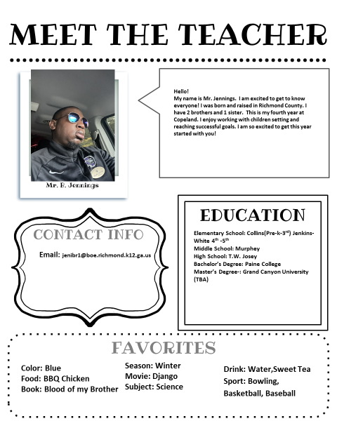
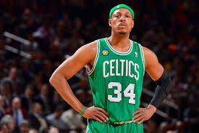


Slide 4


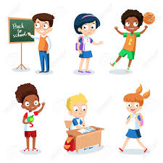

Slide 5


Slide 6


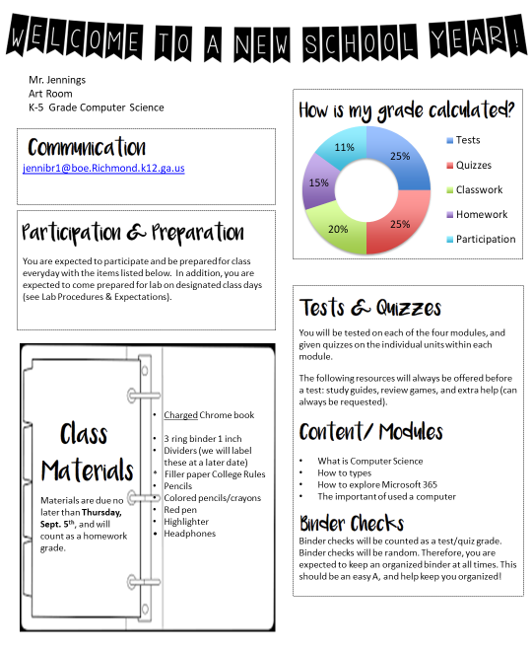
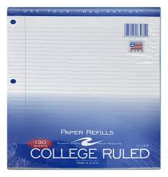


Slide 7
Our Classroom Rules!!!!!

Slide 8
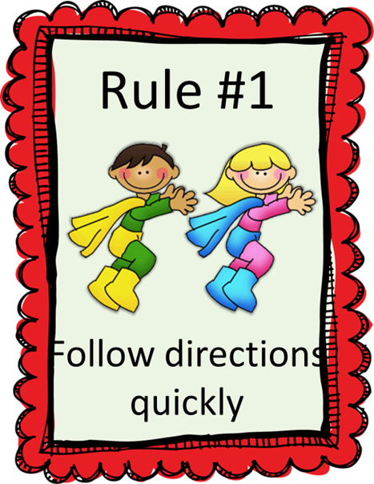
Rule # 1
Follow directions quickly

Slide 9
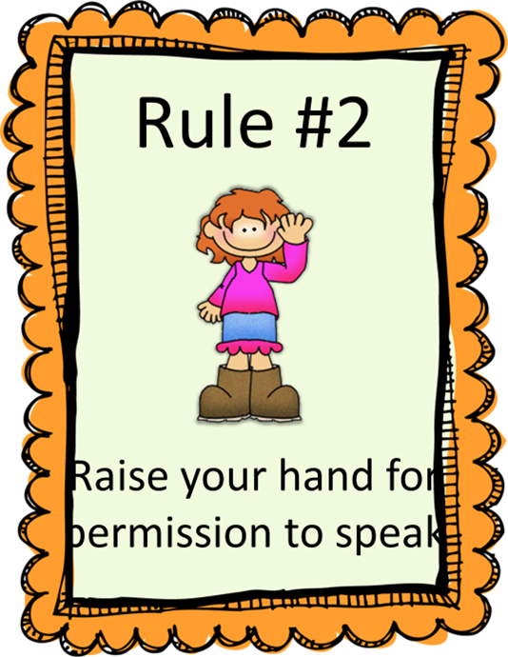
Rule # 2
Raise your hand for permission to speak!!!

Slide 10
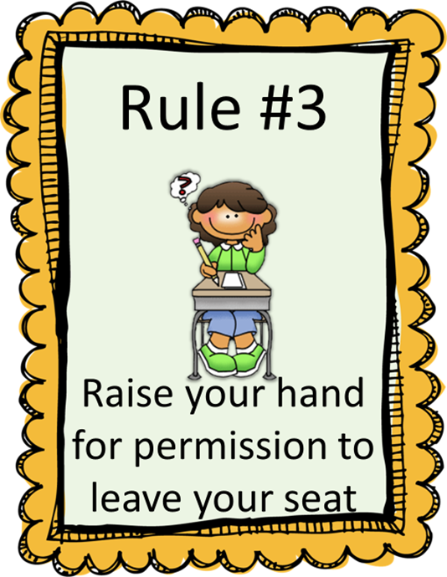
Rule #3
Raise your hand for permission to leave your seat!!!

Slide 11

Rule # 4
Make smart choices!!!

Slide 12
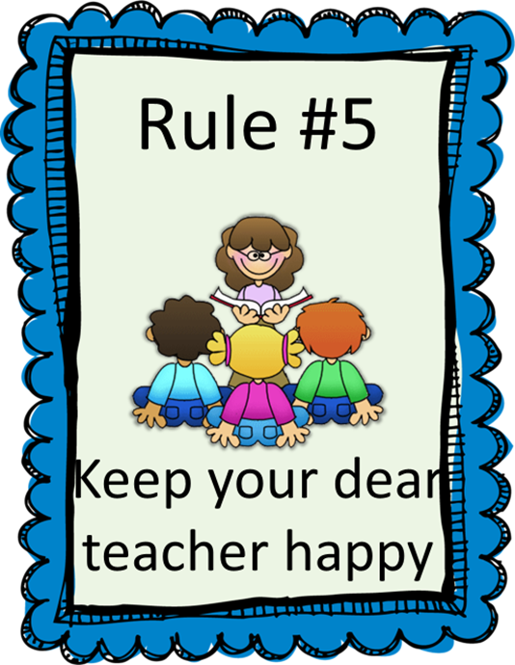
Rule # 5
Keep your teacher happy!!

Slide 13

Rule #6
Do NOT Open my door without Permission!!!!

Slide 14

Rule #7
NO ELECTRONIC !!!!!!

Slide 15
Expectations in our classroom

Slide 16
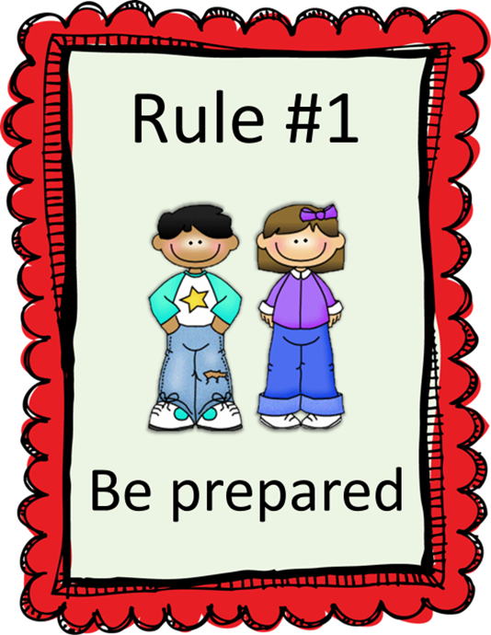
Expectation #1
Be Prepared

Slide 17

Expectation #2
Be Respectful!!!

Slide 18

Expectation # 3
Be a good Listener!!!

Slide 19
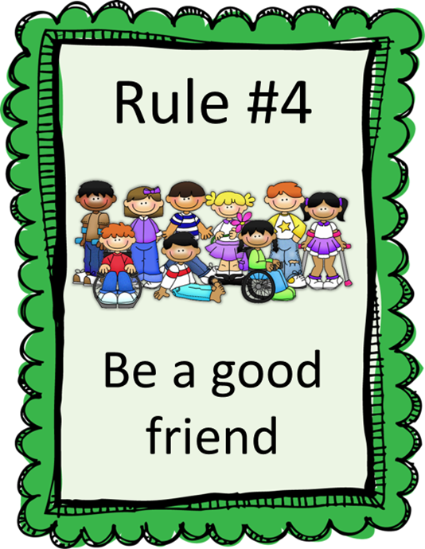
Expectation # 4
Be a good friend!!!

Slide 20
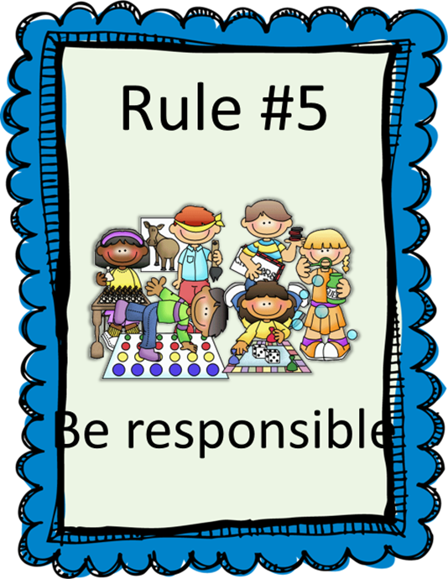
Expectation # 5
Be Responsible!!!

Slide 21
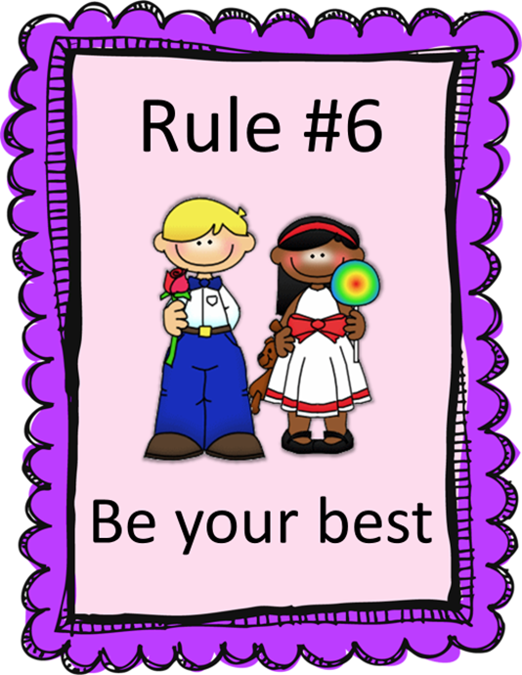
Expectation # 6
Be your best!!!

Slide 22

Fish Tank
PLEASE DO NOT TOUCH MY FISH TANK!!!!!!
LOOK WITH YOUR EYES AND NOT HANDS!!!!

Slide 23
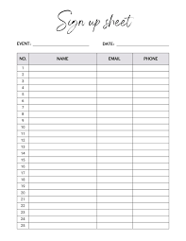
Expectation #7
Every time you come to class there will be an sign in sheet .
IF YOU DO NOT SIGN IN YOU WILL NOT GET AN GRADE.
BY YOU SIGN IN IT WILL COUNT AS A ATTENDANCE GRADE.

Slide 24
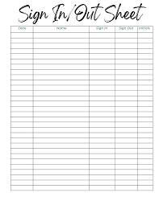
Expectation #8
When you ask to leave my classroom you will have to sign out and In the sheet will be by the door this will help me keep tracking of who leave my class.
If FAIL to sign Out or In will result you from leaving my class.

Slide 25
Expectations in our classroom
Think about it and discuss:
What are expectations?
~ guidelines that help students and teachers maintain structure and create a positive learning environment
Why is it important to set expectations for yourself?
~ So you can help you achieve your goals, increase productivity, and foster personal growth.

Slide 26
Homework
Homework must be turned in the day it is due. There will be no calling home for homework.
If you don’t understand something on your homework make sure you ask me, someone at home, or check with a friend.
Not turning in your homework will affect your grade.
Your family can call or email me with questions, too!

Slide 27

1ST Homework Grade
If you come you will get an FREE 100.
You will have to come check in with me.
Do you have to come NO, But I would LOVE for you to come out.

Slide 28
NO Name
If I receive a paper with no name. It will be placed on the NO NAME board.
Remember to look for your name there throughout the day/week.
If you see you are missing your name, you may turn it in.
If you do not catch a missed assignment you will be marked down 10% each day until you or I figure out it is yours.
This can drastically hurt your grades.
Take pride in your work and put your name on ALL papers. Top right hand corner.

Slide 29
Cheating
What is cheating? is a violation of trust and a betrayal of values.
Why is it a problem? Students who cheat may feel guilty and have low self-esteem, which can lead to other problems in their lives. They may also miss out on important information that they need to learn and apply in higher-level classes. Graduates who cheated may be unprepared for their careers, and their dishonesty could be revealed later, damaging their career in a public and humiliating way.

Slide 30
Stealing
Stealing will not be tolerated.
No excuses.
You will be written up and further action may be taken.

Slide 31
Yelling/Shouting
We will not yell in the classroom.
Yelling does not help any situation.
Remember in order to create a community of respect and a place where we feel safe and welcome we must remember to watch both what we say and how we say it!

Slide 32
Noise Levels
There are times in class when it needs to be quieter for others to work.
There will also be times where we may get noisy.
Come up with an example of a time you think it might get noisy in here and an example of a time it will need to be quiet.
It will always be SILENT during any testing.

Slide 33
Blurting
Blurting and side conversations (unless asked to do) interfere with our learning. And it’s just plain RUDE!
Remember the reason you’re here, is to learn.
You can talk to your friends, tell jokes etc...at the appropriate times. Recess and lunch are two good choices.
If you become a constant blurter or disrupt our class you will be fined Bobcat Bucks or lose recess, be written up etc…

Slide 34
Focus and remember
There are no I CANT’s, only I CAN!
Be respectful at all times.
If you have proved you can behave in the past then you have no excuse for misbehaving now.
EVERYONE can and will learn.
Try your best always, in everything you do.
We all have bad moments but….think before you act.

