Slide 1
Pre-K Orientation
2021 2022
April 26, 2018
1:30pm-2:30pm
McBean Elementary School
706-592-3723
Ms. Pittman & Mrs. Byrnside
Ms. Johnson & Mrs. Diamond

Slide 2
2021-2022

Slide 3
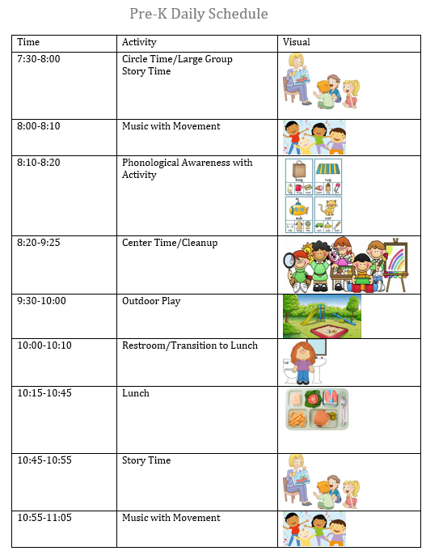
RCSS Pre-K Program Overview
Full instructional day = 6.5 hours
Curricula Used: The Big Day Curriculum
GELDS= Georgia Early Learning & Development Standards
Maximum class size is 22 students
RCSS Pre-K Office: 706-826-1266
Georgia Lottery funded Pre-Kindergarten Program can be found by visiting www.decal.ga.gov

Slide 4
Georgia’s Pre-K Requirements
The following are requirements for enrollment in Georgia’s Pre-K Program:
Age Eligibility
4 years old on or before September 1, 2021
Georgia resident

Slide 5
Required Documentation
The following documents must be received:
Certificate of Immunization
DHR Form 3231 (w/in 30 days of enrollment = September 3, 2021)
Certificate of Eye, Ear, Dental and Nutrition Screen
DHR Form 3300 (w/in 90 days of enrollment = November 3. 2021)
Proof of Age
Original/Certified birth certificate, passport, green/pink, or Federal I-94 card and hospital record of live birth.
NOT ACCEPTABLE = Medicaid cards & forms, Footprint certificate
Proof of Residency
Current: lease, vehicle registration, letter from shelter or employer if employer provides housing, utility bill listing residence as service address, PeachCare eligibility documents
CELL PHONE BILLS NOR A LICENSE ARE ACCEPTABLE FORMS OF DOCUMENTATION!
Copy of Social Security card
Category 1 documentation
EVIDENCE OF:
Supplemental Nutrition Assistance Program (SNAP), SSI (Supplemental Security Income), Medicaid, Temporary Assistance to Needy Families (TANF), or Child and Parent Services (CAPS) program
FAILURE TO SEND in all required documentation will result in student WITHDRAWAL.

Slide 6
Attendance Policy
Students are required to attend a 6.5 hour school day
(8:15 a.m.-3:15 p.m.)
Students are considered tardy at 8:25 a.m.
Chronic or excessive absenteeism and/or tardiness is defined as:
missing more than two days per month without medical or other reasonable explanation, to include attendance patterns (absent every Friday, etc.)
Consequence:
Meeting with parent
Establish interventions for resolution
Disenrollment consideration

Slide 7
Transportation
Parents should inform teachers of primary mode of transportation to be followed DAILY.
Change of Transportation
Parents MUST provide a WRITTEN NOTE (including transportation changes, date(s) of changes, student’s name, parent signature)
PHONE CALLS ARE NOT SUFFICIENT!
Bus Information
All in-zone parents should find out assigned bus numbers for their child, regardless if they utilize school transportation or not.
https://ewa.edulogweb.com/RICHMONDGANT1web/webquery/
Car Riders
Parents must remain in their vehicle in the pick-up line. Students will be delivered to the car line when their designated vehicle pulls up.
Early Pick-up
May result in a tardy.

Slide 8
Work Sampling Online (WSO)
Student documentation portal
monitor and record student progress throughout the school year
Information will be shared throughout the year at Fall and Spring conferences to discuss student progress and relevant information.
Parents will receive a narrative summary at each of these meetings that summarizes the information found in WSO.

Slide 9
Required Materials
Daily Folder (will be provided by teacher)
FULL SIZE Book Bag
Water Bottle
Daily Nutritional Snack
Nap Mat
Fitted sheet for mat
Blanket to cover up with
Two sets of seasonally appropriate back-up clothing

Slide 10
Pre-K Supply Wish List
There are many supplies that are vital to maintaining a healthy classroom that are not provided by the school. We are asking that parents help provide these items as they are able. WE CAN NEVER HAVE TOO MUCH OF ANY OF THE FOLLOWING ITEMS:
Kleenex
Hand Sanitizer
Lysol Disinfectant wipes
Baby wipes
Gallon-sized Zip-Loc bags
Extra Snacks (will be provided to students without one)

Slide 11
Instructional Materials
Students are NOT required to bring in instructional materials (pencils, crayons, paper, etc.), however, it is recommended to have these types of items at home in order to participate in at-home assignments/projects.
At any time throughout the year, feel free to send glue sticks, dry-erase markers, stickers/stamps, kid-friendly magazines, or any other collage materials for student use.

