Slide 1
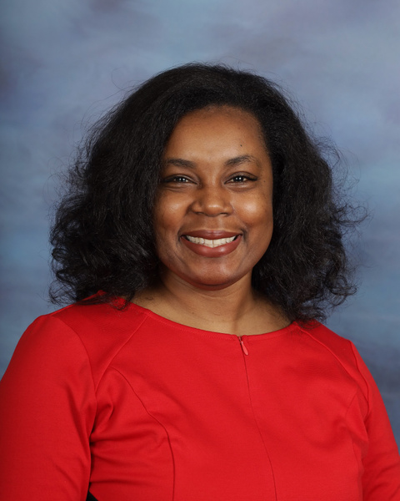
My name is Mrs. Belser and I am excited to be one of Lamar-Milledge’s 1st Grade teachers this year. I am a Chicago, Illinois native who loves God, spending time with my husband and family, and laughing a whole lot! I know this will be a great year!
Mrs. Belser
15+ years teaching experience
Spelman College
Bachelor of Arts in English
Emory University
Candler School of Theology
Master of Divinity
Bethel University
Master of Arts in Children and Family Ministries
Spending time with my family
Cooking
Reading and Writing

Slide 2
Mrs. Belser’s First Grade Class Roster
Room 115
Baker, Faith
Ballard, Ya’Hyness N.
Cincinatus, Cataleya S.
Dublin, Jr., Jacquez K.
Grays, Grayson G.
Guiterrez, Ximena
Hall, Marcus A.
Hickson, Dashon W.
Houston, Marquez T.
Kess, Melodie M.
Nipper, Karen M.
Shearin, Chandler K.
Singleton, Winter A.
Vera Gutierrez, Chloe
Mrs. Belser

Slide 3
Mrs. Belser’s First Grade Class Schedule
Room 115
TIME | SUBJECT
7:25-8:15 | Reading Intervention and SEL
8:15-9:00 | Specials (Planning)
9:00-11:10 (130 mins) | Reading, Language Arts & Writing Read Aloud Fundations My, View Writing Small Groups/Stations Independent Reading
11:10-11:40 (30 mins) | Lunch
11:40-11:55 (15 mins) | Recess
11:55-1:35 (100 mins) | Math Intervention Number Talks WHOLE GROUP Small Group/Stations
1:35-2:05 (25 mins) | Science/Social Studies
2:15-2:30 | Prepare for Dismissal
2:30-3:00 (30 mins) | Planning
Mrs. Belser

