Slide 1
Georgia’s BRIDGE Law
© 2015 Georgia Career Information Center · Georgia State University · All rights reserved.

Slide 2
Building Resourceful Individuals to Develop Georgia's Economy Law
© 2015 Georgia Career Information Center · Georgia State University · All rights reserved.

Slide 3
Using GCIS Junior for
© 2015 Georgia Career Information Center · Georgia State University · All rights reserved.

Slide 4
Using GCIS Junior for Middle School Students
© 2015 Georgia Career Information Center · Georgia State University · All rights reserved.

Slide 5
What is the BRIDGE Law?
BRIDGE is an acronym for “Building Resourceful Individuals to Develop Georgia’s Economy”.
Ensures that Georgia’s 6th -12th grade students are aware of available career and postsecondary education options.
Your school can use the Georgia Career Information System (GCIS) and Georgia Career Information System Junior (GCIS Junior) to fulfill the requirements of the BRIDGE Law.
© 2015 Georgia Career Information Center · Georgia State University · All rights reserved.

Slide 6
BRIDGE Law Objectives for Middle School Students
Before the end of the second semester of the eighth grade, students shall develop an individual graduation plan in consultation with their parents, guardians, or individuals appointed by the parents or guardians to serve as their designee.
Middle school students shall be provided counseling, advisement, career awareness, career interest inventories, and information to assist them in evaluating their academic skills and career interests.
© 2015 Georgia Career Information Center · Georgia State University · All rights reserved.

Slide 7
My Portfolios
Be sure to create a GCIS Junior “My Portfolio” for every student before completing any BRIDGE Law activities. This is how the data is collected and reported to the Georgia Department of Education.
This Portfolio can be transferred to a University System of Georgia or Technical College System of Georgia school to continue the student’s college and career development.
The Georgia Career Information Center can create all of your portfolios. Contact your GCIS Representative for details.
© 2015 Georgia Career Information Center · Georgia State University · All rights reserved..

Slide 8
GCIS-GCIS Junior Advisement Checklist
This is the official advisement checklist used by the Georgia Career Information Center to report your students’ completion of BRIDGE Law career development activities.
© 2015 Georgia Career Information Center · Georgia State University · All rights reserved..

Slide 9
Getting Started with GCIS Junior and the BRIDGE Law
6th Grade: Career Cluster Inventory (80 Questions) OR Career Cluster Inventory (48 Questions) -- complete ONE of the 6th grade assessments and save it in your “My Portfolio”.
7th Grade: Reality Check OR Interest Profiler (60 Questions)-- complete ONE of the 7th grade assessments and save it in your “My Portfolio”.
7th Grade: 3 Career Clusters -- explore at least 3 career clusters and save them in your “My Portfolio”.
8th Grade: 3 Occupations -- explore at least 3 occupations and save them in your “My Portfolio”.
8th Grade: Course Planner (Individual Graduation Plan) -- complete the Course Planner (Individual Graduation Plan) in your “My Portfolio”.
© 2015 Georgia Career Information Center · Georgia State University · All rights reserved.

Slide 10
BRIDGE Law Reporting Tools for GCIS Junior
To run your BRIDGE Law Reports:
Go to www.gcic.peachnet.edu.
Enter your Administration Tools Username and Password.
Click “Sign In”.
Hover over the “BRIDGE” mega menu.
Click the name of the BRIDGE Law Report you wish to generate.
© 2015 Georgia Career Information Center · Georgia State University · All rights reserved..

Slide 11
BRIDGE Law Data Entry
Student Enrollment
Enter number of students enrolled in each grade level to generate your BRIDGE Law Reports.
8th Grade Course Planner (Individual Graduation Plan) Verification
Select the 8th grade students to verify they have completed their Course Planner (Individual Graduation Plan).
© 2015 Georgia Career Information Center · Georgia State University · All rights reserved.

Slide 12
6th Grade:
Portfolios
6th Grade:
Career Cluster Inventory (48 or 80 Questions)
7th Grade:
Reality Check
7th Grade:
3 Career Clusters
8th Grade:
3 Occupations
% of 8th graders who have explored at least 3 occupations and saved them in their “My Portfolio”.
8th Grade:
Course Planner (Individual Graduation Plan)
% of 8th graders who have completed the Course Planner (Individual Graduation Plan).
% of 7th graders who have explored at least 3 career clusters and saved them in their “My Portfolio”.
% of 7th graders who have taken and saved in their “My Portfolio” the Reality Check OR Interest Profiler (60 Questions).
% of 6th graders who have taken and saved in their “My Portfolio” the Career Cluster Inventory (80 Questions) OR Career Cluster Inventory (48 Questions).
% of 6th graders who have portfolio accounts with GCIS or GCIS Junior.
BRIDGE Law Reports for
Middle School Students
© 2015 Georgia Career Information Center · Georgia State University · All rights reserved.

Slide 13
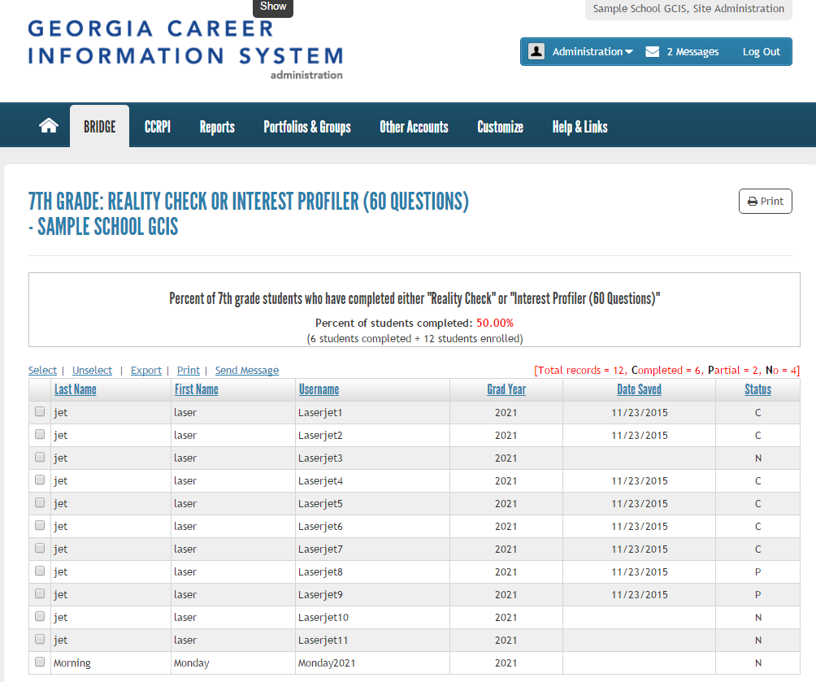
View real-time percent of students who have completed activity
See the date when students last saved the activity
View students’ activity status:
No, Partial, and Completed
© 2015 Georgia Career Information Center · Georgia State University · All rights reserved..

Slide 14
District Reporting Tool: BRIDGE Law Summary Report
Review the number of students enrolled in each grade level
Find the percentage of completion for each grade-specific activity
View the schools in the district that have entered their student enrollment figures (If the student enrollment is not entered, you will not be able to view the school’s progress.)
To Run BRIDGE Law Summary Reports:
Go to www.gcic.peachnet.edu.
Enter your District Tools Username and Password.
Click “Sign In”.
Click BRIDGE Law Summary Report located under Main Menu.
© 2015 Georgia Career Information Center · Georgia State University · All rights reserved..

Slide 15
Additional BRIDGE Law Resources
To access additional resources, go to the GCIC Homepage: www.gcic.peachnet.edu
Click Georgia's BRIDGE Law under Help Yourself
Using GCIS and GCIS Junior for the BRIDGE Law PowerPoint presentations
House Bill 400: Building Resourceful Individuals to Develop Georgia's Economy Law (BRIDGE Law)
GCIS-GCIS Junior Advisement Checklist
Resources for “Move on When Ready (MOWR)”
© 2015 Georgia Career Information Center · Georgia State University · All rights reserved..

Slide 16
Questions???
Georgia Career Information Center
404-413-1720
gcicinformation@gsu.edu
© 2015 Georgia Career Information Center · Georgia State University · All rights reserved..

Slide 17
Georgia Career Information Center www.gcic.peachnet.edu
Georgia’s BRIDGE Law
Building Resourceful Individuals to Develop Georgia's Economy Law
Using GCIS Junior for Middle School Students
© 2015 Georgia Career Information Center · Georgia State University · All rights reserved..

