Slide 1
Juvenile Offenders
Delinquent acts and unruly acts are legal terms for behavior in minors under the age of 16.
Delinquent behavior is an act committed by a juvenile that would be a criminal offense according to state law.
Unruly behavior is an act committed by a juvenile that would not be a criminal offense according to adult law.

Slide 2
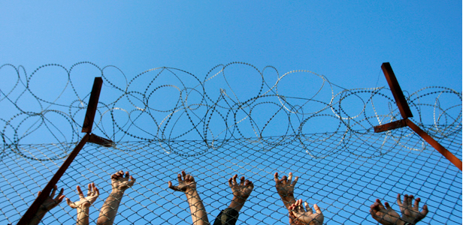

Slide 3
Delinquent Behavior
Delinquent behavior would be considered a crime if it were committed by an adult.
Treatment, rehabilitation, or court supervision is necessary.
Examples include possession of drugs, theft, assault, rape, and murder.
If the act is serious enough, the juvenile may be charged as an adult and subject to all adult penalties.
Repeat offenders are called designated felons and are considered a danger to the community and can be imprisoned for up to five years.

Slide 4
Unruly Behavior
Unruly behavior is when a juvenile violates a law that only pertains to children.
Treatment, rehabilitation, or supervision by the court is necessary.
Examples include skipping school, driving without a license, possession of alcohol or cigarettes, loitering in public places between 12 am and 5 am, and leaving home without parents’ permission.
If a minor commits these acts, he or she may be placed in a juvenile detention center.

Slide 5
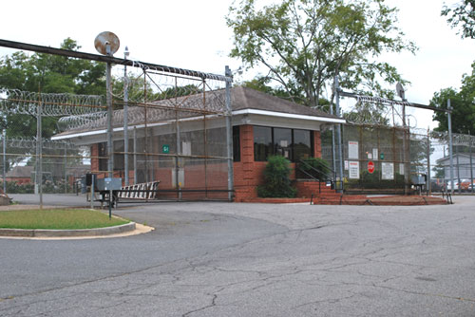

Slide 6
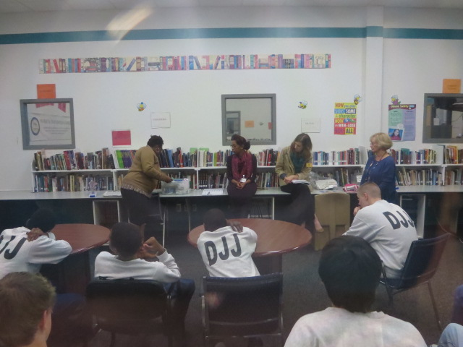

Slide 7
Juveniles’ Rights
Juveniles have the same rights as adults do when taken into custody, as well as several more specifically for juveniles:
The right to have parent/guardian contacted immediately.
The right to have parent/guardian and an attorney present before they can be questioned by authorities.
The right to be represented by an attorney at a trial.
The right to not be placed with adult offenders.
The right not to have names or photographs made public.

Slide 8
Juvenile Courts
Courts in the juvenile justice system are focused on rehabilitating juveniles rather than punishing them like adults.
The system has a lot of flexibility because its main goal is to correct juvenile offenders and not necessarily to punish them.
Juvenile courts have jurisdiction over cases involving children 17 and under, or those under 18 who don’t have a parent/guardian.
In Georgia, juvenile courts may stand alone or be part of the superior court system.

Slide 10
Steps
There are several basic procedures for juveniles entering the criminal justice system.
Taken into Custody - similar to arrest for adults
Intake Officer – decides if there is enough evidence to make a charge against the juvenile
Released to parent/guardian or Detained – detained in a youth detention center or adult prison (depending on the crime). If detained, there must be a hearing within 72 hours to determine if proceedings should continue.

Slide 12
Steps
4. Informal Adjustment – optional if juvenile is first time offender. Juvenile must admit guilt to the judge and is under court supervision for 90 days.
5. Adjudicatory Hearing – judge determines guilt or innocence. There are no juries in juvenile cases.
6. Disposition Hearing – judge hears witnesses and determines punishment.
7. Sentencing – judge rules on punishment. Options include fines, probation, boot camp, youth detention center, and/or mandatory counseling and school attendance.
8. Appeal – juvenile can appeal ruling if there is enough evidence to prove they were innocent.

Slide 13
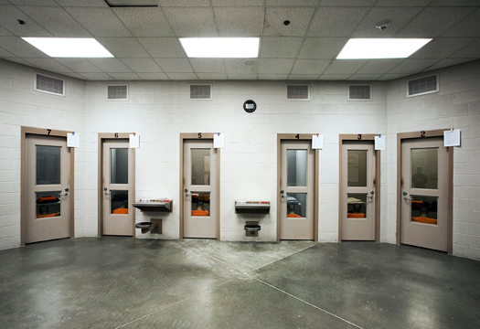
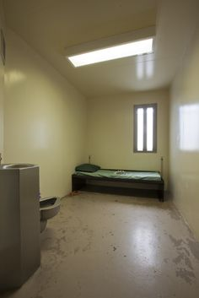

Slide 14
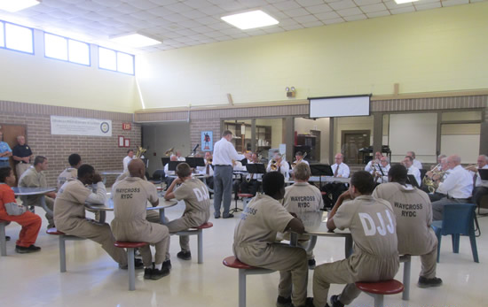
© Brain Wrinkles

Slide 15
7 Delinquent
Behaviors
If a juvenile between the ages of 13-17 commits one of the seven delinquent behaviors listed below, he/she can be tried as an adult and will face the same punishment.
Murder
Voluntary manslaughter
Rape
Aggravated sodomy
Aggravated child molestation
Aggravated sexual battery
Armed robbery with a firearm

Slide 16
Adult Court
The teen accused of one of the seven delinquent behaviors is no longer protected by the juvenile justice system and the case is sent to the Superior Court.
A complaint is first made about the delinquent act and the juvenile may be sent to a detention center.
After the case is investigated, it is either dismissed or a petition is filed.

Slide 17
Adult Court
3. If a petition is filed, an arraignment hearing is scheduled.
4. The alleged offender may remain silent, deny the petition, or agree to the petition.
5. A court date is set and a trial is conducted.

Slide 18
Consequences
The possible consequences are the same as an adult.
A jury may find the defendant guilty and a sentence is passed down.
A guilty verdict may be appealed to the Supreme Court.
If convicted, the juvenile must spend all jail time (minimum of 10 years) in an adult prison without parole.

Slide 19
