Slide 1
War Front
Element: Describe conditions on the war front for soldiers; include the Battle of Verdun.
Vocabulary: Battle of Verdun, eastern front, trench warfare, western front

Slide 2
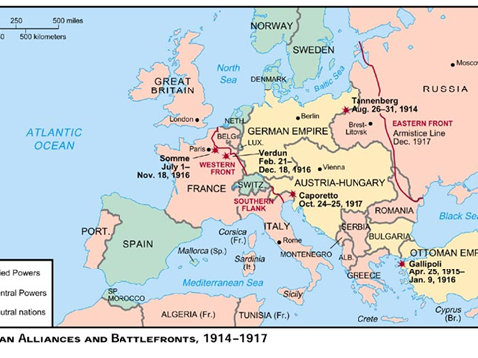

Slide 3
Western Front
Development:
Germany swept through Belgium into northern France
stopped a short distance from Paris at the First Battle of the Marne
turned into a stalemate
developed a system of trench warfare

Slide 4
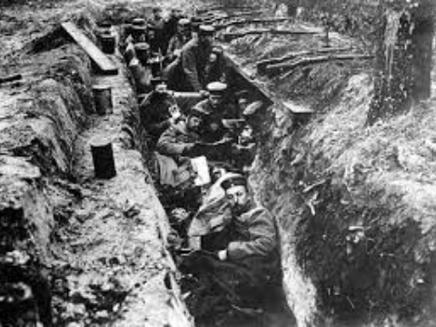

Slide 5
Western Front
Trench warfare:
Soldiers dug 500 miles of trenches and fought each other from there
stretched from the English Channel nearly to the Swiss border
Shells were rained on the men constantly
for four years both sides remained in almost the same position

Slide 6
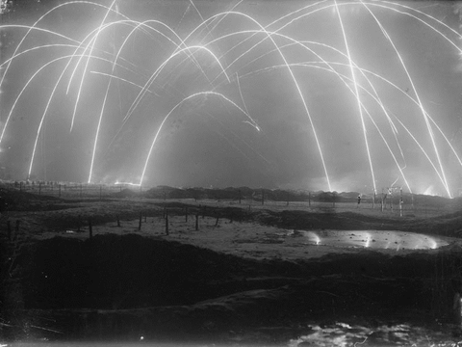

Slide 7
Western Front
Condition of trenches:
included massive tangles of barbed wire, machinegun nests, gun batteries, and heavy artillery
soldiers lived in holes in the ground
territory between the two sides was called no-man’s-land

Slide 8
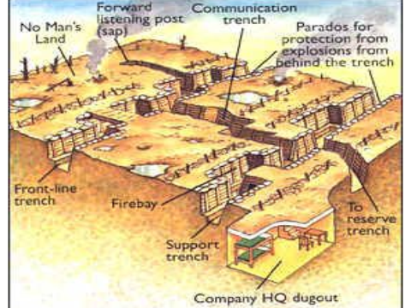

Slide 9
Trench Warfare info. only
At the Battle of the Somme in July, 1916, a soldier was expected to carry the following equipment:
  a rifle, a bayonet, grenades, 170 rounds of ammunition, a gas mask, a shovel and wire cutters, a full water bottle and food rations, extra clothing and medical supplies, and portable cooking stove with fuel
Carrying about 66 pounds on his back, the soldier had to fight the enemy-assuming he lived while crossing “no man’s land”

Slide 10
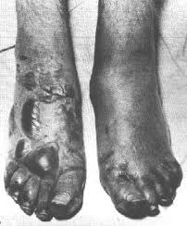
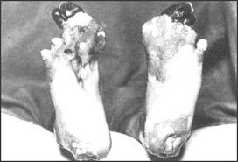
Trench Foot

Slide 11
Western Front
Difficulties:
Military leaders did not know how to fight trench warfare
ordered masses of soldiers to attack the other side and try to break through
begin with heavy artillery
then send in thousands of troops
completely exposed to machine-gun fire
millions of young men died in these attacks and no breakthrough came

Slide 12
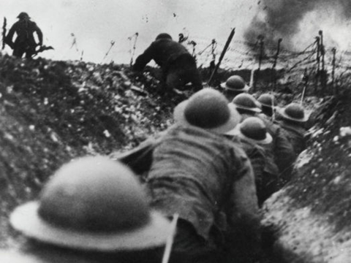

Slide 13
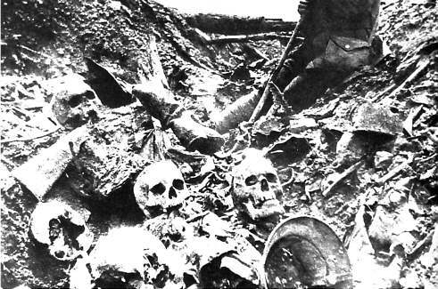
Western Front
Battle of Verdun:
Verdun, France, in 1916
700,000 men were killed in 10 months
new technologies introduced

Slide 14
Let’s Summarize…
How did the Battle of Marne affect German strategy for WWI?
What name characterized the fighting done in WWI?
List 4 new weapons used in this war.
Explain what a “stalemate” is.

Slide 15
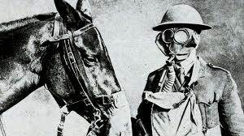
New Technology
Poison Gas:
introduced by the Germans but used by both sides. Some gases caused blindness or severe blisters, others death by choking, soldiers began to use mask

Slide 16
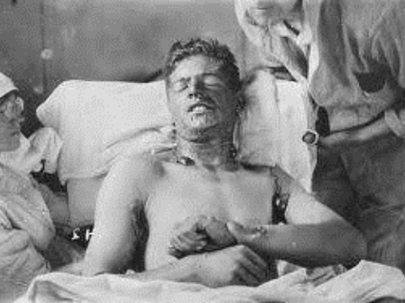

Slide 17
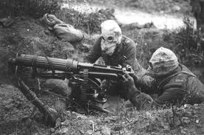
New Technology
Machine Gun:
fires ammunition automatically, could wipe out waves of attackers and thus made it difficult for forces to advance

Slide 18
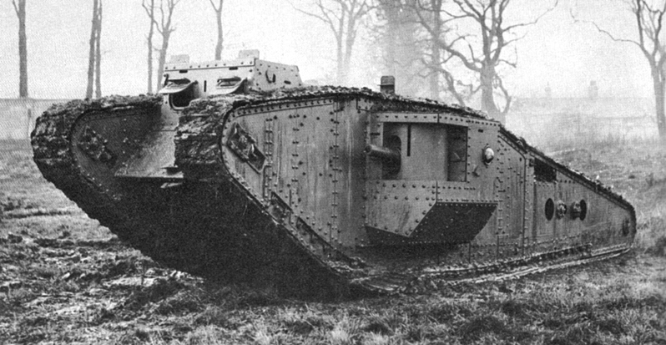
New Technology
Tank:
an armored combat vehicle that moved on chain tracks-and thus could cross many types of terrain

Slide 19
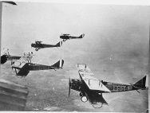
New Technology
Airplanes:
spotted enemy positions from the air, later used to attack ground targets then in time, machine guns were mounted on airplanes to fight each other for control of the air

Slide 20
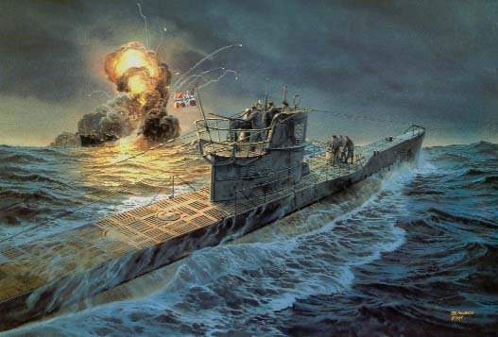
New Technology
Submarine:
known as u-boats
primary weapon against ships was the torpedo, an underwater missile

Slide 21
Let’s Summarize …
What new technology was introduced during World War I?
How did new technology impact the warfront for soldiers?
Why do you think World War I is often called the “First Modern War”?

Slide 22
Eastern Front
Description:
the war was far more mobile
Russian army moved into eastern Germany
defeated at the Battle of Tannenberg and the Battle of Masurian Lakes
eliminated Russia as a threat to Germany

Slide 23
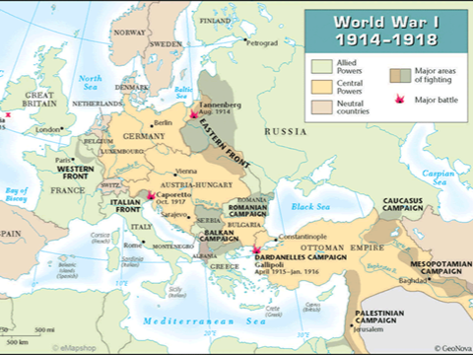

Slide 24
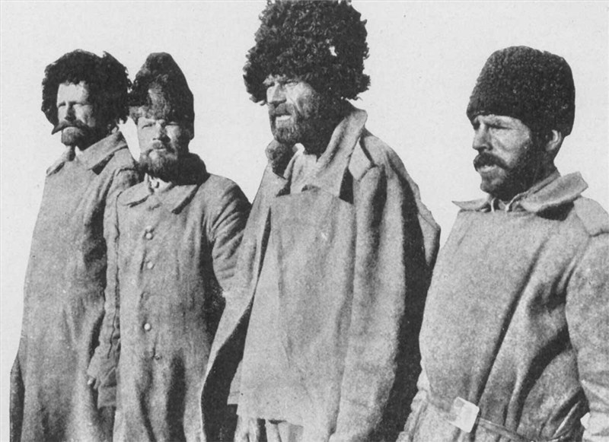
Russia Struggles
Russia had yet to become industrialized so they were short on supplies.
Their only advantage was a large population.

Slide 25
Eastern Front
Difficulty:
Russia defeated Austria-Hungary and dislodged them from Serbia
then Germans aided Austrians to defeat the Russians in several battles and drove them back
2.5 million Russians had been killed, captured, or wounded
almost out of the war

Slide 26
Let’s Summarize …
How was the Eastern Front different from the western front?
What were the advantages and disadvantages that Russia had on the Eastern Front?

