Slide 1
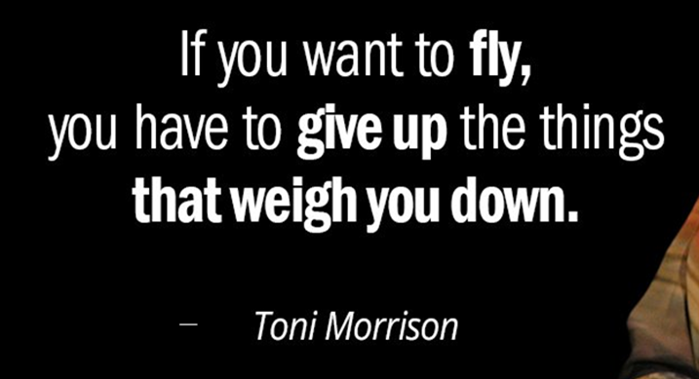
Wednesday, October 7, 2020
Bell Ringer: Write about it Wednesday- Interpret and explain the meaning of the quote. How can this statement be applied to a students life? (volunteers will share out their response).
Work Session: View & Take notes on the main idea v. Theme video. At the bottom of your notes, answer the following question: What is the difference between theme and main idea? https://www.smekenseducation.com/distinguishing-main-idea-from-t/
Fill out a vocabulary sheet for the key terms Theme & Main Idea
Closing: Sum up the
difference between the
two key terms.

