Slide 1












Richmond County Technical Career Magnet School
School Improvement Plan Review
Replace, Delete,
or Move any of the graphics to customize your own template.
Melisa L. Clark, Principal

Slide 2

CCRPI
CCRPI Scores | 2013-14 | 2014-15 | 2015-16
Richmond County Technical Career Magnet | 70.6 | 87.8 | 76.9
CCRPI – RICHMOND COUNTY | 60.9 | 62.4 | 57.9
CCRPI – STATE | 72.3 | 75.5 | 73.6

Slide 3
Attendance
Attendance | 2016-17 Fall | 2016-17 Winter
Total School Enrollment | 425 | 397
Percentage of Students Absent 6+ Days | .9% | .75%
Every School Day Counts!

Slide 4

Teacher Absences
Number of Teachers | Number of Teachers Absent 5 or More Days
24 | 20

Slide 5
Discipline
Discipline | 2016-17
Number of discipline incidents - 9th Grade | 36
Number of discipline incidents - 10th Grade | 59
Number of discipline incidents - 11th Grade | 101
Number of discipline incidents - 12th Grade | 57
Percentage of In-School Suspensions | 45%
Number of Tribunal Hearings | 2

Slide 6
Discipline
Discipline | 2016-17
Number of Out-of-School Suspensions- 9th Grade | 2
Number of Out-of-School Suspensions - 10th Grade | 4
Number of Out-of-School Suspensions - 11th Grade | 33
Number of Out-of-School Suspensions - 12th Grade | 56

Slide 7















Updates on SIP
Doing Well…
We now have highly qualified teachers in each content class.
All math classes are utilizing Math XL.
We have started the RCTCM After School Academy.
The Media Specialist has purchased various informational texts and magazines for Literacy Time.
Increase in Media Center Circulations.
Improved Economics grades for seniors currently taking the course on Edgenuity.
Georgia Virtual Students have improved their performance since last semester.
RCTCM University – Teachers sharing Best Practices
Bridging the Gap between Feeder Schools and RCTCM
Increased participation for Parent Nights.
Need to be revised…
We need more positive recognition moments/incentives.
Increasing Teacher Accountability of Literacy Time.

Slide 8



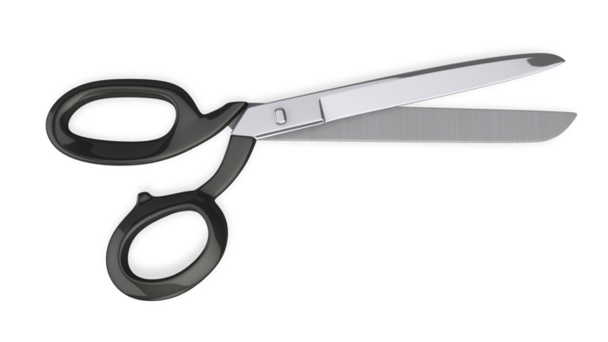
Professional Learning Plan to Support School Improvement
List any professional learning you have held so far in 2016-17.
Class Flow
Microsoft 365
SLDS
Revision Assistant
Math XL
RTI
Infinite Campus
Active Shooter
Instructional Strategies for Remediation
List any PL that you need to have in 2016-17.
Customer Service
Near & Dear Groups
Marketing RCTCM
Rebranding RCTCM
Differentiation
Team Building

Slide 9
Explain how your Master Schedule addresses the needs of your students:
We are continuing with Collaborative Planning by content area.
Added Math Support/Math Study Skills course.
Adding Economics back to the schedule, pairing with Financial Literacy for 10th graders.
Adding World Literature (next year only) – All 10th & 11th graders are currently taking Honors American Literature.
Adding more “elective” options for students upon their request.

Slide 10


Final Thoughts
List any areas of support you may need for the remainder of 2016-17.
Culinary Aide in order to complete Culinary Industry Certification requirements.
Promotional Supplies for incoming and upcoming students.
Marketing items for the community.
Funds to provide Team Building PL at Gravatt’s Challenge Course (Aiken, SC).
Funds to provide more Saturday School opportunities, in preparation for EOCs/ EOPAs.
Assistance in planning a Summer Transition Academy for our incoming middle schoolers and 9th graders.

