Slide 1
Risk Management 101

Slide 2

Risk Management is…
The forecasting and evaluation of financial risks
Identification of procedures to avoid or minimize their impact.
Goals:
    Avoid or minimize losses
    Identify opportunities
    Improve decision making

Slide 3

Some Key Terms
Insurance Policy
Policyholder
Risk
Probability
Premium
Coverage
Claim
Deductible

Slide 4

Insurance Policy
A document detailing the terms and condition of the insurance contract
Between the insurer and insured (Policyholder)
Determines claims that must be paid
Outlines the insurer’s promises to pay for loss
Sets the premium and deductible payment
Designed to meet specific needs

Slide 5

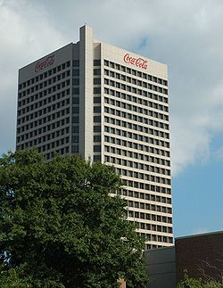
Policyholder
A person or company that “holds” a policy from insurance company.

Slide 6

Risk
The probability of a loss or something bad happening
Risk includes damages and liabilities
Insurance companies take responsibility of risk in exchange for premium.

Slide 7


Probability
Insurance companies must use the probability of risks to create a premium.
Clients are pooled into large groups.
      For example: 18 year old drivers have a higher probability of experiencing an accident than 40 year old drivers.

Slide 8

Premium
Amount to be paid for insurance
Premiums are given to insurance companies in exchange for risk responsibility.
Paid as a lump sum or in installments during the duration of the policy
Premium rates are decided by the probability of a risk

Slide 9
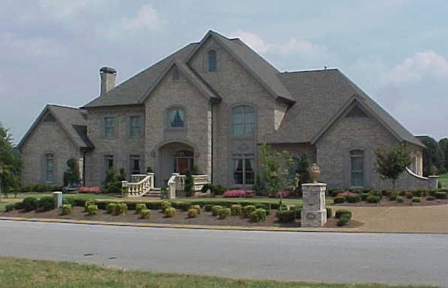


Coverage
Coverage is the amount or responsibility an insurance company takes for a risk in exchange for the premium
Specific types of coverage: Home, life, and auto

Slide 10

Claim
Request (by the policyholder) for payment of a loss
Insurance claims are reviewed by the company for their validity and then paid out to the insured or requesting party (on behalf of the insured) once approved.

Slide 11

Deductible
The amount the policyholder must pay before the insurance company pays the claim
This maintains responsibility of the policyholder and reduces the amount of smaller claims for the insurance company
A larger deductible = insurance company covers smaller amount risk and policyholder will take more responsibly of the risk
**Larger deductibles allow for a smaller premium to be charged by the insurance company.

Slide 12
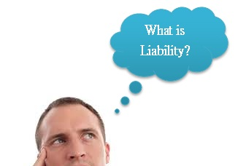
Premiums v. Deductibles
Premiums | Deductibles
Paid in a lump sum or in installments | Only paid when a claim is made
Paid with every policy | Varies in amount, per claim, within a policy

Slide 13
Types of Insurance
General Liability
Property
Business Owner’s Policy
Commercial Auto
Worker’s Compensation
Professional Liability
Data Breach
Homeowners
Renters
Life
Personal Automobile
Personal Umbrella
Note: There are many other types of insurance, but these are the only ones that will be focused on in this presentation.

Slide 14
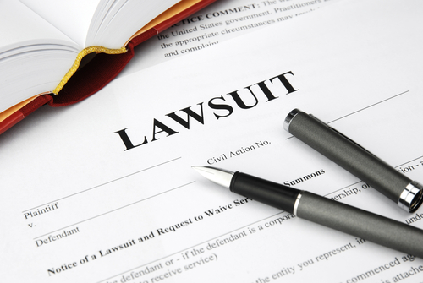
General Liability Insurance
Provides both defense and damages if you, your employees or your products or services cause or are alleged to have caused Bodily Injury or Property Damage to a third party.

Slide 15

Property Insurance
Will protect you if you have a fire, vandalism, theft, smoke damage, etc.
This includes property such as a building, office equipment, computers, inventory, or tools.

Slide 16

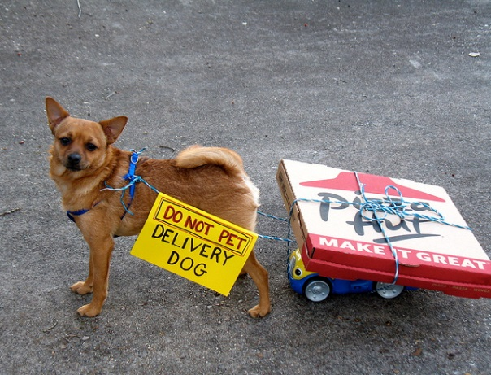
Commercial Auto Insurance
Protects a company’s vehicles. This includes vehicles that carry employees, products, or equipment.
If employees are using their own cars for business use, the company should have non-owned auto liability.

Slide 17

Worker’s Compensation
It provides wage replacement and medical benefits to employees who are injured on the job.
In exchange for these benefits, the employee gives up his rights to sue his employer for the incident.

Slide 18

Professional Liability Insurance
Also known as Errors and Omissions Insurance
The policy provides defense and damages for failure to or improperly rendering professional services.

Slide 19
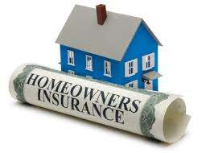
Homeowner’s Insurance
This type of insurance can protect against damage to the home and against damage to items inside the home.
Additionally, this type of insurance may protect you from accidents that happen at home or may have occurred due to actions of your own.

Slide 20
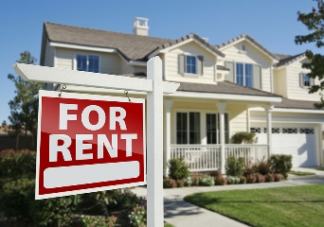
Renter’s Insurance
This is a subset of Homeowner’s Insurance.
The coverage is protects against damage to the physical property, contents of the property, and personal injury within the home.

Slide 21

Life Insurance
Life insurance protects an individual against death. The insurer pays a certain amount of money to a beneficiary upon your death. You pay a premium in exchange for the payment of benefits to the beneficiary.

Slide 22

Two Major Types of Life Insurance
Term
Provides protection for a specified period of time.
Does not build cash value
Whole
Provides protection for your entire lifetime and accumulates a cash value that the policy owner can borrow against.
Initially higher premiums
Can not be used until matured

Slide 23
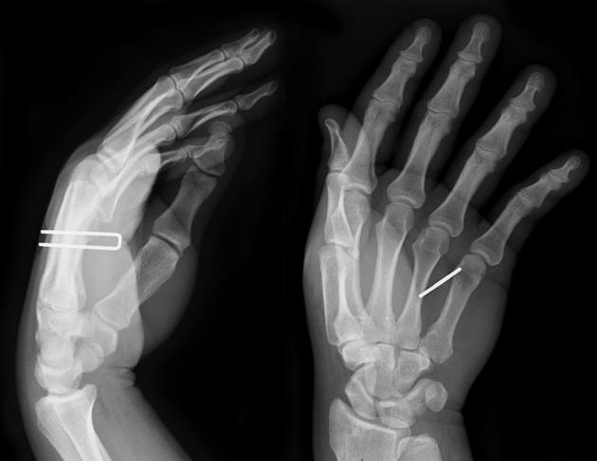
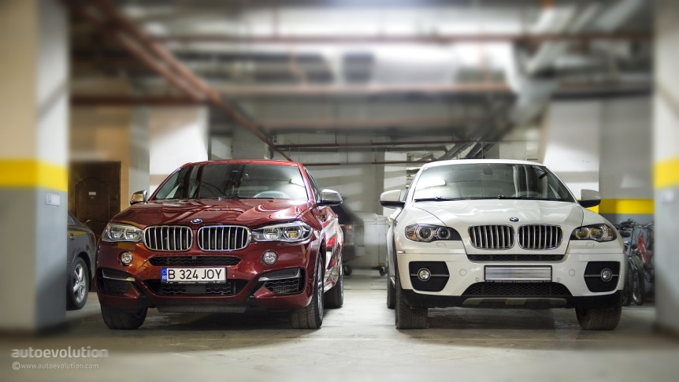
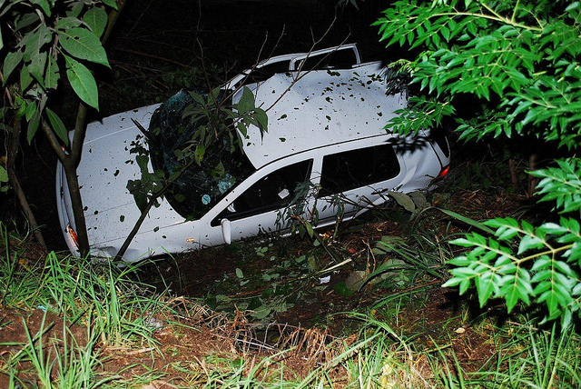
Personal Automobile Insurance
It has a dual function, protecting against both physical damage and bodily injury resulting from a crash, and also any liability that might rise from the collision.

Slide 24
Questions
Comments
Concerns

