Slide 1

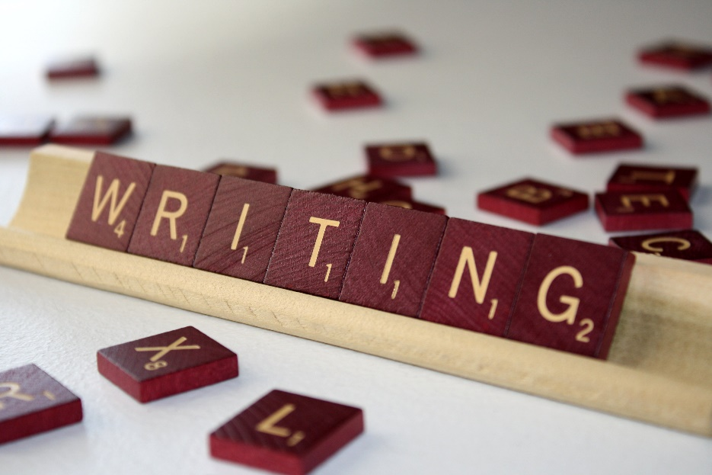
August 2016 QuickWrites

Slide 2
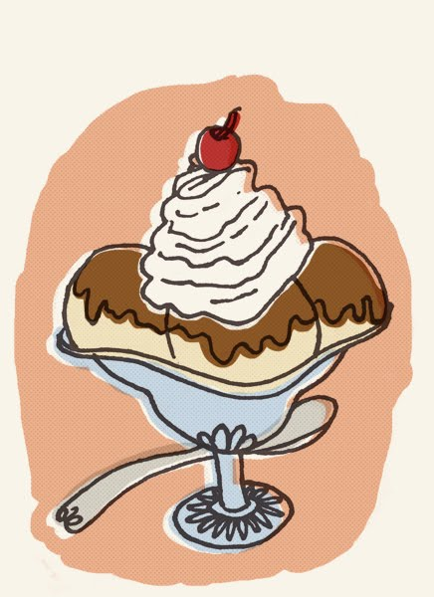
Tuesday August 2, 2016
Today is “National Ice Cream Sandwich Day.” Share what your favorite dessert is and give three reasons why you like that particular dessert.

Slide 3

Wednesday August 3, 2016
Today is “National Watermelon Day.” Watermelon is a popular summer food. Describe your favorite summer food and why you like this particular food.

Slide 4

Thursday August 4, 2016
On this date in 1901, musician Louis Armstrong was born. Armstrong was an amazing jazz trumpeter. If you could play any instrument, which would it be and why? If you already play an instrument, why did you select that instrument?

Slide 5
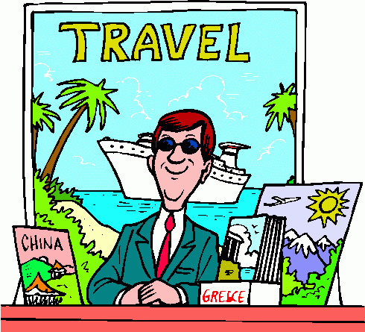
Friday August 5, 2016
If you could travel anywhere in the world, where would you like to travel and why?

Slide 6
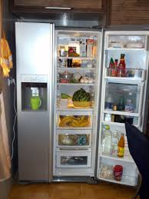
Monday August 8, 2016
On this date in 1899, a man by the name of Albert T. Marshall received the patent for an "automatic refrigerating apparatus," better known as the refrigerator. In at least one paragraph, explain why you think the refrigerator was such an important invention

Slide 7
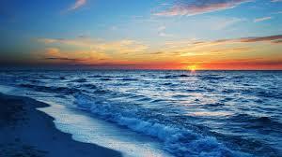
Tuesday August 9, 2016
Describe your favorite trip to the ocean. If you have not been to the ocean, explain why you would or would not like to go to the ocean.

Slide 8

Wednesday August 10, 2015
Herbert Clark Hoover, the 31st President of the United States was born on August 10, 1874. Would you like to be President of the United States? Why or why not?

Slide 9
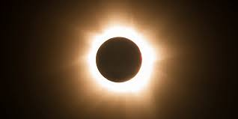
Thursday August 11, 2016
On this day in 1999, the last total solar eclipse of the millennium crossed many populated areas throughout Europe, India, and Iran, making it the most observed eclipse in history. Using pictures and words, create a diagram explaining a solar eclipse.

Slide 10
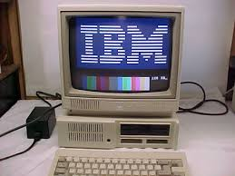
Friday August 12, 2016
On this day in 1981, IBM announced their new PC. How do you think computers have possibly helped our lives? How do you think computers have possibly harmed our lives?

Slide 11
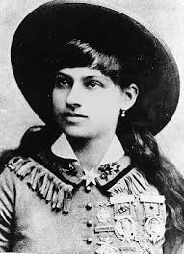
Monday August 15, 2015
Annie Oakley was born on this date in 1860. Would you liked to have lived back in the Wild West days of cowboys, cowgirls, and stagecoaches? Why or why not?

Slide 12
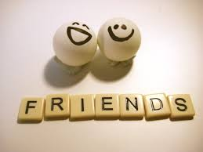
Tuedsay August 16, 2016
Describe a time that you had to solve a problem with a friend or family member. What was the problem and how was it resolved?

Slide 13
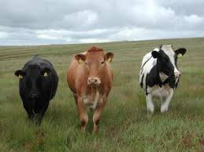
Wednesday August 17, 2016
On this day in 1786, Frontiersman Davy
Crockett was born. Before turning fifteen,
Davy was on his own, helping drive cattle
from Tennessee to Virginia. What do you
think were some of the obstacles Davy
encountered on his journeys?

Slide 14
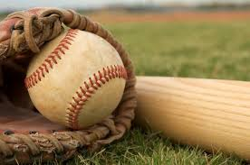
Thursday August 18, 2016
On this day in 1934, baseball great Roberto Clemente was born. Baseball is considered “America’s Pastime.” When you are outside of school, what is your favorite pastime and why?

Slide 15
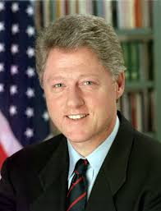
Friday August 19, 2016
On this day in 1946, Bill Clinton, our 42nd President, was born. What do you think would be the most challenging part of being President of the United States?

Slide 16
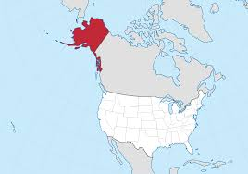
Monday August 22, 2016
On this day in 1741, Vitus Bering discovered Alaska. Alaska later became the 49th state. Using resources in the classroom, learn five (5) facts about this state and summarize them in your own words.

Slide 17
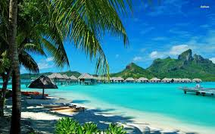
Tuesday August 23, 2016
On August 12, 1898, Hawaii was annexed to the United States. This means that the islands became property of the U.S. Hawaii actually didn’t become the 50th state until August, 21, 1959. Using resources in the classroom, learn five (5) facts about this state and summarize them in your own words.

Slide 18

Wednesday August 24, 2016
On this day in 1932, Amelia Earhart flew across the United States. What type of character traits do you feel Amelia needed to have to reach this goal of hers?

Slide 19
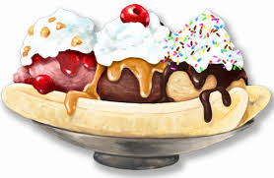
Thursday August 25, 2016
Today is “National Banana Split Day.” Explain how to make a banana split.

Slide 20
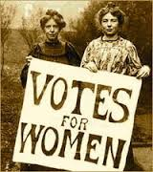
Friday August 26, 2016
On this day in 1920, the 19th Amendment - Women’s Equality was signed. Why do you think it was important for women to be able to vote?

Slide 21
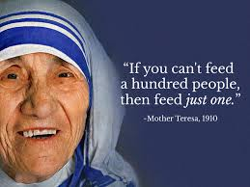
Thursday August 29, 2016
Mother Teresa was born on this day in 1910. Mother Teresa dedicated her life to helping others. List five (5) things you can do to help others today or this week.

Slide 22
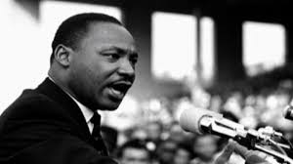
Friday August 30, 2016
On this day in 1963, Martin Luther King, Jr. delivered his famous “I Have a Dream” speech. Martin Luther King, Jr.’s dream was for all people, no matter what their skin color, to be treated equal. What is your dream?

Slide 23
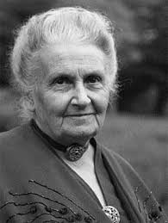
Wednesday August 31, 2015
On this day in 1870, a famous educator by the name of Maria Montessori was born. What is something new you would like to learn about this school year?

