Slide 1
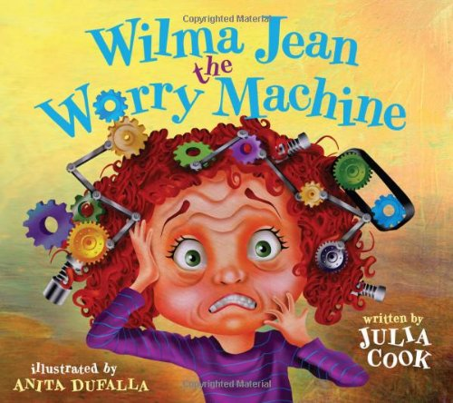
A Classroom Guidance Lesson On Worrying
By: Dr. Parkman, School Counselor
Garrett Elementary School

Slide 2
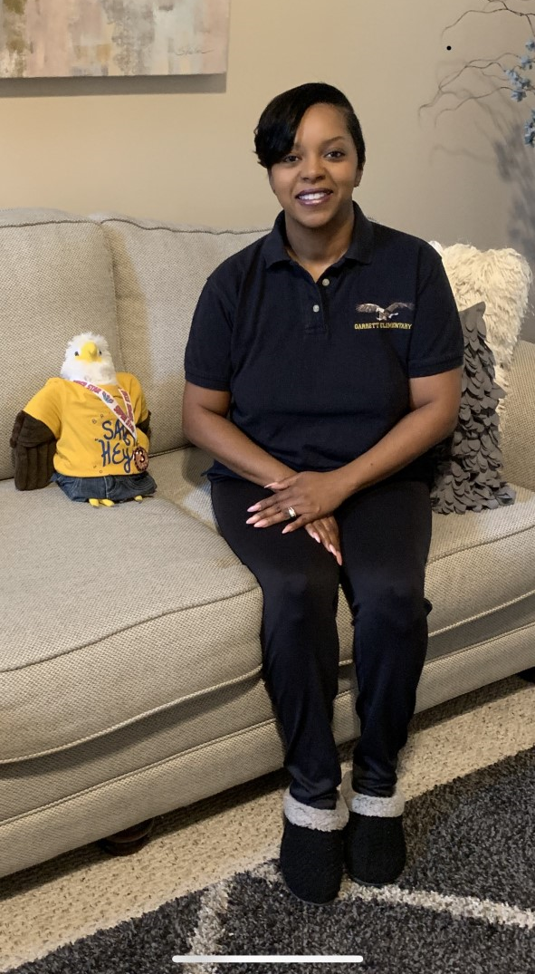
Good day Garrett Eagles!
I hope everyone is staying safe and enjoying their time at home with family while we are out. The school district is busy getting our school cleaned and ready for when we return, and the lunchroom
staff has been busy preparing lunches for
students that wish to eat a school lunch!
Harry the Eagle and I have been working from
my home and have prepared a lesson on worrying
just in case some of you are feeling a little worried
about recent changes in our daily routine due to
the Coronavirus.

Slide 3
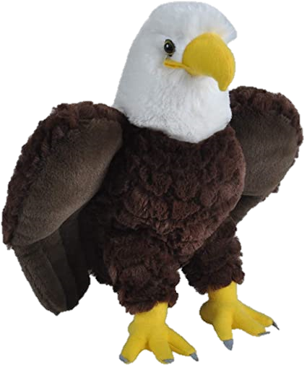
Everyone worries some times, and little bit of worrying can be good.

Slide 4
For example, when you’re worried about a test, you’re more likely to study for it.

Slide 5
In this situation, worrying shows you care and you want to do your best.

Slide 6
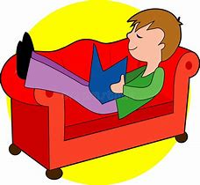
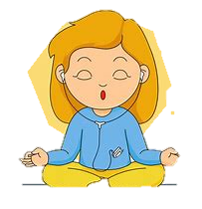
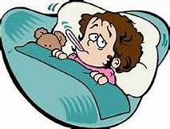
After studying, relax and remind yourself that your parents and your teachers know you are not perfect and only want you to do your best as well. This should help you not to worry too much.
Too much worrying can make you sad or even make you feel sick.

Slide 7
Wilma Jean The Worry Machine is a story about a young girl who worries… a lot!!! In the story, Wilma Jean’s teacher explains that there are worries she can control and worries she cannot control. She helps Wilma Jean come up with a plan for things she can control to help her not to worry so much. After reading the story, talk with your parents or another trusted adult about one thing you may be worried about. For example, many of you may be thinking what if we’re not able to return to school soon.

Slide 8
We have no control over when we will be able to return, but know that our leaders and doctors are working hard so that we can. Until then, make the most of your time at home completing your assignments in the comfort of your home with your family and put your worries in your worry hat that you can draw like Wilma Jean’s hat. Harry the Eagle and I hope you enjoy the story.
Double click the picture on the next page to listen to the story.
Go EAGLES!
Remember to SOAR!
Dr. Parkman · Garrett Elementary School · Richmond County School System

Slide 9
https://www.youtube.com/watch?v=gpAijfP99Ng&feature=youtu.be

