Slide 1
Geography of Ancient Greece
EQ: How did geography affect the development of Ancient Greece?
Warm Up: Write a brief description of the geography we see at Glenn Hills High. And suggest two ways in which geography can influenced cultures.
Homework:

Slide 2
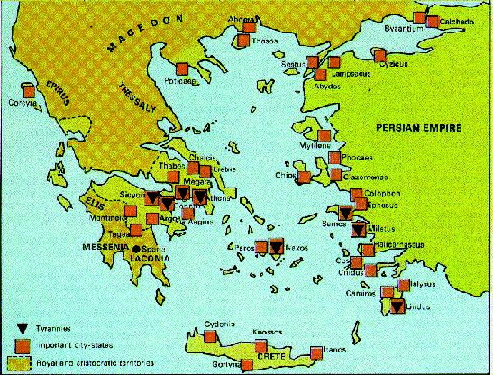
Geography
Greece is a peninsula about the size of Louisiana in the Mediterranean Sea.
It’s very close to Egypt, the Persian empire (includes Turkey) and Rome.

Slide 3
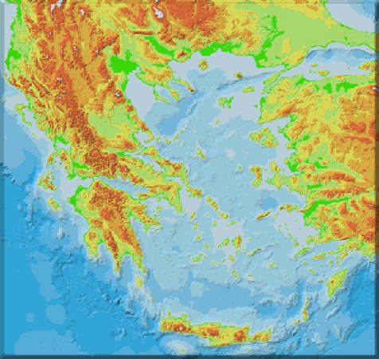
Greek geography
Greece is mountainous
Greek communities often times developed independently because of the mountains, thus they were diverse
As a result, they fought each other a lot.

Slide 4
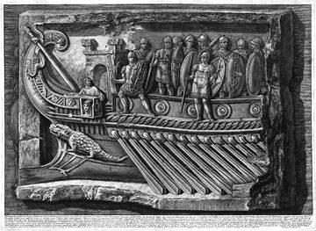
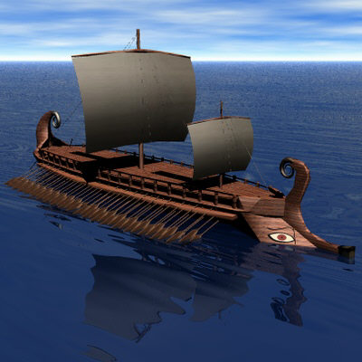
Technology results from necessity
Since Greek coastal cities were sandwiched between the ocean and the sea, they developed an awesome navy for trading and fighting.

Slide 5
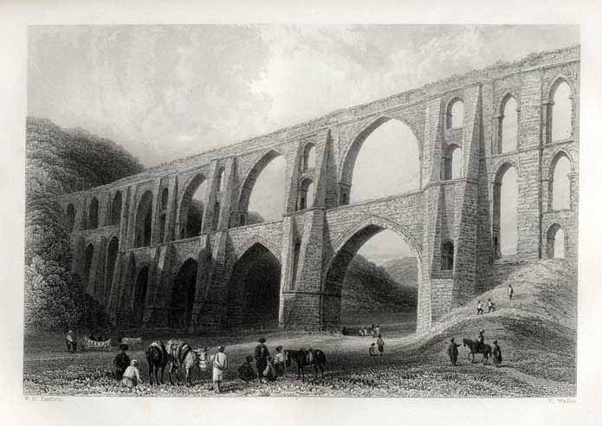
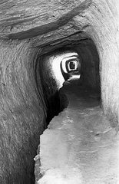
Technology results from scarcity
All cities need fresh water. This is a Greek aqueduct, basically a brick water pipe.
The first aqueduct was Assyrian, but most ancient societies had them.

Slide 6
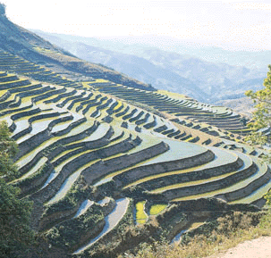
Terracing saves water and soil in mountainous environments

Slide 7
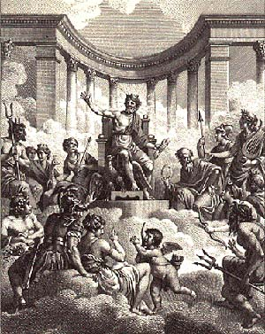
Greek religion was polytheistic.

