Slide 1
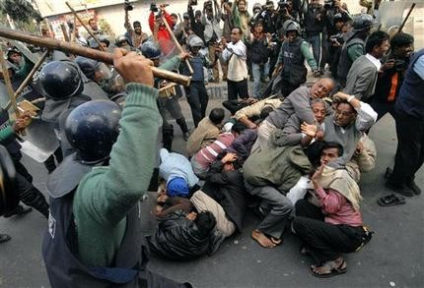
Athens vs. Sparta
DEMOCRACY
Aim/Goals: How did Athens compare to life in Sparta?
Do Now: Look at the images (pictures) to the right. Decide which type of government you would want to live in. Explain in a few sentences.
Homework :Write a paragraph explaining if you would rather live in Athens or Sparta and why.
MILITARY RUN GOVERNMENT

Slide 2
Do Now Response: Government
Democracy: a system of government where the people have a say in the government. Example: they vote for their leaders; freedom | Totalitarian: A state or country completely controlled by a single power, such as a monarch or dictator. They control everything and the people do not have a say!

Slide 3
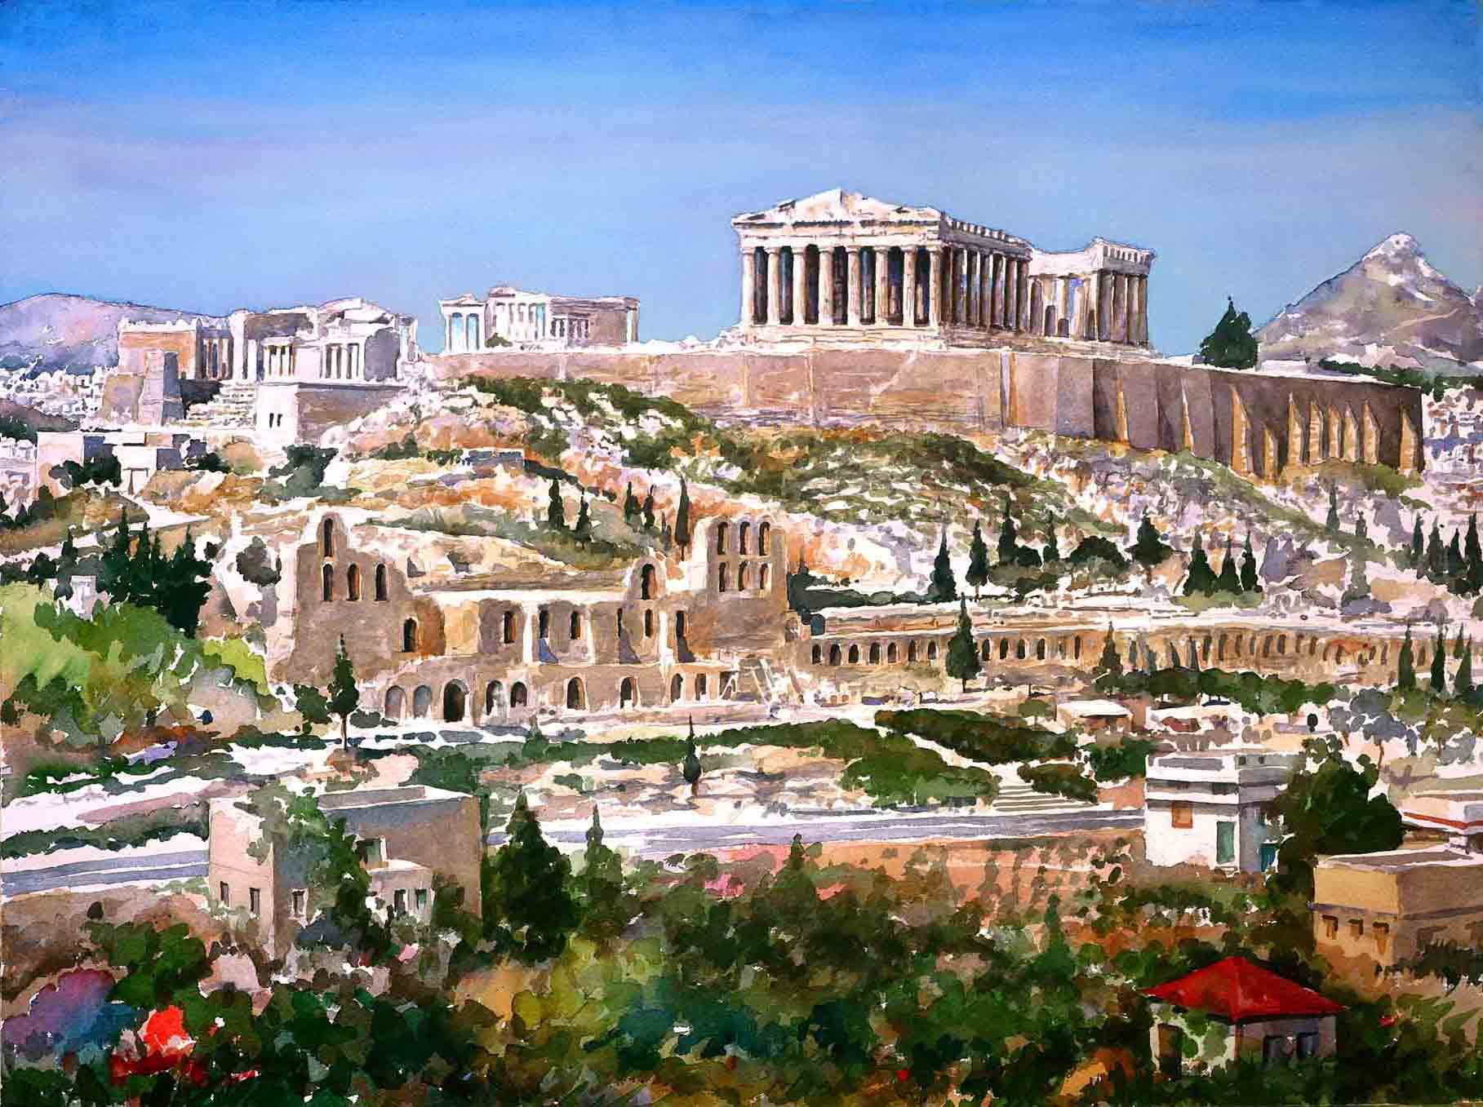
Activity: City-State Governments
Read Document #1 and answer question #1 in chart form.
Monarchy Ex. England
Aristocracy Ex. France before the revolution in 1789
Oligarchy Ex. Saudi Arabia

Slide 4
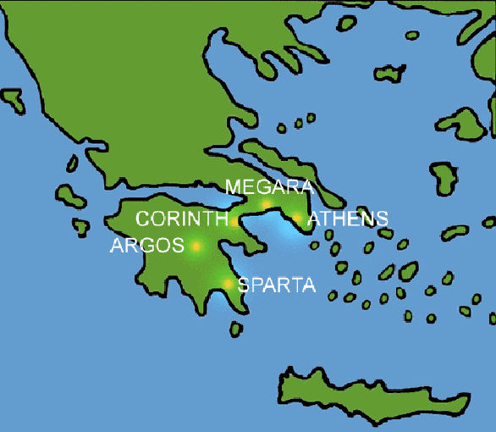
Aegean Sea
Ionian Sea
Mediterranean Sea

Slide 6
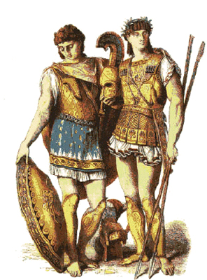
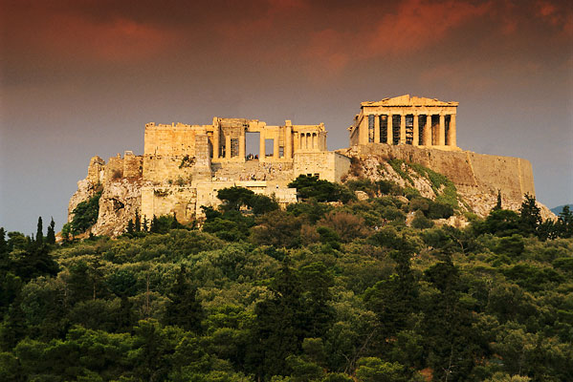
Athens vs. Sparta

Slide 7
Activity:
You are sitting in pairs for a reason. The students to the left are from Athens and will read and answer Document #2, questions #2, 3 and 4. The students to the right are Spartans and will read and answer Document #3, questions #6, 7 and 8.

Slide 8
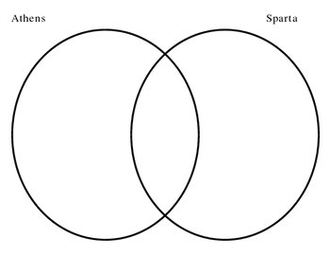
SIMILARITIES
DIFFERENCES
DIFFERENCES

Slide 9
SIMILARITIES
-Direct Democracy
-Only male citizens
Involved in government
-trade with other city-states
-Education for the boys
only
-Boys/men served in the
Military at 18 for 2 years
-Women were not equal
-Navy
-Located by the water
-Monarchy/Totalitarian
-Military society
-Trade and travel not allowed
-Military training for all boys
-Girls to be trained to be
mothers of soldiers
-Women obey men but they
could own property and
had rights.
-Army
-Located inland
-same language
-Olympics
-city-states
-located in Greece
-same gods and
religious beliefs
DIFFERENCES
DIFFERENCES

Slide 10
Regents Questions
1. The Ancient Athenians are credited (to do) with A. inventing and using the wheel B. eliminating slavery C. establishing governments that had democratic elements D. inventing the printing press

Slide 11
Regents Questions
2. Which ancient civilization established the basis of western democracy? A. Phoenician B. Egyptian C. Sumerian D. Greek

Slide 12
Regents Questions
3. The Ancient Greek city-state of Sparta A. was primarily concerned with the health of their people B. was a powerful military state C. granted universal suffrage to their people D. placed great emphasis on literature and the arts

