Slide 1
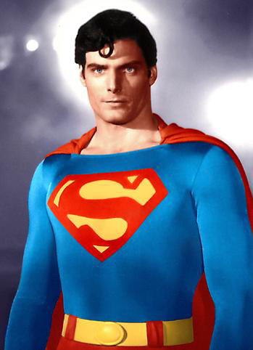
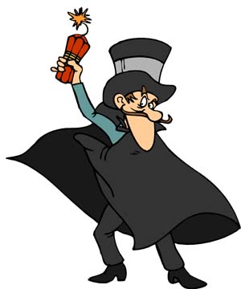
Alexander the Great
IMAGE 1
Aim/Goal: Was Alexander the Great a hero or a villain?
Do Now: Look at the images and explain what you see in a few sentences.
Homework: Is a man, such as Alexander, who spreads the ideas of others to new areas of the world, more important than those men who developed the ideas? Support your opinion in at least two paragraphs.
IMAGE 2

Slide 2
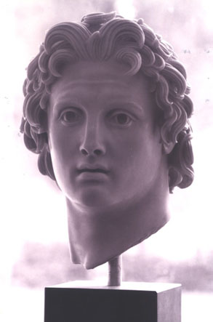
DEFINITIONS:
Hero: someone who does good things.
Villain: someone who does bad things; evil

Slide 3
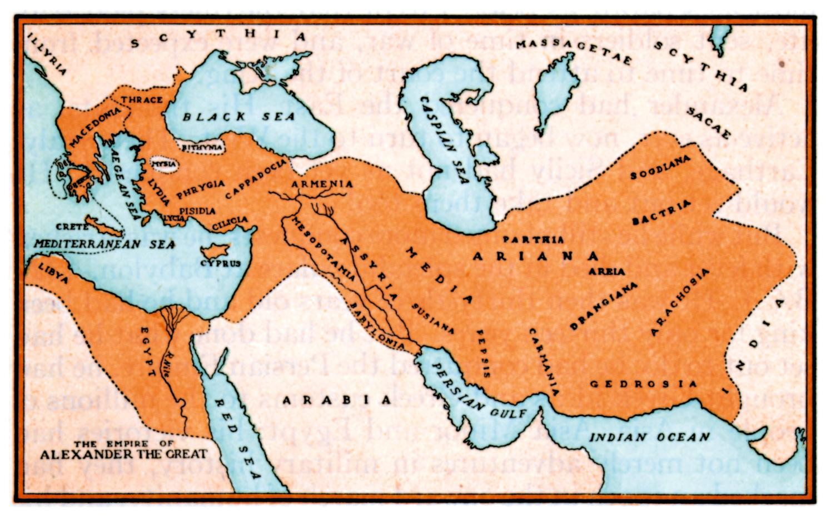
HOW MANY CONTINENTS DID ALEXANDER THE GREAT CONQUER?
LIST THEM.

Slide 4
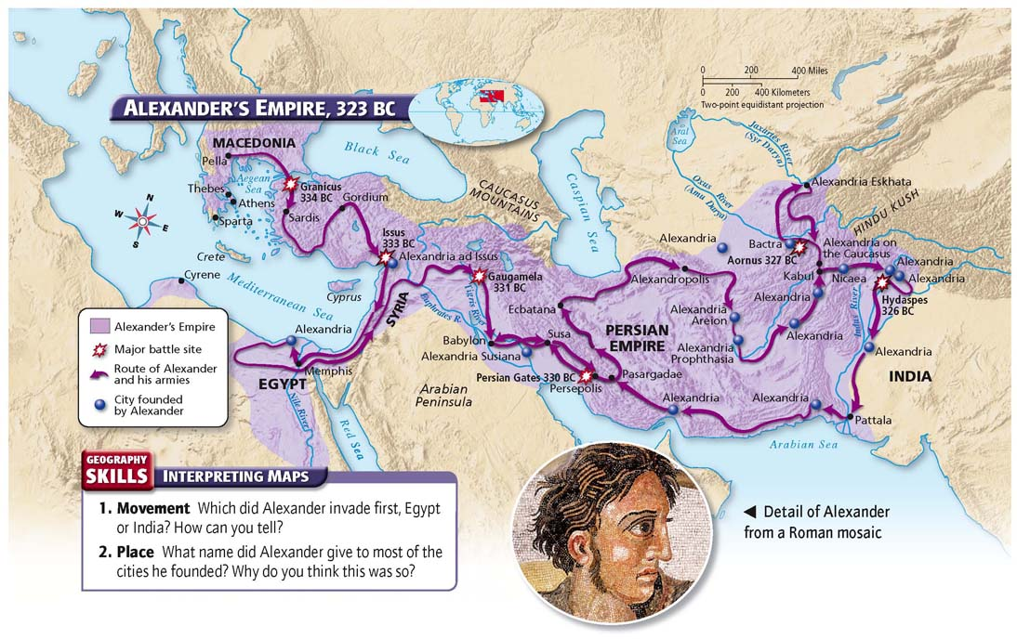

Slide 5
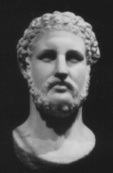
Notes:
Alexander the Great
A. Early Childhood
1. Son of Greek Macedonian king, Philip II.
2. He wanted to prove himself to his father.
3. Had his father assassinated (killed).

Slide 6
ACTIVITY:
DOCUMENT #1
“The Hellenistic Age lasted from 323 BC – 30 BC. Greek knowledge, culture, and customs were spread throughout much of the ancient world. The driving force behind this spreading of Greek civilization was Alexander the Great who died in 323 BC.”
According to document #1, what was Alexander the Great’s main accomplishment?
_______________________________________________________________________
DOCUMENT #2
“At age 33, using only men and horses, Alexander had placed almost a million square miles under his control. Everywhere his army went, whether Egypt or Afghanistan, Pakistan, India, or Turkey, Alexander and his army of Greeks were victorious. Alexander had truly deserved his title, at least as a military commander.”
According to document #2, why did Alexander the Great earn his title?
_______________________________________________________________________
_______________________________________________________________________
_______________________________________________________________________

Slide 7
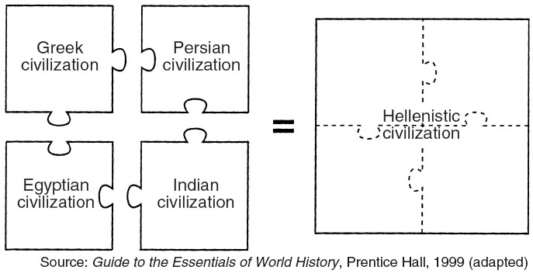
REGENTS BASED QUESTION
Which leader is most closely associated with the accomplishments shown by
The illustration?
Charlemagne C) Alexander the Great
Suleiman the Magnificent D) Mansa Musa

Slide 8
ACTIVITY:
DOCUMENT #3
“Those who surrendered quickly to Alexander were often showed mercy and generosity. The Phoenician towns of Gaza and Tyre, however refused to surrender. After nine months of attacks, Alexander and his army burst into the walled cities. Eight thousand enemy soldiers were slaughtered, two thousands Tyrian soldiers were crucified, remaining women and children were all sold into slavery, and the ancient cities
were totally destroyed.”
According to document #3, why were the two cities of Tyre and Gaza destroyed?
_________________________________________________________________________________
_________________________________________________________________________________
DOCUMENT #4
“It was not Alexander’s plan to ransack Asia like a robber, or to ruin it… but to bring all of the kingdom
of Earth under one form of government, and to make one nation of mankind… one law all over the
world, and one form of justice… the common light of universal government.”
According to document #4, why was Alexander attacking different kingdoms in Asia?
_________________________________________________________________________________
_________________________________________________________________________________

Slide 10
Notes Continued:
B. Builder of a Huge Empire
1. Conquered (to take over) Persian Empire to the east of Greece as well as parts of Asia and Africa. Wanted to conquer the world.
2. Those enemies who surrendered without a fight were treated with mercy and kindness; those who fought back were destroyed.
C. Accomplishments
1. Hellenization, which is the spread of Greek culture and learning to conquered areas.
2. Cultural diffusion, which was the spread of Asian and African ideas into Greek society.
D. Death
1. At the age of 33, he either died from alcoholism, malaria or a broken heart after his army refused to fight any more.

Slide 11
Summary Question:
In your opinion, was Alexander the Great a hero (good) or a villain (bad)?

