Slide 1
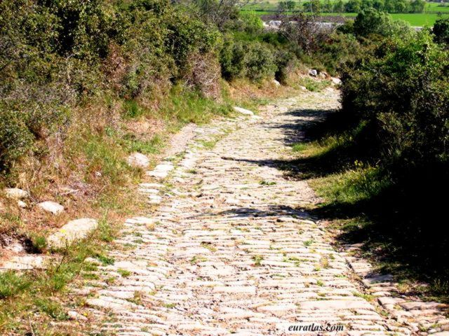
Contribution of ancient Rome
Aim/Goals: How did Rome leave its mark on World History?
Do Now: “All Roads lead to Rome.” In two sentences explain what this quote means.
Homework: Write an ad in which you try to convince the people of another country to become part of the roman Empire.

Slide 2
ROME HAS GIVEN THE WORLD:
1.
2.
3.
4.

Slide 3
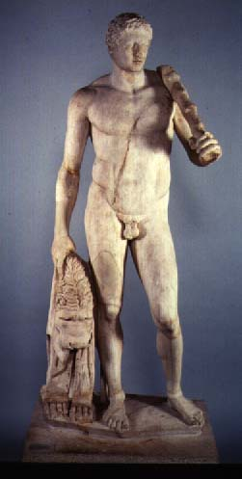
ART
1. Roman sculptors believed in realism. They created work exactly how the person looked. Whereas, the Greeks made everyone perfect.

Slide 4
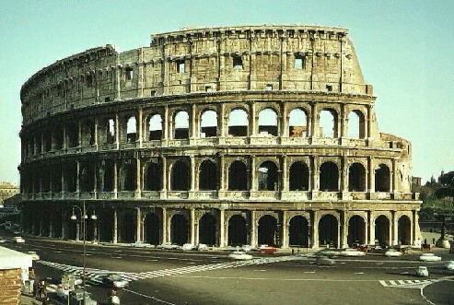
Architecture
Romans building used Greek columns which made them imitators (copy cats).
Made immense (huge) palaces, temples, and stadiums.
Created arches (Think McDonald’s)

Slide 5

GOLDEN ARCHES

Slide 6
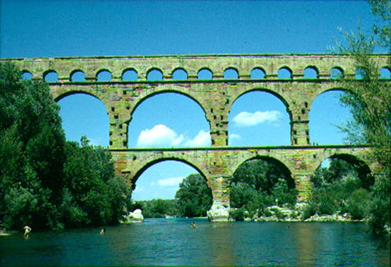
ENGINEERING
Built roads, bridges, and harbors (water; ships; trade).
Aqueducts, which were bridge like stone structures that brought water from the hills to Roman cities.

Slide 7
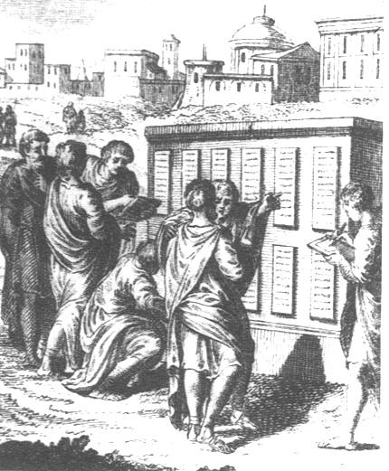
The Twelve Tables

Slide 8
Activity:
Read aloud Document #1 (Twelve Tables)
1. Ms. Gluck steals five dollars and is sentenced to three years in jail. Mr. McKeon commits the same crime and is sentenced to only three months in jail. Is this system of justice fair? Why?
2. What happens in America if a child is born deformed (damaged)?
3. Rhianna needs a witness in court that Chris Brown gave her a beat down. Ms. Gluck saw him beat her but she doesn’t want to get involved. What will happen in a court of law?
4. Your next door neighbor has a huge tree and it is leaning on your property. What can you do?

Slide 9
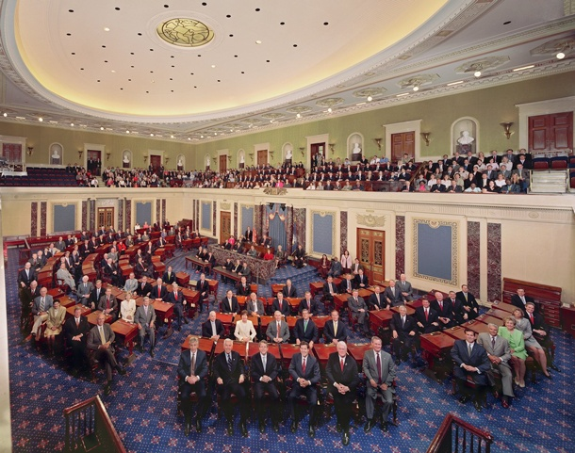
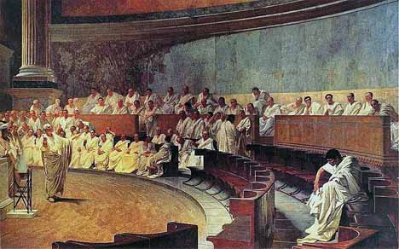
The Senate

Slide 10
Document #2

Slide 11
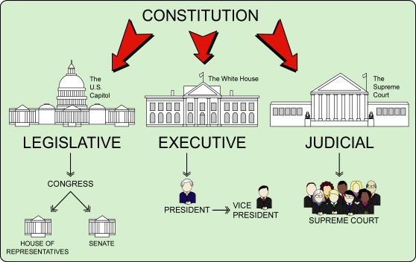
Document #3
Approves the Makes the laws Applies the laws
laws

