Slide 1

Christianity
Aim/Goal: Why did Christianity spread
through the Roman Empire?
Do Now: List three (3) things that you
know about Christianity.
Homework #13: Listed on today’s
handout.
You are a Jew or a Christian during the
Roman Empire. In a paragraph, explain if
you would show loyalty to the Roman gods
and Emperors if your religion stated that
you could not.

Slide 2
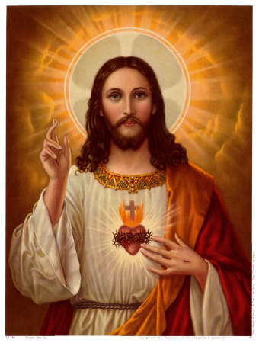
Christianity
1.
2.
3.
4.
5.

Slide 3
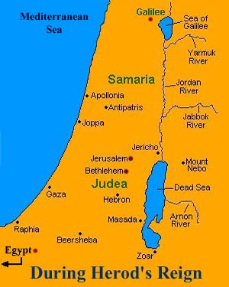
Activity:
Read paragraphs 1 and 2 of the handout. Answer questions #1-2 in full sentences in your notebooks.
The Romans treated people who had different religions
___________________.
2. The Romans treated the Jews ______________
__________________. Jesus has to deal with the Jewish people because _________
__________________________
__________________________.

Slide 4
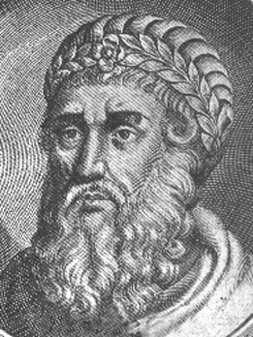
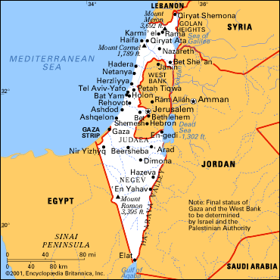
Images for Questions #1 & #2

Slide 5
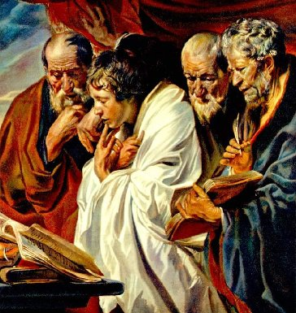
Activity:
Read paragraph 3 and answer question #3 in full sentences in your notebook.
3. The four disciples were ____________
_________________ and they accomplished _________________
___________________
___________________.

Slide 6
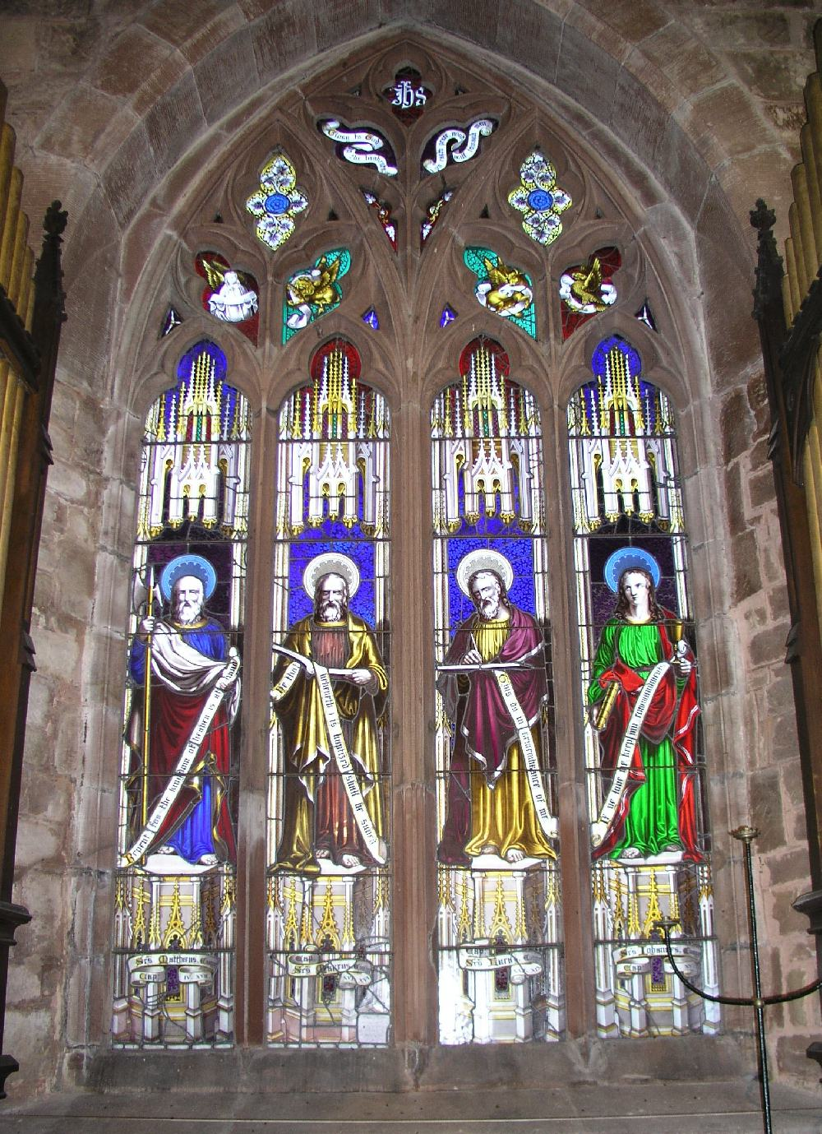

Slide 7
Paragraph 4
Read Aloud
According to the New testament, Jesus grew up in Nazareth. He learned to be a carpenter (builder) and began teaching when he was 30 years old. Christian tradition holds that for three (3) years Jesus traveled from place to place, preaching to Jews who lived in the countryside. Much of what he taught was part of the Jewish tradition he learned while he was growing up. Like all Jewish teachers, Jesus preached there was only one true God.
Question for thought:
Do you think it is amazing that a man at the age of 30 and who only spread the word of God for 3 years, could be so powerful in having a religion named after him? DISCUSSION!

Slide 8
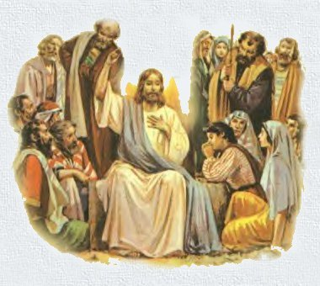
Activity:
Read paragraphs 5-7 and in full sentences in your notebook, answer questions #4 -5.
4. Will answer after we answer question 5.
5. Jesus teachings alarm the Romans because ____________________
______________________
______________________

Slide 9
Teachings of Jesus

Slide 10
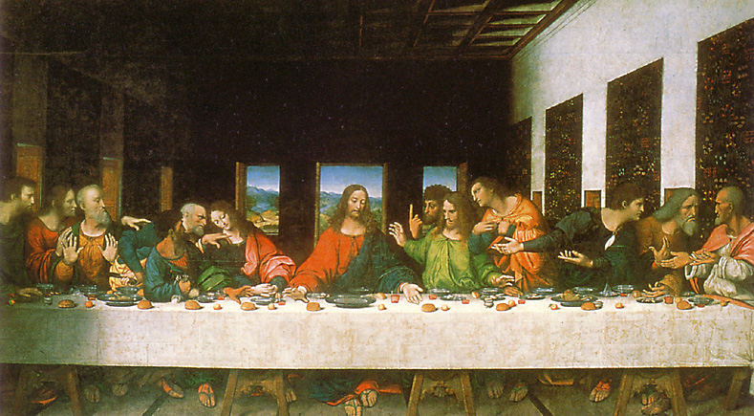
The Last Supper

Slide 11
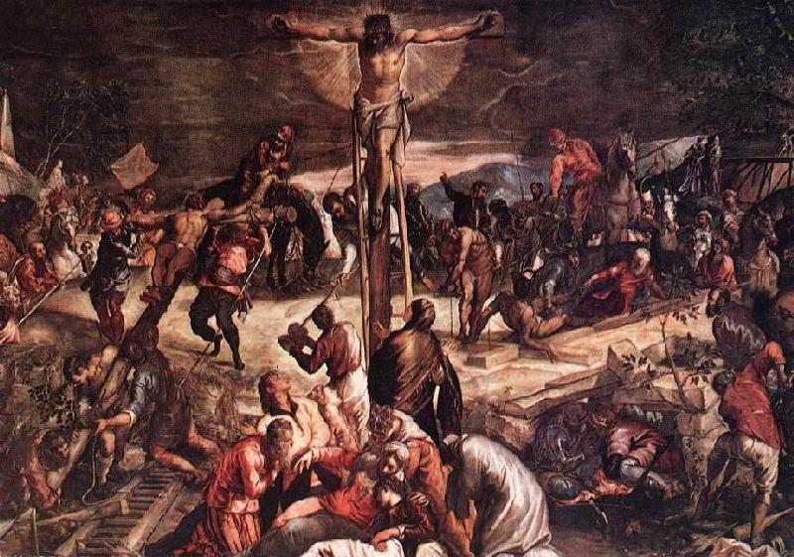
Jesus Crucifixion

Slide 12
Summary Activity:
Do you think if Jesus didn’t challenge the Roman Emperors he would have been crucified? Explain.

