Slide 1
Fall of the Roman Empire
Essential Question: Why did the Roman Empire decline (to fall)?
Do Now: What does this quote mean to you?
“The sun never sets (goes down) on the Roman Empire.”
Homework #15: On a separate sheet of paper, answer Part C of today's handout.
Study for Thursday’s exam.

Slide 2
FRANCE
GREECE
SPAIN
TURKEY

Slide 3
Vocabulary:
Barbarians: uncivilized person; violent person; aggressive person.
Ethnocentrism: a belief that your culture (background) is superior (better) than others.

Slide 4
Preparing for the Class Skit (Play) One volunteer is needed to read!

Slide 5
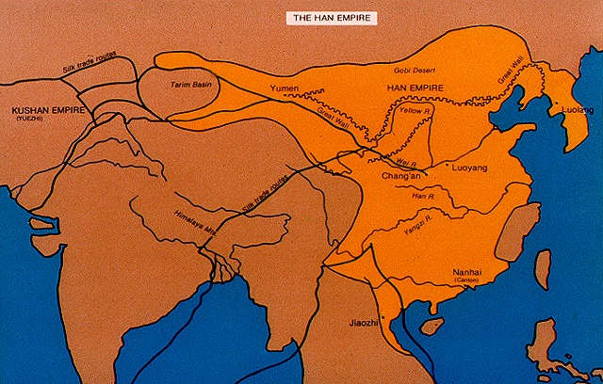
Han Empire (China) 206 B.C. – 184 A.D.
Huang He

Slide 6
WHY DO GREAT EMPIRES DECLINE?
The following scene takes place in the nursing home (a place for old people to go until they died) for Empires.
Oldus: I can’t believe that I am here in a nursing home. I use to stretch from England all the way to Asia and Africa. Now I’m sitting here cleaning my false teeth and waiting for the nurse to bring me my medicine.
Tiredus: I hear you. I also held an incredible territory, from the Huang He in the south to the Yangtze River to the west. Now look at me, all I can eat is mashed potatoes and ice cream. I am sick and tired of peeing in my pants.
Oldus: We use to be great Empires, feared and hated by many. Now we are nothing, what happened?

Slide 7
Tiredus: Well, my warriors were so successful and conquered so much territory that other tribes wanted to take land from us.
Oldus: Same here. We use to say that the sun never sets on the Roman Empire. Barbarians from the north tried to take pieces of our empire from us.
Tiredus: I’m with you on that. We tried to stop the barbarians to our north from attacking by building the Great Wall. Well, we should have built it another 30 feet higher and 20 feet thicker.
Oldus: Well, we didn’t build a Great Wall but we used our soldiers to defend the outer areas of the Empire. We had many soldiers but needed more.

Slide 8
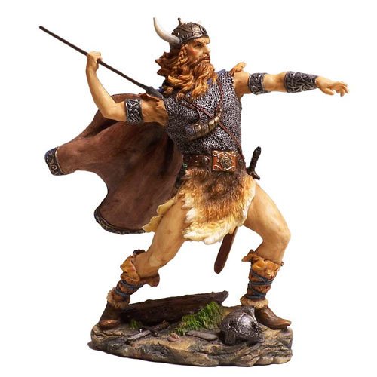

Slide 9
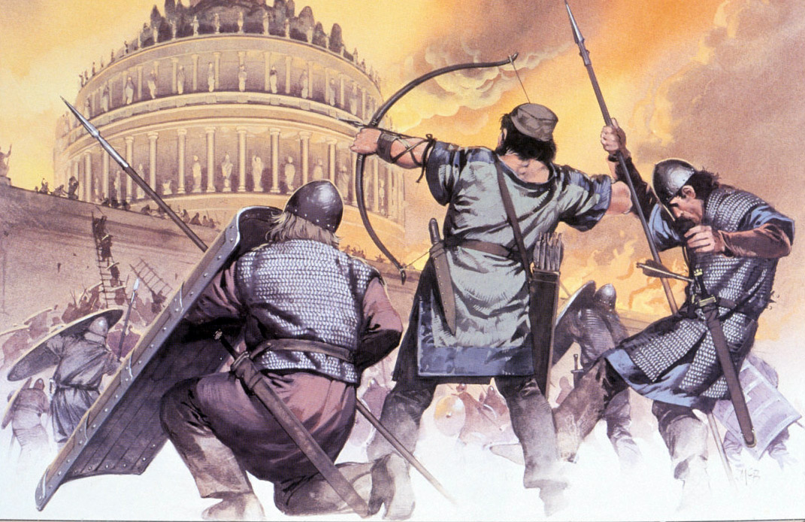

Slide 10
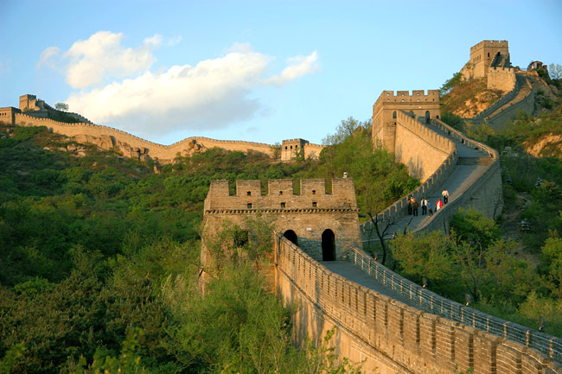
The Great Wall of China

Slide 11
Tiredus: I know. Those barbarians were not very nice when they finally attacked our capital, Peking. Almost nothing was left standing.
Oldus: Tell me about it. I’m surprised that the Coliseum is still standing after the destruction those creeps cause in Rome.
Tiredus: Well, my people got what they deserved. We needed more and more taxes (money) to defend the Empire but all the people did was complain and refuse to pay their taxes. Eventually, they began to attack their Emperor. Ungrateful dummies!
Oldus: We have a lot in common. The Roman people must have thought that soldiers and army equipment are free because they revolted (went against) against the higher taxes also. How dare they curse and attack our Emperors? Those people are almost as terrible as Ms. Gluck’s students who do not do Global History homework.

Slide 12
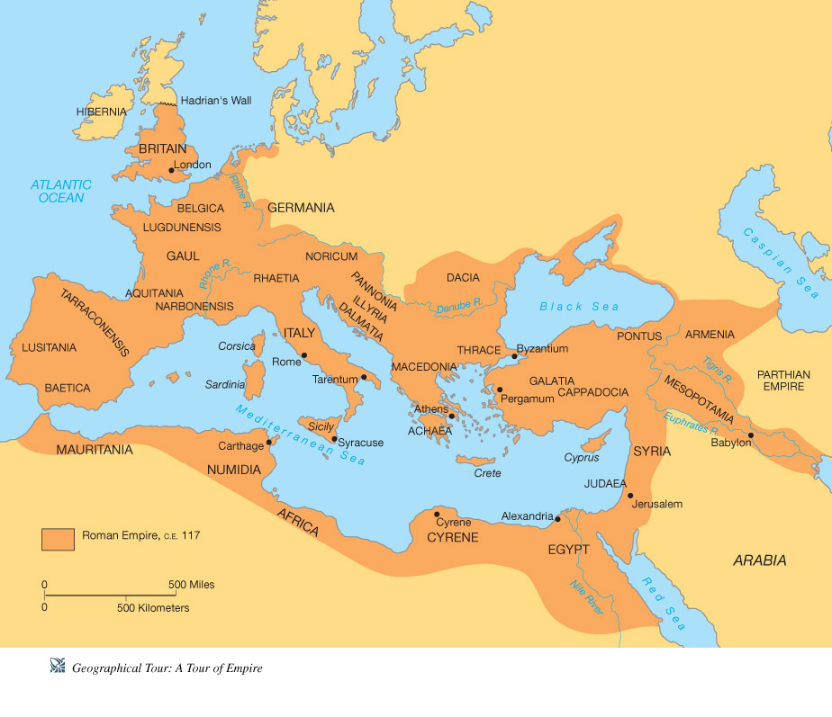
Roman and Han Empires
FRANCE
Peking

Slide 13
Answer the following in your notebooks:
Roman Empire was named: _________________________
Han (China) was named: _________________________
What happened to the Roman and Han Empires? The Roman and Han Empires
__________________________________.
What problems did they face? The Roman and Han Empire faced ______________________
________________________________________.

Slide 14
READ ALOUD
There are many reasons why the greatest empire in history ended. When you read about the reasons, ask yourself, “Which of these reasons was the most important one to explain why the Roman Empire fell?”
Please keep in mind that the Roman Empire did not fall in a day. Some historians say that it took 400 years.

Slide 15
ACTIVITY:
You are to read the “The Long Decline” pp. 147-151.
You are to answer Questions 1-3 on pg. 150. Keep in mind that these are different questions. #3 the critical thinking question should be several sentences long. Use your textbook to answer.

Slide 16
Responses:
Part A: List three reasons why the Roman Empire fell.
1.
2.
3.

Slide 17
Continuation of Responses:
Part B: Explain the causes of the Roman Empire.
The causes of the Roman Empire were
__________________________________________________________________________________________________________________________________________________________________________.

Slide 18
Summary Question:
An immediate result of the fall of the Roman Empire was 1. a renewed interest in education and the arts 2. a period of disorder and weak central government 3. an increase in trade and manufacturing 4. the growth of cities and dominance by the middle class

Slide 19
Both the Ancient Romans and the Ancient Chinese viewed foreigners (people from different places) as barbarians. This is an example of 1. cultural diffusion 2. materialism 3. imperialism 4. ethnocentrism

