Slide 1
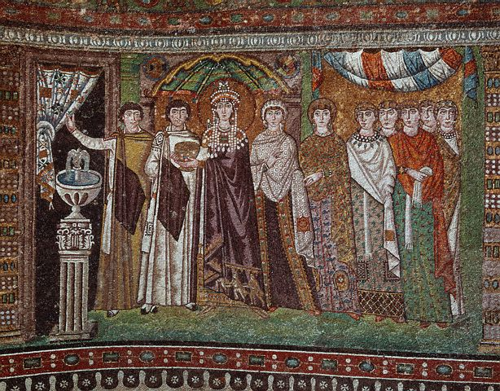
The Byzantine Empire: The New Rome
E.Q: Why was the Byzantine Empire able to survive 1000 years?

Slide 2
E.Q.: Why was the Byzantine Empire able to survive 1000 years?
Do Now: Do Not Copy, Just Answer! IF A COMPANY WAS MOVED FROM NEW YORK CITY TO MEXICO CITY, HOW WOULD THIS AFFECT THE COMPANY AND ITS EMPLOYEES? Would it be the same company or would the move change the company? EXPLAIN IN A FEW SENTENCES!
Homework: Justinian was known as “The Emperor who never sleeps.” In a paragraph, explain why this quote written about him.

Slide 3
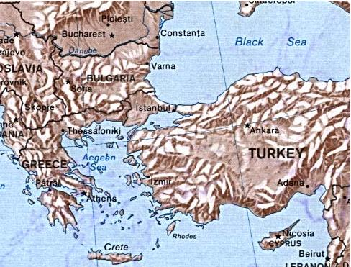
Constantinople
What are the advantages of building a major city here?

Slide 4

Advantages
MAP
Peninsula
Provided natural safe harbors for ships
  both merchant and military ships
Provided natural defense
  water on three sides. (the Black and Aegean Seas)

Slide 5
Advantages
MAP
Trade
Easy access to the Mediterranean Sea
Located at an important land route that linked Europe and Asia (Silk Road)

Slide 6
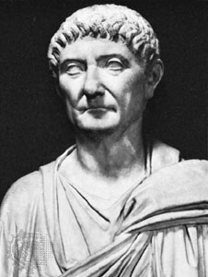
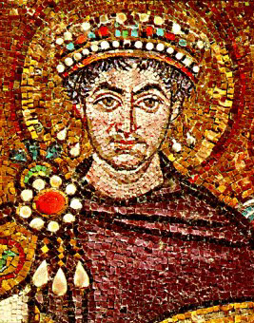
EMPERORS OF ROME

Slide 7
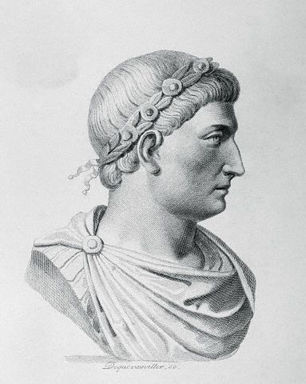
Constantine
In 330 Diocletian’s successor, Constantine, rebuilt the old Greek port of Byzantium, at the entrance to the Black Sea. He renamed it Constantinople and made the city the capital of the Eastern Roman Empire.

Slide 8
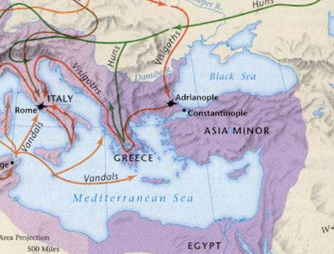
Constantinople
From World History: Connections to Today Prentice Hall, 2003

Slide 9
ACTIVITY:
Read Document #1 and answer questions #1-3.
The Byzantines preserved (to keep) from Rome and Greece _________________________________________________________________.
The Byzantines reach their height under Emperor __________________.
The Byzantine Empire declined because
_______________________________________
______________________________________.

Slide 10
Byzantine: Blend
Roman
Empire Building
realism
Warfare
City Building and Planning
Roman Law
Greek
Language
Philosophy: Small groups met discussed the great Greek ideas
Religion: Eastern Orthodoxy will be the mixture of Greek Christians who separated from Rome

Slide 11
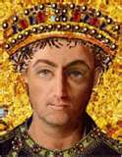
JUSTINIAN

Slide 12
Justinian Code
Emperor Justinian is best known for his code of law called the Justinian Code. His code included Roman laws. Later Emperors continued to update the code. By the 1100s, it had reached Western Europe, where it has become law for both the roman Catholic Church and medieval rulers. Even today, international law is influenced by the Justinian Code.

Slide 13
Activity:
Read Document #2 and answer question #4.
4. The Justinian Code is similar to the legal principals (beliefs) in the U.S. today because __________________________
___________________________________

Slide 14
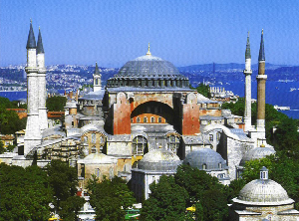

Slide 15
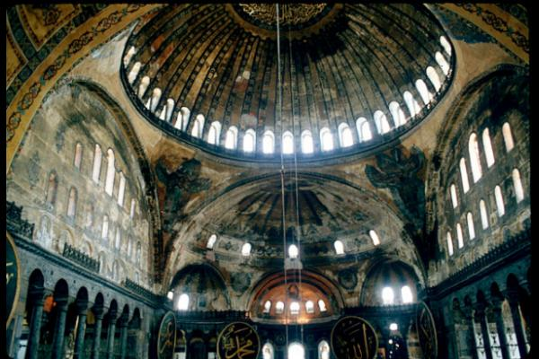

Slide 16
ALL GOOD THINGS MUST COME TO AN END
As a class, we will read and answer Document #3.
“The Byzantine Empire in the years (700-1000) performed a valuable duty. It acted as a barrier against the Muslim invasions, which threatened all of Western European civilization. When Constantinople finally was conquered by the Ottoman Turks (Muslims), the Western Kingdoms were strong enough to resist the Muslim invaders; Europe would not fall to Islam after all.”
5. Based on this document, why does Western Europe owe the Byzantine Empire a huge debt (to owe something)?

