Slide 1
Byzantine Empire
Essential Question: How did the Byzantine Empire contribute to civilization?
Do Now: Look at the image on the next slide. In a few sentences, explain how this piece of Byzantine art was created.
Homework: Write a paragraph describing the contributions of the Byzantine Empire to Global History.

Slide 2
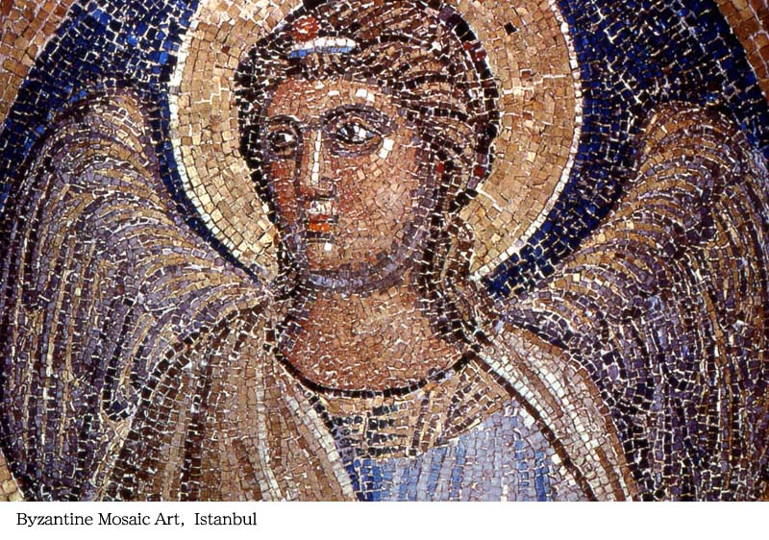

Slide 3
The Eastern Empire
As Western Europe succumbed to the Germanic invasions, imperial power shifted to the Byzantine Empire (the eastern part of the Roman Empire).

Slide 4
Constantinople
Constantinople became the sole capitol of the empire and remained so until the successful revival of the western empire in the 8th century by Charlemagne.

Slide 5
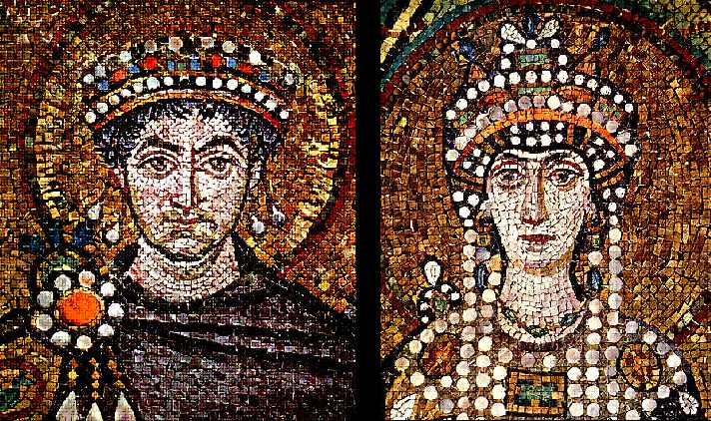
The Reign of Justinian
The height of the first period of Byzantine history (324-632) was the reign of Emperor Justinian (r. 537-565) and his wife Empress Theodora (d. 548)

Slide 6
The Imperial Goal: Unity
The imperial goal in the East was to centralize government and impose legal and doctrinal conformity.
One God One Empire One Religion

Slide 7
1st Method: Law
Justinian collated and revised Roman law. His Corpus Juris Civilis (body of civil law) had little effect on medieval common law. However, beginning with the Renaissance, it provided the foundation for most European law down to the 19th century.

Slide 8
2nd Method: Religion
Religion as well as law served imperial centralization. In 380, Christianity had been proclaimed the official religion of the eastern empire. Now all other religions were considered “demented and insane.”

Slide 9
Increase in Church Wealth
Between the 4th and 6th centuries, the patriarchs of Constantinople, Alexandria, Antioch, and Jerusalem acquired enormous wealth in the form of land and gold.

Slide 10
Increase in Clergy
The prestige and comfort that the clergy enjoyed swelled the ranks of the clergy in the Eastern Church.

Slide 11
Independent Thinking
Ideas thought to be heresies by the Roman Catholic Church received imperial support:
Arianism denied that Father and Son were equal and coeternal.
Monophysitism taught that Jesus had only one nature, a composite divine-human one.
Iconoclasm forbid the use of images (icons) because it led to idolatry.

Slide 12
3rd Method: Strong Cities
During Justinian’s reign, the empire’s strength was its more than 1,500 cities. The largest with 350,000 inhabitants, was Constantinople, the cultural crossroads of Asian and European civilizations.

Slide 13
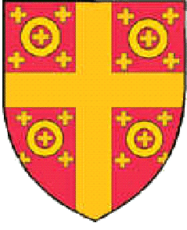
"Not since the world was made was there . . . so much wealth as was found in Constantinople. For the Greeks say that two-thirds of the wealth of this world is in Constantinople and the other third scattered throughout the world."
--Robert of Clari, a French crusader who witnessed the pillage of the city in 1204, describing Constantinople.

Slide 14
Loyal Governors and Bishops
Between the 4th and 5th centuries, councils were made up of local wealthy landowners, who were not necessarily loyal to the emperor. By the 6th century, special governors and bishops replaced the councils and proved to be more loyal to the emperor.

Slide 15
Extensive Building Plans
Justinian was an ambitious builder. His greatest monument was the magnificent domed church of Hagia Sophia (Holy Wisdom), which was constructed in just five years (532­37).

Slide 16
The Empire at Its Height
The empire was at its height In 565, during Justinian’s reign. It included most of the lands surrounding the Mediterranean Sea.

Slide 17
Decline in the 7th Century
In the seventh century the empire lost Syria, the Holy Land, Egypt, and North Africa to invading Islamic armies.

Slide 18
The Iconoclastic Controversy
The Iconoclastic Controversy, a movement that denied the holiness of religious images, devastated much of the empire for over a hundred years.
During the eighth and early ninth centuries the use of such images was prohibited, but icons were restored by 843.

Slide 19
Recovery of Territory
The Byzantines called upon the European states to push back the Muslim conquerors. The European states complied, successfully pushed back the Seljuks, returned territory to the Byzantines, and carved out kingdoms of their own in Syria and Palestine.

Slide 20
The Fall of Constantinople
in 1204, the Crusaders attacked, conquered, and pillaged the city of Constantinople, a goal that the Muslims had been trying achieve for centuries

Slide 21
Conquered by the Ottoman Turks
In 1453, the city was finally and permanently conquered by the Ottoman Turks and renamed Istanbul. Byzantine culture, law, and administration came to its final end.

Slide 22
Contribution to Western Civilization
Throughout the early Middle Ages, the Byzantine Empire remained a protective barrier between western Europe and hostile Persian, Arab, and Turkish armies.
The Byzantines were also a major conduit of classical learning and science into the West down to the Renaissance. While western Europeans were fumbling to create a culture of their own, the cities of the Byzantine Empire provided them a model of a civilized society.

