Slide 1
AIM: WHY DID THE CHURCH DIVIDE?
DO NOW: READ THE PRIMARY SOURCE ON THE HANDOUT.
ANSWER QUESTIONS 1 AND 2.
HOMEWORK #2: JUSTINIAN CODE V. PRESENT LAWS HANDOUT. ANSWER ALL 5 QUESTIONS IN FULL SENTENCES ON A SEPARTE SHEET OF PAPER.

Slide 2
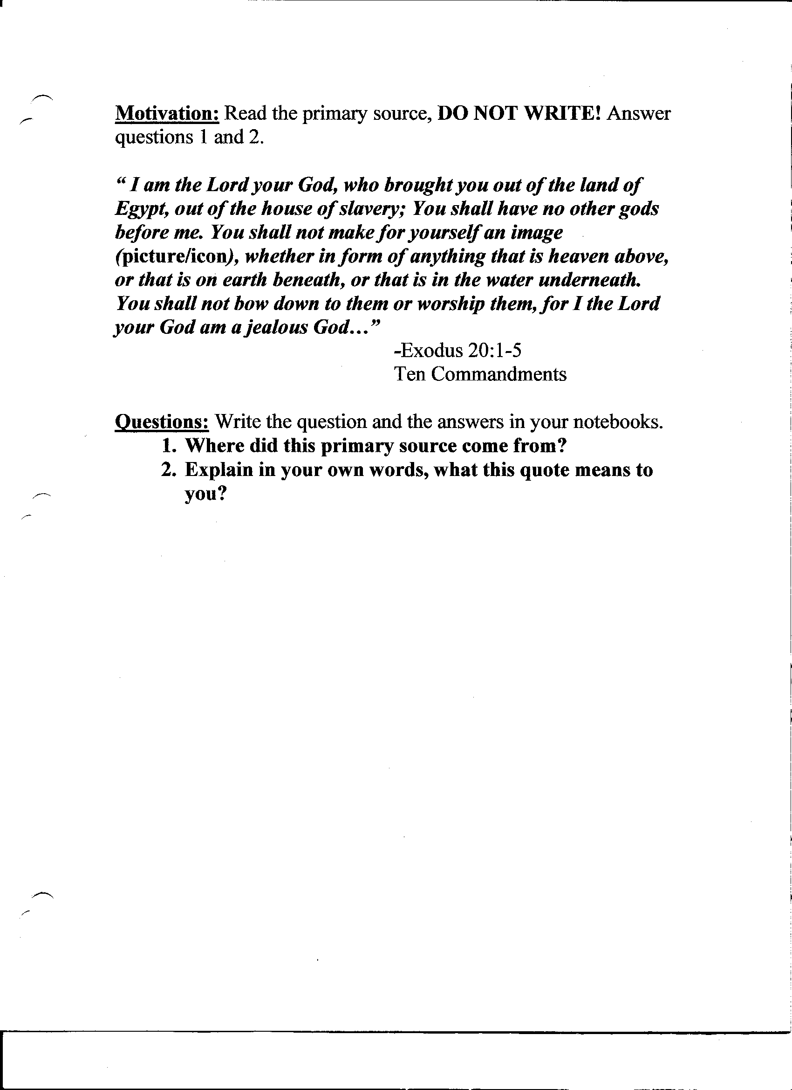

Slide 3
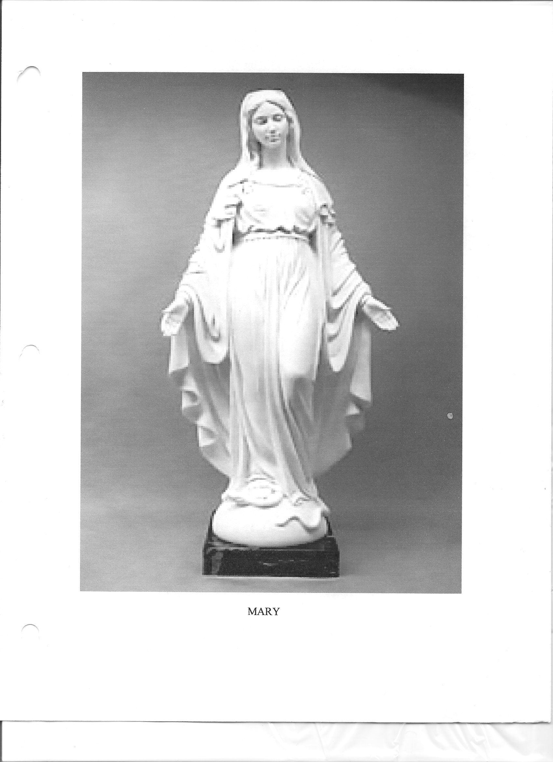

Slide 4
What is an Icon?
They appear in several forms; in mural painting, mosaic and most typically painted on small wooded panels.
Flat 2 dimensional religious images can be recognized in special ways - prayed to and carried in the air in religious processions - and specific technical rules guide their artistic form.

Slide 5
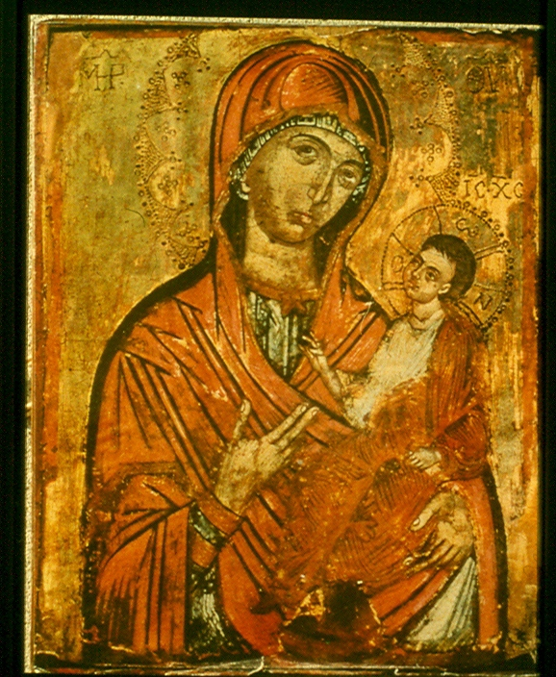

Slide 6
ACTIVITY #1
READ DOCUMENT #1
ANSWER QUESTIONS #1-2 IN FULL SENTENCES IN YOUR NOTEBOOK.

Slide 7
The West - Roman Catholic Church
All Mass was in Latin
clergy were celibate
Religious icons of martyrs and saints to be respected
Only Pope was Supreme head of Church in the West - above any political ruler
Pope and Bishops could interpret the scriptures.

Slide 8
The East- Orthodox Church
“Mass” was in Greek - so everyone could understand. Monks who did missionary work often converted it into the language of the people they were trying to convert
Emperor was superior to Patriarch of Constantinople.
Bishops couldn’t marry
Other priest didn’t have to be celibate
Icons caused much controversy - used but disapproved of.

Slide 9
What was the problem?
Some Byzantine Christians were against icons - they thought it was wrong to worship something that was man- made. Worship should only be made to God.
These anti-icon Christians became known as “ICONOCLASTS” - meaning icon smashers
Those in favor thought they helped the faithful honor the figures represented.

Slide 11
ACTIVITY #2
READ DOCUMENT #2 AND ANSWER QUESTIONS #3-4 IN FULL SENTENCES IN YOUR NOTEBOOK.

Slide 12
A Rift Develops
In 730 Emperor Leo III passionately joined the ranks of iconoclasts; he banned icons and ordered all religious images be burned, whitewashed or destroyed.
Pope Gregory III, favored icons and excommunicated (to kick out of the Chruch forever) Emperor Leo.

Slide 13
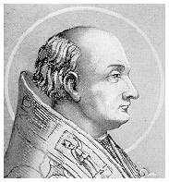
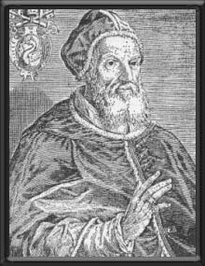
EMPEROR LEO III : BYZANTINE EMPIRE (EAST)
POPE GREGORY III: ROMAN
EMPIRE (WEST)

Slide 14
The Great Schism (SPLIT)
After decades of controversy the Byzantines finally accepted icons.
In 1054 the Christian church split into 2 churches forever. In the West; the Roman Catholic (universal) Church. In the East; the Eastern Orthodox (correct belief) Church.

