Slide 1
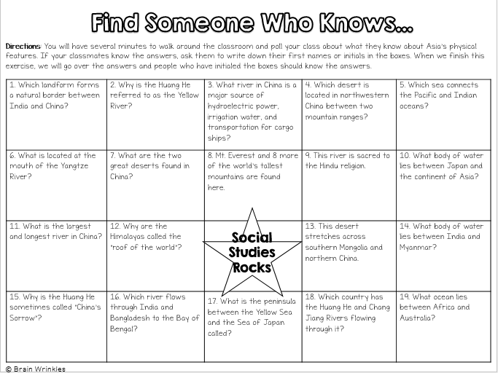
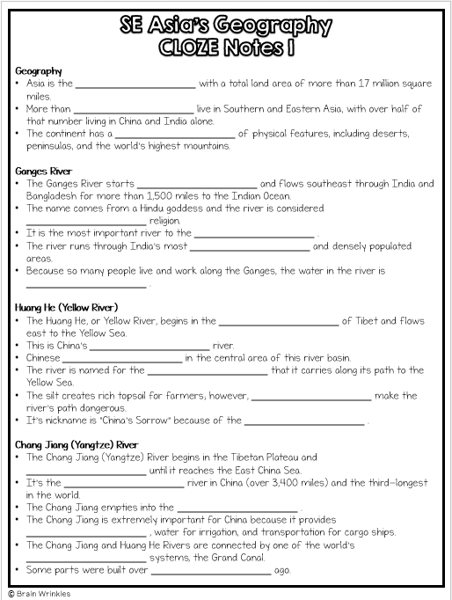
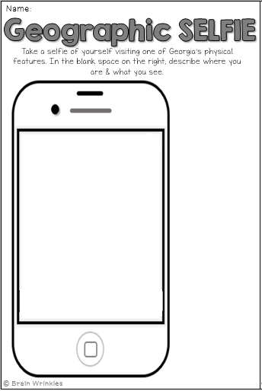
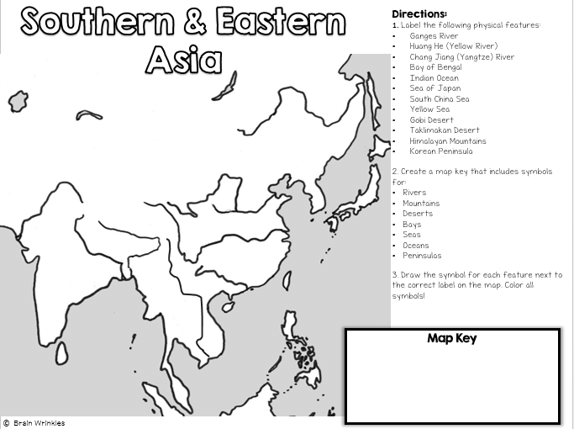
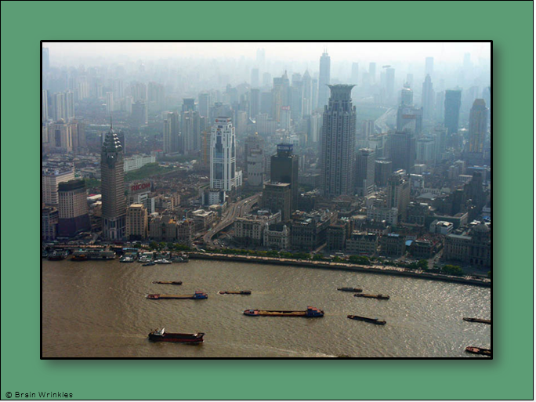
Southern & Asia’s Eastern
GEOGRAPHY
GEOGRAPHY
Presentation, Graphic Organizers, & Activities

Slide 2
STANDARDS:
SS7G9 Locate selected features in Southern and Eastern Asia.
Locate on a world and regional political-physical map: Ganges River, Huang He (Yellow River), Chang Jiang (Yangtze) River, Bay of Bengal, Indian Ocean, Sea of Japan, South China Sea, Yellow Sea, Gobi Desert, Taklimakan Desert, Himalayan Mountains, and Korean Peninsula.
Locate on a world and regional political-physical map the countries of China, India, Japan, North Korea, South Korea, and Vietnam.
© Brain Wrinkles

Slide 3
Instructional Activities
The students will use the following maps to help prepare them for our upcoming test on Friday.
See Maps 4-5
Also, students will have to answer the following study guide questions about Southern and Eastern Asia’s Geography.

Slide 4
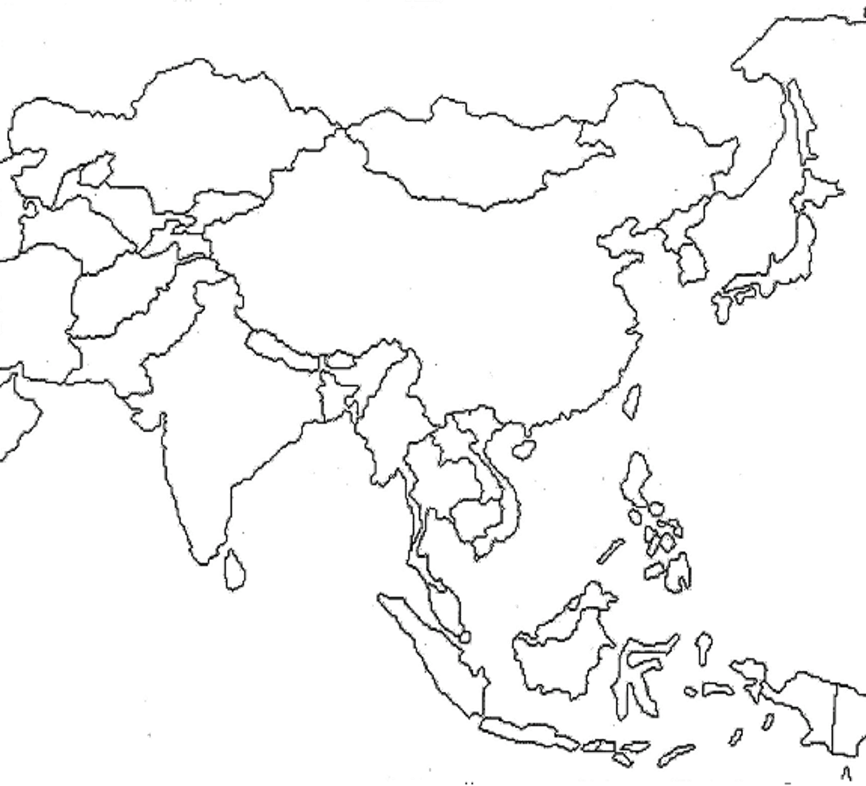
Southern & Eastern
Asia
Directions:
Label the following countries on the political map of SE Asia:
China
India
Japan
North Korea
South Korea
Vietnam
Map Key
© Brain Wrinkles

Slide 5
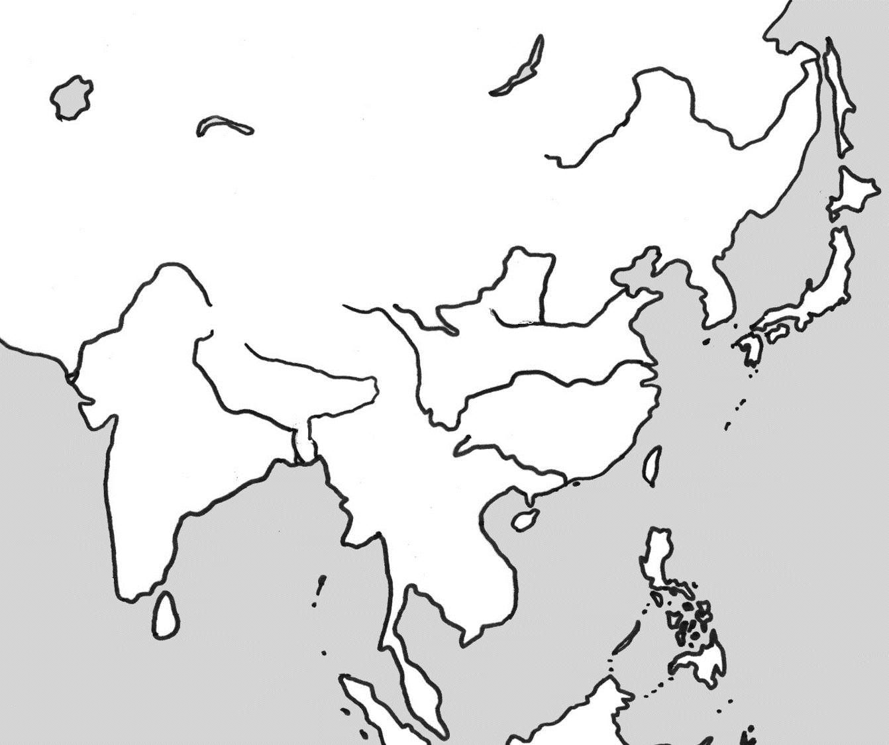
Southern & Eastern
Asia
Directions:
1. Label the following physical features:
Ganges River
Huang He (Yellow River)
Chang Jiang (Yangtze) River
Bay of Bengal
Indian Ocean
Sea of Japan
South China Sea
Yellow Sea
Gobi Desert
Taklimakan Desert
Himalayan Mountains
Korean Peninsula
2. Create a map key that includes symbols for:
Rivers
Mountains
Deserts
Bays
Seas
Oceans
Peninsulas
3. Draw the symbol for each feature next to the correct label on the map. Color all symbols!
Map Key
© Brain Wrinkles

Slide 6
Geography of Southern & Eastern Asia Study Guide

Slide 7
Geography
Asia is the _____________________ with a total land area of more than 17 million square miles.
More than _____________________ live in Southern and Eastern Asia, with over half of that number living in China and India alone.
The continent has a _____________________ of physical features, including deserts, peninsulas, and the world’s highest mountains.
Ganges River
The Ganges River starts _____________________ and flows southeast through India and Bangladesh for more than 1,500 miles to the Indian Ocean.
The name comes from a Hindu goddess and the river is considered _____________________ religion.
It is the most important river to the _____________________ .
The river runs through India’s most _____________________ and densely populated areas.
Because so many people live and work along the Ganges, the water in the river is _____________________ .
Huang He (Yellow River)
The Huang He, or Yellow River, begins in the _____________________ of Tibet and flows east to the Yellow Sea.
This is China’s _____________________ river.
Chinese _____________________ in the central area of this river basin.
The river is named for the _____________________ that it carries along its path to the Yellow Sea.
The silt creates rich topsoil for farmers; however, _____________________ make the river’s path dangerous.
It’s nickname is “China’s Sorrow” because of the _____________________ .
Chang Jiang (Yangtze) River
The Chang Jiang (Yangtze) River begins in the Tibetan Plateau and _____________________ until it reaches the East China Sea.
It’s the _____________________ river in China (over 3,400 miles) and the third-longest in the world.
The Chang Jiang empties into the _____________________ .
The Chang Jiang is extremely important for China because it provides _____________________ , water for irrigation, and transportation for cargo ships.
The Chang Jiang and Huang He Rivers are connected by one of the world’s _____________________ systems, the Grand Canal.
Some parts were built over _____________________ ago.
© Brain Wrinkles
SE Asia’s Geography
CLOZE Notes 1

Slide 8
Bay of Bengal
The Bay of Bengal is an extension of the _____________________ .
The Bay of Bengal _____________________ on its west and Myanmar on its east.
_____________________ and many other large rivers flow into this bay.
Indian Ocean
The Indian Ocean is the _____________________ of Earth’s five oceans.
It is located between Africa to the west, _____________________ , and Australia to the east.
Sea of Japan
The Sea of Japan is a small sea that is bound by Russia to the north, the Korean Peninsula to the west, and _____________________ .
It is an arm of the Pacific Ocean that lies between the _____________________ and Japan.
The sea has large deposits of mineral resources and abundant fish, both of which are important to _____________________ .
South China Sea
The South China sea is located _____________________ and the Philippines.
The South China Sea connects the _____________________ oceans, so many of the world’s international shipping channels run through it.
There are often _____________________ and typhoons in this region.
Yellow Sea
The Yellow Sea is an extension of the Pacific Ocean that lies _____________________ and the Korean Peninsula.
The Huang He (Yellow River) empties into the _____________________ .
It becomes the East China Sea south of the _____________________ .
The Yellow Sea is well-known for its _____________________ .
Unfortunately, in recent years, many species of _____________________ in the Yellow Sea due to overfishing by some countries.
© Brain Wrinkles
SE Asia’s Geography
CLOZE Notes 2

Slide 9
Gobi Desert
The Gobi Desert is Asia’s _____________________ .
It expands across southern Mongolia and _____________________ .
Much of the Gobi Desert is covered with sand and _____________________ that is exposed by powerful winds blowing across the region.
The Gobi Desert is known as “Shamo”, the Chinese word for _____________________ .
It can be one of the hottest and also _____________________ places on earth.
Taklimakan Desert
The Taklimakan Desert lies between two rugged mountain ranges in _____________________ .
It is over 600 miles in length, making it one of the _____________________ in the world.
_____________________ cover 85% of its surface.
The Taklimakan Desert receives _____________________ annual precipitation.
The plant and animal life in this desert have had to adapt to the _____________________ in order to survive.
Himalayan Mountains
The Himalayas lie along the _____________________ of the Indian subcontinent and the southern border of China.
They form the _____________________ between India and China.
The mountains stretch for about _____________________ .
The Himalayan mountain range is the _____________________ mountain region.
It is sometimes called “the roof of the world” because of the _____________________ .
Nine of the world’s ten _____________________ are located here.
_____________________, the world’s highest mountain, is part of the Himalayan range.
Korean Peninsula
The Korean Peninsula is a mountainous peninsula that juts _____________________ in between the Yellow Sea and the Sea of Japan.
Over half of the peninsula is made up of mountains, but there is still plenty of _____________________ .
Since the end of World War II in 1948, the peninsula has been divided into _____________________ : North Korea (communist) and South Korea (democratic).
© Brain Wrinkles
SE Asia’s Geography
CLOZE Notes 3

Slide 10
Southern &
Eastern Asia’s
GEOGRAPHY
© Brain Wrinkles

Slide 11
Geography
Asia is the world’s largest continent with a total land area of more than 17 million square miles.
More than 4 billion people live in Southern and Eastern Asia, with over half of that number living in China and India alone.
The continent has a wide variety of physical features, including deserts, peninsulas, and the world’s highest mountains.
© Brain Wrinkles

Slide 12
© Brain Wrinkles

Slide 13
Ganges River
The Ganges River starts in the Himalayas and flows southeast through India and Bangladesh for more than 1,500 miles to the Indian Ocean.
The name comes from a Hindu goddess and the river is considered sacred to the Hindu religion.
It is the most important river to the Indian subcontinent.
© Brain Wrinkles

Slide 14
© Brain Wrinkles

Slide 15
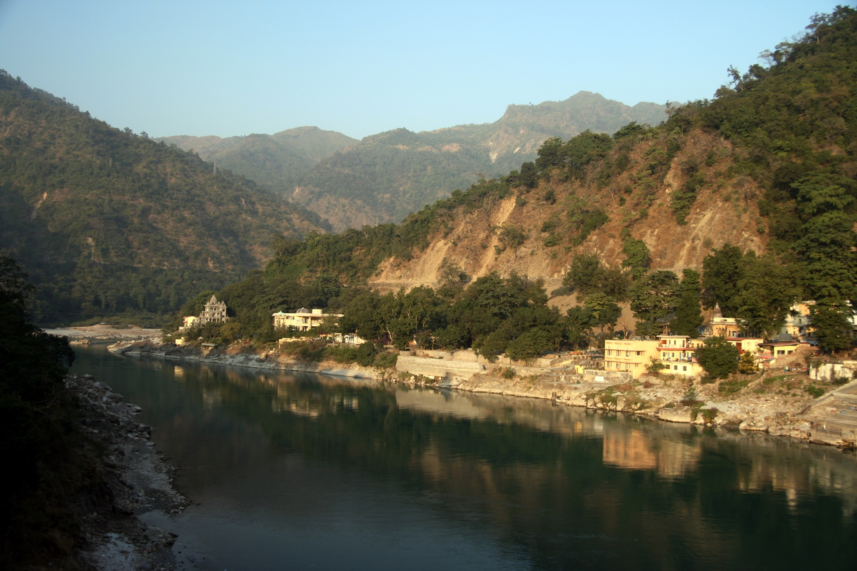
© Brain Wrinkles

Slide 16
Ganges River
The river runs through India’s most fertile farmland and densely populated areas.
Because so many people live and work along the Ganges, the water in the river is heavily polluted.
© Brain Wrinkles

Slide 17
© Brain Wrinkles

Slide 18
Huang He
(Yellow River)
The Huang He, or Yellow River, begins in the mountainous plateau of Tibet and flows east to the Yellow Sea.
This is China’s second-longest river.
Chinese civilization began in the central area of this river basin.
© Brain Wrinkles

Slide 19
© Brain Wrinkles

Slide 20
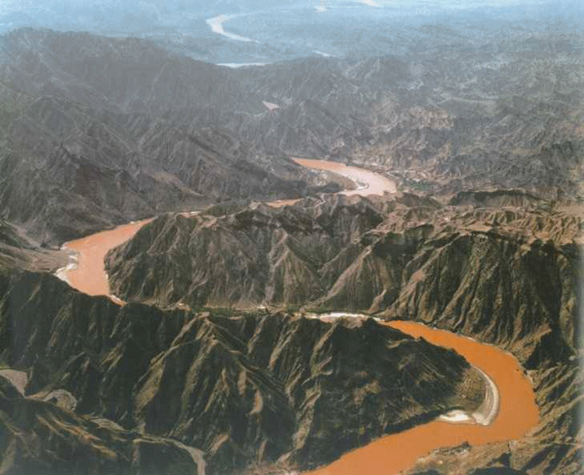
© Brain Wrinkles

Slide 21
Huang He
(Yellow River)
The river is named for the muddy yellow silt that it carries along its path to the Yellow Sea.
The silt creates rich topsoil for farmers; however, annual floods make the river’s path dangerous.
It’s nickname is “China’s Sorrow” because of the frequent flooding.
© Brain Wrinkles

Slide 22
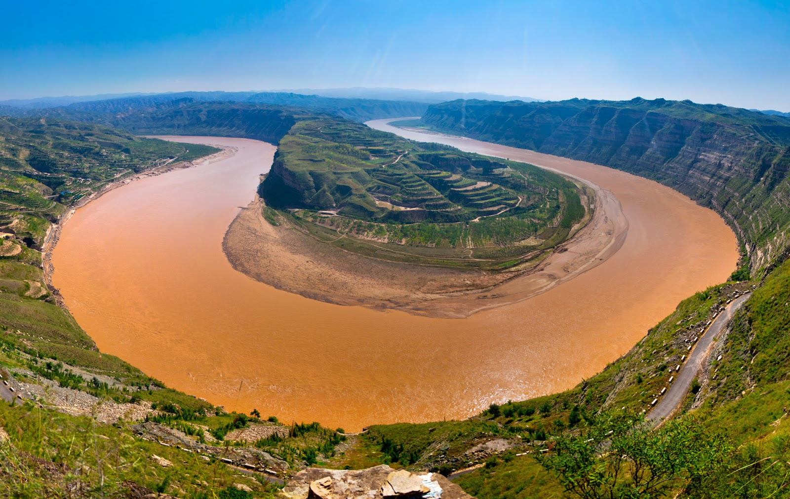
© Brain Wrinkles

Slide 23
Chang Jiang
(Yangtze) River
The Chang Jiang (Yangtze) River begins in the Tibetan Plateau and travels east until it reaches the East China Sea.
It’s the largest and longest river in China (over 3,400 miles) and the third-longest in the world.
The Chang Jiang empties into the Pacific Ocean.
© Brain Wrinkles

Slide 24
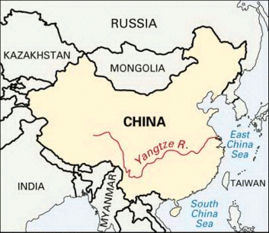
© Brain Wrinkles

Slide 25
© Brain Wrinkles

Slide 26
Chang Jiang
(Yangtze) River
The Chang Jiang is extremely important for China because it provides hydroelectric power, water for irrigation, and transportation for cargo ships.
The Chang Jiang and Huang He Rivers are connected by one of the world’s oldest canal systems, the Grand Canal.
Some parts were built over 2,000 years ago.
© Brain Wrinkles

Slide 27
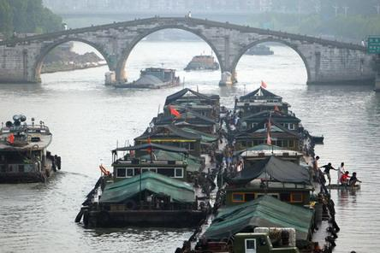
© Brain Wrinkles

Slide 28
Bay of Bengal
The Bay of Bengal is an extension of the Indian Ocean.
The Bay of Bengal touches India on its west and Myanmar on its east.
The Ganges and many other large rivers flow into this bay.
© Brain Wrinkles

Slide 29
© Brain Wrinkles

Slide 30
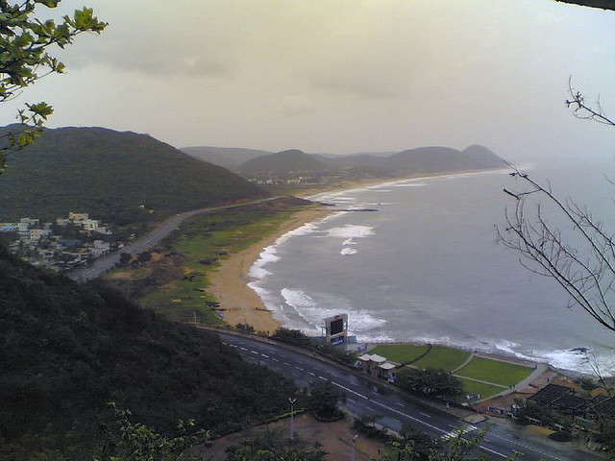
© Brain Wrinkles

Slide 31
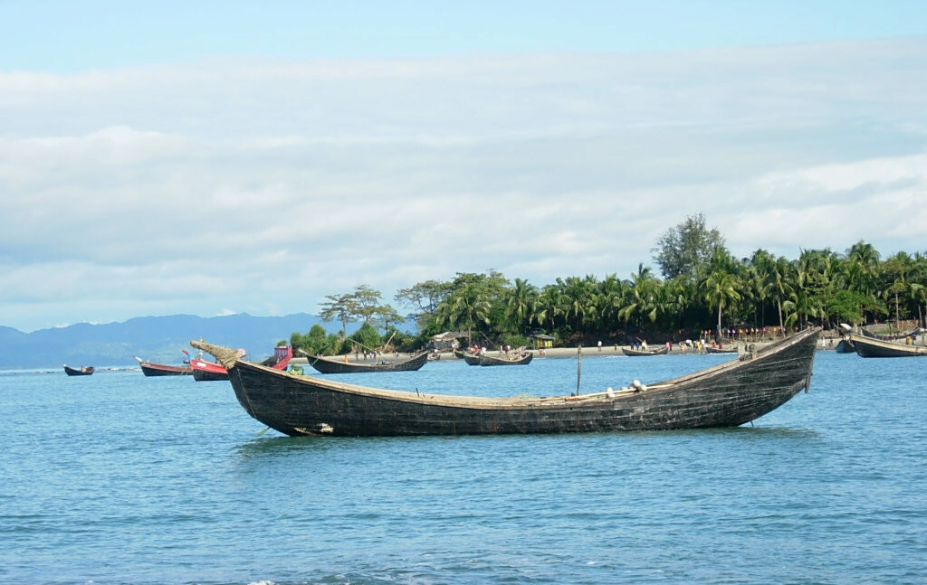
© Brain Wrinkles

Slide 32
Indian Ocean
The Indian Ocean is the third largest of Earth’s five oceans.
It is located between Africa to the west, Asia to the north, and Australia to the east.
© Brain Wrinkles

Slide 33
© Brain Wrinkles

Slide 34
Sea of Japan
The Sea of Japan is a small sea that is bound by Russia to the north, the Korean Peninsula to the west, and Japan to the east.
It is an arm of the Pacific Ocean that lies between the Asian continent and Japan.
The sea has large deposits of mineral resources and abundant fish, both of which are important to Japan’s economy.
© Brain Wrinkles

Slide 35
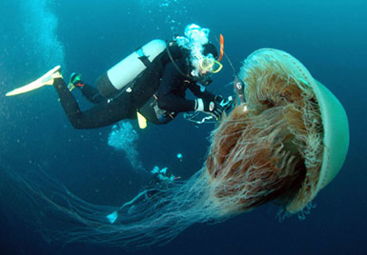
© Brain Wrinkles

Slide 36
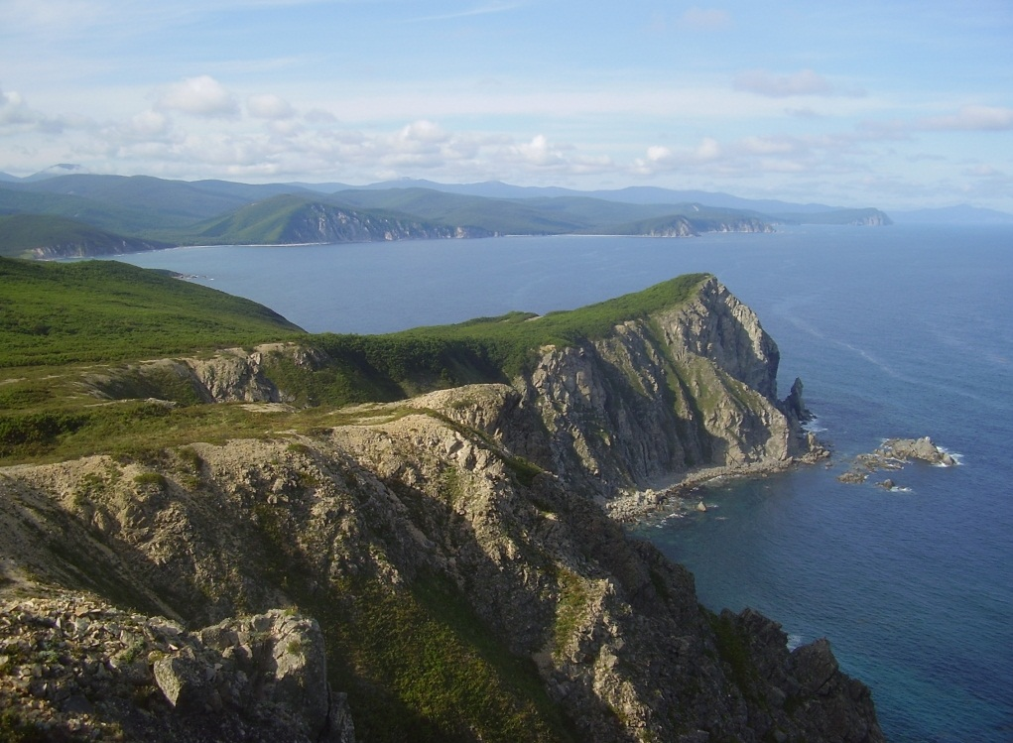
© Brain Wrinkles

Slide 37
South China Sea
The South China sea is located between Vietnam and the Philippines.
The South China Sea connects the Pacific and Indian oceans, so many of the world’s international shipping channels run through it.
There are often violent monsoons and typhoons in this region.
© Brain Wrinkles

Slide 38
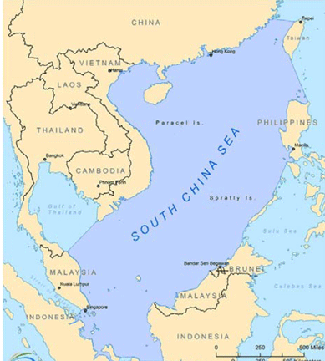
© Brain Wrinkles

Slide 39
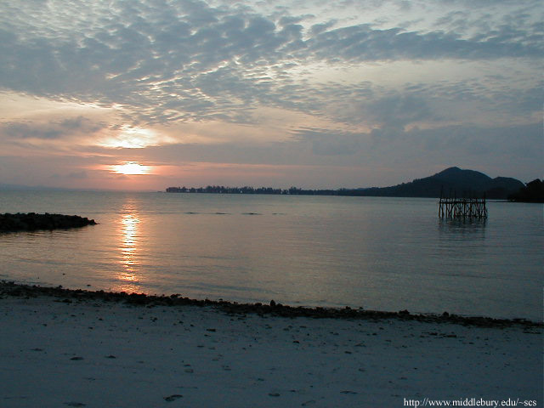
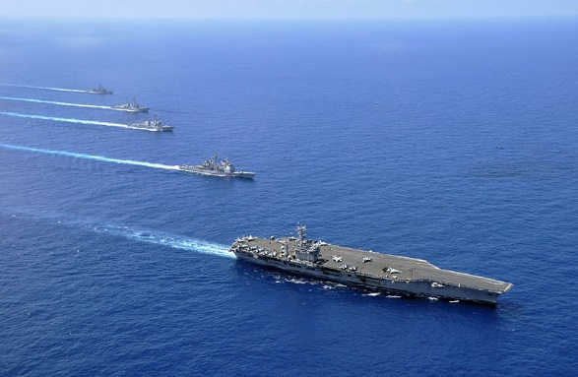
© Brain Wrinkles

Slide 40
Yellow Sea
The Yellow Sea is an extension of the Pacific Ocean that lies between China and the Korean Peninsula.
The Huang He (Yellow River) empties into the Yellow Sea.
It becomes the East China Sea south of the Korean Peninsula.
© Brain Wrinkles

Slide 41
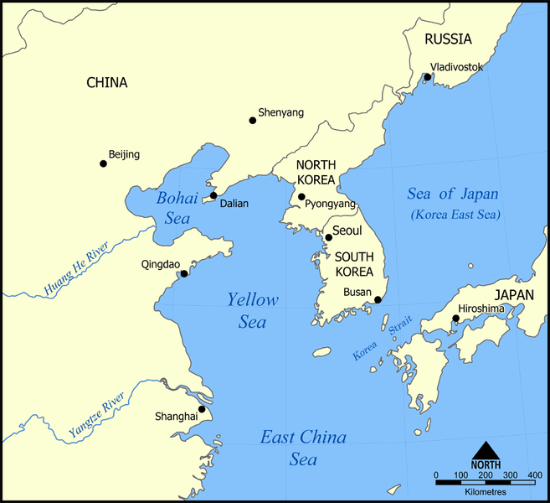
© Brain Wrinkles

Slide 42
Yellow Sea
The Yellow Sea is well-known for its fishing industry.
Unfortunately, in recent years, many species of fish have declined in the Yellow Sea due to overfishing by some countries.
© Brain Wrinkles

Slide 43
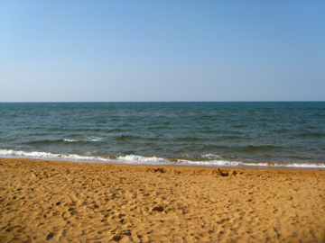
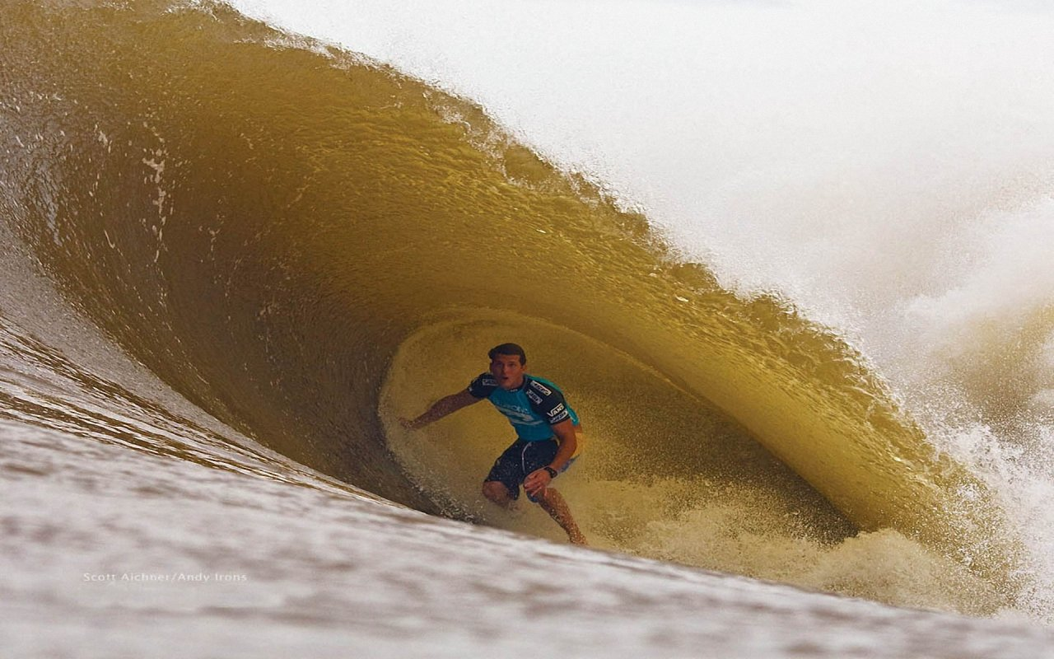
© Brain Wrinkles

Slide 44
Gobi Desert
The Gobi Desert is Asia’s largest desert.
It expands across southern Mongolia and northern China.
Much of the Gobi Desert is covered with sand and bare rock that is exposed by powerful winds blowing across the region.
© Brain Wrinkles

Slide 45
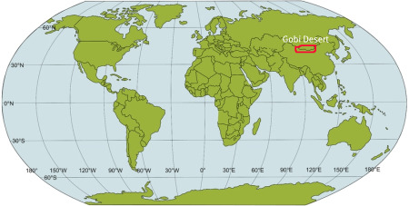
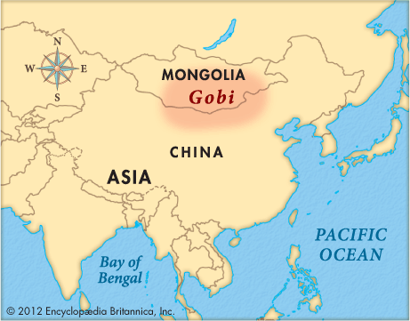
© Brain Wrinkles

Slide 46
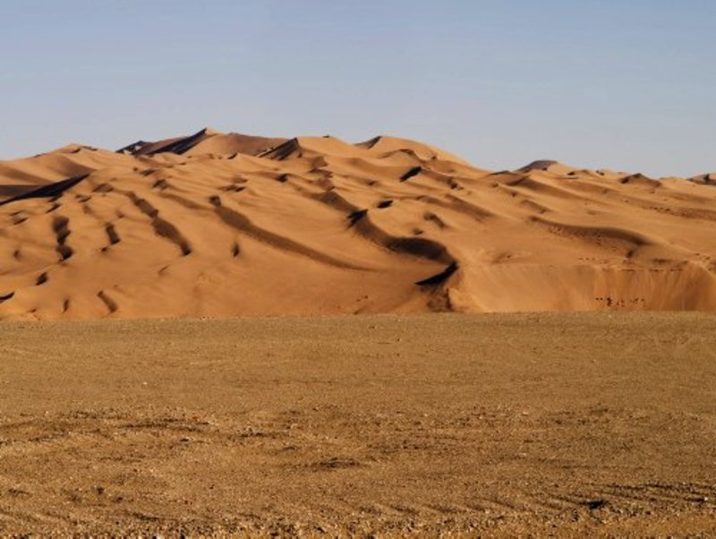
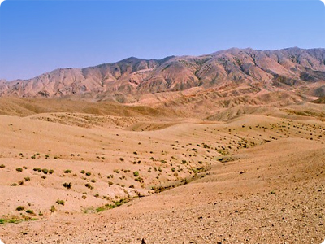
© Brain Wrinkles

Slide 47
Gobi Desert
The Gobi Desert is known as “Shamo”, the Chinese word for “sand desert”.
It can be one of the hottest and also one of the coldest places on earth.
© Brain Wrinkles

Slide 48
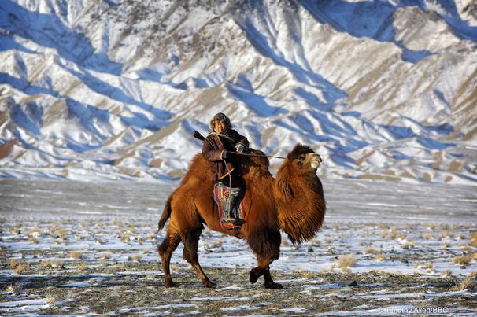
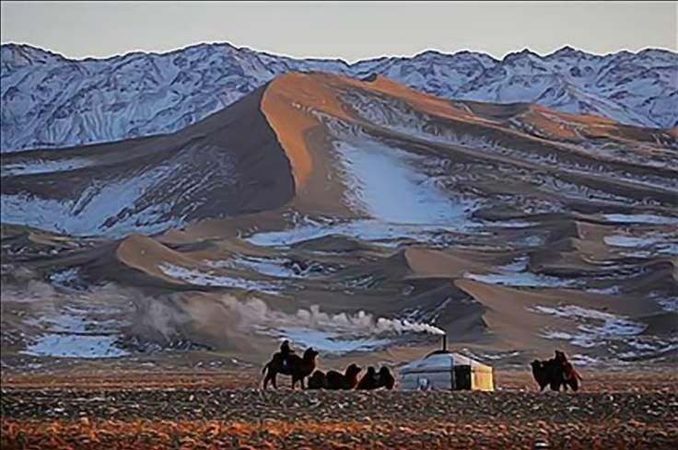
© Brain Wrinkles

Slide 49
Taklimakan
Desert
The Taklimakan Desert lies between two rugged mountain ranges in northwestern China.
It is over 600 miles in length, making it one of the longest deserts in the world.
Giant sand dunes cover 85% of its surface.
© Brain Wrinkles

Slide 50
© Brain Wrinkles

Slide 51
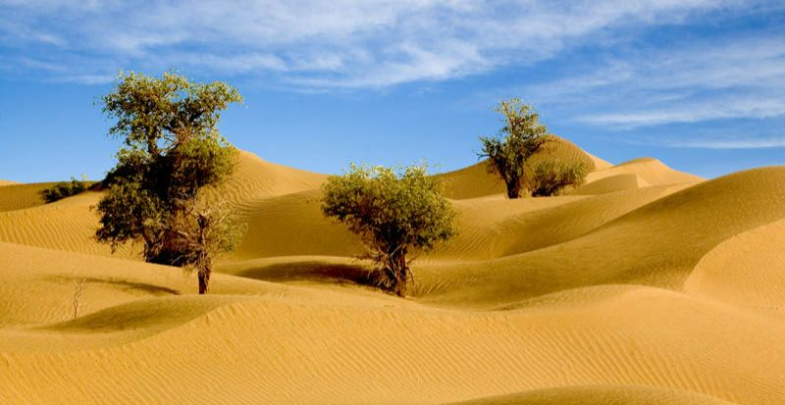
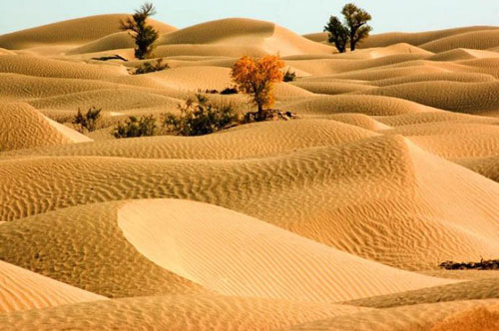
© Brain Wrinkles

Slide 52
Taklimakan
Desert
The Taklimakan Desert receives very little annual precipitation.
The plant and animal life in this desert have had to adapt to the dry environment in order to survive.
© Brain Wrinkles

Slide 53
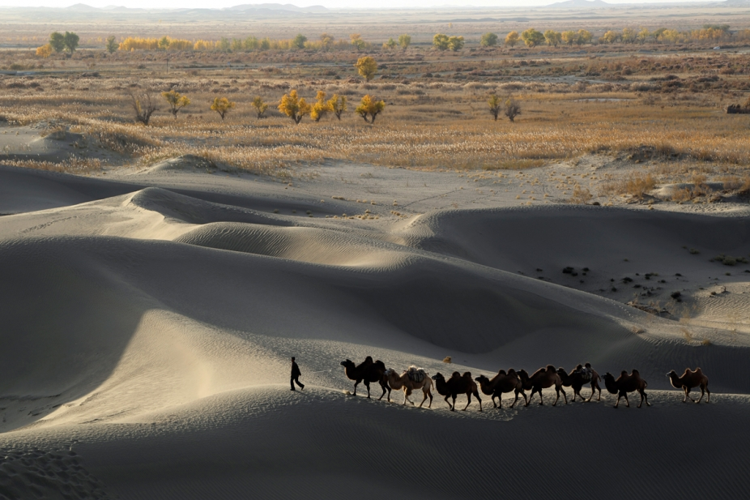
© Brain Wrinkles

Slide 54
Himalayan
Mountains
The Himalayas lie along the northern edge of the Indian subcontinent and the southern border of China.
They form the natural border between India and China.
The mountains stretch for about 200 miles.
© Brain Wrinkles

Slide 55
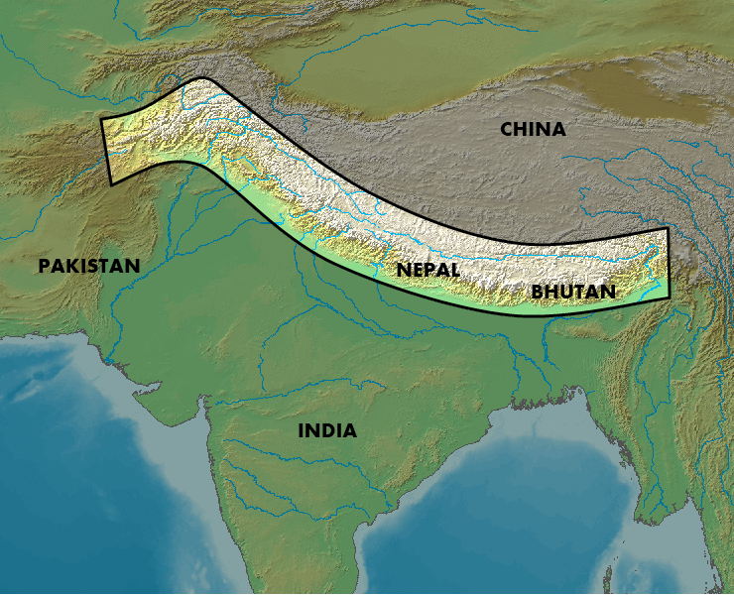
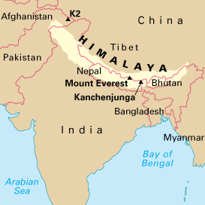
© Brain Wrinkles

Slide 56
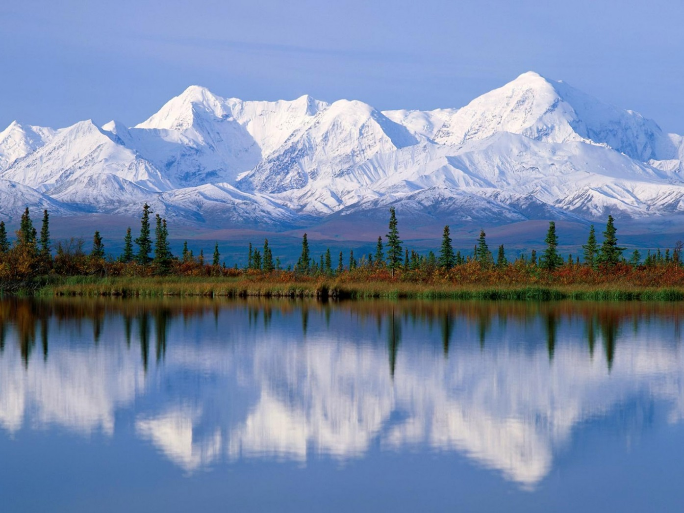
© Brain Wrinkles

Slide 57
Himalayan
Mountains
The Himalayan mountain range is the world’s highest mountain region.
It is sometimes called “the roof of the world” because of the area’s high altitudes.
© Brain Wrinkles

Slide 58
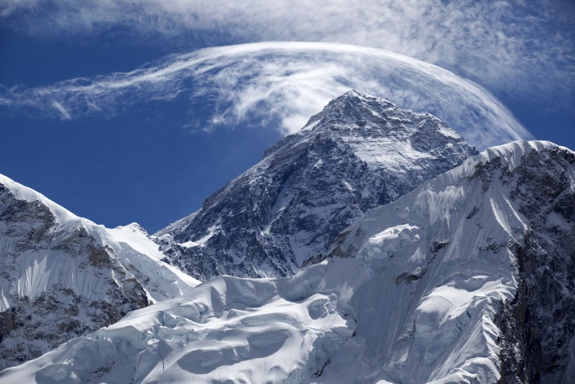
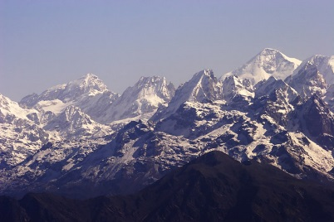
© Brain Wrinkles

Slide 59
Himalayan
Mountains
Nine of the world’s ten largest peaks are located here.
Mt. Everest, the world’s highest mountain, is part of the Himalayan range.
© Brain Wrinkles

Slide 60
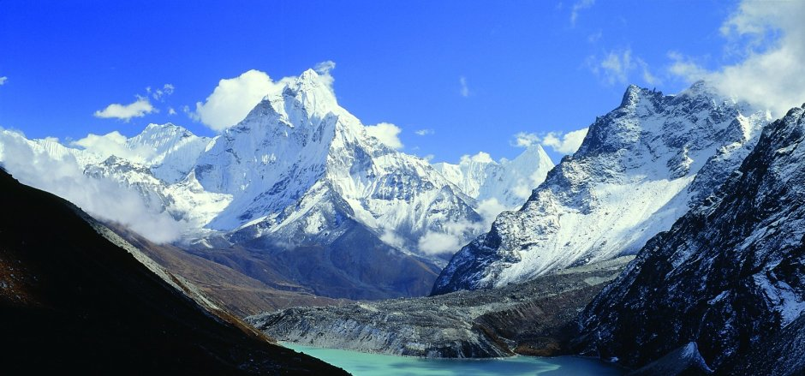
© Brain Wrinkles

Slide 61
Korean
Peninsula
The Korean Peninsula is a mountainous peninsula that juts out of northeastern China in between the Yellow Sea and the Sea of Japan.
Over half of the peninsula is made up of mountains, but there is still plenty of rich farmland.
© Brain Wrinkles

Slide 62
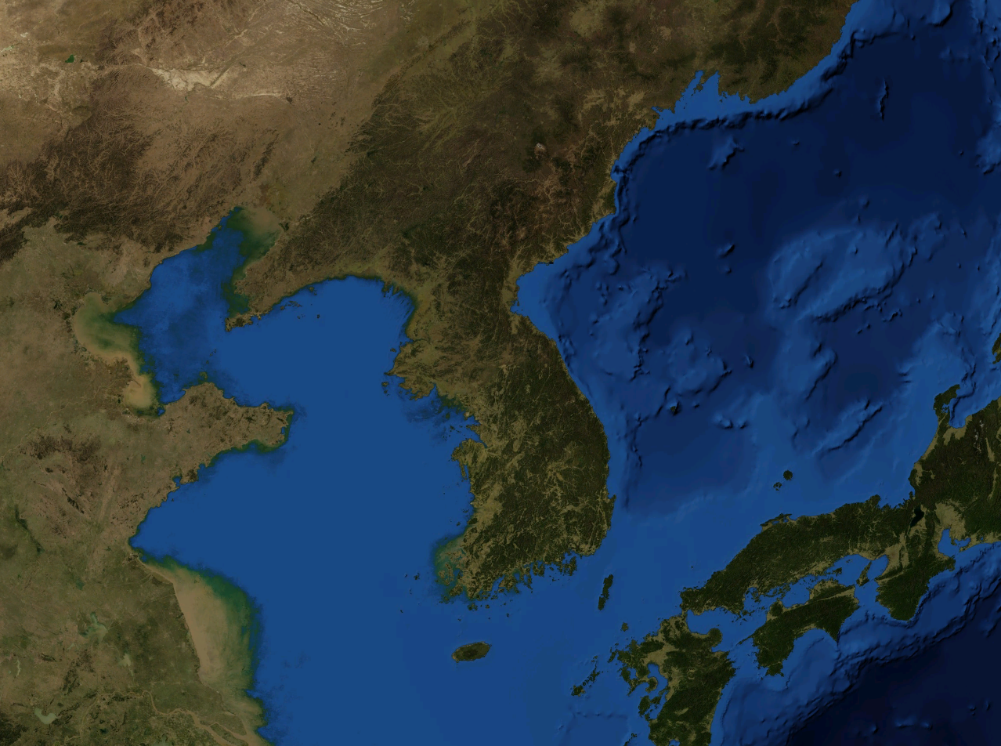
© Brain Wrinkles

Slide 63
Korean
Peninsula
Since the end of World War II in 1948, the peninsula has been divided into two countries: North Korea (communist) and South Korea (democratic).
© Brain Wrinkles

Slide 64
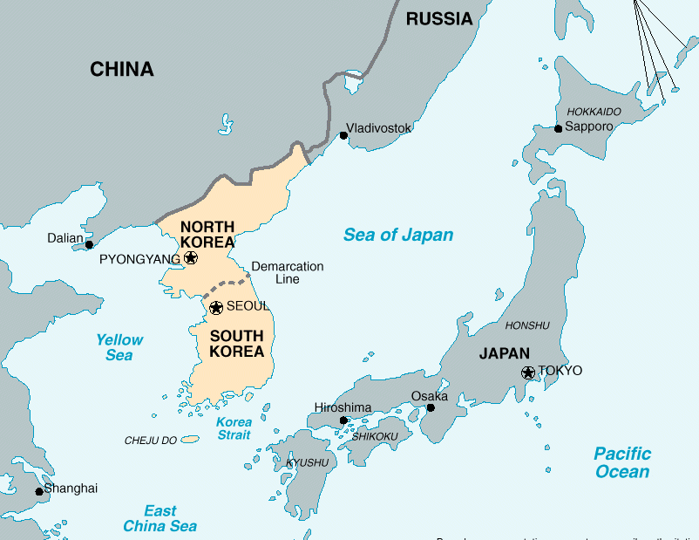
© Brain Wrinkles

Slide 65
What:
Where:
Illustration:
What:
Where:
Illustration:
What:
Where:
Illustration:
© Brain Wrinkles
Indian Ocean
Chang Jiang (Yangtze) River
Ganges River
Directions: Complete the chart below with information that you learn during the presentation. If time allows, color your illustrations.
SE Asia’s Physical Features
What:
Where:
Illustration:
What:
Where:
Illustration:
What:
Where:
Illustration:
Sea of Japan
Bay of Bengal
Huang He (Yellow River)

Slide 66
What:
Where:
Illustration:
What:
Where:
Illustration:
What:
Where:
Illustration:
© Brain Wrinkles
Himalayan Mountains
Gobi Desert
South China Sea
Directions: Complete the chart below with information that you learn during the presentation. If time allows, color your illustrations.
SE Asia’s Physical Features
What:
Where:
Illustration:
What:
Where:
Illustration:
What:
Where:
Illustration:
Korean Peninsula
Taklimakan Desert
Yellow Sea

Slide 67
You Are Now Entering…
Directions: Choose one of SE Asia’s physical features and create a “welcome sign” that visitors will see as they enter the feature’s region. The sign should include key facts about the feature, as well as significant illustrations.
© Brain Wrinkles

Slide 68
Roll A Six!
You will work with a partner, with only 1 pencil to share.
When I say “Go”, one person will begin labeling the map as fast as you can.
The other person should start rolling the dice. As soon as you roll a 6, you take the pencil and begin labeling your map. Your partner should start rolling the dice now.
This is a race to see who can complete the map first, but the catch is you can only label your map if you roll a 6!
© Brain Wrinkles

Slide 69
Southern & Eastern
Asia
© Brain Wrinkles

Slide 70
SE Asia’s Geography
I HAVE…
WHO HAS…?
An Interactive Review Game
© Brain Wrinkles

Slide 71
Key Terms List
Asia
Ganges River
Huang He (Yellow River)
Chang Jiang (Yangtze) River
Bay of Bengal
Indian Ocean
Sea of Japan
South China Sea
Yellow Sea
Gobi Desert
Taklimakan Desert
Himalayan Mountains
Korean Peninsula
China
India
Japan
North Korea
South Korea
Vietnam
© Brain Wrinkles

Slide 72
START Who has the world’s largest continent? | I have Asia. Who has the river that is sacred to the Hindu religion?
I have Ganges River. Who has the largest and longest river in China? | I have Chang Jiang (Yangtze) River. Who has the river that is known for its muddy yellow silt?
I have Huang He (Yellow River). Who has the body of water that is an arm of the Indian Ocean? | I have Bay of Bengal. Who has the ocean that lies between Africa, Asia, and Australia?
© Brain Wrinkles
© Brain Wrinkles
© Brain Wrinkles
© Brain Wrinkles
© Brain Wrinkles
© Brain Wrinkles

Slide 73
I have Indian Ocean. Who has the body of water that benefits Japan’s economy with its fish and mineral resources? | I have Sea of Japan. Who has body of water that connects the Pacific and Indian oceans?
I have South China Sea. Who has the sea that is located between China and the Korean Peninsula? | I have Yellow Sea. Who has Asia’s largest desert that is mostly just bare rock?
I have Gobi Desert. Who has the landform that forms the natural border between India and China? | I have Himalayan Mountains. Who has the dry desert in northwestern China that is mostly large sand dunes?
© Brain Wrinkles
© Brain Wrinkles
© Brain Wrinkles
© Brain Wrinkles
© Brain Wrinkles
© Brain Wrinkles

Slide 74
I have Taklimakan Desert. Who has the landform that juts out of northeastern China between the Yellow Sea and Sea of Japan? | I have Korean Peninsula. Who has the country on the Korean Peninsula that is communist?
I have North Korea. Who has the country that the Chang Jiang and Huang He rivers flow through? | I have China. Who has the country that the Ganges River flows through?
I have India. Who has the country that is bordered by China, Cambodia, and Laos? | I have Vietnam. Who has the country that is a large island near North and South Korea?
© Brain Wrinkles
© Brain Wrinkles
© Brain Wrinkles
© Brain Wrinkles
© Brain Wrinkles
© Brain Wrinkles

Slide 75
I have Japan. Who has the country on the Korean Peninsula that is democratic? | I have South Korea. STOP
© Brain Wrinkles
© Brain Wrinkles

Slide 76
Find Someone Who Knows…
Directions: You will have several minutes to walk around the classroom and poll your class about what they know about Asia’s physical features. If your classmates know the answers, ask them to write down their first names or initials in the boxes. When we finish this exercise, we will go over the answers and people who have initialed the boxes should know the answers.
1. Which landform forms a natural border between India and China? | 2. Why is the Huang He referred to as the Yellow River? | 3. What river in China is a major source of hydroelectric power, irrigation water, and transportation for cargo ships? | 4. Which desert is located in northwestern China between two mountain ranges? | 5. Which sea connects the Pacific and Indian oceans?
6. What is located at the mouth of the Yangtze River? | 7. What are the two great deserts found in China? | 8. Mt. Everest and 8 more of the world’s tallest mountains are found here. | 9. This river is sacred to the Hindu religion. | 10. What body of water lies between Japan and the continent of Asia?
11. What is the largest and longest river in China? | 12. Why are the Himalayas called the “roof of the world”? |  | 13. This desert stretches across southern Mongolia and northern China. | 14. What body of water lies between India and Myanmar?
15. Why is the Huang He sometimes called “China’s Sorrow”? | 16. Which river flows through India and Bangladesh to the Bay of Bengal? | 17. What is the peninsula between the Yellow Sea and the Sea of Japan called? | 18. Which country has the Huang He and Chang Jiang Rivers flowing through it? | 19. What ocean lies between Africa and Australia?
Social
Studies
Rocks
© Brain Wrinkles

Slide 77
Name:
Name:
Geographic SELFIE
Geographic SELFIE
Take a selfie of yourself visiting one of SE Asia’s physical features. In the blank space on the right, describe where you are & what you see.
Take a selfie of yourself visiting one of SE Asia’s physical features. In the blank space on the right, describe where you are & what you see.
© Brain Wrinkles
© Brain Wrinkles

