Slide 1
SS7H3e Explain the reasons for foreign involvement in Korea and Vietnam in terms of containment of Communism. .
Concepts:
Conflict Creates Change
Conflict Resolution

Slide 2
The student will understand that when there is conflict between or within societies, change is the result. When you have conflicts with your friends does it change your friendship? Can change have intended and / or unintended consequences? Can change be positive and / or negative?
Conflict Creates Change

Slide 3
The student will understand that when there is conflict between or within societies, change is the result. Was there conflict between Vietnam and France? How did the Vietnamese gain their independence? Did ALL Vietnamese people want communism as the form of government?
Conflict Creates Change

Slide 5
Vietnam War
after WWII, the Japanese were forced to leave Southeast Asia; the French saw this as an opportunity to reclaim Indo-China (Vietnam, Laos, Cambodia); the Vietnamese, however, wanted self-rule; the French were defeated and an international peace conference divided Vietnam at the 17th Parallel (N); non-communist South Vietnam fought against communist North Vietnam for control of the country; North Vietnam was supported by China and the Soviet Union; South Vietnam was supported by the U.S.

Slide 6
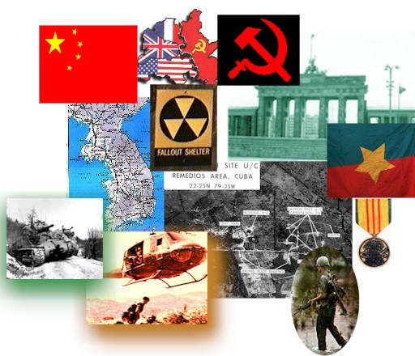

Slide 7
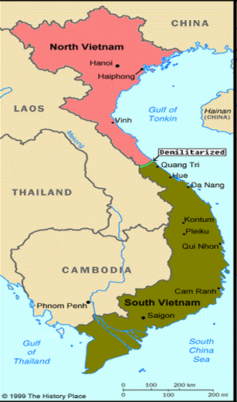
1960s and early 1970s: The Vietnam War
With a goal of stopping the spread of communism (policy of containment) in Southeast Asia – the United States replaced France in South Vietnam after France was unable to keep Vietnam as a colony.
North Vietnamese leader Ho Chi Minh was determined to reunite Vietnam under a communist government, while U.S. President Lyndon B. Johnson was determined to prevent the spread of communism into South Vietnam.

Slide 8
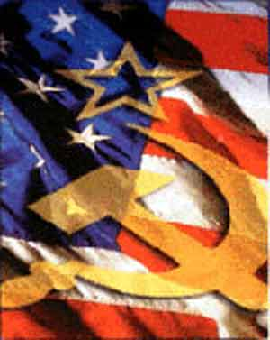
The Vietnam War Causes
The policy of containment by western democracies to keep communism from spreading in Asia created more Cold War tensions, also part of the Domino Theory.

Slide 9
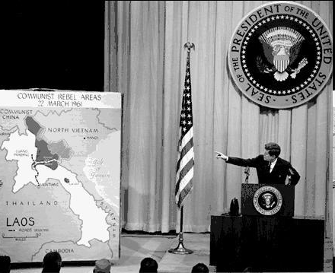
Even the president of the United States needs to know their geography. Here, JFK points to Indo-China and the threat of communism.

Slide 10
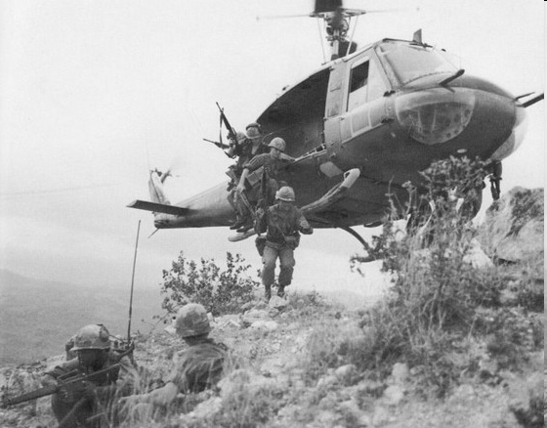

Slide 11
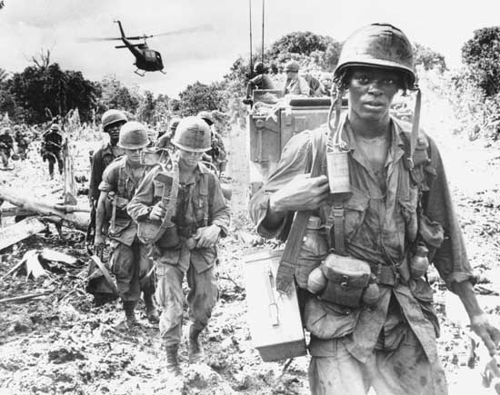

Slide 12
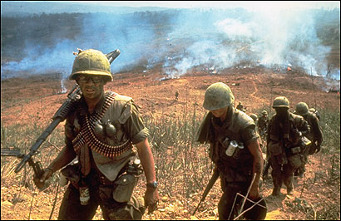

Slide 13
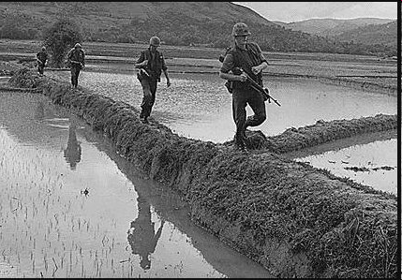
Rice paddies in Vietnam

Slide 14
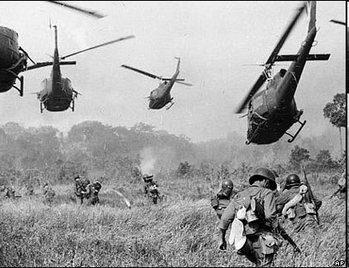

Slide 15
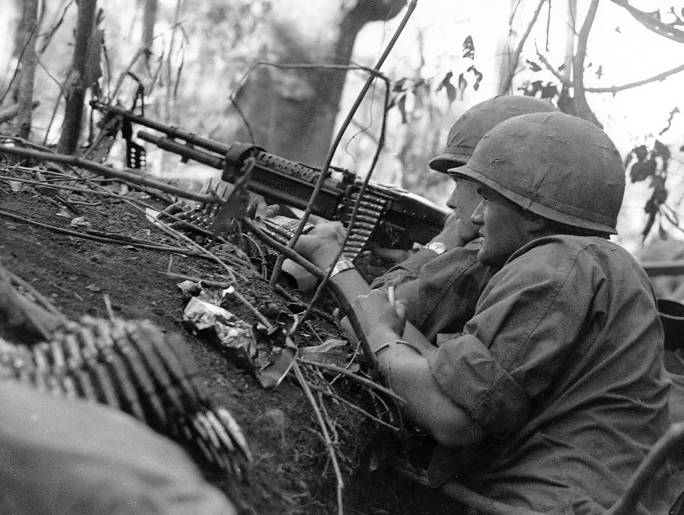

Slide 16
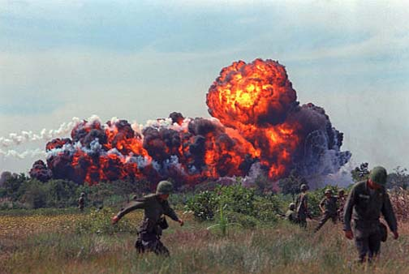

Slide 17
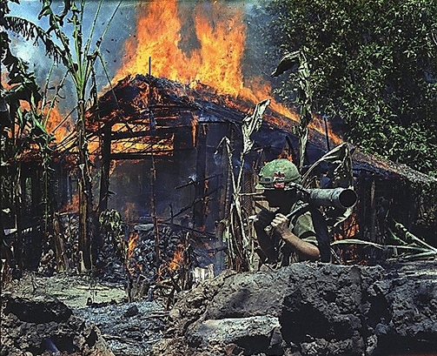

Slide 18
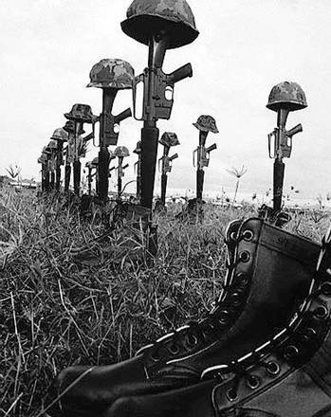
CASUALTIES OF WAR
The death toll for American soldiers exceeded 58,000 troops
2 millions Vietnamese died in the conflict.

Slide 19
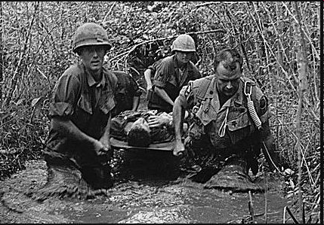
www.squidoo.com

Slide 20
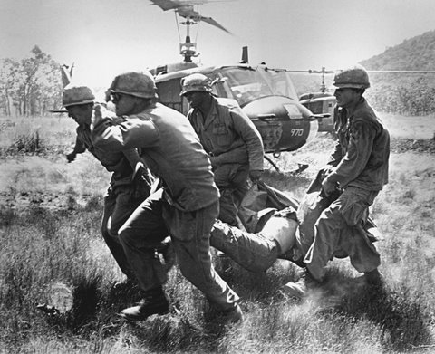

Slide 21
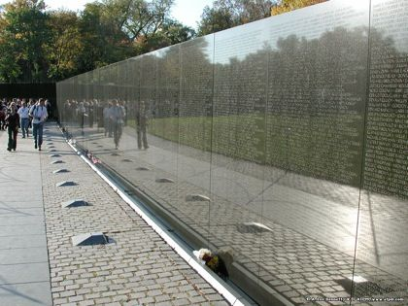
VIETNAM MEMORIAL in Washington, DC

Slide 23
HOW THE VIETNAM WAR WAS LOST
Geography - enemy was able to use their geography of jungle coverage & knowledge of the land; Ho Chi Minh Trail (supply line)
Deception – Vietcong were southern Vietnamese people who were soldiers for the communist forces
Guerilla warfare -“hit-and-run” battle tactics to evade capture and defeat using tunnel systems

Slide 24
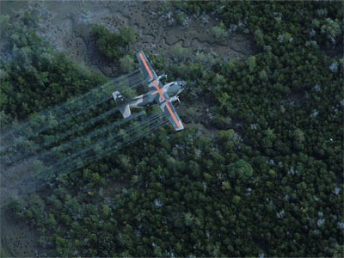

Slide 25
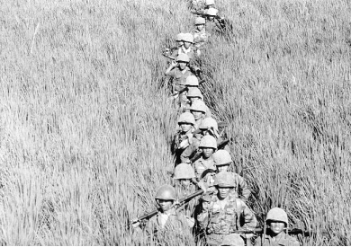

Slide 26
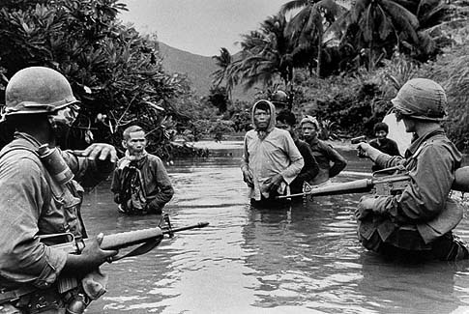

Slide 27
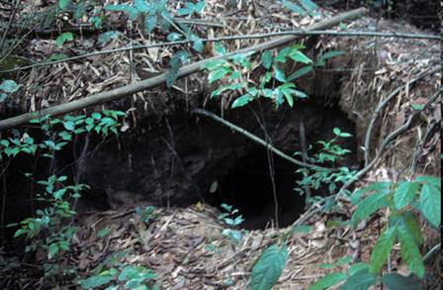
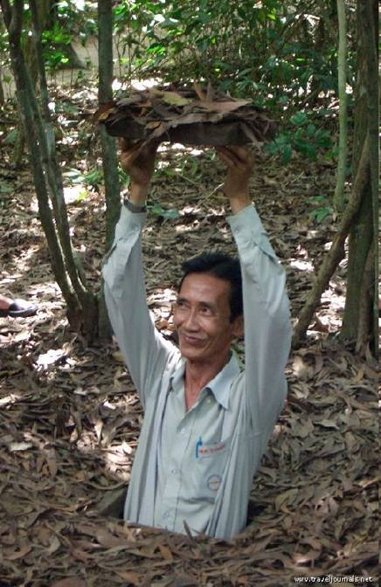

Slide 28
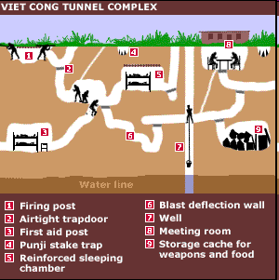
news.bbc.co.uk

Slide 29
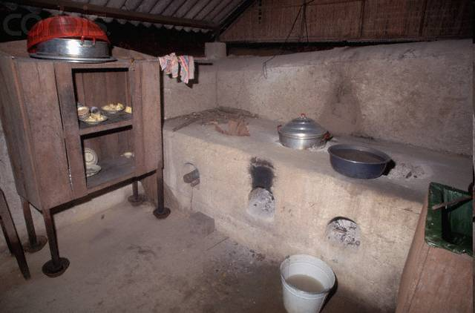

Slide 30
Vietnam War
1. What were two main causes of the Vietnam War?
Answer: The communists wanted reunification of Vietnam, and the United States feared the domino theory (the spread of communism) in Southeast Asia.
2. Who were the Viet Cong?
Answer: Communists in South Vietnam fighting on the side of the North Vietnamese.
3. What is the name of the US policy to stop the spread of communism in Asia?
Answer: Policy of containment.

Slide 31
DRAWING CONCLUSIONS
What evidence today supports that the United States did not accomplish its goal of containing communism in Southeast Asia?

Slide 32
DRAWING CONCLUSIONS
The evidence is that Vietnam is a communist country today. Both the north and the south became reunified (united together) under communist rule.

Slide 33
WHAT IF ???
What if the United States was able to defeat the communist forces of North Vietnam… how would Vietnam be a different country today?

Slide 34
WHAT IF ???
What if Vietnam’s independence leader Ho Chi Minh used non-violent protests against France like Mohandas Gandhi of India did against Great Britain… how would Vietnam be different today? Would they be a democracy? Would the Vietnam War still happen?

Slide 35
The student will understand that when there is conflict between or within societies, change is the result. What are some examples of conflict between the US and communist Vietnam? How did the Vietnam war change life in both the United States and Vietnam?
Conflict Creates Change

Slide 36
Compare and Contrast KOREAN WAR and VIETNAM WAR
KOREAN WAR
VIETNAM WAR

Slide 37
Compare and Contrast KOREAN WAR and VIETNAM WAR
KOREAN WAR
VIETNAM WAR
UNITED STATES WAS NOT ABLE TO STOP THE SPREAD OF COMMUNISM FROM CONTROLLING SOUTH VIETNAM
TODAY, ALL OF VIETNAM IS REUNIFIED UNDER A COMMUNIST GOVERNMENT
MANY AMERICANS REMEMBER THE VIETNAM WAR BECAUSE OF CONTROVERSIES, WAR CASUALTIES, AND FAILURE TO STOP THE SPREAD OF COMMUNISM
Civil war over government (communism vs democracy)
US involved in conflict to contain the spread of communism
Both communist revolutions supported by China and the Soviet Union
Communist governments remain in North Korea and Vietnam
UNITED STATES WAS ABLE TO STOP THE SPREAD OF COMMUNISM FROM CONTROLLING SOUTH KOREA
TODAY, THE KOREAN PENINSULA IS DIVIDED BETWEEN DEMOCRATIC SOUTH KOREA AND COMMUNIST NORTH KOREA
KOREAN WAR IS KNOWN AS THE FORGOTTEN WAR

Slide 38
SUMMARIZING ACTIVITY
Explain the reasons for United States foreign involvement in Korea and Vietnam.

Slide 39
SS7H3e Explain the reasons for foreign involvement in Korea and Vietnam in terms of containment of Communism. .
Concepts:
Conflict Creates Change
Conflict Resolution

